Slide 1
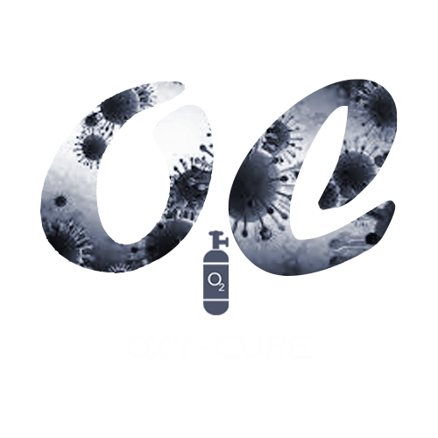
Oxy-Cure
Members: Gayathri Girish
John Rohit Ernest
Spandana Ponnathota
Nitin Nataraj

Slide 2
Problem Statement
Domain: Healthcare
Statement: Conceive a solution that enables oxygen concentrator seekers (individuals) to connect with vendors and act as a bridge in the oxygen supply chain.

Slide 3
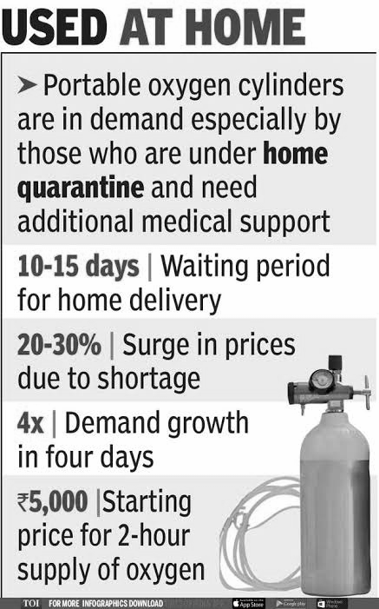
Need
People across India scrambled for life-saving oxygen supplies and patients lay dying outside hospitals as the capital recorded the equivalent of one death from COVID-19 every five minutes.
For the second day running, the country’s overnight infection total was higher than ever recorded anywhere in the world since the pandemic began last year, at 332,730.
India’s second wave has hit with such ferocity that hospitals are running out of oxygen, beds, and antiviral drugs.
News Clipping

Slide 4
SOLUTION
A typical hospital meets its medical oxygen in 3 ways.
Liquid oxygen tankers - ideal for large hospitals
Oxygen cylinders - a solution for midscale hospitals
Oxygen concentrators - small hospitals or personal use at home. It is onsite production and does not depend on a 3rd party, once it is set up.
We are very much focused on oxygen concentrators which could turn out to be a lifesaver.
We aim to bridge the oxygen concentrator supply chain gap by designing an app capable of connecting vendors to seekers.

Slide 5
Tech Stack
IDE : Android Studio
SDK: Flutter
Programming Language: Dart
Database: NoSQL hosted on Firebase
Platform: Android, iOS

Slide 6
Project Description
Our project aims to mend the oxygen supply chain by connecting vendors to potential oxygen seekers. We intend to achieve this by means of a Mobile App that provides vendors a platform to log their inventory and put themselves on the map.

Slide 7
Working
Users put out an oxygen requirement alert.
The vendors closest to them with enough stock are then identified and connected to the user.
The user can then make an order within the app using integrated payment gateways.

Slide 8
CHALLENGES
Logistics: The main challenge is about bring oxygen in a consumable form to the hospitals. There are only a finite number of oxygen tankers and cylinders around. So the logistics of refilling them to the destination is a severe bottle-neck.
Geographical location: Most of the oxygen production capacity was concentrated in Eastern India, while Delhi in the North and Maharashtra and Gujarat in the West were the worst affected and had the most pressing need for oxygen.
Lack of awareness: Most people experiencing lack of oxygen do not know that vendors sell oxygen concentrators for personal use.

Slide 9
Future Scope
This is just the basic app. Additionally a fitbit and apple watch integration could be implemented to monitor user O₂ levels.
The app can be modified to alert the user when their oxygen levels fall below a threshold, also providing an option to connect with nearby doctors.

