Slide 1
AgenticRAG: Intelligent Document QA Assistant
- Lakshmi Spandana Sompalli

Slide 2
Introduction
AgenticRAG is an agent-based Retrieval-Augmented Generation (RAG) system designed for smart question-answering over diverse documents.
It leverages modular agents for ingestion, retrieval, and response, integrated via a Model Communication Protocol (MCP) and powered by Cohere's LLM.

Slide 3

Agent-Based Architecture with MCP
Documents upload
Uploaded documents
Ingestion agent
Ack
Retrieved request
Message passing
Retrievel agent
query
LLM response agent
answer

Slide 4

System Flow Diagram (Message Passing)
User uploads documents → IngestionAgent extracts text
Text chunks → RetrievalAgent builds FAISS vector store
User query → RetrievalAgent retrieves relevant chunks
LLMResponseAgent builds prompt & queries LLM
Answer displayed in user interface

Slide 5
Tech Stack Used
Backend: Python
Document parsing: pdfplumber, python-docx, python-pptx, pandas
Embeddings: SentenceTransformers
Vector search: FAISS
LLM API: Cohere
Frontend: Streamlit
Architecture: Agent-based with MCP protocol

Slide 6
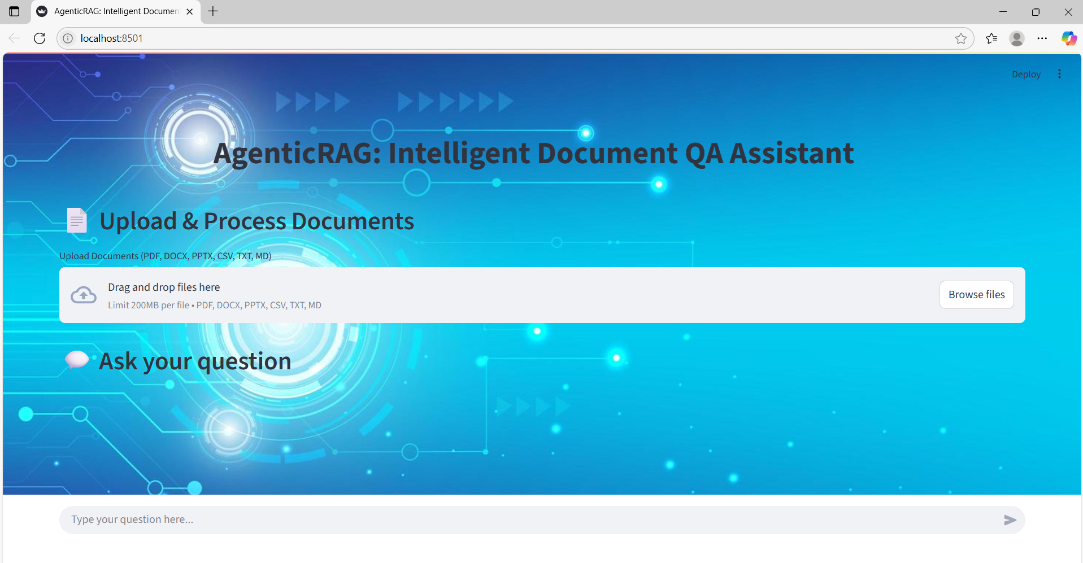
UI Screenshots

Slide 7
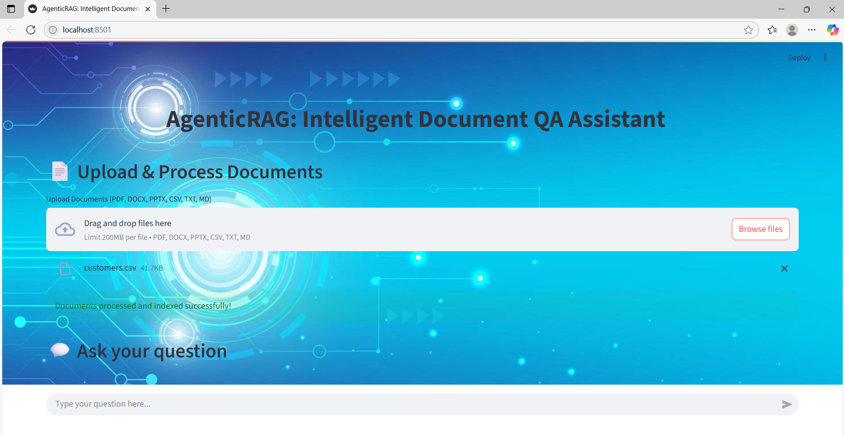

Slide 8
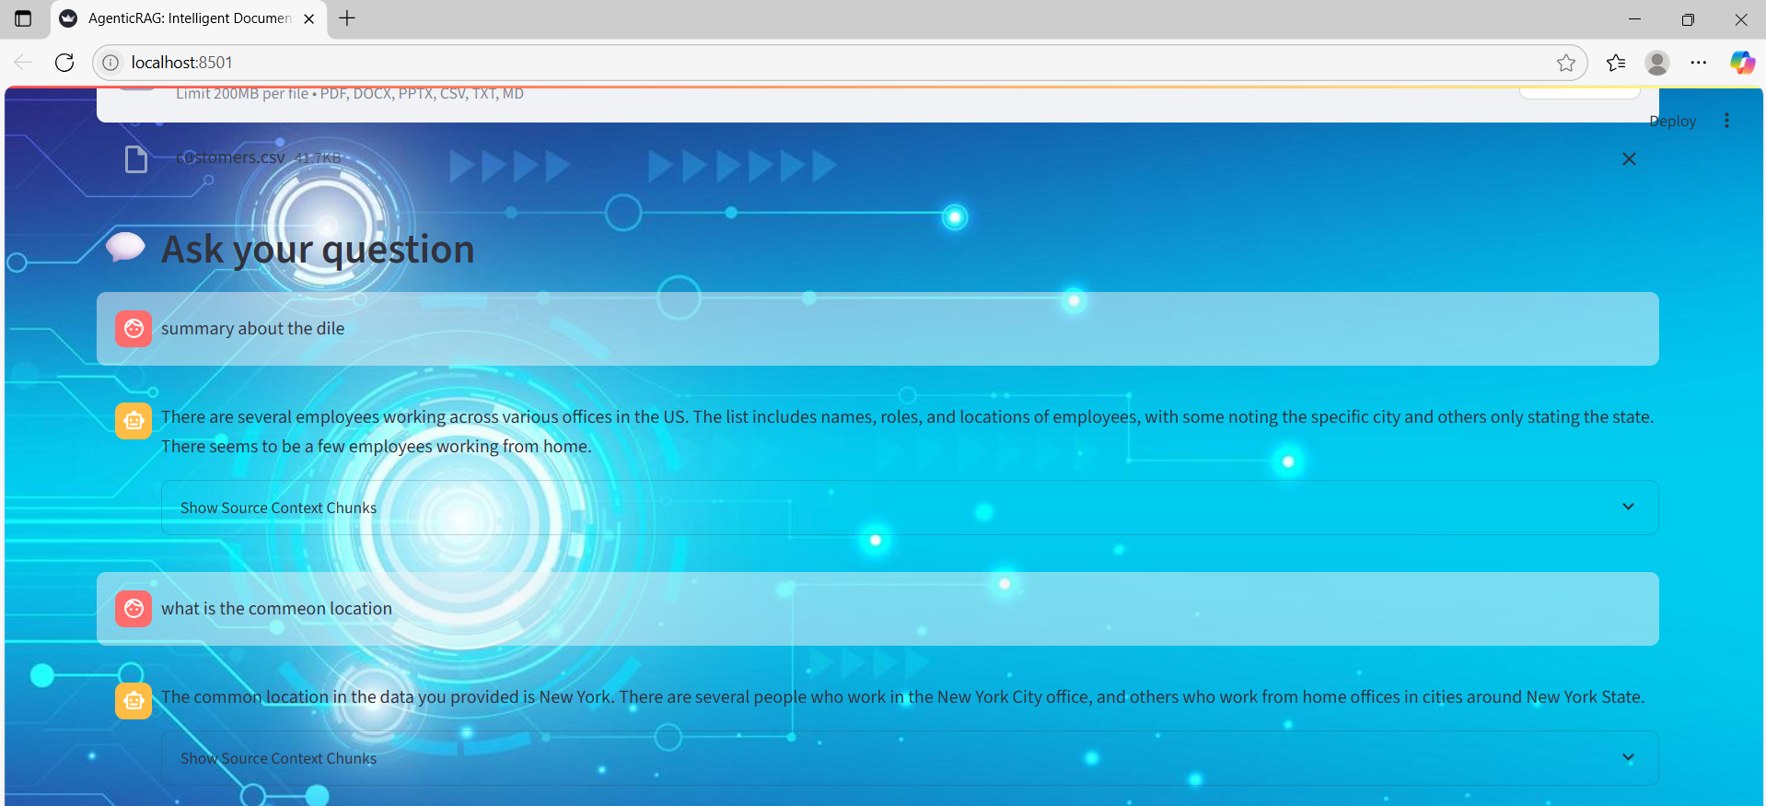

Slide 9
Challenges Faced
Handling multiple document formats reliably
Optimizing chunking and vector search performance
Managing environment variables and API keys securely

Slide 10
Future Scope / Improvements
Authentication and user roles
Support more formats including OCR for images
Enhanced UI and conversation persistence
GPU acceleration for embedding speedup
Multi-turn conversation context

Slide 11
THANK YOU

