Slide 1
IBM University Engagement Project Submission
“Exploring the Power of Agentic AI with IBM Granite and IBM Bob”

Slide 2

Project Tile – Recipe RAG Assistant – An Intelligent Document Q&A Recipe Generator
Domain of Project – Generative AI / Food & Nutrition
Student Name | Recent Passport Photo | Email ID | Mobile number [WhatsApp]
Spandana R Bathula |  | vpp22csspandanarb@gmail.com | 8105972071

Slide 3
Problem Statement -
Problem Statement :Recipe RAG Assistant
The Challenge
Finding suitable recipes can be difficult when users have dietary restrictions, limited ingredients, cuisine preferences, and time constraints. Recipe information is often scattered across different sources and documents. Without personalized and context-aware guidance, users spend time searching and manually adapting recipes to their needs.
The Objective
Build an AI-powered Recipe RAG Assistant that delivers personalized recipe recommendations and cooking guidance. The solution should:
Personalized Recipes – Adapt recipes based on dietary restrictions, ingredients, cuisine, and cooking time.
Recipe RAG Retrieval – Retrieve relevant information from PDF, TXT, and sample recipe documents.
Conversational Q&A – Answer natural-language recipe and cooking questions.
Ingredient Substitution – Suggest alternatives for unavailable ingredients.
Nutrition Insights – Provide estimated calories and nutritional information.
Shopping List – Generate a list of ingredients that are not already available.
Source Transparency – Display the recipe sources used to generate responses.
RAG Architecture – Use Sentence Transformers + FAISS for retrieval and Groq LLM for response generation.

Slide 4
Proposed Solution -
Proposed Solution: AI-powered Recipe RAG Assistant
The proposed solution is an AI-powered Recipe RAG Assistant built using Streamlit, FAISS, Sentence Transformers, and Groq LLM to provide personalized, context-aware recipe recommendations. The system addresses challenges in recipe discovery, dietary preferences, ingredient availability, and cooking-time constraints through an intelligent RAG architecture.
At its core, the solution uses a Retrieval-Augmented Generation (RAG) pipeline to retrieve relevant recipe information from uploaded PDF/TXT files and preloaded recipe documents. The recipe data is converted into embeddings using all-MiniLM-L6-v2 and stored in a local FAISS vector store, enabling efficient semantic retrieval.
The system provides key capabilities:
Recipe Retrieval retrieves relevant recipe information based on the user's natural-language query.
Personalization Layer adapts recipes according to dietary restrictions, available ingredients, cuisine preferences, and maximum cooking time.
Conversational Q&A allows users to interact with the assistant through a chat interface and receive context-aware recipe recommendations.
Ingredient & Nutrition Assistant suggests ingredient substitutions, provides estimated nutrition information, and identifies missing ingredients.
The solution also generates a user-friendly structured response containing step-by-step instructions, substitutions, nutrition information, an automatic shopping list, and the retrieved recipe sources.
Groq's openai/gpt-oss-120b model is used for response generation, while Sentence Transformers and FAISS handle semantic embedding and retrieval.
Overall, the solution delivers an end-to-end intelligent recipe assistant that combines document-based knowledge retrieval with personalized AI generation to help users discover and prepare recipes according to their individual needs.

Slide 5
Technology Used
Streamlit – For building the interactive web application and user-friendly recipe chat interface
.
Groq API – For accessing the openai/gpt-oss-120b model to generate personalized and context-aware recipe responses.
Sentence Transformers – all-MiniLM-L6-v2 for converting recipe documents and user queries into semantic embeddings.
FAISS – For storing embeddings and performing fast semantic similarity search over recipe documents.
RAG (Retrieval-Augmented Generation) – To retrieve relevant recipe information first and then generate grounded, personalized answers.
PyPDF – For extracting recipe content from uploaded PDF documents
.
Python-dotenv – For securely loading the Groq API key from the .env environment file.
Git & GitHub – For version control and project source-code management.

Slide 6
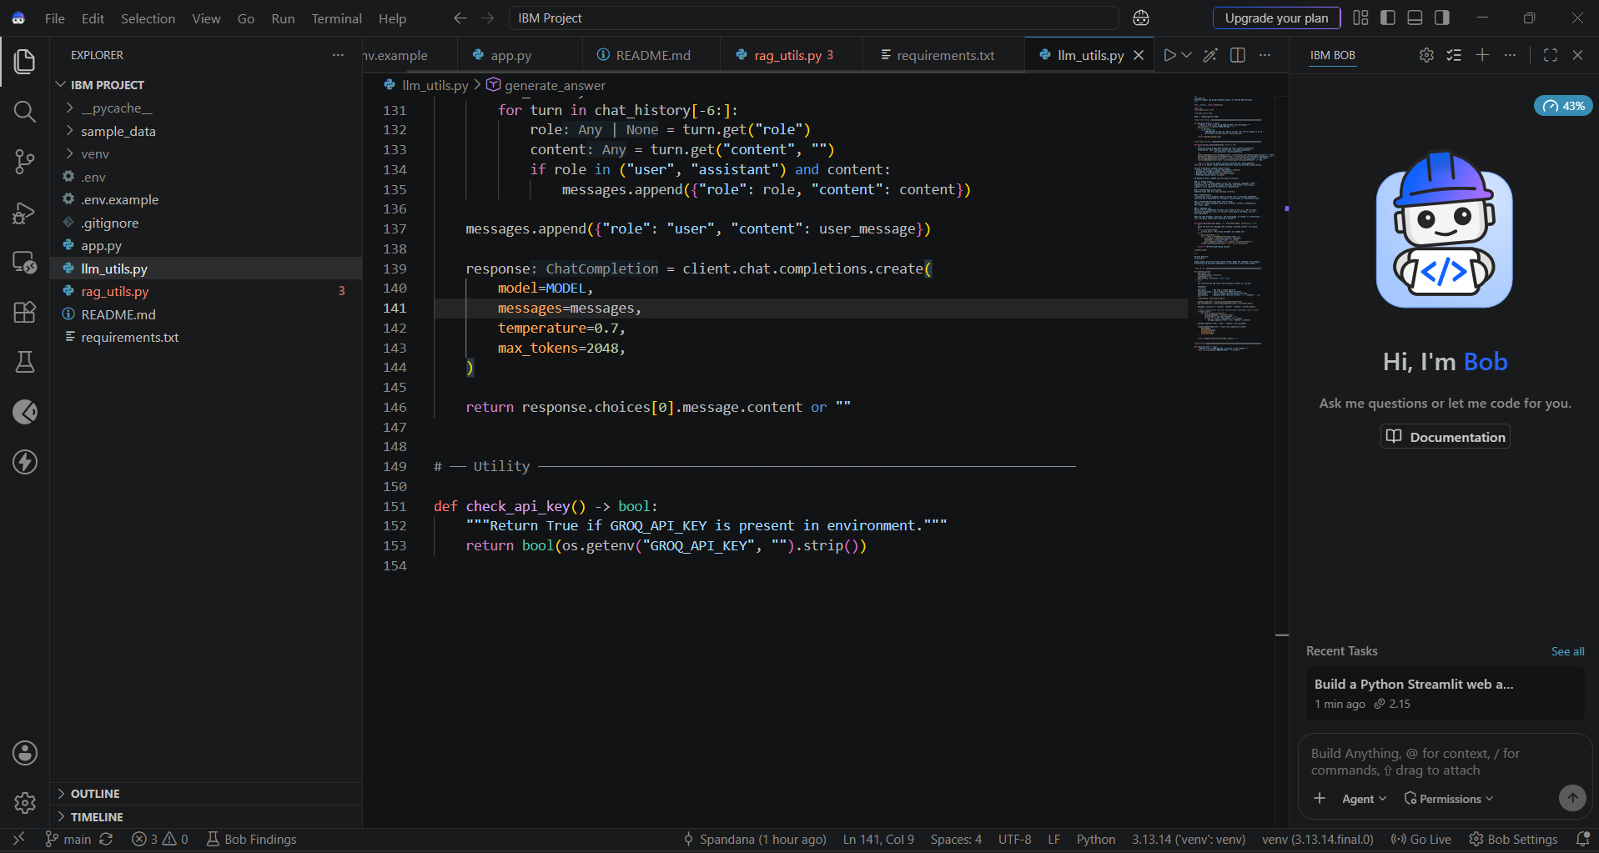
Required Files created using IBM bob -
ppp.py
requirements.txt
sample_data
.env
rag_utils.py
llm_utils.py
README.md
.env.example

Slide 7
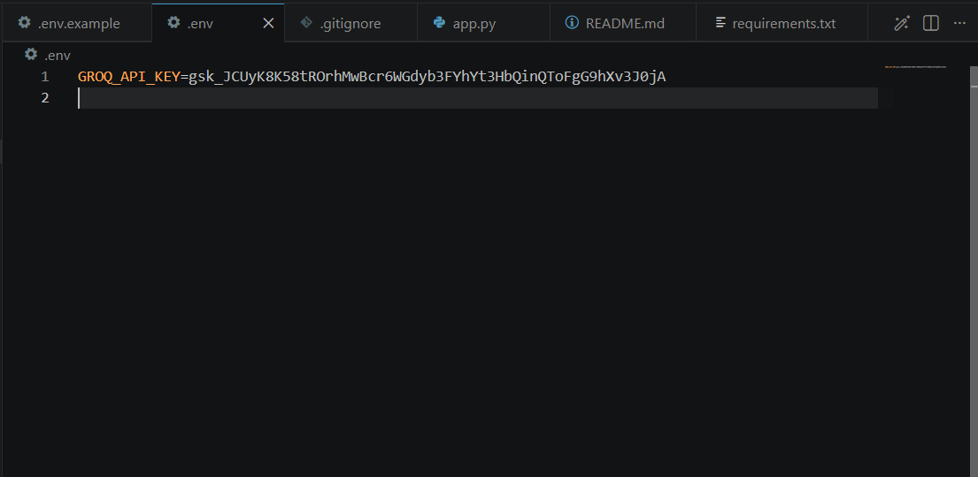
IBM Bob Screenshots:

Slide 8
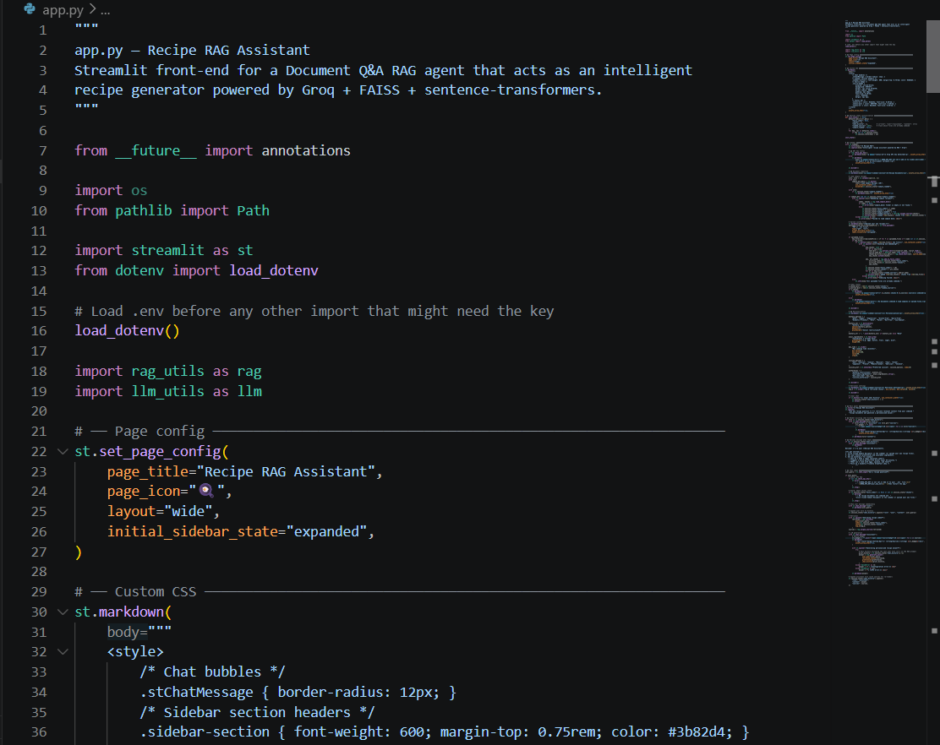

Slide 9

Role of Agentic AI in the solution
Agentic AI enables the Recipe RAG Assistant to function as an intelligent, context-aware system rather than a simple chatbot. It combines RAG, FAISS, Sentence Transformers, and Groq LLM to provide personalized recipe guidance.
The system retrieves relevant recipe information from PDF, TXT, and preloaded recipe documents using semantic search. Sentence Transformers generate embeddings, while FAISS identifies the most relevant recipe content for the user's query.
The assistant also considers user preferences such as dietary restrictions, available ingredients, cuisine preferences, and maximum cooking time to generate tailored recommendations.
It provides multiple useful outputs including step-by-step recipes, ingredient substitutions, estimated nutrition information, shopping lists, and recipe sources.
The system supports conversational interaction, allowing users to ask follow-up questions and receive responses based on retrieved recipe context.
Overall, the use of RAG and AI-driven personalization makes the Recipe RAG Assistant a practical and intelligent cooking companion that helps users discover and prepare recipes according to their individual needs.

Slide 10
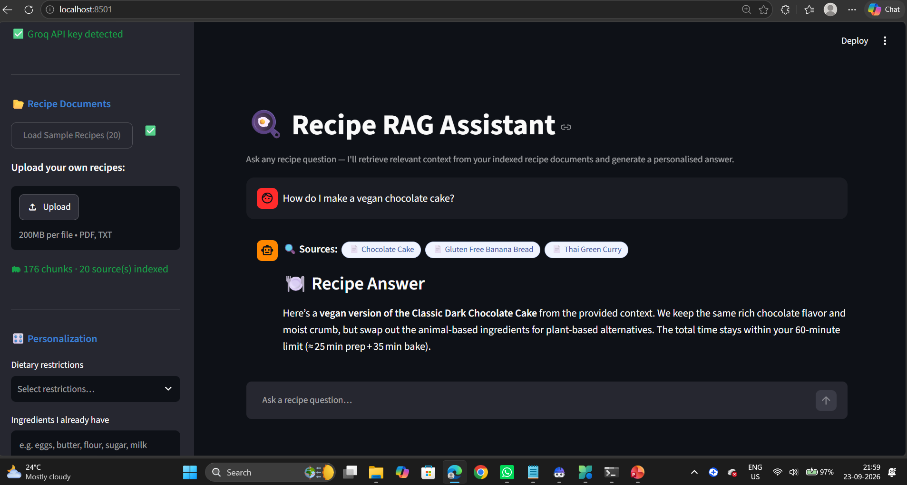
Project Output Screenshot
Please put IBM Bob output screenshots with 2-3 prompts.
You can take 2-3 more slides for each screenshot
·
·
·

Slide 11
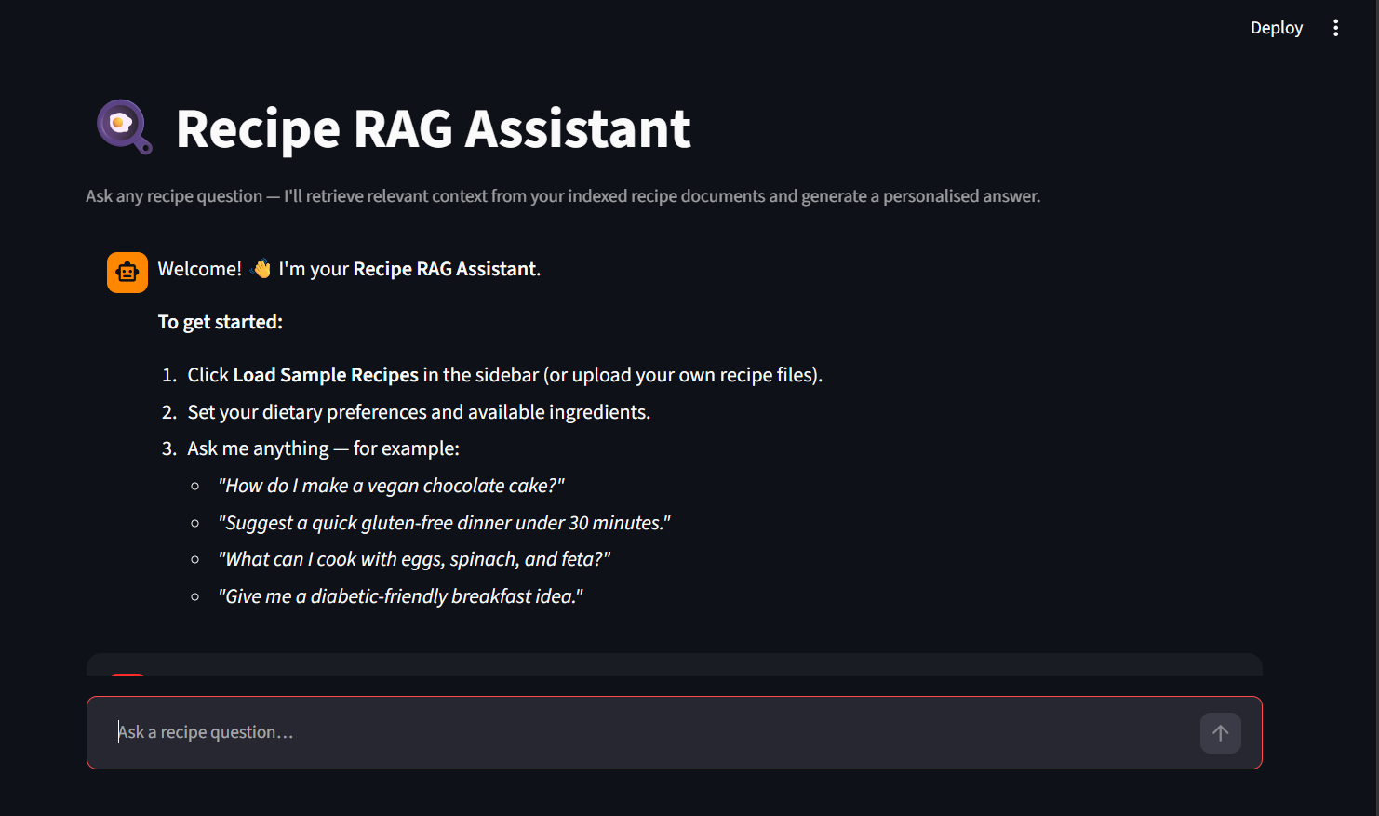
Project Output Screenshot
Please put IBM Bob output screenshots with 2-3 prompts.
You can take 2-3 more slides for each screenshot
·
·
·

Slide 12
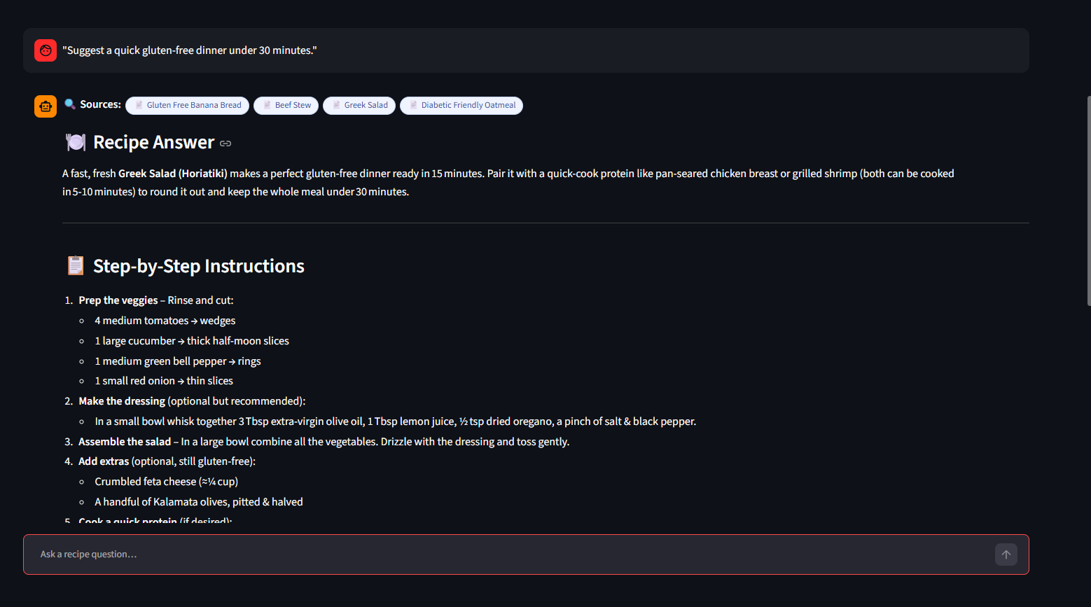
Project Output Screenshot
Please put IBM Bob output screenshots with 2-3 prompts.
You can take 2-3 more slides for each screenshot
·
·
·

Slide 13
Novelty and Uniqueness
RAG-Based Recipe Assistance – Uses FAISS and Sentence Transformers to retrieve relevant recipe information before generating responses.
Personalized Recipe Recommendations – Considers dietary restrictions, available ingredients, cuisine preferences, and cooking-time limits.
Multi-Source Recipe Support – Works with PDF, TXT, and preloaded recipe documents.
Smart Ingredient Substitution – Suggests suitable alternatives when required ingredients are unavailable.
Integrated Nutrition Insights – Provides estimated calories and nutritional information along with recipes.
Automatic Shopping List – Identifies unavailable ingredients and generates a personalized shopping list.
Source Transparency – Displays the recipe sources used to provide more trustworthy and traceable answers.
Conversational Cooking Assistant – Allows users to ask follow-up questions and receive context-aware cooking guidance.

Slide 14
Git Hub Link
· https://github.com/SpandanaRB/recipe-rag-assistant?utm_source=chatgpt.com
·
·
·

Slide 15
Future Scope
1. Personalized Recipe Recommendations –
The system can provide personalized recipe recommendations based on dietary
restrictions, available ingredients, cuisine preferences, and cooking-time constraints. This will help users quickly find suitable recipes without manually searching through multiple sources or adapting recipes themselves.
2. Intelligent Recipe Information & Guidance –
The system can use RAG-based retrieval to provide relevant recipe information from PDF, TXT, and preloaded recipe documents. It can also offer ingredient substitutions, nutrition insights, shopping lists, and conversational cooking guidance based on the user’s requirements.
·
·
·

Slide 16
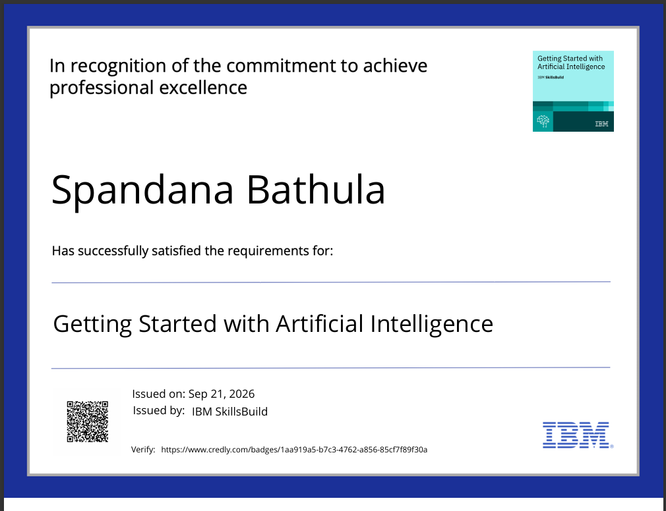
Certificates Earned:
Please add your credly certificate

Slide 17
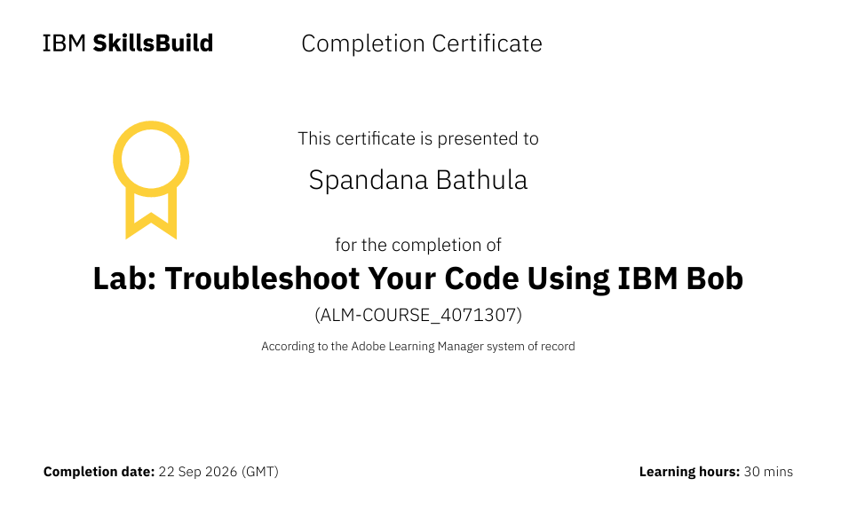
Certificates Earned:​
Add your IBM BOB Certificate

Slide 18


