Slide 1

The Influence of Factors of Production on Gross Output

Slide 2
Motivation for Industry Selection
How important are technological devices in our daily activities?
As analytics students, we understand the significance of computers and smartphones in our academic pursuits, as they facilitate research and communication.
Apart from academic tasks, our daily activities are also heavily reliant on electronic devices.
Intrigued by the evolution of technology, we aim to understand how the manufacturing firms have adapted changes over the past 34 years.

Slide 3
Reasons Behind Selecting the Key Variables
Our analysis prioritizes on understanding how manufacturing operations allocate resources and achieve strategic effectiveness.
When considering resources in a manufacturing firm, the first aspect that comes to mind is its utilization of factors of production, such as Material, College Labor, Non-college Labor, and Energy.
The production process also involves determining the value of goods produced, which is represented by the gross output.

Slide 4
Gross Output
(Units & Millions)
Material
(Units & Millions)
Energy
(Units & Millions)
KEY VARIABLES
College Labor
(Units & Millions)
Non-College Labor
(Units & Millions)

Slide 5
Overview of the Variables
Gross Output: Gross output is the total worth of products and services manufactured by a firm within a specific timeframe, indicating the efficiency of resource utilization in generating these outputs.
Material: Material denotes the resources utilized in the production process including raw materials and components essential for manufacturing.
Energy: Energy pertains to the power sources consumed during production activities comprising electricity, fuel, and other forms of energy.

Slide 6
Overview of the Variables
College Labor: College labor comprises individuals with advanced education and specialized training often acquired from colleges or universities. Their expertise in analytical thinking, problem-solving and technical knowledge enhances efficiency, innovation and quality in manufacturing processes.
Non-College Labor: Non-college labor comprises workers without advanced education, undertaking manual tasks in the production process such as packaging, cleaning, maintenance, basic equipment operation, material handling etc.

Slide 7
OBJECTIVE
The aim is to analyze the data of the Computer and Electronic Devices Manufacturing Industry to address the following four questions:
What Trends and Fluctuations are observed in the units of Factors of Production?
What alignment is observed in trends between Investment Patterns and Overall Economic Output?
What is the Correlation Analysis between Gross Output and Input Dynamics?
What is the yearly Financial Performance of the industry?

Slide 8
APPROACH
To address the questions outlined in the preceding slide, we will systematically use various data visualization techniques suited to specific needs.
This involves using diverse visualization tools like line charts, scatter plots, and bar graphs, chosen for relevance.
Our goal is to extract actionable insights for enhancing our understanding of underlying patterns and trends.

Slide 9
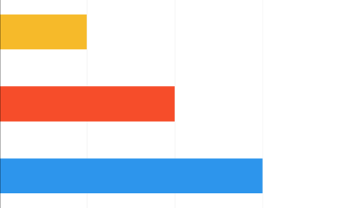

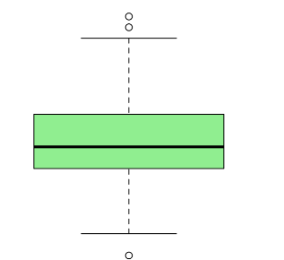
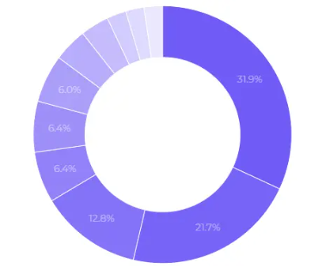


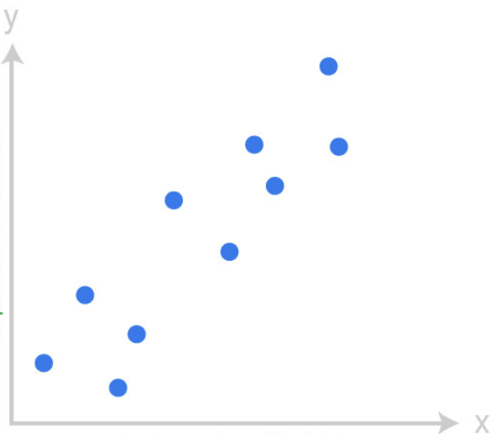
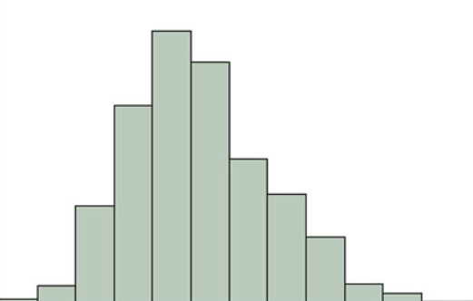
DASHBOARDS

Slide 10
What Trends and Fluctuations are observed in the units of Factors of Production?
Across the years, fluctuations in the input units have been evident with a sharp rise in energy and material units in the 2001.
The increased demand for computers in the early 2000s, was driven by technological advancements and growing consumer needs that increased the requirement for raw materials like metals and plastics which consequently raised the need for material units.
Fluctuations in global energy prices, particularly oil and natural gas between the late 1990s and early 2000s directly impacted production costs resulting in the rise of energy units during 2001.

Slide 11
What alignment is observed in trends between Investment Patterns and Overall Economic Output?
The dip in gross output from 2001 to 2003 reflects the economic disruption caused by the dotcom bubble bursting which impacted the value of the production.
Post-bubble burst, declining energy units indicate a shift to energy-efficient practices, while decreasing non-college labor units imply a reduced need for unskilled labor over the years.
The firm has consistently required material and college labor over time, suggesting stable production needs and ongoing reliance on skilled personnel. This reflects the company's commitment to quality and innovation.

Slide 12
What is the Correlation Analysis between Gross Output and Input Dynamics?
Gross output has a negative correlation with all production factors, indicating that decreased consumption often leading to higher output.
As anticipated, non-college labor shows a significant negative correlation with gross output, reflecting its reduced need for unskilled labor over the years.
On the other hand, the remaining units show a weaker negative correlation, indicating that fluctuations in these factors align with the principle of economies of scale, wherein mass production results in decreased input costs.
This negative correlation also indicate improved resource efficiency over time.

Slide 13
What is the yearly Financial Performance of the Industry?
In the first decade, the company embraced adaptive strategies and process optimizations, leading to a consistent growth in gross output value.
The burst of the bubble sparked a surge in demand for output products, raising market competition and causing a temporary dip in gross output value.
Following the bubble burst, the company refined operations and strategically invested in inputs, leading to improved output value and efficiency.
We can also observe through increased investment in college labor for innovation and a gradual decrease in material units for enhanced resource efficiency over time.

Slide 14
Project Significance and Stakeholder Benefits
Profitability: Stakeholders may see increased profits due to higher gross output values.
Efficiency: Operational efficiency is improved by optimizing investment in production factors leading to cost reductions and increased returns.
Market Competitiveness: Effective management of production factors and output optimization can enhance the company's competitiveness, potentially resulting in increased market share and profitability for stakeholders.

Slide 15
Limitations
Limited Predictive Capability: The dataset primarily covers manufacturing specifics like production volumes and resource utilization, limiting its ability to forecast future profitability or industry trends accurately.
Insufficient Data: Although the data offers insights into the manufacturing firm, it still doesn't directly capture its contribution to economic growth stimulated by the gross domestic product (GDP) through production and sales activities.

Slide 16
Conclusion
Upon analyzing the firm's data, we gain understanding of its performance trajectory over time and its ability to effectively navigate changes in technology and the market.
This highlights the significance of allocation and making smart choices about resource placement, which have been crucial to the firm’s development.
Adaptability is extremely important for any firm to grow and improve over time.

Slide 17
Recommendations
Continuous Improvement: Regularly evaluating and improving manufacturing processes using feedback and performance metrics ensures competitiveness.
Diversification Strategy: Exploring new product or market opportunities through thorough research minimizes risks and maximizes growth potential by identifying untapped segments and meeting evolving customer demands.

Slide 18

THANK YOU

