Slide 1
KUBEAI
Smart Remediation, Seamless Clusters

Slide 2
Problem statement
Modern IT infrastructures are increasingly complex, making them vulnerable to unexpected failures caused by resource exhaustion, such as CPU and RAM overutilization. These failures can lead to significant downtime, performance degradation, and financial losses. Traditional monitoring systems often fail to predict such failures in advance, resulting in reactive troubleshooting rather than proactive prevention. This project addresses the issue by leveraging AI-driven predictive analytics to detect potential system failures before they occur. By analyzing historical data and real-time metrics, the model forecasts critical risk levels and failure types with high accuracy. The results are presented through an interactive dashboard, enabling IT teams to take timely preventive actions, optimize resource allocation, and enhance overall system reliability.

Slide 3
Solution
In order to address the above problem faced in our laptops, we have developed an AI-driven predictive analytics system designed to detect and prevent IT infrastructure failures caused by resource exhaustion, such as CPU and RAM overutilization. Our approach involves training a machine learning model on historical system performance data to accurately forecast potential failures before they occur. By leveraging AI, we analyze patterns in system behavior, identify anomalies, and provide early warnings of critical failures. The results, including predicted risk levels and failure types, are presented through an interactive dashboard that offers real-time insights. This dashboard enables IT teams to take proactive measures, optimize resource allocation, and prevent downtime, ultimately enhancing system reliability and efficiency. Our solution bridges the gap between traditional reactive troubleshooting and modern AI-powered predictive maintenance, ensuring seamless and uninterrupted operations in complex IT environments.

Slide 4
Advantages
Our AI-driven predictive analytics system offers several key advantages in IT infrastructure management. By proactively detecting potential failures before they occur, it minimizes downtime, reduces operational disruptions, and enhances overall system reliability. The use of machine learning enables accurate forecasting of resource exhaustion issues, allowing IT teams to take preventive measures rather than reacting to failures. The interactive dashboard provides real-time insights, making it easier to monitor system health and optimize resource allocation efficiently. Additionally, the automation of failure detection reduces the need for constant manual monitoring, improving productivity and cost-effectiveness. This solution ensures seamless operations, enhances decision-making, and strengthens the overall resilience of IT systems.

Slide 5
Disadvantages
While our AI-driven predictive analytics system offers numerous benefits, it also comes with certain challenges. One of the key disadvantages is the dependency on high-quality historical data for accurate predictions—poor or insufficient data can lead to unreliable results. Additionally, the system requires continuous model training and fine-tuning to adapt to changing infrastructure conditions, which can be resource-intensive. Implementing AI-based failure prediction also involves an initial investment in computational resources and integration with existing IT systems. Furthermore, false positives or inaccurate predictions may lead to unnecessary interventions, potentially disrupting operations. Lastly, organizations may require skilled personnel to interpret AI-driven insights and take appropriate actions, adding to the overall implementation complexity.

Slide 6
Problems Solved
Our AI-driven predictive analytics system addresses several critical challenges in IT infrastructure management. It solves the problem of unexpected system failures caused by resource exhaustion, such as CPU and RAM overutilization, by providing early warnings and accurate failure predictions. Traditional monitoring tools often react to issues after they occur, leading to downtime and performance degradation; our solution shifts this approach to proactive failure prevention. By automating failure detection and risk assessment, it reduces the need for manual monitoring, optimizing resource allocation and improving operational efficiency. Additionally, the interactive dashboard provides real-time insights, enabling IT teams to make data-driven decisions, minimize disruptions, and enhance overall system reliability.

Slide 7
Challenges faced
During the development of our AI-driven predictive analytics system, we encountered several challenges. One major hurdle was ensuring the availability and quality of historical system performance data, as inaccurate or incomplete data could lead to unreliable predictions. Fine-tuning the machine learning model to achieve high accuracy while minimizing false positives required extensive experimentation and optimization. Integrating the system with existing IT infrastructure posed compatibility challenges, requiring careful API development and seamless data flow management. Additionally, real-time processing of system metrics demanded efficient computational resource allocation to prevent performance bottlenecks. Another challenge was designing an intuitive and user-friendly dashboard that effectively visualizes complex predictive analytics for IT teams. Lastly, handling security concerns, such as protecting sensitive infrastructure data, was crucial to ensuring safe and reliable implementation.

Slide 8
Future scope
The future scope of this project includes expanding its capabilities to predict a wider range of system failures using advanced AI models and deep learning techniques. Integrating real-time cloud monitoring with platforms like AWS, Azure, or Google Cloud can enhance scalability and adaptability for large-scale IT infrastructures. The system can be further improved by incorporating anomaly detection algorithms and self-learning mechanisms to continuously refine predictions. Additionally, implementing automated remediation actions based on predictions can help minimize downtime without human intervention. Enhancing the dashboard with more detailed analytics, visualizations, and alerting mechanisms will provide IT teams with deeper insights and proactive decision-making tools.

Slide 9
Target audience
IT Infrastructure Teams
DevOps Engineers
System Administrators
Cloud Service Providers
Data Centers & Network Operations Teams
Enterprises Managing Large-Scale IT Systems
AI & ML Researchers in Predictive Analytics
Cybersecurity Professionals for Risk Mitigation

Slide 10



TECHNOLOGIES USED
Frontend
Backend
Other Tech
Jupyter Notebook
Machine Learning (Scikit-learn)
Matplotlib
NumPy
Pandas
Git & GitHub
React.js
Tailwind CSS
Recharts
React Router
Framer Motion
Fetch API
Python
Flask
Flask-CORS
nbformat
JSON

Slide 11
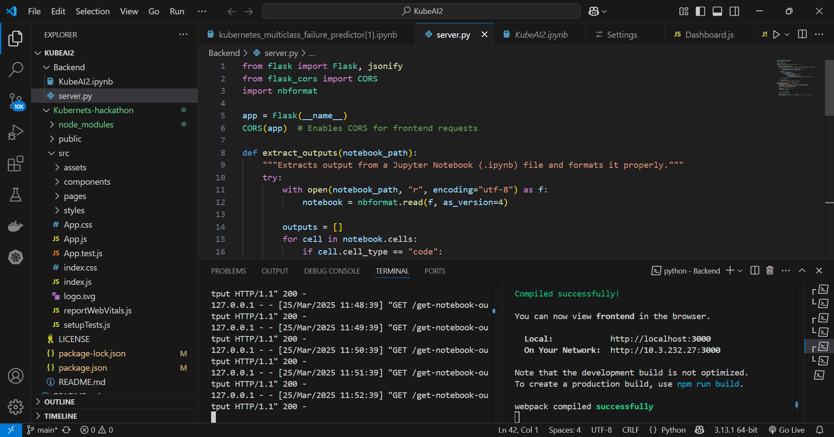
implementation

Slide 12
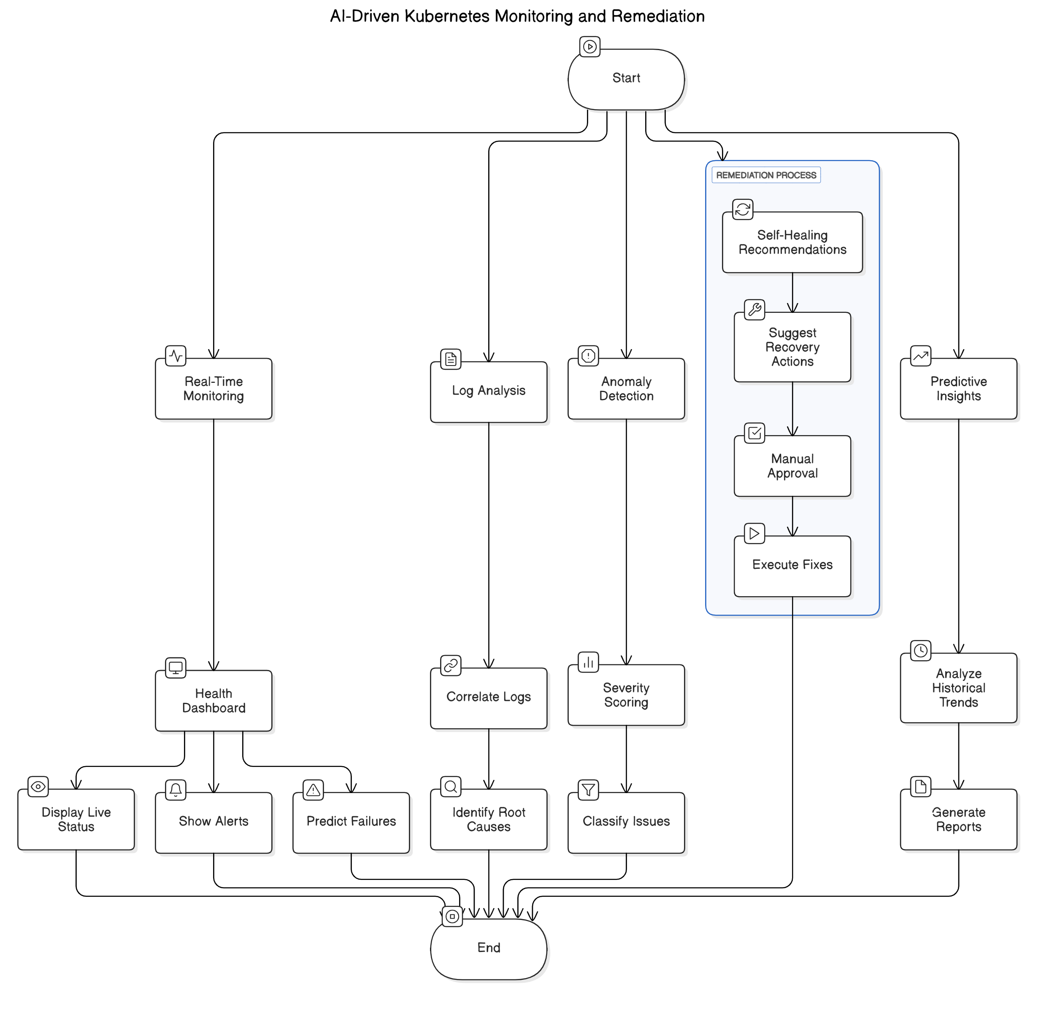
ARCHITECTURE DIAGRAM

Slide 13
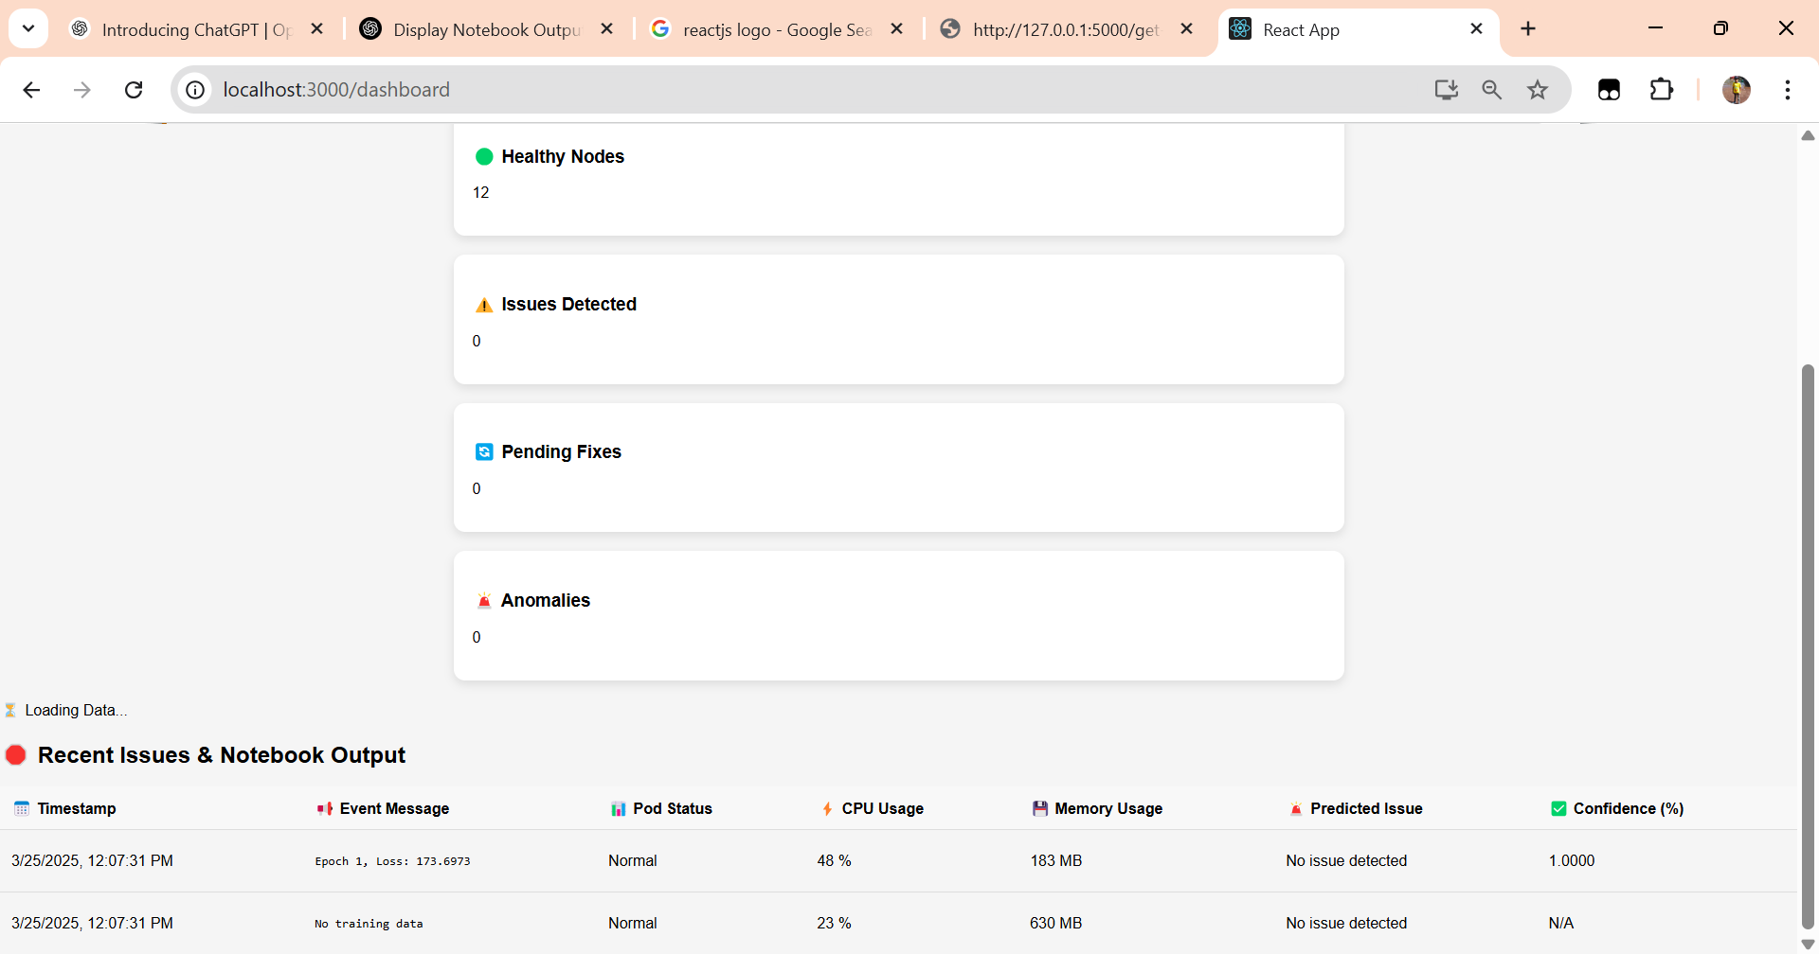
OUTPUT

