Slide 1
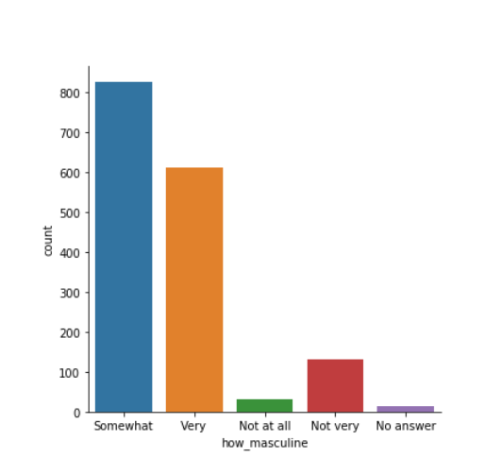
SEABORN COUNT PLOT
BY SPANDAN K C

Slide 2

INTRDOUCTION
Count plots are used to display the number of observations per category by representing them as bars.
Count plot are used for categorial data.
These type of plots are widely used while doing comparisons between groups .

Slide 3
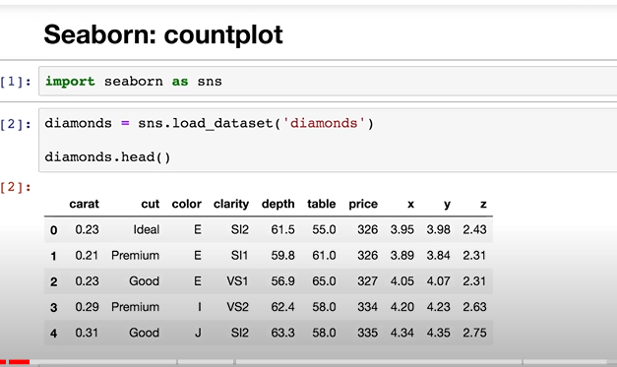
Example Data for creating Count plot
1. Got dataset from github.com/kimfetti/Videos.
2.Import the seaborn library.
3. Load the diamonds dataset from the seaborn library.
4. Each row of the dataset contains information about one particular diamond.

Slide 4
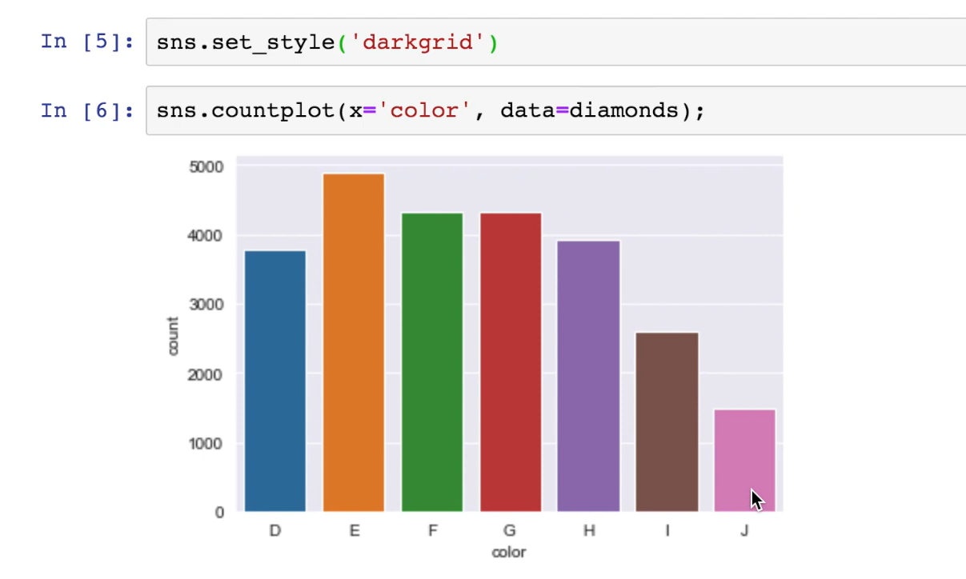
Set the style to "dark grid" using seaborn.
Create a count plot by calling the count plot function from the seaborn library.
Specify the "color" column from the diamonds dataset for the plot.
Seaborn will count the number of observations for each category in the "color" column.
For example, seaborn counts around 1,500 diamonds** with a color of "J."

Slide 5
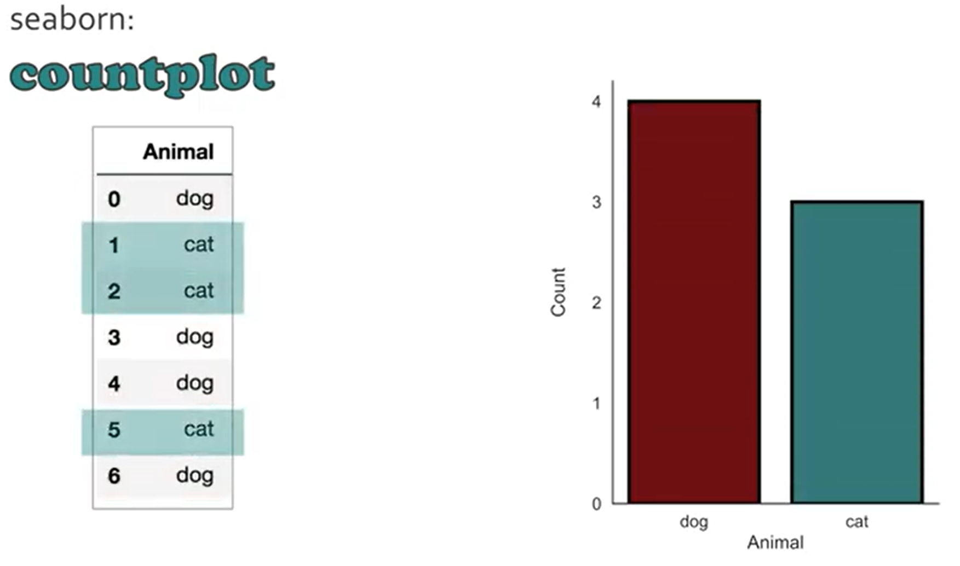
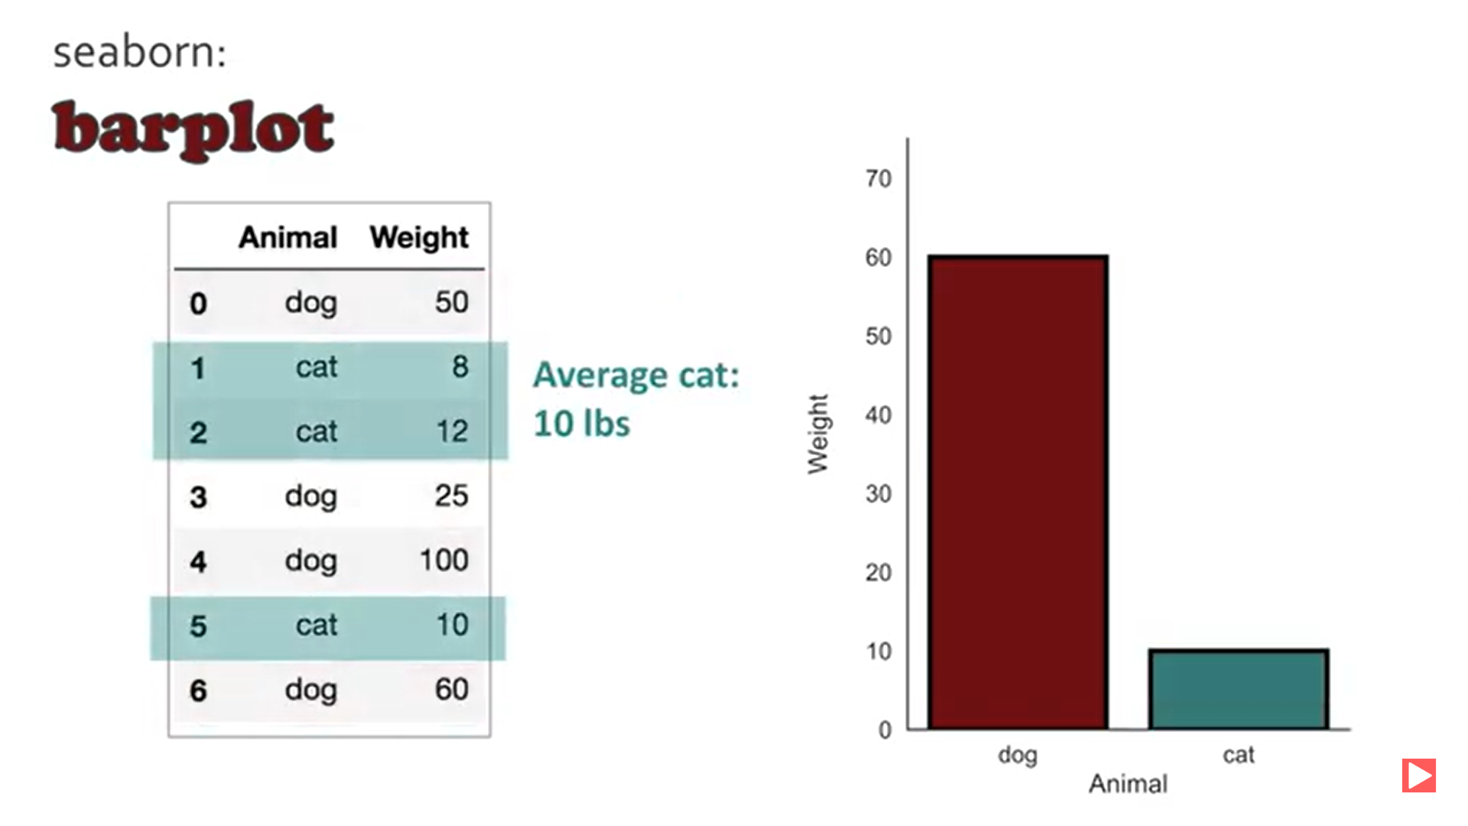
Difference between Count plot and Bar plot
1. Count Plot:
Simply counts observations in each category.
Shows frequency for each category.
2. Bar Plot:
Shows an estimate of a summary statistic (e.g., average).
Can display mean or sum for each category.

Slide 6
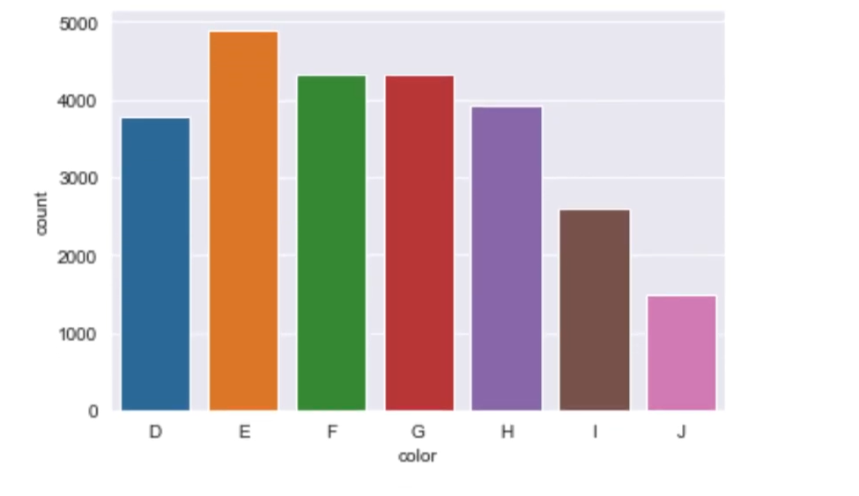
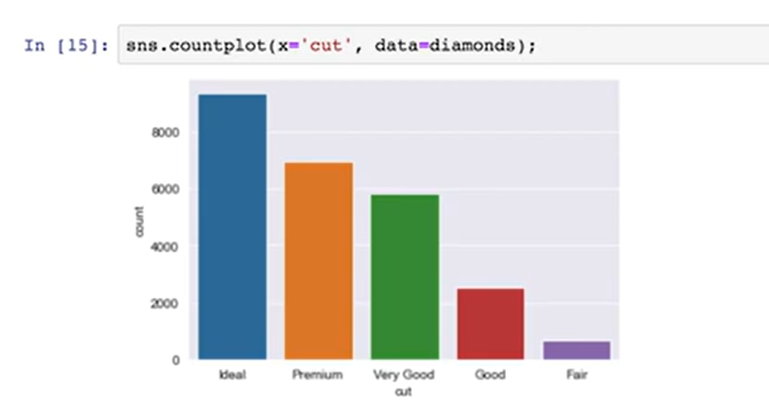
Sorting Count Plots in Seaborn
1. Default Sorting:
- Bars are sorted alphabetically or by a predefined order.
2. Examples:
- Color column: Alphabetical (D to J).
- Cut column: Predefined order (Ideal to Fair).
3. Challenge:
- Default sorting can be confusing when comparing data.
4. Solution:
- Use the order` argument to customize sorting by popularity or any custom order.

Slide 7
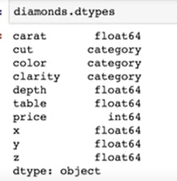
Ordering Bars in Seaborn Using Category Data Types
Seaborn uses category data types to order bars in count plots.
Columns like cut, color, and clarity are categorized.
Seaborn arranges bars based on these predefined categories.

Slide 8
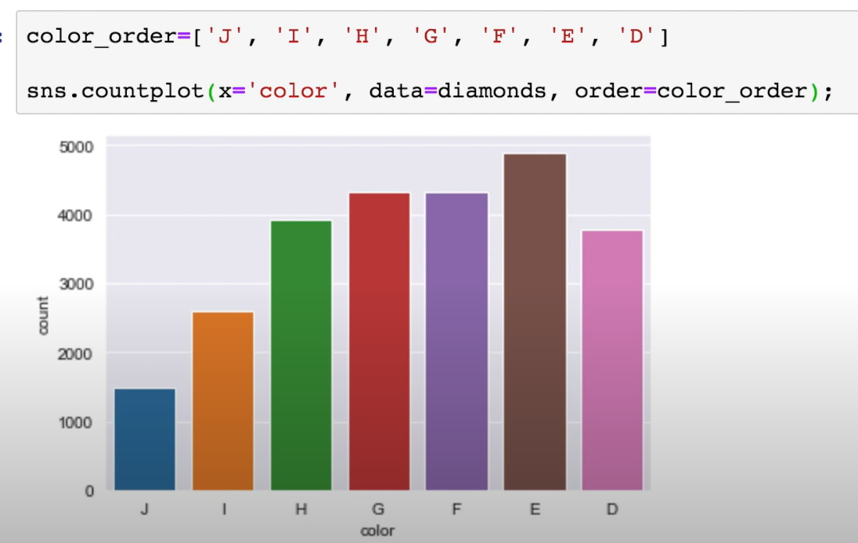
CHANGING ORDER OF BARS
1. Define Custom Order:
Create a list with the desired order for your categories.
Example: `color_order = ['J', 'I', 'H', 'G', 'F', 'E', 'D']`
2. Use the “order” Argument:
Pass this custom order to Seaborn’s countplot using the “order “ argument.
Example: `sns.countplot(x='color', data=diamonds, order=color_order)
3. Result:
The bars will now be displayed in the custom order you’ve specified (e.g., from J to D).

Slide 9
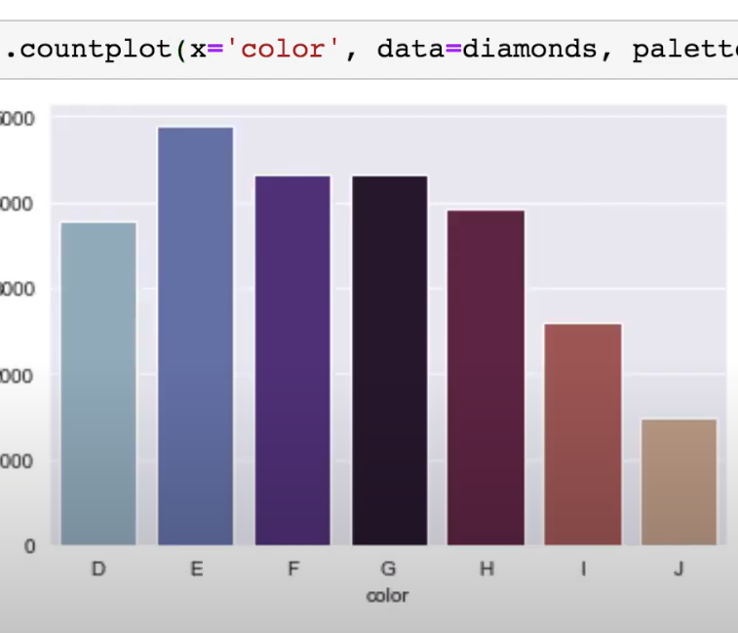
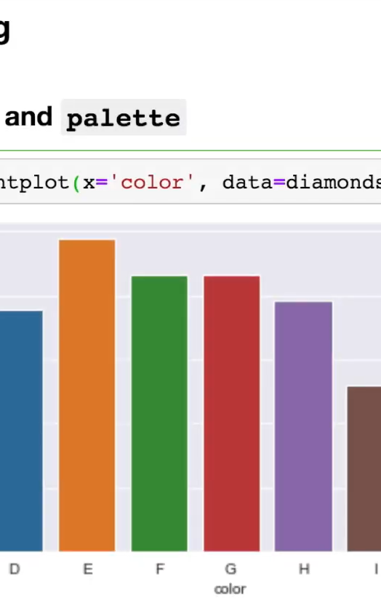
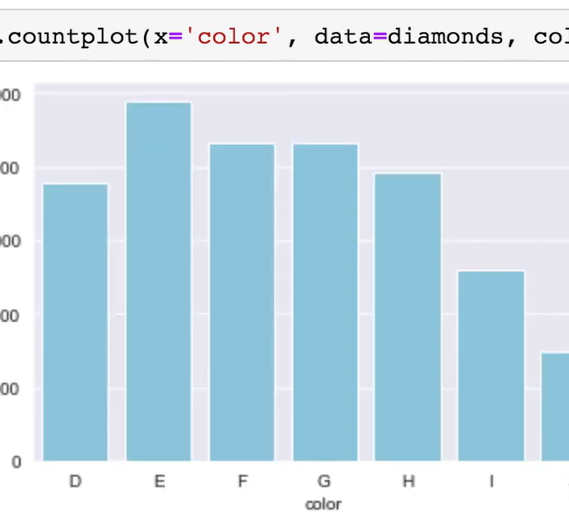
Styling bars
1. Single Color for All Bars:
- Use “color” to set one color for all bars.
- Example: `sns.countplot(x='color', data=diamonds, color='blue')`
2. Multiple Colors with Palette:
- Use “palette” to assign different colors to each bar.
- Example: `sns.countplot(x='color', data=diamonds, palette='Set2')`

Slide 10
Thnak YOU
Any questions ?

