Slide 1
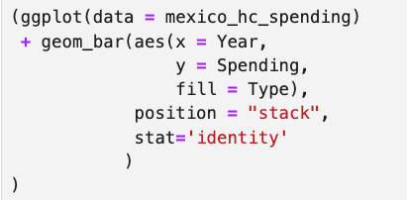
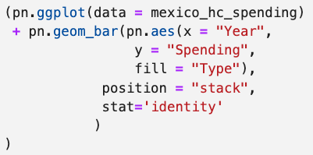
Add pn. to all functions
Put all column names in strings

Slide 2
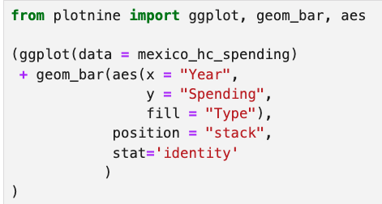
Import all functions using
from plotnine import …
Put all column names in strings

