Slide 1
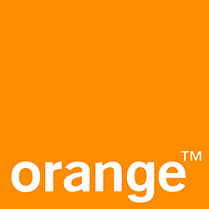




User Controlled Trust and Security Level of Web Real-Time Communications
Kevin CORRE
PhD Defense
May 31st, 2018
Maryline LAURENT, TELECOM SudParis, Reléctrice
Yvon KERMARREC, IMT Atlantique, Relécteur
Walter RUDAMETKIN, Université de Lille, Examinateur
Dominique HAZAEL-MASSIEUX, W3C, Examinateur
Vincent FREY, Orange Labs, Encadrant Industriel
Olivier BARAIS, Université de Rennes 1, Directeur de thèse
Gerson SUNYÉ, Université de Nantes, co-Directeur de thèse
Notes:
Drag Picture and Send to Back

Slide 2




Voice Over IP with WebRTC
Context
Voice over IP: the techniques to communicate using voice or
voice and video over any compatible IP networks
WebRTC: W3C API and IETF protocols profiles for Web based real-time audio, video, and data communication capabilities
Use cases: VoIP, gaming, streaming, data sharing
Alice and Bob: two users of a WebRTC application
Communication Service: the web server providing the
WebRTC application

Slide 3



WebRTC Signalling
Establishing a Peer-to-Peer Communication between two browsers
Signalling
Communication Service
SDP
Offer
SDP
Answer
Alice
Bob
Peer-to-Peer Media Encrypted

Slide 4


Can Users Trust Any WebRTC Application?
Malicious, or Corrupted Communication Service
Signalling
Communication Service
Session 1
Session2
Alice
Eve
Bob
The Communication Service can setup a Man-in-the-Middle Attack (MitM)

Slide 5

WebRTC
Identity Architecture : Overview
Communication Service
SDP
Message
——
Identity
Alice
Bob
Identity Assertion Validation
Identity Assertion Generation
Identity Provider

Slide 6
WebRTC
Identity Architecture : Identity Assertion
v=0
o=mozilla...THIS_IS_SDPARTA-54.0.1 5897145307417630851 0 IN IP4 0.0.0.0
[...]
a=fingerprint:sha-256 33:B1:D7:4B:29:29:29:AA:87:01:47:B3:59:41:[...]5D
a=group:BUNDLE sdparta_0 sdparta_1
a=ice-options:trickle
a=identity:eyJhc3NlcnRpb24iOiJleUowZVhBaU9pSktWMVFpTENKaGJHY2lPaUpTVXpJMU5pSXNJbXAzYXlJNmV5SnJkSGtpT2lKU1UwRWlMQ0p1SWpvaWVHNWxNblpw[…]
pZHAiOnsiZG9tYWluIjoiZW5lcmd5cS5pZHAucmV0aGluay5vcmFuZ2UtbGFicy5mciIsInByb3RvY29sIjoicmV0aGluay1vaWRjIn19
identity is a base 64 encoded JSON
{
"assertion": "eyJhc3 …. jIn19" ,
"idp": {
"domain": "orange.fr",
"protocol": "default"
}
}
validateAssertion returns:
{
"identity": "alice@orange.fr" ,
"content": "fingerprint:sha-256 33:B1[…]5D"
}
Binds Alice identity to Alice’s fingerprint: a sha-256 hash of Alice’s public key
The Identity Architecture binds the fingerprint to an identity validated by the Identity Provider.

Slide 7
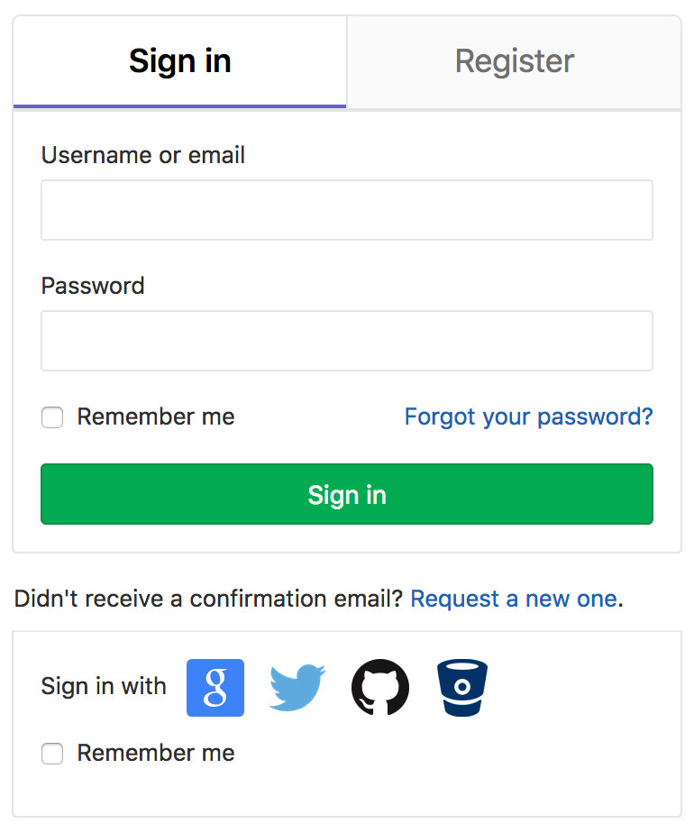
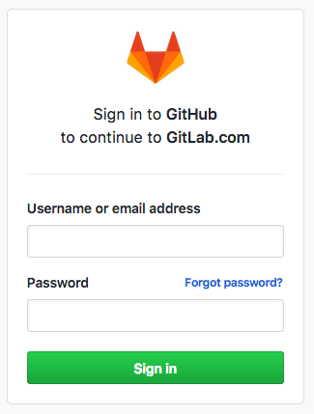
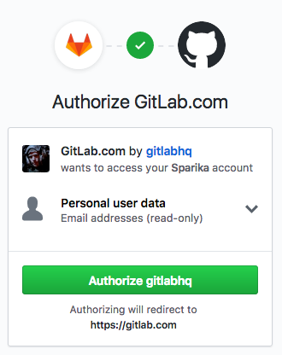

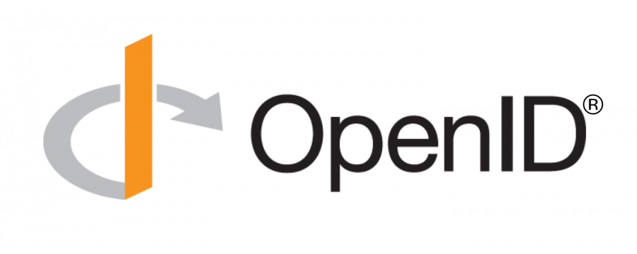
Identity Provider
A New Actor in the Communication Setup
Identity Provider: the web server providing an authentication delegation
service to other web application
Password fatigue
Authentication
Authorization

Slide 8
Security, Authenticity
Some Definitions
Security is usually defined as Confidentiality, Integrity, and Availability
Eve
m
//
C
I
A
Claims: identifier, name, birthdate, access rightname, fingerprint, …
Identity: a set of claims
Authentication delegation: letting a trusted third party assert the validity of identity claims
Alice
Bob
claims
Alice
Bob
Alice:claims?
IdP

Slide 9
Security, Authenticity, and Privacy
Some Definitions
Eve
learns <Alice,Bob>
Privacy threats include surveillance, correlation, identification, secondary use, disclosure, exclusion, …
claims
Alice
Bob
Concern regarding privacy is drastically increasing following recent privacy breaches
Alice:claims?
IdP
learns <Alice,Bob, claims>

Slide 10

User-Chosen Independent Identity
Industrial Objective: The Interoperability of TelCo Services for OTT Communications
Ultimately, users rely on [to be] trusted-actors to ensure the security, authenticity, and privacy of their communications
We claim that in order to trust their communications, users must have a choice regarding the configuration of their communication setup
reTHINK H2020 project, D2.1:
« In reTHINK, the aim is to provide identity that is independent of both the front-end applications and the communication providers, using an independent and unique identifier. This identity should be managed by the user, not the service provider, and is verified by a user-chosen independent trusted entity. »

Slide 11

Security with WebRTC
Anon
A Complex Scenario
CS3
Signalling Federation
In WebRTC, the situation may be too complex with multiple sessions, communication services, identity providers, and peers…
CSA
CSB
/IdPB
Alice
Bob
IdPA
How could users control the security and trust level of their WebRTC session?

Slide 12
OUTLINE
The Agenda for Today
1. WebRTC Security and Identity Arch.
Context
2. STATE OF THE ART
on VoIP and WebRTC Security
3. RESEARCH QUESTIONS
4. PRIVACY in WebRTC ID. ARCH.
Contribution 1
5. CONTROLLING WebRTC ID. ARCH. Contribution 2
6. MODELLING WebRTC ID. ARCH.
Contribution 3
7. CONCLUSION and
PERSPECTIVES

Slide 13
Our State of the Art Survey
WebRTC Security 2012-2017
Keromitys published a survey on « VoIP Security » in 2012, classifying and reviewing 245 articles
WebRTC W3C Working Group was created in may 2011 and the security architecture first draft was published in January 2012
We survey VoIP security research since 2012 to 2017
We collect and classify 208 articles based on title and abstract and then review the 25 articles dealing with WebRTC security

Slide 14
Security of the WebRTC Identity Architecture
State of the Art on WebRTC Security for 2012-2017
Loreto’17
Rahaman’15
Jennings’13
Barnes’14
reTHINK’14-17
Javed’17
Security
Reiter’17
Javed’16
Copeland IETF-Draft’17
Privacy
Privacy
Trust
Privacy
Javed’17
Li’14
Corre Patent’16
Javed’16
Beltran’15 & ‘15
Corre PETS’17
De Groef’16
Role of the IdP
Contributions do not reference implementation or integration with existing protocol
Negotiation
Negotiation
Negotiation
Corre ICWE’17
Copeland’16

Slide 15
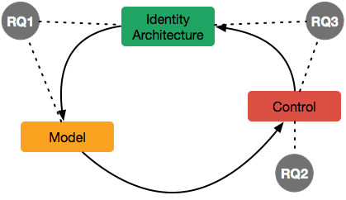
Research Questions
The Problem We Are Addressing
RQ1: What are the risks for the user of a WebRTC session and which abstractions can we use to show these risks to the user?
Contribution 1
RQ2: Can we act on a WebRTC session to raise the trust and security level?
RQ3: Can we let users chose actors they trust to participate in the communication setup?
Contribution 2
Contribution 3
Privacy / Role of the IdP

Slide 16
Research Questions and Contributions
Thesis Organisation
Contribution 1
Contribution 2
Contribution 3

Slide 17
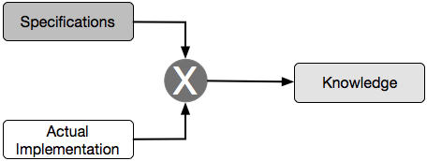
Methodology
An Empirical Methodology for Studying WebRTC Security
Implementation experiments:
Reveal implementation and integration issues
Deployment surveys:
Demonstrate if and how a feature is used
Measure a feature’s interest in the community

Slide 18
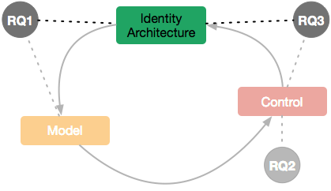
Privacy in the WebRTC Identity Architecture
Contribution 1
RQ1: What are the risks for the user of a WebRTC session and which abstractions can we use to show these risks to the user?
RQ2: Can we act on a WebRTC session to raise the trust and security level?
Contribution 1
RQ3: Can we let users chose actors they trust to participate in the communication setup?
Contribution 2
Contribution 3

Slide 19
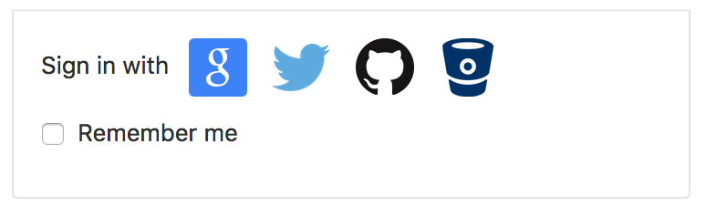
The Identity Continuity Principle
A Potential Privacy Issue
Alice’s CS responsible for configuring the IdP
CS
alice.cs_webrtc.com
Alice
Bob
Alice’s identities in CS context and in WebRTC context must be coherent to Bob
IdP
killer_19@idp.com
The choice of an IdP is limited in the same way for WebRTC as it is on the general Web

Slide 20
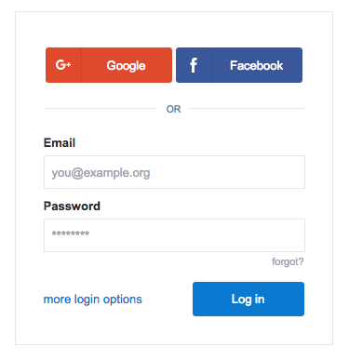
Users Cannot Choose their Identity on the Web
Which limits trust on the Web.
IdP
On the Web, users are presented with a very limited choice of IdP
Vapen’15 reports that 47% of 77 websites offers only one IdP and only 19% offers 4 or more IdPs
Website
Authentication delegation is a practical architecture for security on the Web, however the domination of a few IdPs is a privacy issues for end-users

Slide 21




OAuth2 and OpenID Connect Data Collection
Overview
Why can’t users choose their IdP?
Could users choose any IdP?
We collect OAuth2/OIDC usages on websites from alexa.com top-500
Out of 500 websites, we collected 103 OAuth2/OIDC Relying Parties,
using 23 OAuth2/OIDC providers
63/103 Relying Parties
52/103 Relying Parties
30/103 Relying Parties
Uses OAuth1, not included in our data.
6/103 Relying Parties

Slide 22

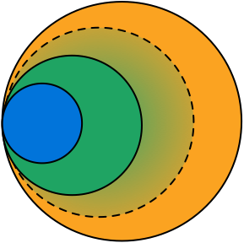

Websites Require Different Kind of Authorization
Authorization Classes
Authentication
Profile
Specialised
https://github.com/login/oauth/authorize?
scope=user:email
https://www.facebook.com/dialog/oauth?
scope=email,user_birthday,user_likes,
user_friends,publish_actions
https://accounts.google.com/o/oauth2/auth?
scope=/auth/plus.login,/auth/userinfo.email
(MIN, MAX) classification

Slide 23
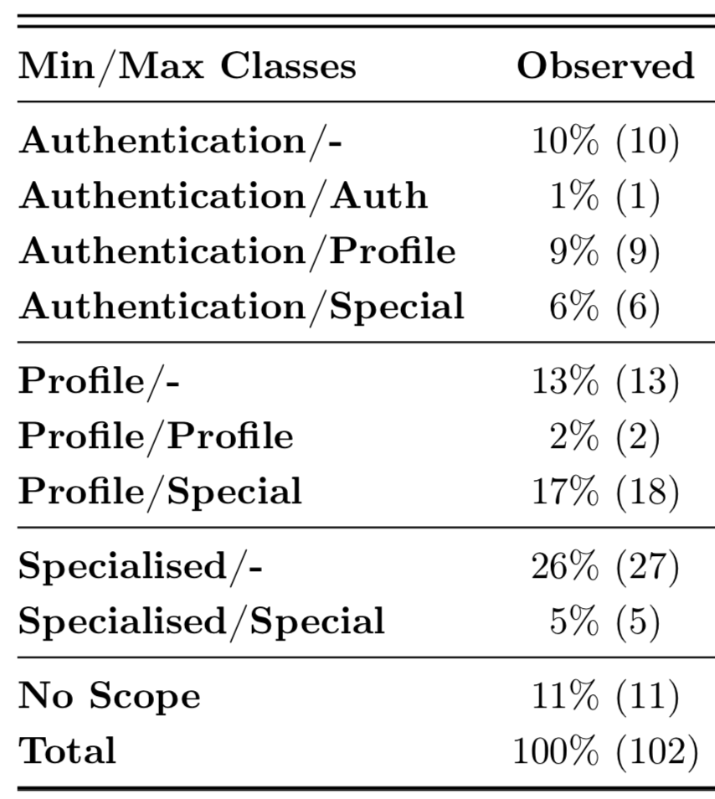
RQ3.1 Do Websites Require Specialised API?
Our results
26% of websites classified as
(Authentication, _)
58% of websites (Authentication
and Profile) could request
authorization from any IdP.
58% do not require specialised API and data, and could accept any IdP from an authorization point of view
32% of websites classified as
(Profile, _)
OIDC standardises user profile scopes and data, but it is scarcely implemented
31% of websites classified as
(Specialised, _)
OpenID Connect standardises Authentication and Profile scopes.
However, we observe that it is scarcely implemented by IdPs outside
of Google.
23% of websites request
Specialised data but also adapt
for lower auth level.
40% of websites offer several
IdPs, i.e. classified as (_, MAX)

Slide 24
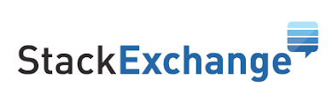

RQ3.2 Do IdPs Offer Dynamic Discovery ?
Our results
Dynamic discovery let users select their own IdP
OpenID Connect discovery JSON metadata should be available at
/.well-known/openid-configuration
No implementation of OIDC discovery metadata on IdPs
No implementation of OIDC discovery form on websites

Slide 25
Privacy in the WebRTC Identity Architecture
Contribution 1
RQ1: What are the risks for the user of a WebRTC session and which abstractions can we use to show these risks to the user?
The IdP can gather critical call informations
Users do not have much choice regarding their IdP in WebRTC
RQ3: Can we let users chose actors they trust to participate in the communication setup?
58% of websites only require authentication or profile authorization
OIDC -standard profile, discovery- is scarcely implemented

Slide 26
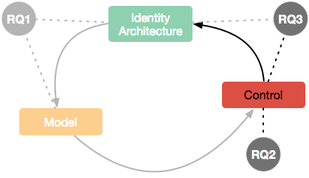
Controlling WebRTC Identity Parameters
Contribution 2
RQ1: What are the risks for the user of a WebRTC session and which abstractions can we use to show these risks to the user?
RQ2: Can we act on a WebRTC session to raise the trust and security level?
Contribution 1
RQ3: Can we let users chose actors they trust to participate in the communication setup?
Contribution 2
Contribution 3

Slide 27
Giving More Control to WebRTC Users
Contribution 2
Claim: a trust decision (to trust) implies that a choice is possible:
Alice should be able to choose her IdP,
Bob may want to have some control too
Alice
Bob
IdP
RQ2.1: How to let users negotiate the other peer’s identity parameters?
RQ3.4: Can we leverage the WebRTC identity architecture to let users
chose their IdP for user-to-server authentication?

Slide 28
Allowing Users to Choose their Identity on the Web
Recap
Users do not have much choice regarding their IdP on the Web
Identity continuity means that the same IdP is used for WebRTC and on the CS website
58% of websites only require authorization or profile
The lack of dynamic discovery means manual implementation of IdPs is required

Slide 29
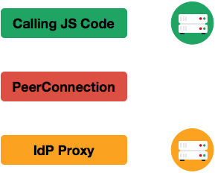
WebRTC IdP Proxy
WebRTC Identity Discovery
IdP Proxy standard location is DOMAIN/.well-known/idp-proxy/PROTOCOL
This standard location acts as a discovery mechanism
CS
{
"assertion": "eyJhc3 …. jIn19" ,
"idp": {
"domain": "orange.fr",
"protocol": "default"
}
}
API Calls
API Calls
IdP
https://orange.fr/.well-known/idp-proxy/default

Slide 30
WebRTC IdP Proxy
The CORE Component of the WebRTC Identity and Security Architecture
CS
The IdP Proxy serves as an authentication protocol abstraction layer
API Calls
API Calls
IdP
generateAssertion(fingerprint) -> identityAssertion
validateAssertion(identityAssertion) -> identity, fingerprint

Slide 31

Implementing the Missing Part
Local Authentication Scenario
Local Authentication Scenario
The CS plays the IdP’s role
Useful in multi CS architecture
OIDC Sketched in WebRTC annex
Require modification of OIDC
CS/IdP
CS
API Calls
API Calls
API Calls
API Calls
OIDC IdP

Slide 32
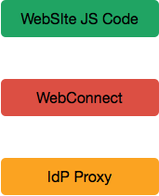
WebConnect Web API
Leveraging WebRTC Identity Architecture for User-to-Server Authentication
ID Validation
(JSON Web Token)
WebConnect provides an API and a graphical user interface, on top of the WebRTC Identity Architecture
CS
A web browser extension simulate the following web API:
Alice
.connect
.register
void register (String iss,
String proxy,
String sub,
String name,
String picture);
Promise<JWT> connect(Object request);
WebRTC API Calls
IdP

Slide 33
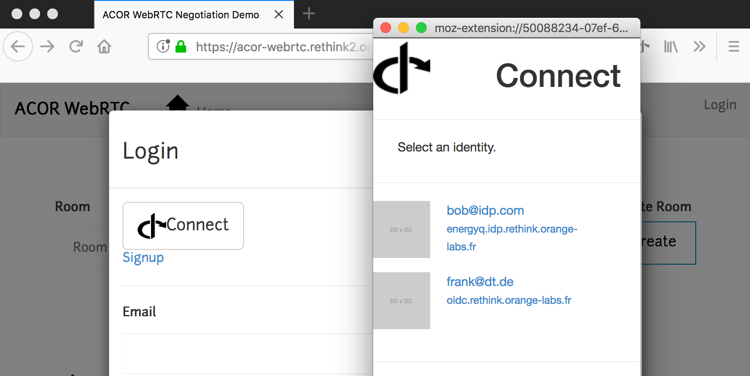
WebConnect: a Browser-based Identity Metasystem
The User Experience

Slide 34
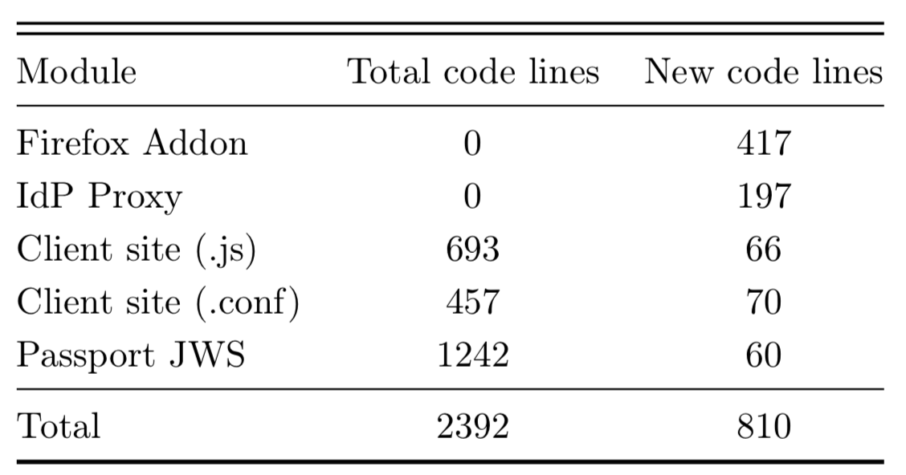
WebConnect Developer Usability
Evaluation
Implementation work is a constraint for web developers
CS
.connect
.register
WebRTC API Calls
IdP
WebConnect integration to an existing website is simple: under 200 lines of code using a library such as Passport

Slide 35


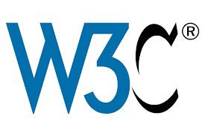
WebConnect Privacy
Evaluation
This solution allows users to select any compatible and trusted IdP to authenticate on a website offering WebConnect
For instance, a user could choose an IdP implementing
For instance, a user could choose an IdP implementing privacy preserving solutions, privacy preserving policies, or self-host its own IdP
For instance, a user could choose an IdP implementing privacy preserving solutions, privacy preserving policies
For instance, a user could choose an IdP implementing privacy preserving solutions
Privacy by Design Foundation
Cozy Cloud
WebID-TLS

Slide 36
WebConnect Security
Evaluation
WebConnect do not follow OIDC standard
Website can authenticate the IdP without prior registration
The IdP cannot authenticate the website and cannot control authorization delegation
Same limit as for WebRTC Identity Architecture
Security relies on secure implementation and control of the API by the browser

Slide 37
Controlling WebRTC Identity Parameters
Contribution 2
RQ2: Can we act on a WebRTC session to raise the trust and security level?
SDP attribute extension to negotiate identity parameters
The WebRTC API does not handle authentication assurance level
RQ3: Can we let users chose actors they trust to participate in the communication setup?
The IdP Proxy provides discovery and authentication protocol abstraction
We use the IdP Proxy in a user-server authentication

Slide 38
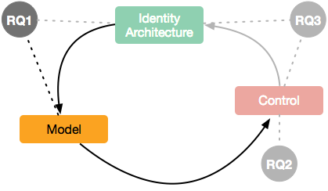
Modelling Trust and Security of a WebRTC Session
Contribution 3
RQ1: What are the risks for the user of a WebRTC session and which abstractions can we use to show these risks to the user?
RQ2: Can we act on a WebRTC session to raise the trust and security level?
Contribution 1
RQ3: Can we let users chose actors they trust to participate in the communication setup?
Contribution 2
Contribution 3

Slide 39
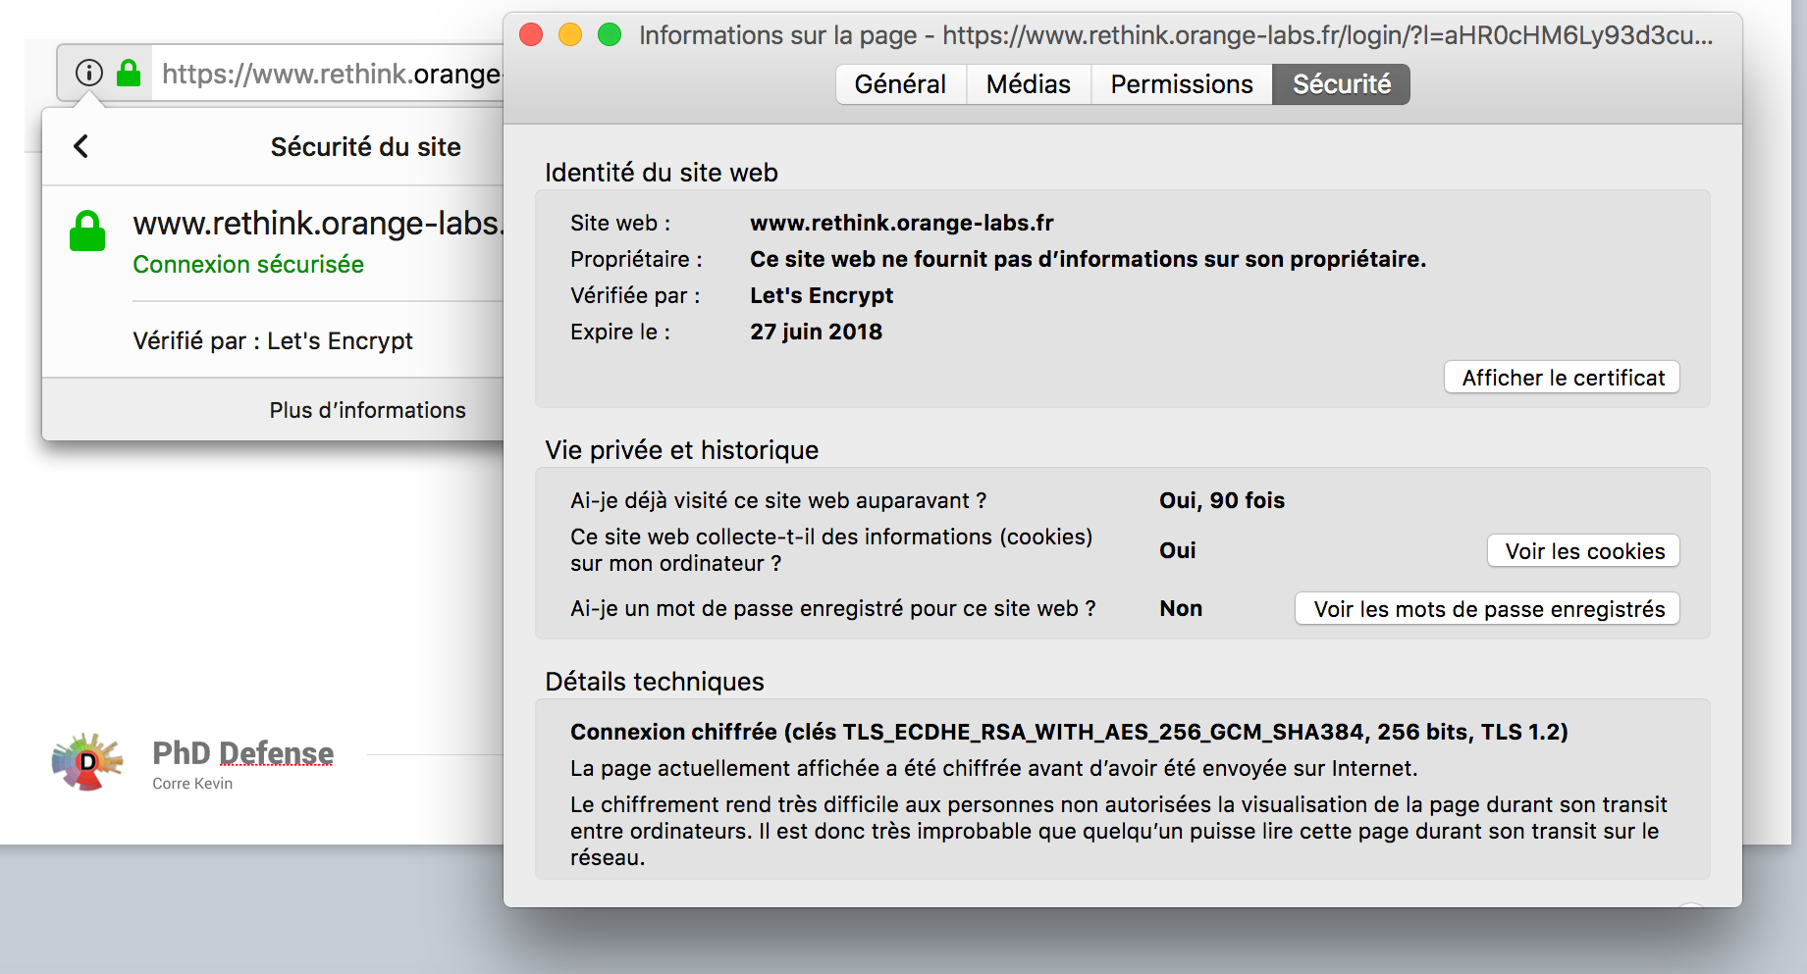
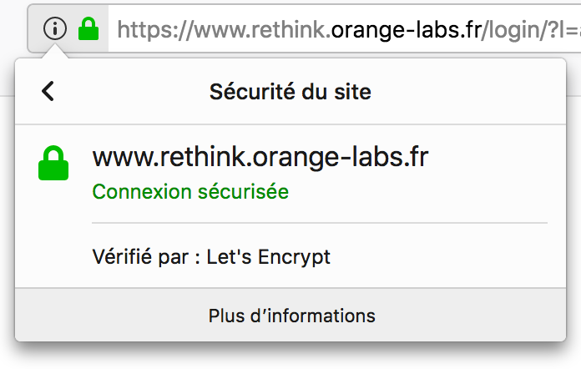
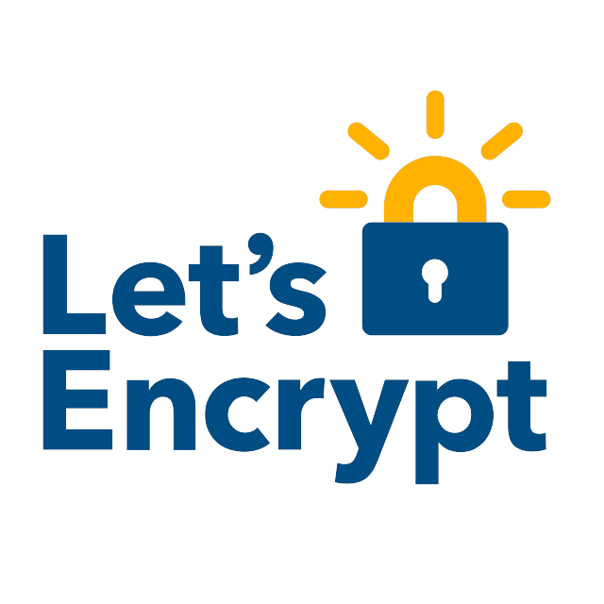
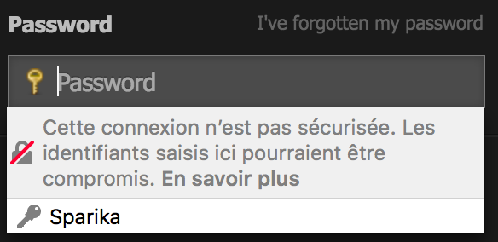
Security on the Web vs WebRTC
Advertising Security Configurations to Users
On the Web the security model is simple: One domain with a single certificate chain
Emited For
CN
Emited By
CN
Fingerprint SHA-256
rethink.orange-labs.fr
Let's Encrypt Authority X3
78:C0:58:2B:D3:5F:9F:13:3F:57:E3:BA:FA:FF:32:1D:
F7:EA:5E:A0:95:7F:0A:6F:93:BB:BB:41:CE:39:63:ED
A WebRTC session is quite more difficult to represent to users
A certificate contains:

Slide 40
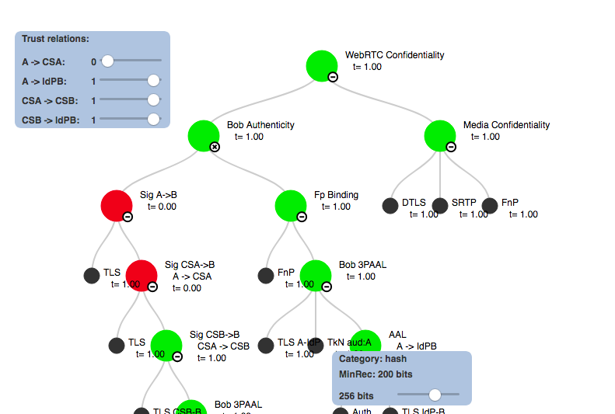
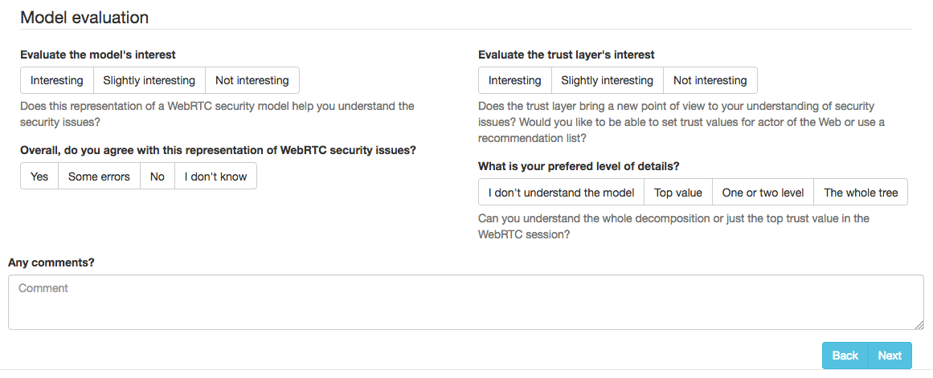
Preliminary Survey on Advanced Users
Validating our Approach
“the model [...] is interesting for people who do not have much knowledge in the field but still are interested in knowing how it roughly works”
Which actor <browser, CS, IdP> should play the role of the trusted recommendation source?
CS
Browser
IdP

Slide 41
Conclusion
Our results
Contribution 1: Demonstrated the privacy risks related to the role of IdP in the WebRTC communication setup and some of the technical reasons for this situation
Contribution 2: Proposed two solutions for allowing users to choose which actors are allowed to participate in the peer authentication
Contribution 3: Proposed a model of a WebRTC session security targeted at [advanced] users to facilitate the comprehension of their security configuration to help them decide/choose
We validated our contributions through implementation or deployment survey

Slide 42
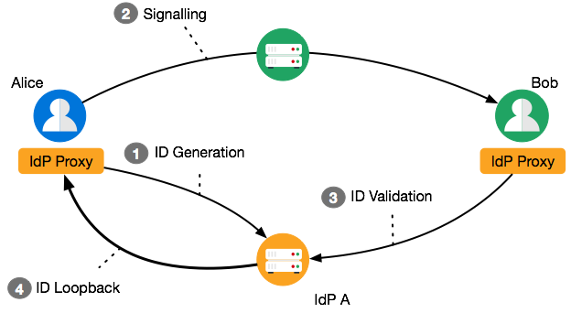
WebRTC Identity Proxy Interface
Short-Term Perspective
In the current architecture Alice does not get feedback from her IdP <the trusted actor>
i.e. Alice does not know to whom she is authenticating
We propose that IdPA loopback on Alice when the identity assertion is validated
How can IdP A authenticate Bob?

Slide 43
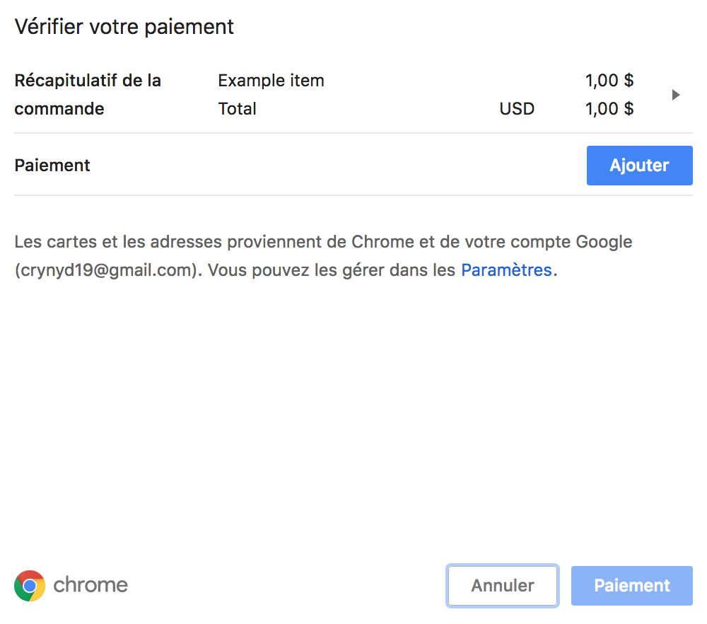
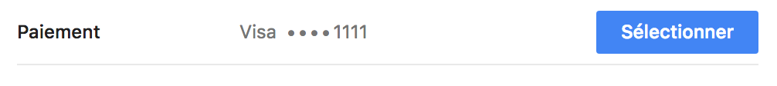
Authenticating with the WebPayment API
Mid and Long Term Perspectives
W3C Web Payment Working Group, 3 may 2018: « Right now there seem to be no major obstacles to resolving our list of issues for exiting Candidate Recommendation and advancing Payment Request API to Recommendation by Q4 of this year. »
What if we request payment for 0€?
Is there an API to abstract payment, authentication, and authorization?

Slide 44
Publications
Our results
[1] Kevin Corre, Simon Bécot, Olivier Barais, and Gerson Sunyé. “A WebRTC Exten- sion to Allow Identity Negotiation at Runtime”. Web Engineering - 17th International Conference, ICWE 2017, Rome, Italy, June 5-8, 2017
[2] Kevin Corre, Olivier Barais, Gerson Sunyé, Vincent Frey, and Jean-Michel Crom. “Why can’t users choose their identity providers on the web?” PoPETs 2017.3 (2017), pp. 72–86
[3] Rebecca Copeland, Kevin Corre, Ingo Friese, and Saad El Jaouhari. Requirements for Trust and Privacy in WebRTC Peer-to-peer Authentication. Internet-Draft draft-copeland-rtcweb-p2p-idp-auth-00. IETF Secretariat, Sept. 2016
[4] Kevin Corre and Vincent Frey. “Method of managing the authentication of a client in a computing system”. WO2017006013 A1 Patent App. PCT/FR2016/051,601. 2016
[9] Ibrahim Tariq Javed, et al. “Cross-domain identity and discovery framework for web calling services”. Annales des Télécommunications 72.7-8 (2017), pp. 459–468
WebConnect
https://github.com/Sparika/WebConnect
https://github.com/Sparika/passport-jwt
ACOR SDP
https://github.com/Sparika/ACOR_SDP
OIDC/WebRTC Integration
https://github.com/reTHINK-project/dev-IdPServer
https://github.com/reTHINK-project/dev-IdPServer-phpOIDC
Trust Viz
https://github.com/Sparika/trustModelSurvey
Acknowledgment
This work has received funding from the European Union’s Horizon 2020 research and innovation program under grant agreement No 645342, project reTHINK.
CONVENTION CIFRE N° 2014 / 1185

Slide 45
Additional Slides
Notes:
Drag Picture and Send to Back

Slide 46
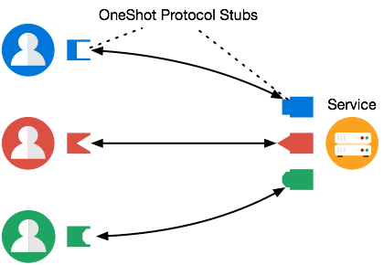
WebRTC Identity Proxy Interface
Perspectives
We focused on user control and manual configuration, ultimately we want to implement automatic reconfiguration of the WebRTC session
A protocol composition language may facilitate recomposition at runtime
We also want to add trust context (i.e. types) to the WebRTC security and trust model
Such model could be used to diversify security configuration and protocols

Slide 47
Authorization and Authentication Delegation
OAuth2 and OIDC Authorization URLs
https://accounts.google.com/o/oauth2/auth?
client_id=74[…].googleusercontent.com&
redirect_uri=http://www.dailymail.co.uk/
registration/signin/google.html&
scope=email+https://www.googleapis.com/
auth/plus.login&
[...]
IdP domain
Website domain
and identifier
Requested authorizations

Slide 48
Negotiating the Other Peer’s Authentication
Integrating into the SDP Session Negotiation Protocol
Can we extend the SDP identity-attribute?
Communication Service
identity-attribute = "identity:" identity-assertion
[ SP identity-extension
*(";" [ SP ] identity-extension) ]
SDP
Offer
SDP
Answer
Alice
Bob
The identity-attribute grammar does not allow to use extensions while being anonymous (no identity-assertion provided).

Slide 49
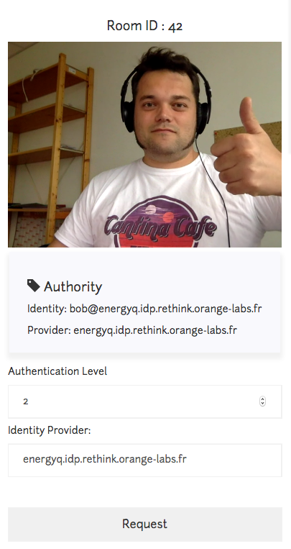
Negotiating the Other Peer’s Authentication
Integrating into the SDP Session Negotiation Protocol
Instead, we define a new session level attribute
for Authentication Class and Origin Request (ACOR)
acor = "acor:" List<Authentication Class Values>
";" List<Identity Provider Origin>
We implement it in a simple communication
service written in NodeJS.
https://github.com/Sparika/ACOR_SDP/

Slide 50
Negotiating the Other Peer’s Authentication
Results
Can be set
Can be verified
Origin Request
already available
The data format for identity assertion verification does not allow extensions. This may be a problem even outside negotiation scenario.
Authentication
Class Request
We can initiate an anonymous session and then request authentication,
albeit without being able to verify the authentication strength.
It is also impossible to provide multiple identities or change identity
after an initial authentication.

Slide 51
Negotiating the Other Peer’s Authentication
Recommendation Sources
In order to negotiate its peer’s authentication, the user must rely on a trusted
recommendation source
Authentication
aware
Call context
aware
Trusted
CS
Browser
IdP
None of these three actors appears best placed to serve as the trusted recommender

Slide 52
OpenID Connect vs WebRTC
Comparison of Role
Client
/authorize?
Owner
/token?
Client
Client?
Grant
AuthN/Z
/token?
/token?
IdP (RS)
AuthN
Owner
Client?
AuthN/Z?
Client
Client?
/authorize? implicit
/jku?
AuthN
AuthN/Z?
IdP

Slide 53
Implementing the Missing Part
Local Authentication Scenario
CS/IdP
Local Authentication Scenario
The CS plays the IdP’s role
Implemented a Map(Assertion->Identity) with a simple REST interface
Could be useful in multi CS architecture
API Calls
API Calls

Slide 54
Implementing the Missing Part
OpenID Connect Integration
CS
Initially sketched in WebRTC annex, can we integrate
OIDC with WebRTC?
Integration requires modifications to the protocol:
We reuse OIDC Identity Assertion in WebRTC
New OIDC parameters for the session fingerprint
New OIDC response mode
API Calls
API Calls
OIDC IdP

Slide 55
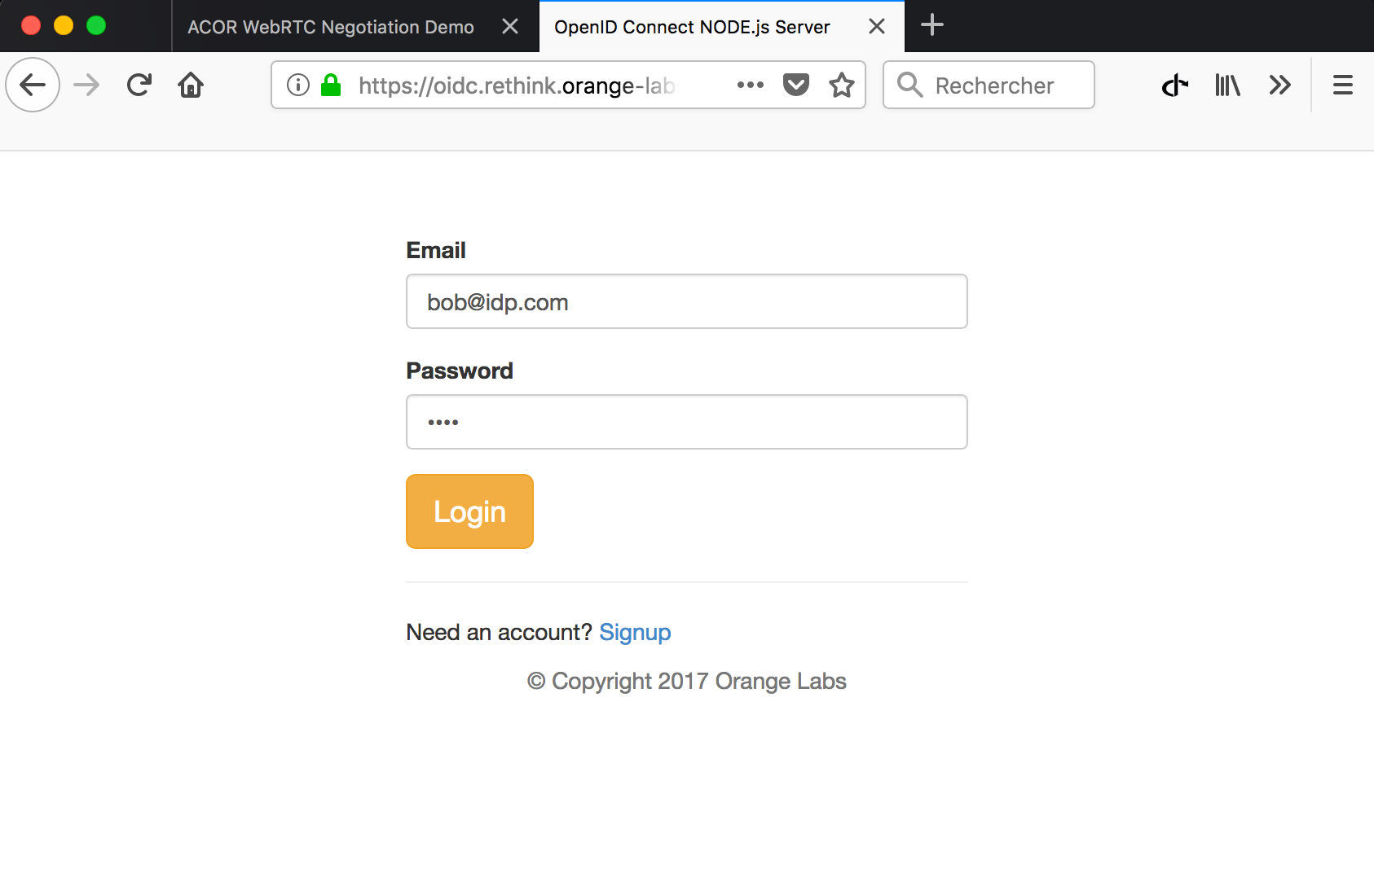
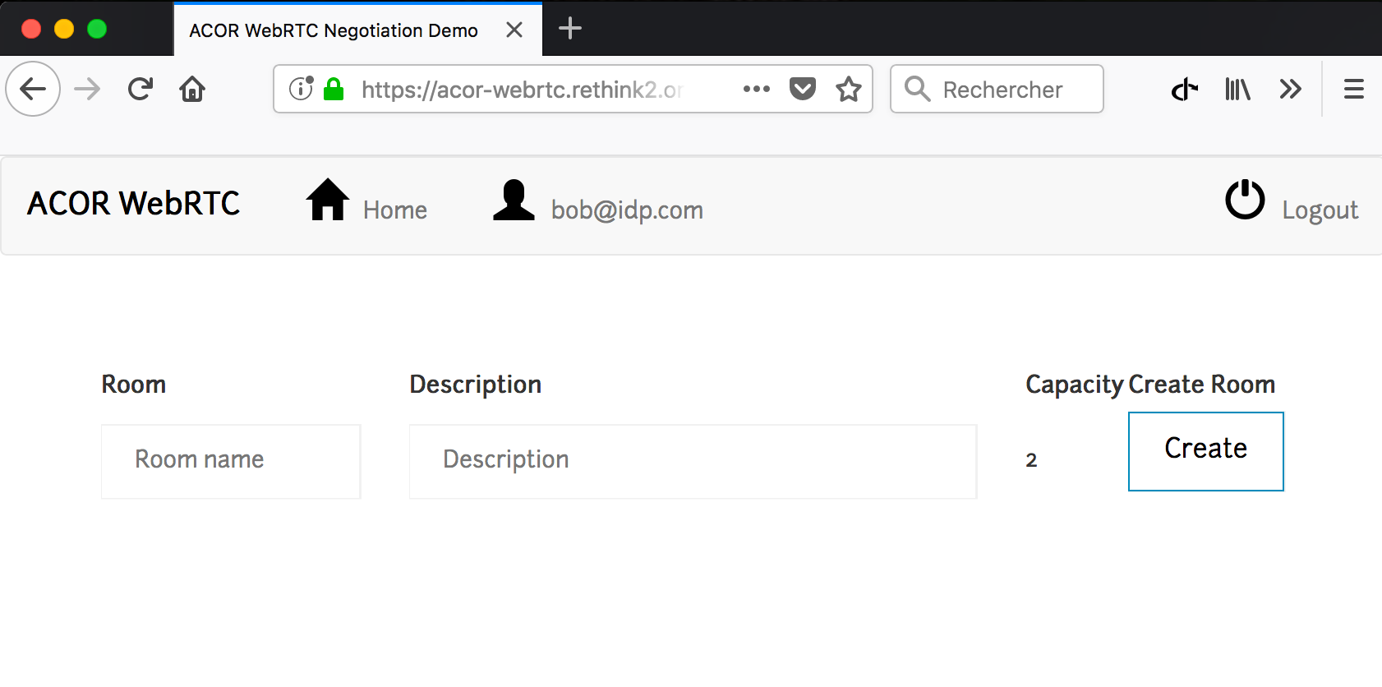
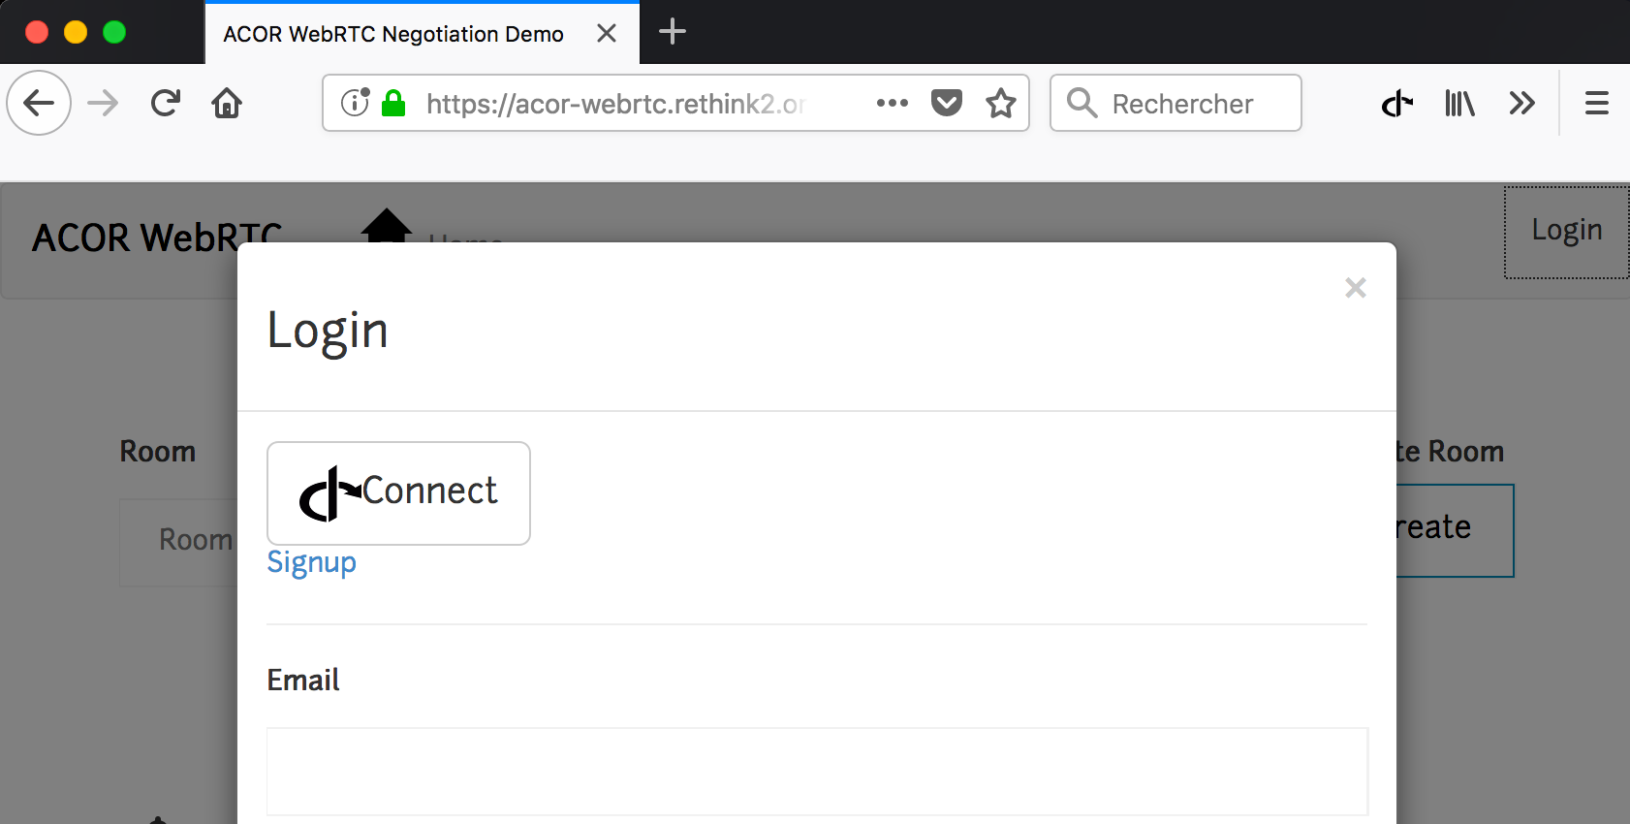
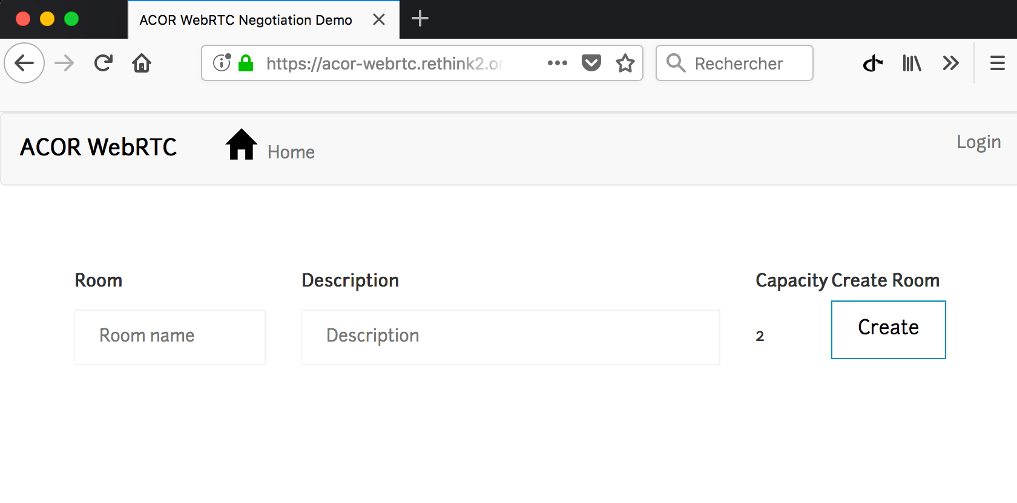
WebConnect: a Browser-based Identity Metasystem
The User Experience

Slide 56
WebConnect Security
Evaluation
WebRTC IdP Proxy
WebConnect
IdP Proxy served from an HTTPS well-known origin and whose domain matches the identity ending in @domain
HTTPS JSON Key URL (JKU) on a well-known origin and whose domain matches the JWT:ISS domain claim
Our implementation modify OIDC standard to allow the website to authenticate the IdP without prior registration
However, the IdP is unable to authenticate the website and as such cannot control authorization delegation
Security relies on secure implementation and control of the API by the browser

Slide 57
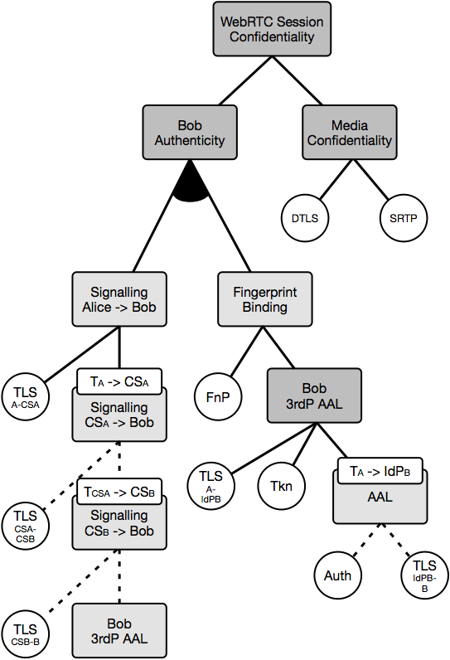
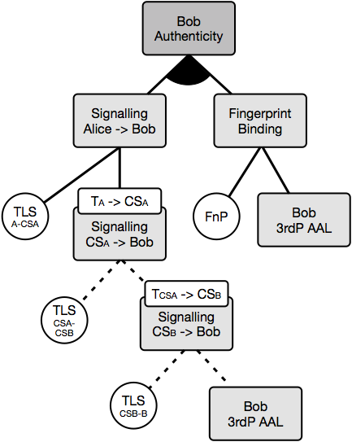
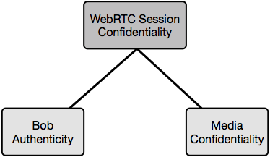
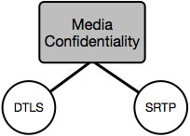
A WebRTC Security and Trust Model
Transitive Defense Tree

Slide 58
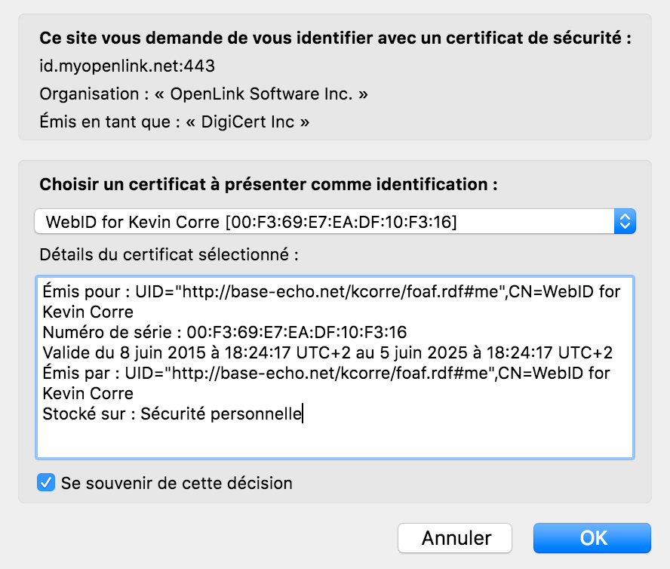
Even with WebConnect, users still have to rely on a third-party IdP
WebID-TLS is a W3C working group protocol for authentication using TLS client-authentication and a self hosted certificate bound to an identity description file: i.e. a self-hosted IdP
WebRTC Identity Proxy for WebID-TLS
Short-Term Perspective
WebID-TLS is a W3C protocol for self-hosted identity and TLS client-authentication
Is WebID-TLS compatible with WebRTC IdP Proxy (sandboxed JS)?
Can it be updated to a JSON Web Token based authentication signed using client-side Javascript?

Slide 59
WebPayment, WebID-TLS, WebConnect
Perspectives
We questioned wether WebRTC is a protocol abstraction capable of handling OIDC
Similar user experience and interface
Browser acts as the Trusted Computing Base
Similar request protocol
WebPayment
WebConnect
WebID-TLS
OAuth2/OIDC
Payment
Authentication
Authentication
Authorization
Is there a protocol abstraction interface capable of handling payment, authentication, and authorization?

