Slide 1
STAND ALONE BLAST
Alejandro Caro-Quintero
Post-Doctoral Fellow
Ochman Lab

Slide 2
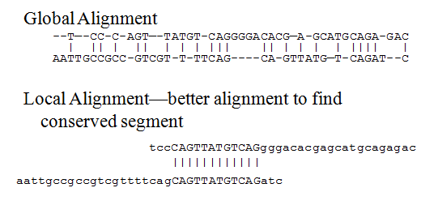
Global vs Local Alignments
Notes:
The global approach compares one whole sequence with other entire sequences.
The local method uses a subset of a sequence and attempts to align it to subset of other sequences(Smith Waterman algorithm)

Slide 3
Global
Local
The global approach is useful when you are comparing a small group of sequences, but becomes become computationally expensive as the number of sequence in the comparison increases.
Local alignments use heuristic programming methods that are better suited to successfully searching very large databases, but they do not necessarily give the most optimum solution.

Slide 4
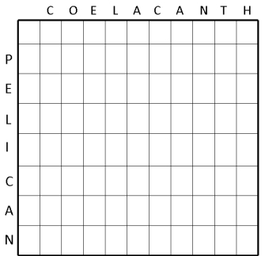
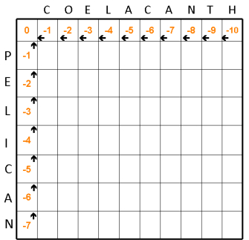
Alignment Theory dynamic programming
Needleman-Wunsch (global alignment)
COELACANTH VS PELICAN
Lobo, I. (2008) Basic Local Alignment Search Tool (BLAST). Nature Education 1(1):215

Slide 5
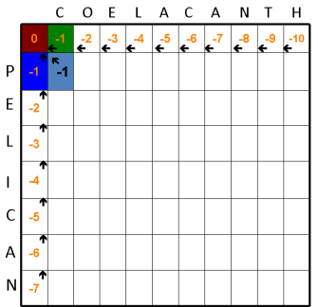
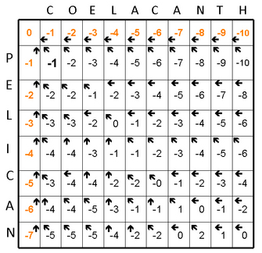
Alignment Theory dynamic programming
Needleman-Wunsch (global alignment)
one point is added if two letters match, and one point is subtracted if they do not.
Lobo, I. (2008) Basic Local Alignment Search Tool (BLAST). Nature Education 1(1):215

Slide 6
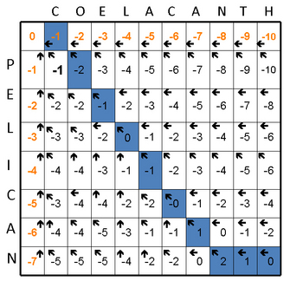
Alignment Theory dynamic programming
Needleman-Wunsch (global alignment)
one point is added if two letters match, and one point is subtracted if they do not.
COELACANTH
-PELICAN--

Slide 7
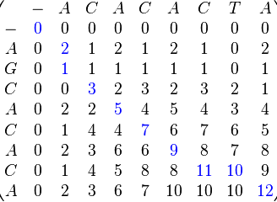
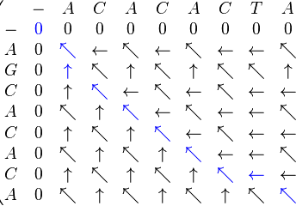
Alignment Theory dynamic programming
Smith–Waterman algorithm (local alignment)
two points are added if two letters match, and one point is subtracted if they do not
The main difference is that first column and row start with 0 (therefore 0 can be reach at any character)
Sequence 1 = ACACACTA
Sequence 2 = AGCACACA

Slide 8
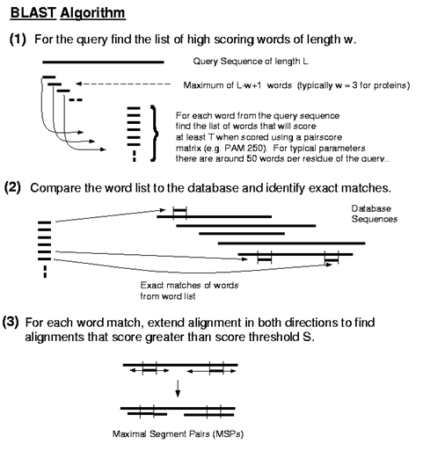
Basic Local Alignment Search Tools (BLAST)
Heuristic approach based on Smith Waterman algorithm (local alignments). BLAST increases the speed of alignment by decreasing the search space or number of comparisons it makes.
Altschul SF, Gish W, Miller W, Myers EW, Lipman DJ (1990) “Basic local alignment search tool.” J. Mol. Biol. 215:403-410.
Notes:
Sequence (query) is broken into words of length W
Align all words with sequences in the database
Calculate score T for each word that aligns with a sequence in the database using a substitution matrix
Discard words whose T value is below a neighborhood score threshold
Extend words in both directions until score falls by dropoff value X when compared to previous best score

Slide 9
Basic Local Alignment Search Tools (BLAST)
Notes:
Sequence (query) is broken into words of length W
Align all words with sequences in the database
Calculate score T for each word that aligns with a sequence in the database using a substitution matrix
Discard words whose T value is below a neighborhood score threshold
Extend words in both directions until score falls by dropoff value X when compared to previous best score
The results of the word matching and attempts to extend the alignment are segment called HSPs (High-scoring Segment Pairs)

Slide 10
Programs and applications
Notes:
Word methods, also known as k-tuple methods, are heuristic methods that are not guaranteed to find an optimal alignment solution, but are significantly more efficient than dynamic programming. These methods are especially useful in large-scale database searches where it is understood that a large proportion of the candidate sequences will have essentially no significant match with the query sequence. Word methods are best known for their implementation in the database search tools FASTA and the BLAST family

Slide 11
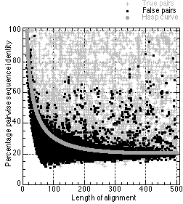

Practical implication (protein search)

Slide 12
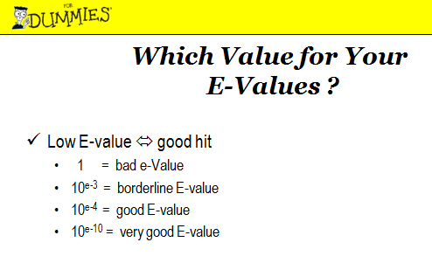
Practical implication (nucleotide search)
Gene comparison > 70 % of sequence identity and > 70 % coverage (>100 nucleotides)
E-value < 10 -4 (database size dependence)

Slide 13
BLAST command line
SERVER USERS ONLY
1)Login in to server account.
>ssh username@lonestar.tacc.utexas.edu
2)Load blast module.
>module load blast
3)Download query and database files.
>wget ftp://ftp.ncbi.nlm.nih.gov/genomes/Bacteria/
Shewanella_baltica_OS185_uid58743/NC_009665.faa
>wget ftp://ftp.ncbi.nlm.nih.gov/genomes/Bacteria/
Shewanella_baltica_OS185_uid58743/NC_009665.fna
>wget ftp://ftp.ncbi.nlm.nih.gov/genomes/Bacteria/
Shewanella_baltica_OS195_uid58261/NC_009997.faa
>wget ftp://ftp.ncbi.nlm.nih.gov/genomes/Bacteria/
Shewanella_baltica_OS195_uid58261/NC_009997.ffn
4)Start an interactive job
>idev –m 45
fna =nucleotide chromosome seq
ffn= nucleotide protein coding genes
frn= nucleotide RNA coding genes
faa= protein coding genes

Slide 14
BLAST command line
ALL
4)Format database
>makeblastdb -in NC_009665.fna -dbtype nucl –out balticaOS185_chromosome
>makeblastdb -in NC_009665.faa -dbtype prot –out balticaOS185_protein
-in =input fasta file to setup the database in this case S. baltica OS185
-dbtype = nucleotides (nucl) or amino acid (prot)
-out= database name
Other commands:
>makeblast -help

Slide 15
BLAST command line
ALL
5)Homology Search- Protein search
>blastp -db balticaOS185 –query NC_009997.faa
–evalue 0.001 balticaOS185 –out OS185_db_vs_OS195_q
-outfmt 5 -num_threads 8
** -remote –db BLAST database name (e.g., nr )

Slide 16
BLAST command line
ALL
5)Homology Search- Protein search
> time blastp -db balticaOS185_protein –query NC_009997.faa –evalue 0.0001 –out OS185_db_vs_OS195_q_protein
-outfmt 5 -num_threads 8
time blastn -db balticaOS185_chromosome –query NC_009997.ffn –evalue 0.0001 –out OS185_db_vs_OS195_q_chromosome -outfmt 5 -num_threads 8
Which on took longer (time)
Test different values of outfmt 0-10 (look at the tabular output)
Pick one gene from NC_009997.ffn and use the following
** -remote –db BLAST database name (e.g., nr )

Slide 17
Output format
alignment view options: 0 = pairwise, 1 = query-anchored showing identities, 2 = query-anchored no identities, 3 = flat query-anchored, show identities, 4 = flat query-anchored, no identities, 5 = XML Blast output, 6 = tabular, 7 = tabular with comment lines, 8 = Text ASN.1, 9 = Binary ASN.1 10 = Comma-separated values 11 = BLAST archive format (ASN.1)

Slide 18
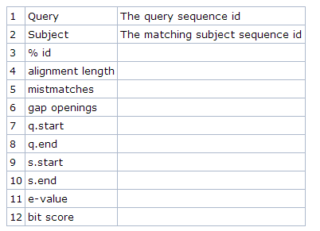
Tabular output

Slide 19
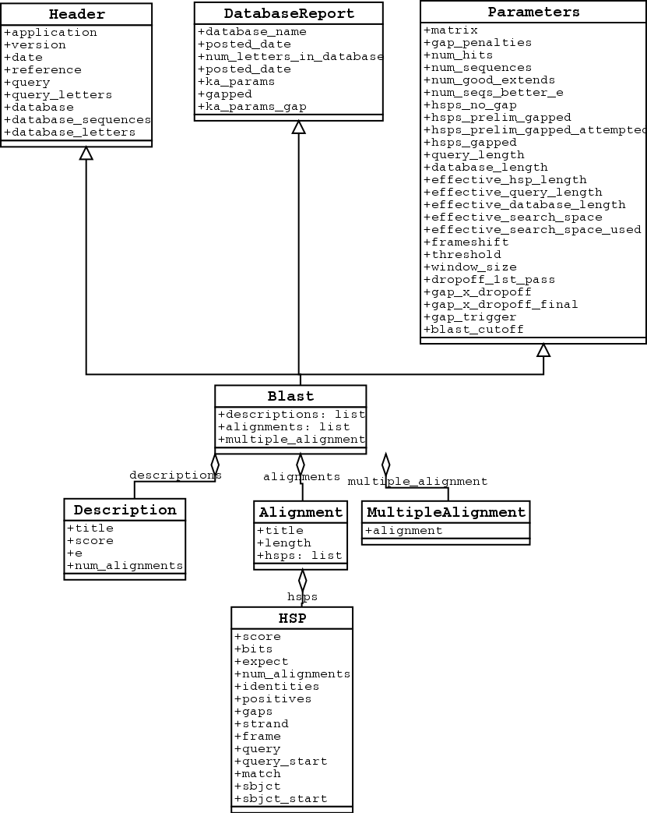

Biopython parse function
Format 5 (XLM) to get all information

Slide 20
Gene and protein annotation Comparative functional genomics/metagenomics Taxonomic assignment/ abundance Genome Syntheny Expression profiles in transcriptome analysis SNPs identification Primer specificity HGT detection Merge pair end reads/scafolding
BLAST

Slide 21
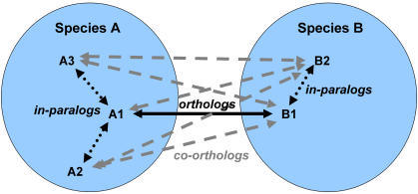
Orthologous finding

Slide 22
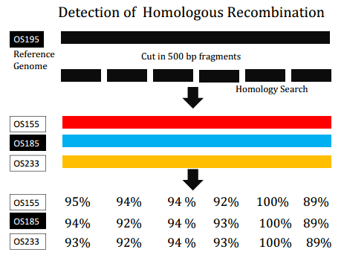
Genomics

Slide 23
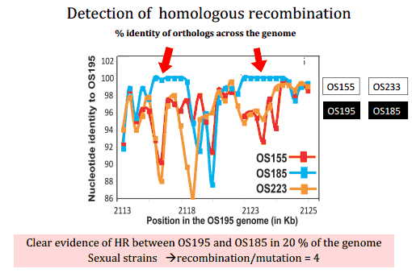
Genomics

Slide 24
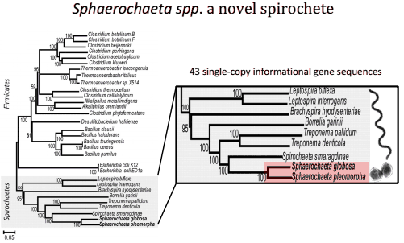
Genomics

Slide 25
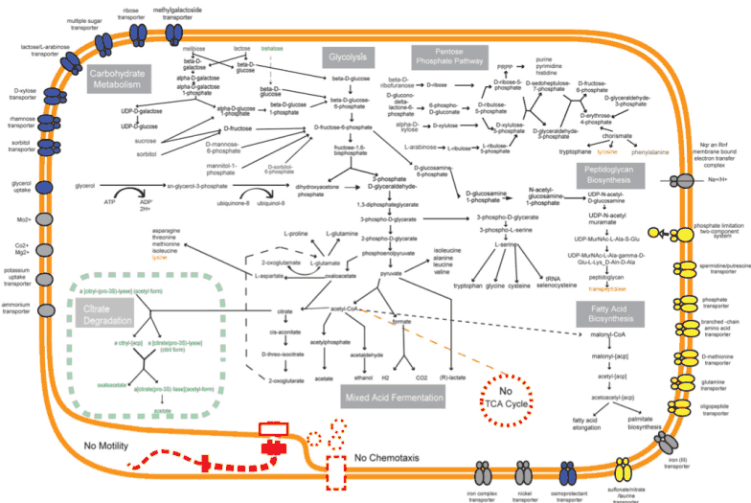
Genomics

Slide 26
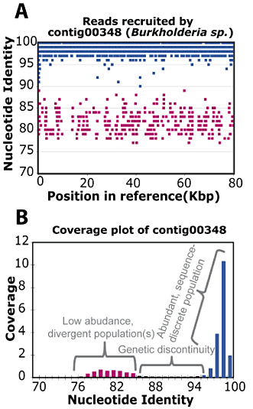
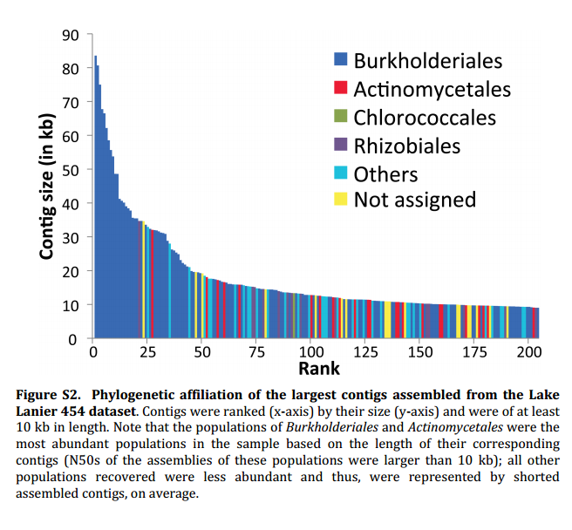
Fresh water microbial communities
Metagenomics

Slide 27
Extra slides

Slide 28
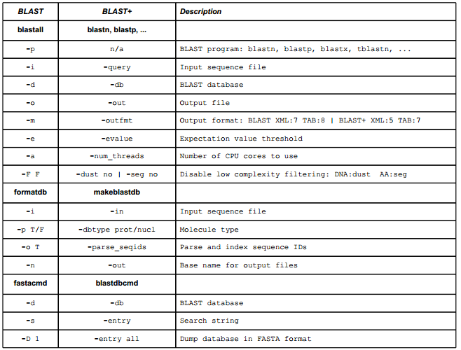
BLAST command line

Slide 29
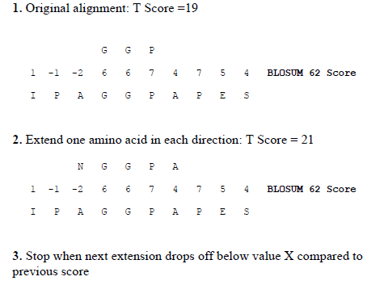
Blast protein search

Slide 30
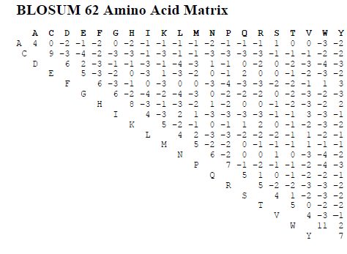
Blast protein search

