Slide 1

Predict → Validate → Compare
CAPSTONE PROJECT
Predictive Dynamic Route Recommendation
Using Traffic Forecasting and Intelligent Route Decision Optimization
REVIEW – 2
1
Objective-1
2
Dataset
3
Testing
4
Baseline
TEAM:
CPSTN-Draft4
traffic forecasting
METR-LA
207 sensors
20% chronological
6,832 windows
Persistence
comparison
2300030761 - Pranav Y
2300031235 - K Prasanth
2300032492 - M M N S Lalitha
Mentor:
Dr. M. Satyanarayana
Emp ID: 10072
Review-2 focus: complete Objective-1, validate the implementation, use the defined chronological split, and establish baseline metrics.

Slide 2
Review-2 Scope & Readiness Gate
02
Week 10 • 21–26 September 2026
01
Complete Objective-1
02
Unit / Integrity Testing
Short-term traffic forecasting implementation using the CPSTN-Draft4 pipeline.
Checkpoint, graph, sensor ordering, shapes, finite predictions and test-window consistency.
03
Dataset Split
04
Baseline Metrics
70% train / 10% validation / 20% chronological test split; test targets remain inside the test segment.
MAE, RMSE and MAPE against a persistence baseline.
Evidence in this deck: implementation configuration → test integrity → measured results → baseline comparison.
Capstone Review-2 • Predictive Dynamic Route Recommendation

Slide 3
Review-1 → Review-2 Progress
03
Review-1 established
Review-2 demonstrates
Still outside this gate
• Problem, motivation and objectives
• Literature basis and research gap
• Proposed predictive routing framework
• System architecture and validation plan
• Objective-1 implemented
• CPSTN-Draft4 trained and checkpointed
• Chronological test split executed
• Unit / integrity checks encoded
• Baseline metrics produced
• Travel-time route-cost integration
• A* candidate-route generation
• Benefit + reliability decision engine
• End-to-end rerouting evaluation
Key transition: the Review-1 proposal is now backed by a measurable forecasting implementation; routing and decision modules remain subsequent integration work.
Capstone Review-2 • Predictive Dynamic Route Recommendation

Slide 4
Dataset, Preprocessing & Chronological Split
04
207
12
12
6,832
20%
METR-LA sensors
input steps = 60 min
forecast steps = 60 min
test windows
chronological test
Chronological data split
70% TRAIN
10%
VALIDATION
20% TEST
Preprocessing consistency
Graph / window alignment
• 0 values treated as missing
• Interpolation followed by forward/back fill
• Scaler fitted on training period only
• Sensor IDs aligned to the checkpoint graph
• First test target starts after validation + input history
• Target windows remain fully inside test split
Capstone Review-2 • Predictive Dynamic Route Recommendation

Slide 5
Objective-1: Short-Term Traffic Forecasting
05
Objective
Output delivered for Review-2
Forecast future traffic conditions from recent graph-structured traffic history.
3.268
6.442
Test MAE
Test RMSE
Implementation
• CPSTN-Draft4 spatio-temporal graph model
• 3 input channels: speed + time-of-day features
• 32 hidden channels; dropout 0.10
• 12-step history → 12-step forecast
9.184%
Test MAPE
The supplied checkpoint reached its best validation loss of 0.192383 at epoch 24.
Capstone Review-2 • Predictive Dynamic Route Recommendation

Slide 6
CPSTN-Draft4 Model Architecture
06
Implementation architecture used by the supplied Training-Draft4 notebook and checkpoint
INPUT
[B, 12, 207, 3]
Speed + sin(time) + cos(time)
INPUT PROJECTION
3 → 32
1×1 convolution
BLOCK 1
Temporal gate + graph conv
dilation = 1
BLOCK 2
Temporal gate + graph conv
dilation = 2
BLOCK 3
Temporal gate + graph conv
dilation = 4
HEAD
32 → 12
12 future speed steps
Graph propagation uses the normalized 207×207 road-sensor adjacency; the checkpoint preserves sensor ordering and normalization statistics.
Capstone Review-2 • Predictive Dynamic Route Recommendation

Slide 7
Training Configuration & Checkpoint
07
Dataset
METR-LA
207 nodes
History / Horizon
12 → 12
5-min sampling
Hidden / Dropout
32 / 0.10
compact model
Optimizer
AdamW
lr 2×10⁻³
Loss
SmoothL1
β = 0.5
Regularization
weight decay 1×10⁻⁴
gradient clip 2.0
Batch size
128
training
Max epochs / patience
25 / 5
early stopping
Best checkpoint: epoch 24 • validation loss = 0.192383 • exported for independent testing
Capstone Review-2 • Predictive Dynamic Route Recommendation

Slide 8
Testing, Unit Checks & Integrity Validation
08
Model / graph checks
Data / output checks
• Checkpoint keys and configuration match dataset/model
• 207 sensor count and sensor-ID ordering verified
• Normalized graph shape = 207 × 207
• Graph symmetry and finite values checked
• Input shape = [B, 12, 207, 3]
• Prediction/target shape = [6,832, 12, 207]
• Prediction and target values finite
• Test windows stay within chronological test segment
Testing notebook explicitly reconstructs the same CPSTN-Draft4 architecture and loads the checkpoint's scaler + normalized graph instead of rebuilding them.
Capstone Review-2 • Predictive Dynamic Route Recommendation

Slide 9
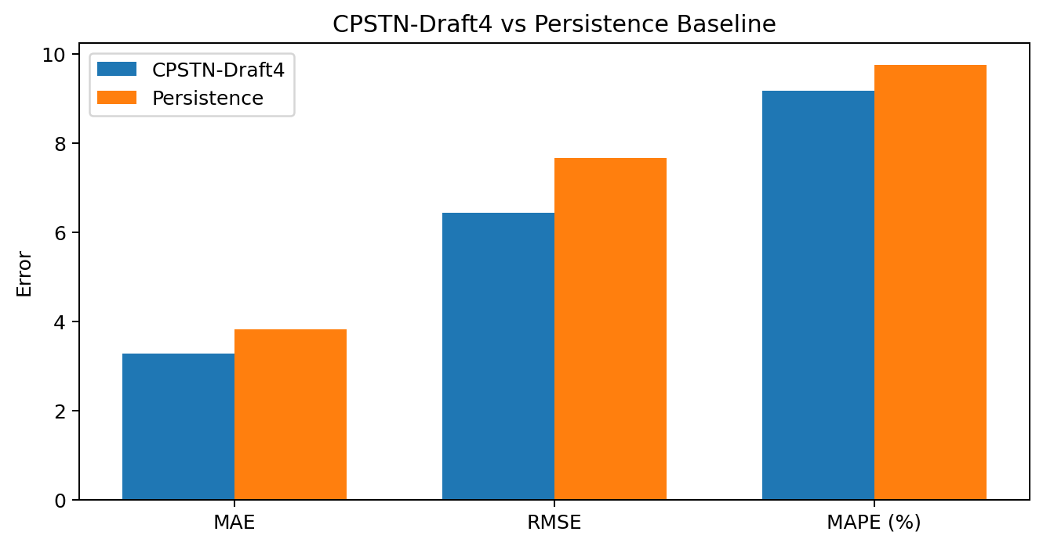
Overall Test Results & Persistence Baseline
09
Measured results
MAE
3.2678
3.8168
RMSE
6.4415
7.6670
MAPE
9.184
9.753
CPSTN-Draft4 vs persistence
MAE reduction: 14.4%
RMSE reduction: 16.0%
MAPE reduction: 5.8%
Baseline: repeat the last observed speed across the complete forecast horizon.
Capstone Review-2 • Predictive Dynamic Route Recommendation

Slide 10
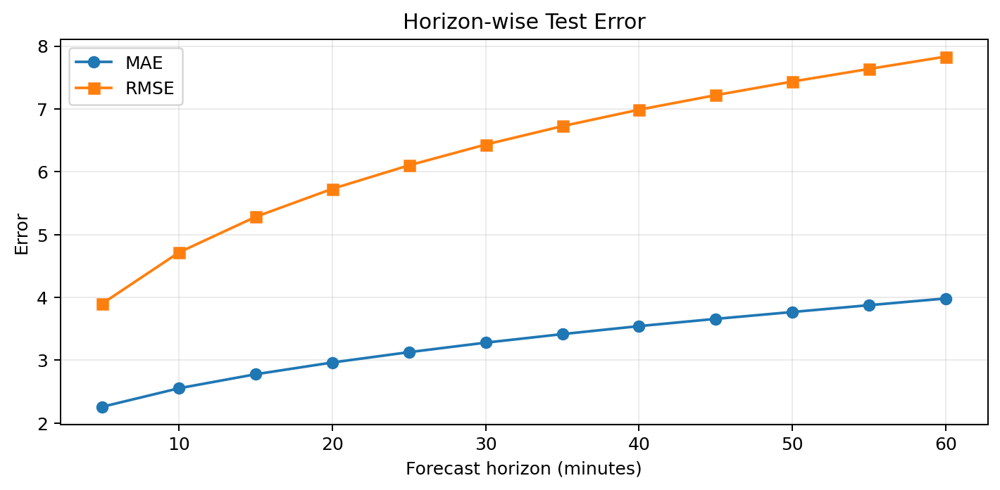
Horizon-wise Forecast Performance
10
Selected horizons
+5 min
MAE 2.260
+15 min
MAE 2.778
+30 min
MAE 3.280
+60 min
MAE 3.983
Trend
Error increases with forecast horizon, which is expected for longer-range traffic prediction.
At +15 min: MAE 2.778
At +30 min: MAE 3.280
Capstone Review-2 • Predictive Dynamic Route Recommendation

Slide 11
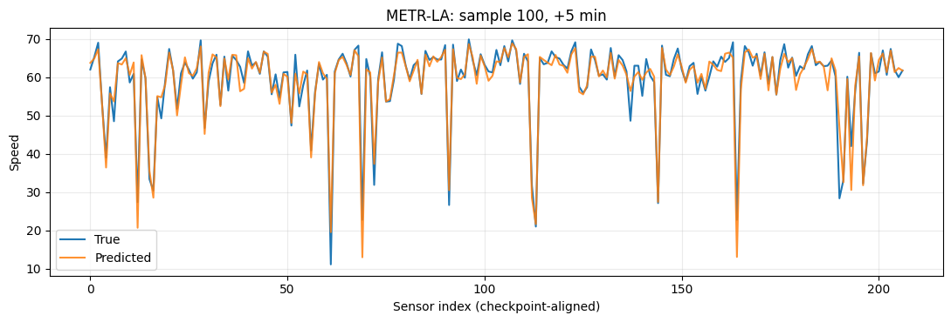
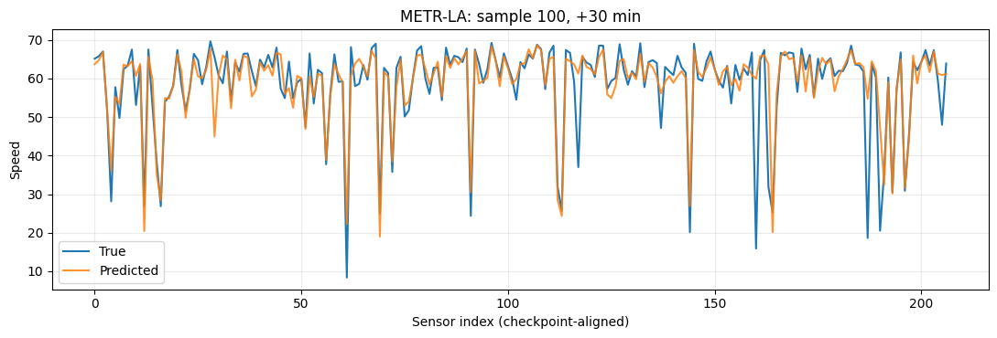
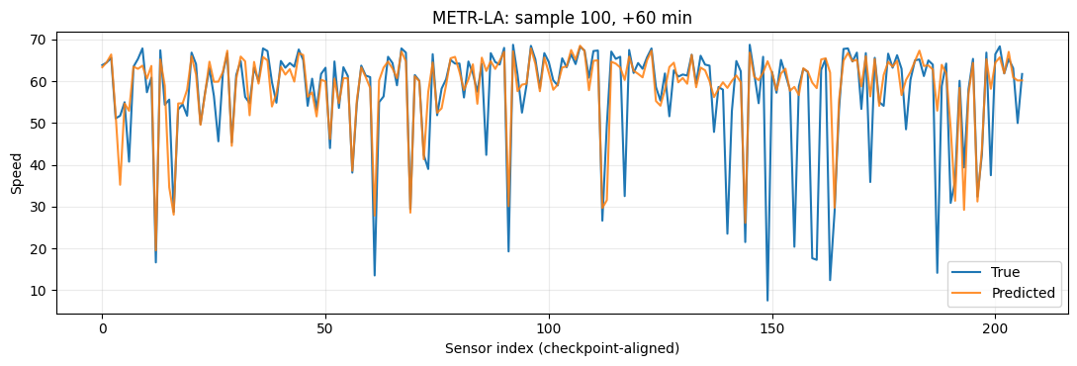
Representative Test Forecasts Across Horizons
11
Sample 100 • checkpoint-aligned METR-LA sensor outputs • True vs Predicted
How to read these plots
• +5 min: close tracking across sensors.
• +30 min: more point-wise deviations.
• +60 min: larger long-horizon deviations.
• Overall: predicted profile follows the observed pattern.
Takeaway: predictions follow the observed traffic profile, with larger deviations at longer horizons.
Capstone Review-2 • Predictive Dynamic Route Recommendation

Slide 12
Sensor-Level Error Distribution
12
Worst 5 sensors by MAE
Best 5 sensors by MAE
717462.0
MAE 6.842
RMSE 12.436
767495.0
MAE 1.031
RMSE 1.952
773939.0
MAE 6.722
RMSE 12.495
718076.0
MAE 1.201
RMSE 2.116
718045.0
MAE 6.613
RMSE 11.500
767455.0
MAE 1.223
RMSE 2.135
717466.0
MAE 6.457
RMSE 11.700
767585.0
MAE 1.228
RMSE 2.177
717468.0
MAE 6.220
RMSE 12.134
717595.0
MAE 1.266
RMSE 2.976
Across all 207 sensors: mean sensor MAE = 3.268; min = 1.031; max = 6.842.
Capstone Review-2 • Predictive Dynamic Route Recommendation

Slide 13
13
Validation Observations & Remaining Refinements
Evidence established
Refinement still required
• Objective-1 forecasting pipeline is executable on METR-LA.
• Checkpoint is independently testable with the exported metadata.
• CPSTN-Draft4 improves on the persistence baseline on MAE, RMSE and MAPE.
• Horizon-wise metrics quantify degradation from +5 to +60 minutes.
• Automated integrity assertions are encoded in the testing pipeline.
• The exported prediction tensor contains some negative predicted speeds (minimum ≈ −8.43), so physical output constraints/post-processing should be considered.
• Route travel-time conversion and A* integration are not established by these forecasting tests.
• The benefit + reliability rerouting decision layer still requires integrated route-level evaluation.
Capstone Review-2 • Predictive Dynamic Route Recommendation

Slide 14
Review-2 Gate / Evidence Mapping
14
Review-2 requirement
Evidence in this presentation
Status
Complete Objective-1
CPSTN-Draft4 implementation + METR-LA test results
MET
Unit testing
Checkpoint / graph / sensor / shape / finite-value assertions
MET
Dataset split
70 / 10 / 20 chronological split + 6,832 test windows
MET
Baseline metrics
Persistence baseline + MAE/RMSE/MAPE comparison
MET
Present Review-2
Slides consolidate implementation, evidence and measured results
READY
Capstone Review-2 • Predictive Dynamic Route Recommendation

Slide 15
THANK YOU

