Slide 1

优化理论和方法

Slide 2

DEF. OPTIMIZATION
An act, process, or methodology of making something (such as design, system, or decision) as fully perfect, functional, or effective as possible; specifically, the mathematical procedure involved

Slide 3



Mathematical optimization
Selection of a best element (with regard to some criterion) from some set of available alternatives
Given:
A function $f:A→R$
Sought:
$x_{0}∈A$ with $f\left(x_{0}\right)≤f\left(x\right), ∀x$ (minimization)
$x_{0}∈A$ with $f\left(x_{0}\right)≥f\left(x\right), ∀x$ (maximization)
$A$: constraints (equalities, inequalities)
$f$: objective function
minimization: cost, loss, energy, …
maximization: utility, fitness, …

Slide 4




minimize:
A function $f(x)$
subject to:
$$x∈Ω$$
Objective function
Constrained optimization
Unconstrained optimization
$$x$$
Decision variables
Constraint set/feasible set

Slide 5




Def.
Local / Global minimizer
Strict local/global minimizer
Local: $∃ε>0$ such that $f\left(x\right)≥f\left(x^{∗}\right), ∀\left|\left|x−x^{∗}\right|\right|<ε$
Global: $f\left(x\right)≥f\left(x^{∗}\right)$, $∀x∈Ω\backslash \{x^{∗}\}$
$$f\left(x\right)=(x+1)^{2}+3$$
Subject to $x∈ℛ$
$$f\left(x^{∗}\right)=\min_{x∈Ω}f(x)$$
Global is difficult
$$x^{∗}={argmin}_{x∈Ω}f(x)$$

Slide 6
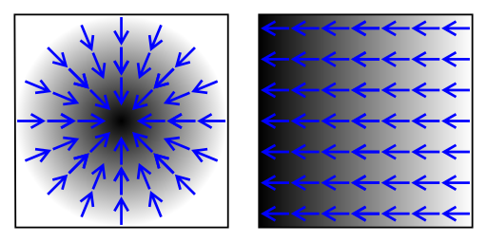
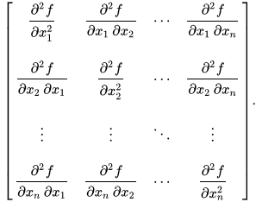



Conditions for Local Minimizers
Derivatives of a function $f:ℛ^{n}→ℛ$
$$Df≜[\frac{∂f}{∂x_{1}},\frac{∂f}{∂x_{2}},…,\frac{∂f}{∂x_{n}}]$$
Gradient of $f$:
$$∇f={(Df)}^{T}$$
Hessian of $f$:
$$F\left(x\right)=D^{2}f\left(x\right)=$$
Example
$$f\left(x_{1},x_{2}\right)=5x_{1}+8x_{2}+x_{1}x_{2}−x_{1}^{2}−2x_{2}^{2}$$

Slide 7


Conditions for Local Minimizers
Objective function
$$x^{∗}={argmin}_{x∈Ω}f(x)$$
Constraint set/feasible set
Def. [feasible direction]
A vector $d∈ℛ^{n}, d≠0$, is a feasible direction at $x_{0}∈Ω$, if $∃α_{0}>0$ such that $x+αd∈Ω, ∀α∈[1,α_{0}$].

Slide 8
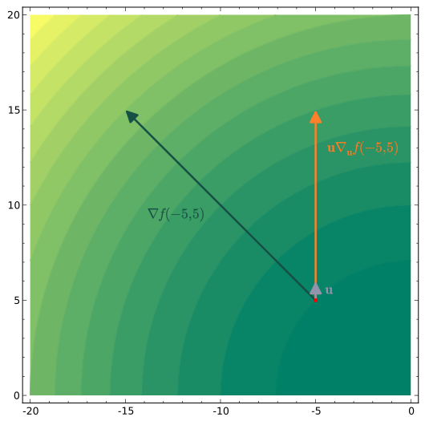

Conditions for Local Minimizers
Def. [directional derivative]
$$\frac{∂f}{∂d}\left(x\right)=\lim_{α→0}{\frac{f\left(x+αd\right)−f(x)}{α}}$$
$$\frac{∂f}{∂d}\left(x\right)=\frac{d}{dα}f\left(x+αd\right)|_{α=0}=∇f(x)^{T}∙d=<∇f\left(x\right),d> =d^{T}∙∇f(x)$$

Slide 9





Conditions for Local Minimizers
$$f(x)$$
Theorem [First-Order Necessary Condition (FONC)]
Let $Ω⊂ℛ^{n}$ and $f∈{C }^{1}, f:Ω→ℛ$. If $x^{∗}$ is a local minimizer of $f$ over Ω, then for any feasible direction $d$ at $x^{∗}$, we have
$d^{T}∙∇f\left(x^{∗}\right)≥0$.
$$x$$
$$f′(x)≤0$$
$$f′(x)≥0$$
Derivative testing

Slide 10


Conditions for Local Minimizers
Corollary [Interior Case]
Let $Ω⊂ℛ^{n}$ and $f∈{C }^{1}, f:Ω→ℛ$. If an interior point $x^{∗}$ of Ω is a local minimizer of $f$ over Ω, then $∇f\left(x^{∗}\right)=0$.
Example:
Min $x_{1}^{2}+0.5x_{2}^{2}+3x_{2}+4.5$
Subject to $x_{1},x_{2}≥0$

Slide 11
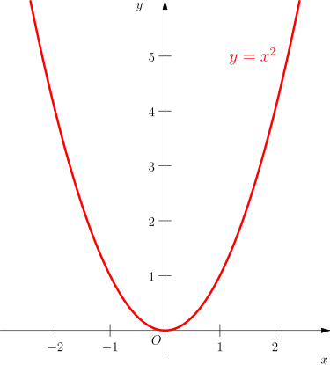


Conditions for Local Minimizers
Theorem [Second-Order Necessary Condition (SONC)]
Let $Ω⊂ℛ^{n}$ and $f∈C^{2}, f:Ω→ℛ, x^{∗}$ is a local minimizer of $f$ over Ω, and $d$ is a feasible direction. If$d^{T}∙∇f\left(x^{∗}\right)=0,$ then
$$d^{T}F\left(x^{∗}\right)d≥0,$$
where $F\left(x^{∗}\right)$ is the Hessian of $f$.
Corollary [Interior Case]
Let $Ω⊂ℛ^{n}$ and $f∈{C }^{2}, f:Ω→ℛ$. If an interior point $x^{∗}$ of Ω is a local minimizer of $f$ over Ω, then $∇f\left(x^{∗}\right)=0$ and $F(x^{∗})$ is positive semidefinite ($F\left(x^{∗}\right)≥0$), i.e.,
$∀d∈ℛ^{n},d^{T}F\left(x^{∗}\right)d≥0$.

Slide 12

Conditions for Local Minimizers
Theorem [Second-Order Sufficient Condition (SOSC), Interior Case]
Let $Ω⊂ℛ^{n}$ and $f∈{C }^{2}, f:Ω→ℛ, x^{∗}$ is an interior point of Ω. Suppose that
$∇f\left(x^{∗}\right)=0,$
$F\left(x^{∗}\right)>0.$
Then, $x^{∗}$ is a strict local minimizer of $f$.

Slide 13







One-Dimensional Search Methods
Minimize $f:ℛ→ℛ$
Line search method — iterative algorithm
1
2
3
4
5
6
…
$$x_{1}$$
$$x_{2}$$
$$x_{3}$$
$$x_{4}$$
$$x_{5}$$
$$x_{6}$$
…

Slide 14



Golden Section Search
Assume:
Closed interval
$f$ is unimodal, i.e., $f$ has only one local minimizer
$$a_{0}$$
$$b_{0}$$
Basic idea:
Narrow the search range progressively until the minimizer is boxed in with sufficient accuracy

Slide 15
























Golden Section Search
Two intermediate points: $ρ<\frac{1}{2}$
$$a_{1}−a_{0}=b_{0}−b_{1}=ρ(b_{0}−a_{0})$$
$$a_{0}$$
$$a_{1}$$
$$x^{∗}$$
$$b_{1}$$
$$b_{0}$$
$f\left(a_{1}\right)<f(b_{1})$ →
the minimizer in $[a_{0},b_{1}]$
$f\left(a_{1}\right)≥f(b_{1})$ →
the minimizer in $[a_{1},b_{0}]$
$$1−2ρ$$
$$ρ\left(b_{1}−a_{0}\right)=b_{1}−b_{2}$$
$$ρ=\frac{3−\sqrt{5}}{2}$$
$$1−2ρ$$
$$ρ\left(1−ρ\right)=1−2ρ$$
$$ρ$$
$$ρ$$
$$a_{1}$$
$$a_{0}$$
$$a_{2}$$
$$a_{1}=b_{2}$$
$$b_{1}$$
$$b_{0}$$
$$\frac{ρ}{1−p}=\frac{1−ρ}{1}$$

Slide 16










Golden Section Search
Every iteration only one evaluation, except for the first one
Range reduction ratio: $1−ρ≈0.61803$
After $N$ iterations: $0.61803^{N}$
Example:
Interval $[0,2]$
Locate the minimizer within a range of $0.3$
$$1−2ρ$$
$$ρ$$
$$ρ$$
$2×0.61803^{N}≤0.3$ → $N=4$
$$a_{0}$$
$$a_{1}=b_{2}$$
$$b_{1}$$
$$b_{0}$$

Slide 17




Fibonacci Method
Each iteration with a new ${0≤ρ}_{k}≤\frac{1}{2}$
Each iteration only one evaluation
$$1−2ρ$$
$$ρ$$
$$ρ$$
$$a_{0}$$
$$a_{1}=b_{2}$$
$$b_{1}$$
$$b_{0}$$
$$ρ_{k+1}\left(1−ρ_{k}\right)=1−2ρ_{k}$$
$$ρ_{k+1}=1−\frac{ρ_{k}}{\left(1−ρ_{k}\right)}$$
Minimize $(1−ρ_{1})(1−ρ_{2})⋯(1−ρ_{N})$
Subject to $ρ_{k+1}=1−\frac{ρ_{k}}{\left(1−ρ_{k}\right)}, ∀k=1,…,N−1$
${0≤ρ}_{k}≤\frac{1}{2}$, $∀k=1,…,N$

Slide 18
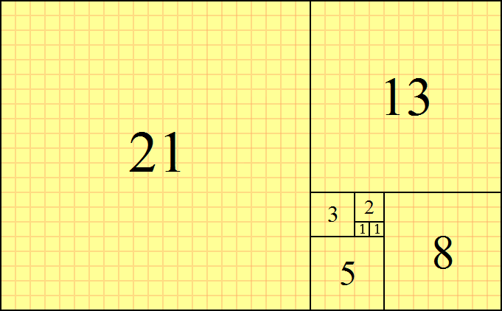



Fibonacci Method
Definition [Fibonacci sequence]
$F_{−1}=0, F_{0}=1$
$F_{k+1}=F_{k}+F_{k−1}$
Define
$ρ_{1}=1−\frac{F_{N}}{F_{N+1}}$, $ρ_{2}=1−\frac{F_{N−1}}{F_{N}}$, …, $ρ_{k}=1−\frac{F_{N−k+1}}{F_{N−k+2}}$, …, $ρ_{N}=1−\frac{F_{1}}{F_{2}}$
$$\left(1−ρ_{1}\right)\left(1−ρ_{2}\right)⋯\left(1−ρ_{N}\right)=\frac{F_{N}}{F_{N+1}}\frac{F_{N−1}}{F_{N}}⋯\frac{F_{1}}{F_{2}}=\frac{F_{1}}{F_{N+1}}=\frac{1}{F_{N+1}}$$

Slide 19


Fibonacci Method
A small anomaly: in the final iteration, we have $ρ_{N}=1−\frac{F_{1}}{F_{2}}=\frac{1}{2}$.
Way out: $ρ_{N}=\frac{1}{2}−ε$
The reduction factor: $\frac{1+2ε}{F_{N+1}}$
Example:
$f\left(x\right)=x^{4}−14x^{3}+60x^{2}−70x$
Range $[0,2]$
Locate to a range of $0.3$

Slide 20







Bisection Method
Assume:
Closed interval
$f$ is unimodal, i.e., $f$ has only one local minimizer
$f$ is continuously differentiable
Basic idea:
Compute $f′(x)$ for $x=\frac{b−a }{2}$
$\left\{\begin{aligned}f^{′}\left(x\right)>0:b=x \\ f^{′}\left(x\right)<0:a=x \\ f^{′}\left(x\right)=0:stop\end{aligned}\right.$
Repeat the above two steps
$$a_{0}$$
$$\frac{b_{0}−a_{0} }{2}$$
$$b_{0}$$
Observations:
$x$ with $f^{′}\left(x\right)=0$ is the only local minimizer
Range reduction factor ${\frac{1}{2}}^{N}$

Slide 21










Newton’s Method
Assume:
$f$ is twice continuously differentiable
$$f(x_{k})$$
$$f(x_{k+1})$$
A root-finding algorithm $f:ℛ→ℛ$, $f\left(x\right)=0$
$x_{k+1}$
$x_{k}$
1. Guess $x_{0}$ for the root
2. Iteratively compute $x_{k+1}=x_{k}−\frac{f(x_{k})}{f‘(x_{k})}$
$x_{k+1}$
Example:
$$f\left(x\right)=x^{3}−12.2x^{2}+7.45x+42$$
$x_{k}$

Slide 22



Newton’s Method
Local minimizer ↔ $x$ with $f’(x)=0$
1. Guess $x_{0}$ for the root
2. Iteratively compute $x_{k+1}=x_{k}−\frac{f‘(x_{k})}{f"(x_{k})}$
Example
$$f\left(x\right)=\frac{1}{2}x^{2}−\sin{x}$$

Slide 23








Newton’s Method
Using quadratic function $g(x)$ to approximate $f(x)$
$$g(x)$$
$$g\left(x\right)=f\left(x_{k}\right)+f^{′}\left(x_{k}\right)\left(x−x_{k}\right)+\frac{1}{2}f"(x_{k})(x−x_{k})^{2}$$
$$f(x)$$
Properties of $g(x)$
$g\left(x_{k}\right)=f(x_{k}）$
$g‘\left(x_{k}\right)=f^{′}\left(x_{k}\right)$
$g\text{"(}x_{k})=f"(x_{k})$
$$x_{k}$$
$$x_{k+1}$$
FONC implies that a minimizer $x_{k+1}$ satisfies
$0=g^{′}\left(x_{k+1}\right)=f^{′}\left(x_{k}\right)+f"(x_{k})(x_{k+1}−x_{k})$,
this means
$x_{k+1}=x_{k}−\frac{f‘(x_{k})}{f"(x_{k})}$.
Remark. Problem with $f"(x_{k})<0$

Slide 24
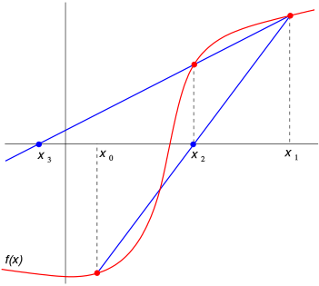




Secant Method
a root-finding algorithm that uses roots of secant lines to approximate a root of a function $f$.
$$y=\frac{f\left(x_{k}\right)−f\left(x_{k−1}\right)}{x_{k}−x_{k−1}}\left(x_{k+1}−x_{k}\right)+f(x_{k})$$
$$y=0→ x_{k+1}=x_{k}−f(x_{k})\frac{x_{k}−x_{k−1}}{f\left(x_{k}\right)−f(x_{k−1})}$$
Example:
$$g\left(x\right)=x^{3}−12.2x^{2}+7.45x+42=0$$
$x_{−1}=13, x_{0}=12$ → $x_{1}=11.40, x_{2}=11.25$

Slide 25



Secant Method
Newton’s Method: $x_{k+1}=x_{k}−\frac{f‘(x_{k})}{f"(x_{k})}$
Se$cant Method: x_{k+1}=x_{k}−f′(x_{k})\frac{x_{k}−x_{k−1}}{f‘\left(x_{k}\right)−f’(x_{k−1})}$
Use $\frac{f‘(x_{k})−f’(x_{k−1})}{x_{k}−x_{k−1}}$ to approximate $f"(x_{k})$
Example: Given voltages $V_{1}, V_{2},…, V_{n}$ at times $t_{1}, t_{2},…, t_{n}$. Determine the best $R$ for the model $V\left(t\right)=e^{−Rt}$, i.e., minimize $f\left(R\right)=2\sum_{i=1}^{n}{(V_{i}−e^{−Rt_{i}})^{2}}$.

Slide 26













Bracketing
Assume: Unimodal
$$a_{0}$$
$$b_{0}$$
Golden Section, Fibonacci, Bisection methods need an initial interval
If $f\left(x_{1}\right)<f\left(x_{0}\right)$ and $f\left(x_{1}\right)<f(x_{2})$ then done.
If $f\left(x_{0}\right)>f\left(x_{1}\right)>f(x_{2})$ then
Golden Section: $x_{k−1}−x_{k−2}=ρ(x_{k}−x_{k−2})$
$$x_{k}=x_{k−1}+\left(2−ρ\right)(x_{k−1}−x_{k−2}）$$
$$2−ρ≈1.618$$
$$ε$$
$$2ε$$
$$4ε$$
$$x_{0}$$
$$x_{1}$$
$$x_{2}$$
$$x_{3}$$

Slide 27









Line Search in Multidimensional Optimization
Minimize $f:ℛ^{n}→ℛ$
$$f(x_{k})$$
Iterative linear search:
$$f(x_{k+1})$$
$x_{k+1}=x_{k}+α_{k}d_{k}$,
$$d_{k}$$
$$x_{k+1}$$
where $x_{0}$ is the initial point, $d_{k}$ the search direction, and $α_{k}$ the step size which is chosen to minimize $φ_{k}\left(α\right)=f(x_{k}+αd_{k})$.
$$x_{k}$$
The minimization of $α_{k}$ is a one-dimensional line search. For example, Secant’s Method: ${φ^{′}}_{k}(α)=d_{k}^{T}∇f(x_{k}+αd_{k})$

Slide 28



Line Search in Multidimensional Optimization
Two issues:
The determination of the minimizer $α_{k}$ is computationally demanding
More computational time on multidimensional optimization
Let $ε∈\left(0,1\right), γ>1, ω∈(ε,1)$.
Armijo condition: $φ_{k}\left(α_{k}\right)≤φ_{k}\left(0\right)+εα_{k}{φ^{′}}_{k}(0)$ and $φ_{k}\left({γα}_{k}\right)≥φ_{k}\left(0\right)+γεα_{k}{φ^{′}}_{k}(0)$
Goldstein condition: $φ_{k}\left(α_{k}\right)≥φ_{k}\left(0\right)+ωα_{k}{φ^{′}}_{k}(0)$
Wolfe condition: ${φ′}_{k}\left(α_{k}\right)≥ω{φ^{′}}_{k}(0)$
Strong Wolfe condition: $\left|{φ^{′}}_{k}\left(α_{k}\right)\right|≤ω|{φ^{′}}_{k}\left(0\right)|$

Slide 29

Line Search in Multidimensional Optimization
A simple practical (inexact) method: Armijo backtracking algorithm
Initial step size: $α_{k}$
If $α_{k}$ satisfies the first Armijo condition, then use it and stop.
Otherwise, iteratively decrease: $α_{k}=μα_{k}$ for $μ∈\left(0,1\right)$ (typically $μ=0.5$) and recheck the above condition.
$α_{k}=α_{0}μ^{m}$, $m≔$ the smallest number satisfying the condition

