Slide 1
Self-supervised Pre-training for Machine Reading Comprehension
Fangkai Jiao
Shandong University
jiaofangkai.com

Slide 2
Outline
Background
General Framework
REPT
MERIt
Conclusion & Future Work

Slide 3
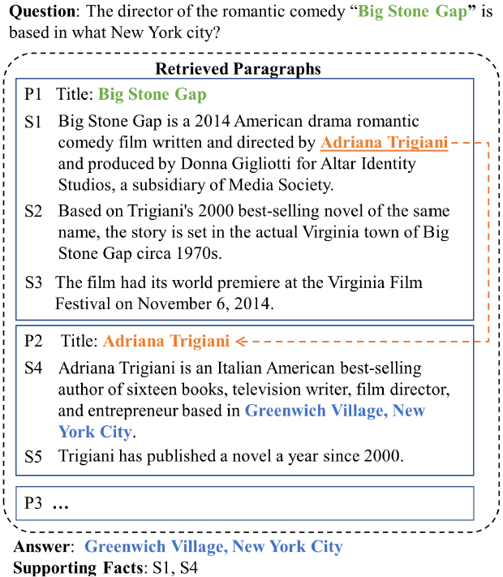
Background
MRC and its application
Limitation of neural networks for MRC
Data hungry
Absence of complex reasoning
Gap between pre-trained LM and MRC
Evidence extraction
Reasoning, e.g., logical reasoning

Slide 4



Background
MRC and its application
Limitation of neural networks for MRC
Data hungry
Absence of complex reasoning
Gap between pre-trained LM and MRC
Evidence extraction
Reasoning, e.g., logical reasoning
Chatbot
Search Engine
Documents Analysis

Slide 5
Two General Frameworks
General
Pre-training
In-domain
Pre-training
Task-oriented
Pre-training
Fine-tuning
/Prompt-tuning
Knowledge
Distillation
Pre-text Task Design
Shortcut Elimination
Post-training
Evaluation

Slide 6
REPT: Bridging Language Models and Machine Reading Comprehension via Retrieval-based Pre-training
Fangkai Jiao, Yangyang Guo, Yilin Niu, Feng Ji, Feng-Lin Li, Liqiang Nie. Findings of ACL 2021.

Slide 7
Motivation
PLMs have a significant gap with MRC system.
Language modeling focuses on general contextual language representation
MRC system requires strong evidence extraction ability to perform reasoning across multiple sentences.

Slide 8
An Intuitive Idea
Evidence extraction
→ Sentence-level evidence retriever
→ Pre-training tasks for training the retriever
Self-supervised tasks
→ Introduce input noise: masking / shuffling / deleting …
→ Shuffling can help learn the discourse knowledge in document level.
Improve the difficulty of task
→ Common entities or nous (coreference) may lead to information leak.
→ Eliminate the information short-cut.

Slide 9
Pre-training Tasks
Query
History The Mentally Retarded Children s Society of SA Inc. was established in 1950 by a group of parents who wanted [MASK A] employment and accommodation opportunities for their children within the local community at a time when institutionalised [MASK B] in Adelaide was their only alternative.
Today [MASK C] [MASK D] provides assisted employment assisted accommodation and respite services to people with intellectual disabilities.
Given a Wikipedia document,
Select 30% sentences as query.
Mask the entities and nouns with pre-defined ratio to eliminate the information short cut.
TO:
Predict the initial preceding and following sentences or each query.
Recover the correct entities and nouns.
Document
The society s aims were to seek education or training facilities for people with intellectual disabilities to establish sheltered workshops and to establish residential hostels.
A number of sheltered workshops were established and in 1980 the name was changed to the Aboriginal word Orana which means Welcome .
Orana s current and previous clients include Mitsubishi Motors Clipsal RAA Elders Limited and Billycart Kids.
Orana was one of the first disability service organisations to achieve Quality Accreditation.
After the unveiling of the Australian Government s Commonwealth Home Support Programme CHSP and seeing it as a natural step of progression Orana now provides quality tailored aged care at home.
The well resourced organization delivers help across a range of areas helping the elderly remain where they want to be in the comfort of their own home during their later years.
Orana continues with its mission to support people remain independent valued and productive members of the community.
Correct order: 1 3 4 2 5 6 7 8 9
Recovery:
[MASK A] -> education
[MASK B] -> care
[MASK C] [MASK D] -> Orana Provides

Slide 10
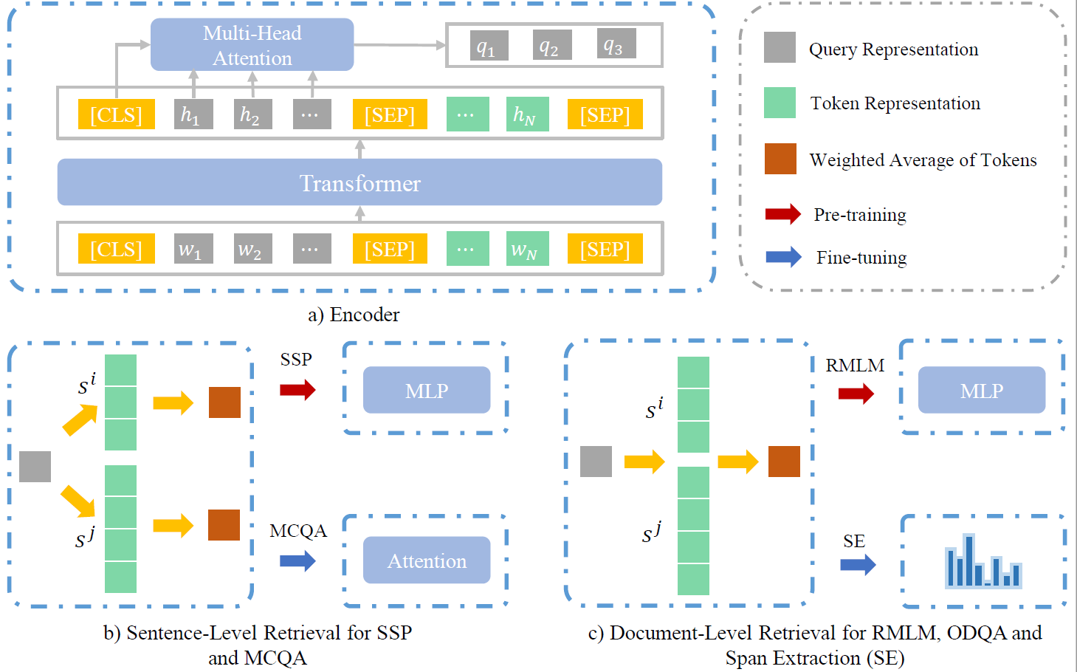
Model Architecture

Slide 11
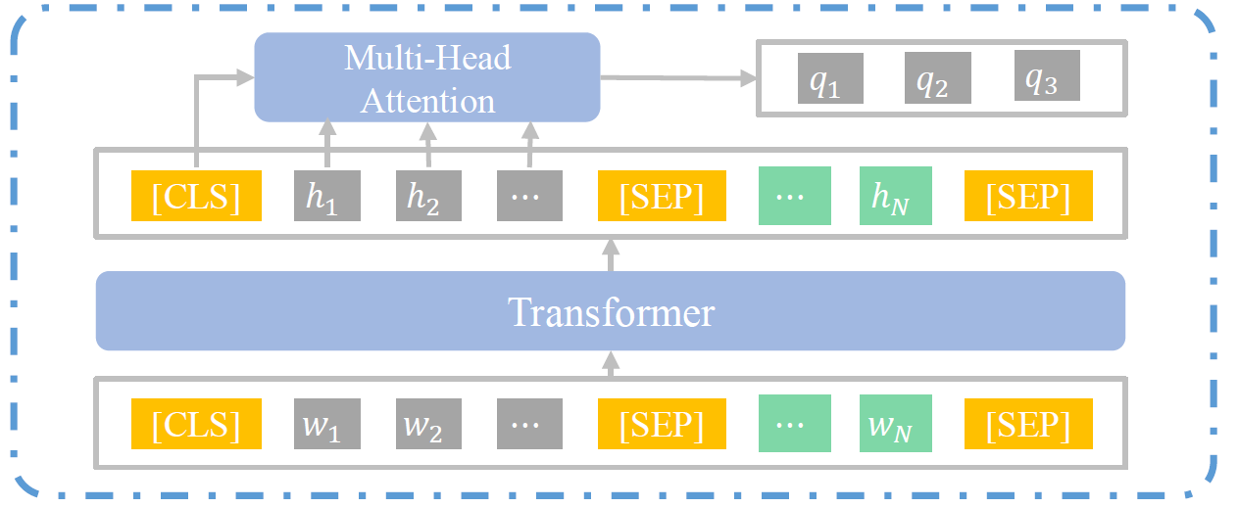


Encoder
Joint encoding
Query representation

Slide 12
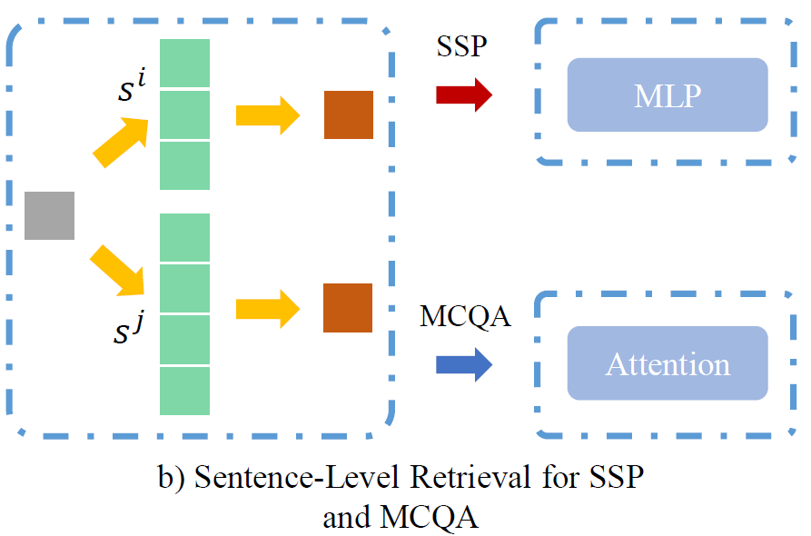



Sentence-level Evidence Extraction
Intra-sentence evidence retrieval
Surrounding Sentence Prediction
Multiple Choice QA

Slide 13
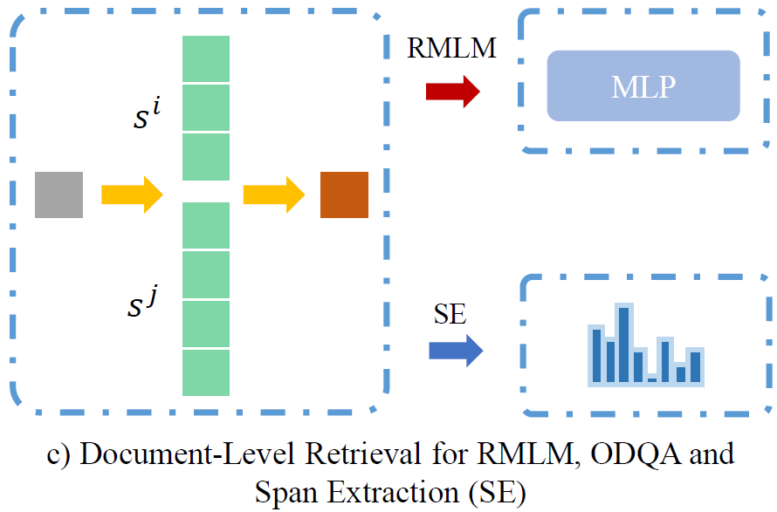


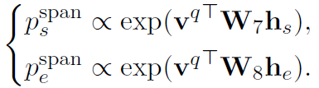
Document-level Evidence Extraction
Document-level evidence retrieval
Masked language modeling
Span Extraction

Slide 14
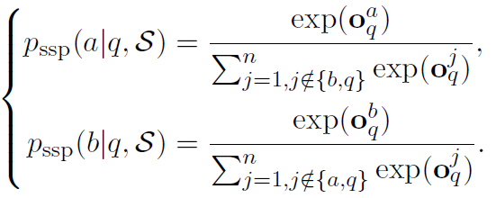

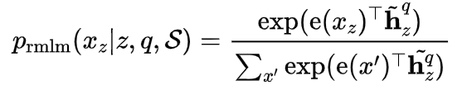
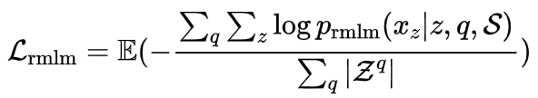
Optimization
Surrounding Sentence Prediction
Retrieval based MLM
Notes:
p_{\mathrm{rmlm}}(x_z|z,q,\mathcal{S})=\frac{\exp (\mathrm{e} (x_z)^\top \tilde{\mathbf{h}}^q_z) }{\sum_{x'}\exp (\mathrm{e} (x')^\top \tilde{\mathbf{h}^q_z })}

Slide 15
Dataset
Pre-training: Wikipedia (13 GB)
Multiple Choice QA
DREAM
RACE
Multi-RC
ReClor
Span Extraction QA
Hotpot QA

Slide 16
Baseline
BERT & RoBERTa
BERT-Q & RoBERTa-Q
BERT-Q w. R & BERT-Q w. S
BERT-Q w. M & BERT w. M
BERT-Q w. R/S & RoBERTa-Q w. R/S (Ours model)

Slide 17
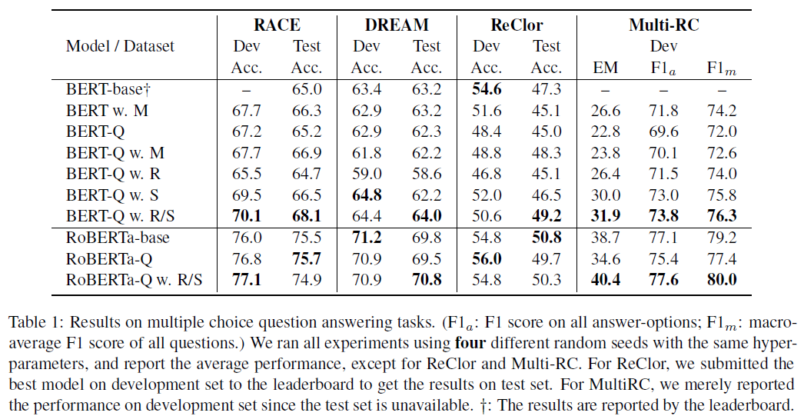
Results of Multiple Choice QA

Slide 18
Results of Multiple Choice QA

Slide 19
Results of Multiple Choice QA

Slide 20
Results of Multiple Choice QA

Slide 21
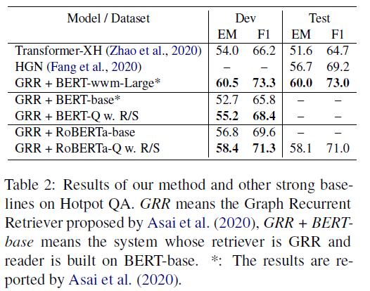
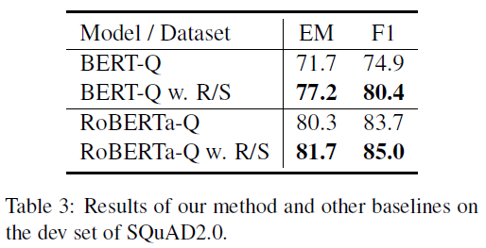
Results of Span Extraction QA

Slide 22
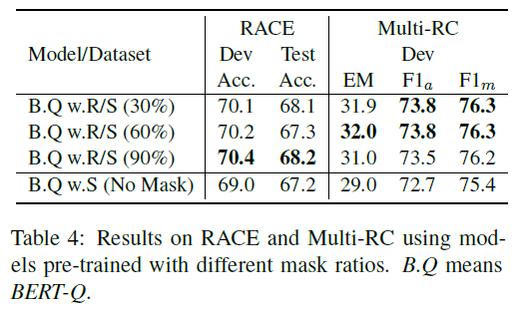
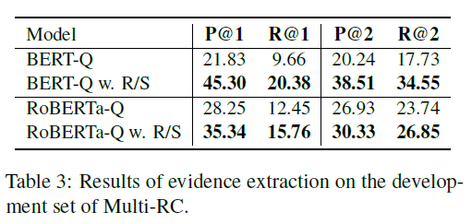
Analysis

Slide 23
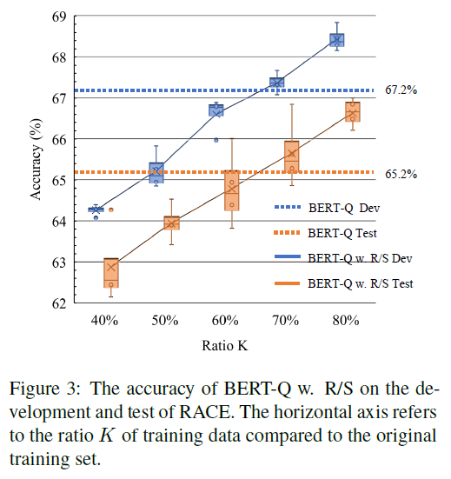
Performance under Low Resource

Slide 24
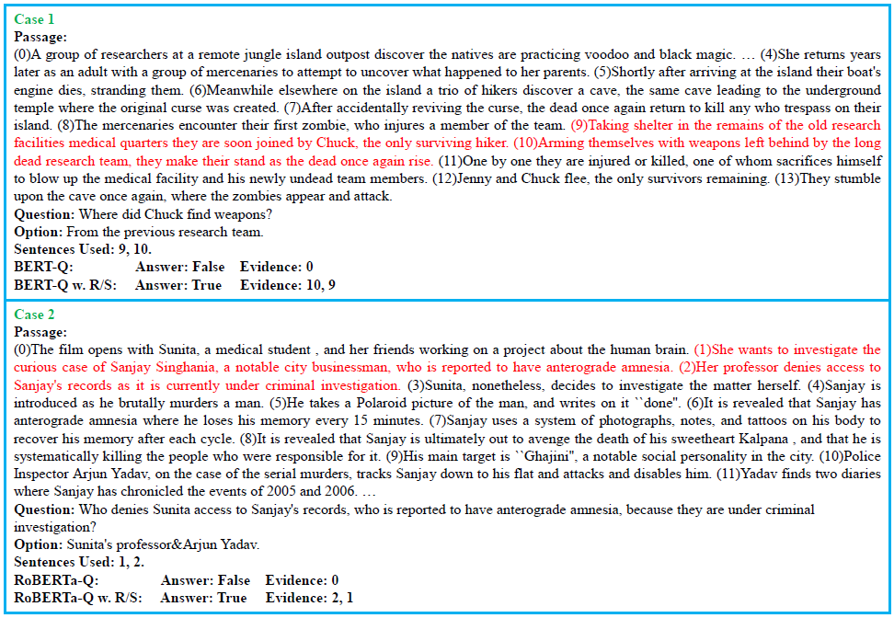

Slide 25
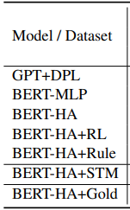
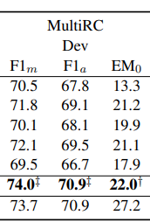
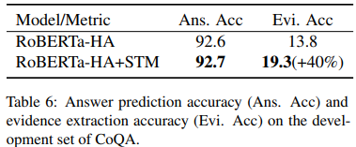
Limitation
The upper bound by evidence extraction¹.
The gap between the different queries in SSP and MRC.
Better solution² ³.
1 A Self-Training Method for Machine Reading Comprehension with Soft Evidence Extraction. Yilin Niu, Fangkai Jiao, Mantong Zhou, Ting Yao, Jingfang Xu, Minlie Huang. ACL 2020.
2 ReasonBERT: Pre-trained to Reason with Distant Supervision. Xiang Deng, Yu Su, Alyssa Lees, You Wu, Cong Yu, Huan Sun. EMNLP 2021.
3 Few-Shot Question Answering by Pretraining Span Selection. Ori Ram, Yuval Kirstain, Jonathan Berant, Amir Globerson, Omer Levy. ACL 2021.

Slide 26
MERIt: Meta-Path Guided Contrastive Learning for Logical Reasoning
Fangkai Jiao, Yangyang Guo, Xuemeng Song, Liqiang Nie. Under review.

Slide 27
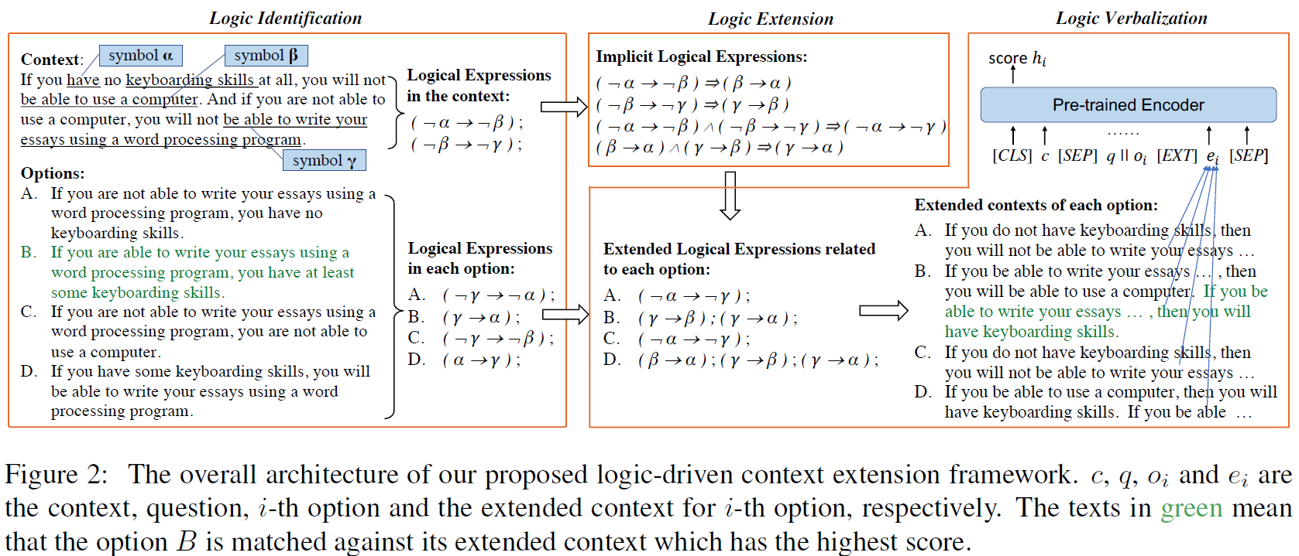
Logic-Driven Context Extension and Data Augmentation for Logical Reasoning of Text
Notes:
上下文的意思是说：如果你不会打字，那么你就没法用电脑，如果你使用不了电脑，你就没办法用文字处理软件写论文。
选项A说如果你不能用文字处理软件写论文，说明不会打字，命题和逆命题的关系
选项B说如果你能够用文字处理软件写论文，那么说明你至少拥有打字的技能，这个是逆否命题
选项C说如果你不会用文字处理软件，那么你也不会使用电脑，这个也是逆命题
选项D说如果你会打字，那么你就能用文字处理软件写论文，这个是否命题相关，如果反过来说就是对的。

Slide 28
Logic-Driven Context Extension and Data Augmentation for Logical Reasoning of Text
Notes:
上下文的意思是说：如果你不会打字，那么你就没法用电脑，如果你使用不了电脑，你就没办法用文字处理软件写论文。
选项A说如果你不能用文字处理软件写论文，说明不会打字，命题和逆命题的关系
选项B说如果你能够用文字处理软件写论文，那么说明你至少拥有打字的技能，这个是逆否命题
选项C说如果你不会用文字处理软件，那么你也不会使用电脑，这个也是逆命题
选项D说如果你会打字，那么你就能用文字处理软件写论文，这个是否命题相关，如果反过来说就是对的。

Slide 29
Logic-Driven Context Extension and Data Augmentation for Logical Reasoning of Text
Notes:
上下文的意思是说：如果你不会打字，那么你就没法用电脑，如果你使用不了电脑，你就没办法用文字处理软件写论文。
选项A说如果你不能用文字处理软件写论文，说明不会打字，命题和逆命题的关系
选项B说如果你能够用文字处理软件写论文，那么说明你至少拥有打字的技能，这个是逆否命题
选项C说如果你不会用文字处理软件，那么你也不会使用电脑，这个也是逆命题
选项D说如果你会打字，那么你就能用文字处理软件写论文，这个是否命题相关，如果反过来说就是对的。

Slide 30
Logic-Driven Context Extension and Data Augmentation for Logical Reasoning of Text
Notes:
上下文的意思是说：如果你不会打字，那么你就没法用电脑，如果你使用不了电脑，你就没办法用文字处理软件写论文。
选项A说如果你不能用文字处理软件写论文，说明不会打字，命题和逆命题的关系
选项B说如果你能够用文字处理软件写论文，那么说明你至少拥有打字的技能，这个是逆否命题
选项C说如果你不会用文字处理软件，那么你也不会使用电脑，这个也是逆命题
选项D说如果你会打字，那么你就能用文字处理软件写论文，这个是否命题相关，如果反过来说就是对的。

Slide 31
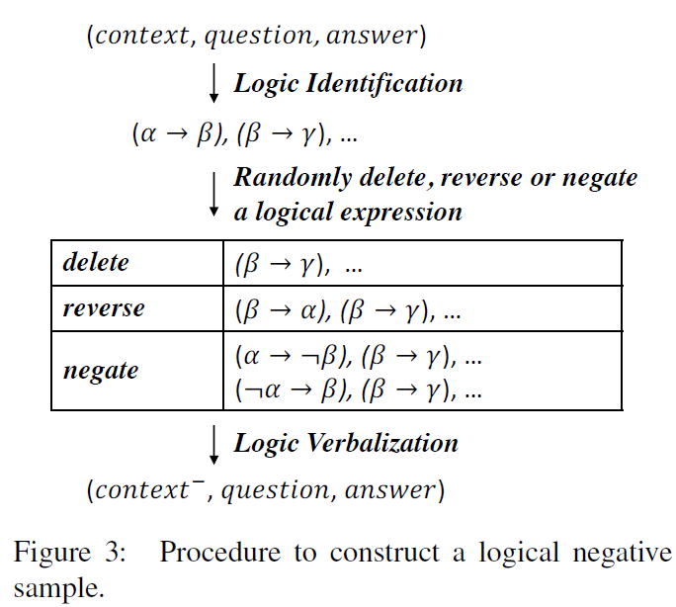
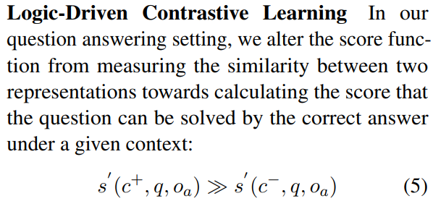
Logic-Driven Context Extension and Data Augmentation for Logical Reasoning of Text
Notes:
这是之前ReClor数据集上的sota，他非常明显的结合了符号逻辑的内容，数据驱动与符号逻辑相结合
问题：
非常依赖手工设计规则去提取、改写逻辑表达式
因为依赖观察数据集设计特定规则，可能会引入很多的噪音。实际测试的时候发现，他的预处理是基于基本的constituency parsing模型和自己设计的算法，对于简单句可以应付，对于有复杂从句的情况就没办法抽取正确的逻辑单元，会漏掉一部分
这个方法是基于训练集做了数据增广，理论上会收到数据集大小的限制，数据集本身越小，这个方法带来的效果就越小

Slide 32
Questions
Is it possible to employ the framework on unlabeled data?
How to discover the potential logical structure in raw text instead of particular text, e.g., a document from LSAT?
How to construct positive and negative data pairs to facilitate contrastive learning?
Does any trivial solution exist? How to avoid the trivial solution?

Slide 33
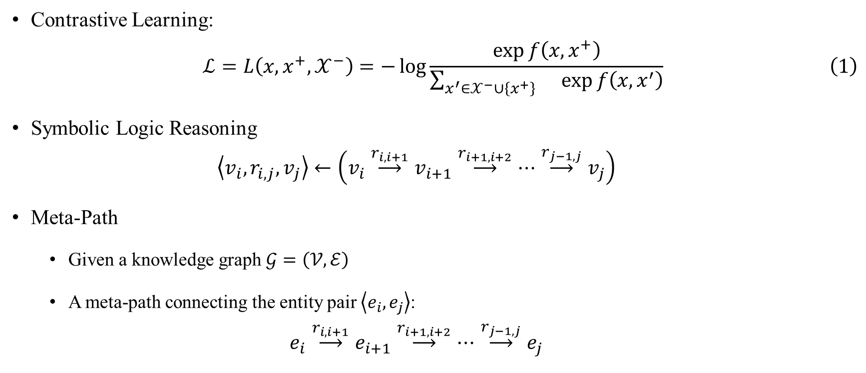
Preliminary
Contrastive Learning:
$$\begin{aligned}ℒ=L\left(x,x^{+},𝒳^{−}\right)=−\log{\frac{\exp{f\left(x,x^{+}\right)}}{\sum_{x^{′}∈𝒳^{−}∪\left\{x^{+}\right\}}{}\exp{f\left(x,x^{′}\right)}}}\#\left(1\right)\end{aligned}$$
Symbolic Logic Reasoning
$$\left\langle v_{i},r_{i,j},v_{j}\right\rangle ←\left(v_{i}\overset{r_{i,i+1}}{⟶}v_{i+1}\overset{r_{i+1,i+2}}{⟶}⋯\overset{r_{j−1,j}}{⟶}v_{j}\right)$$
Meta-Path
Given a knowledge graph $𝒢=\left(𝒱,ℰ\right)$
A meta-path connecting the entity pair $\left\langle e_{i},e_{j}\right\rangle$:
$$e_{i}\overset{r_{i,i+1}}{⟶}e_{i+1}\overset{r_{i+1,i+2}}{⟶}⋯\overset{r_{j−1,j}}{⟶}e_{j}$$

Slide 34
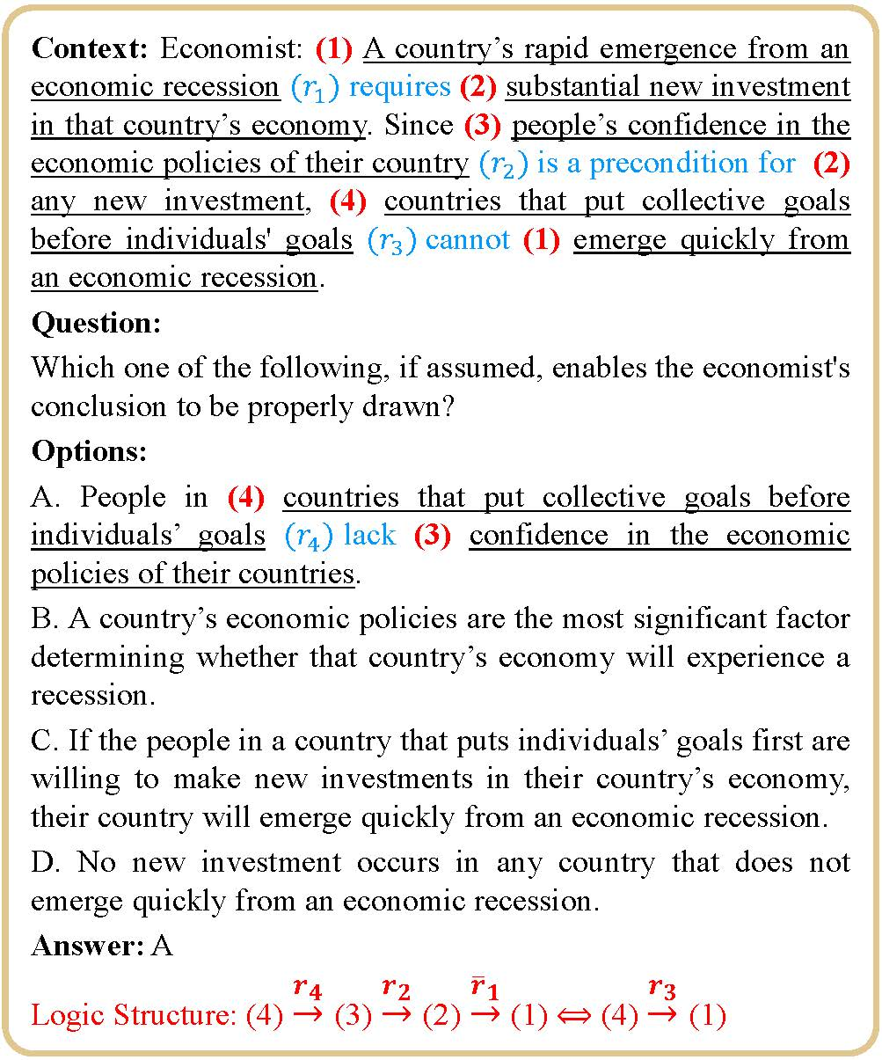
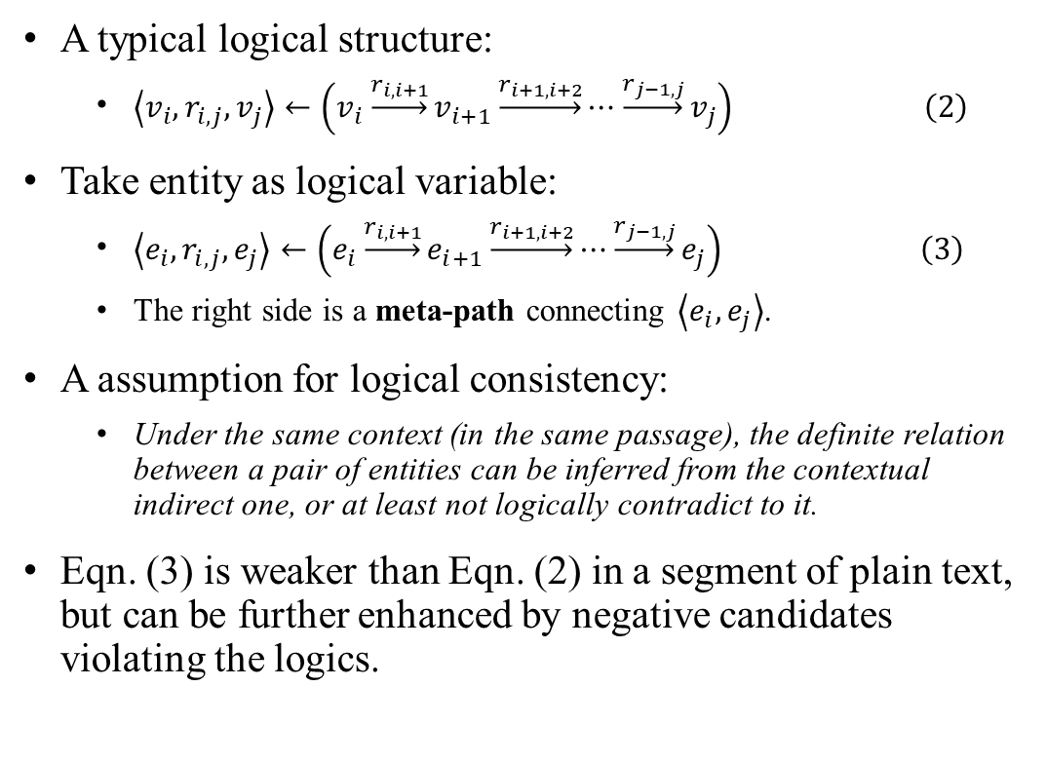
From Logical Reasoning to Meta-Path
A typical logical structure:
$\begin{aligned}\left\langle v_{i},r_{i,j},v_{j}\right\rangle ←\left(v_{i}\underset{→}{r_{i,i+1}}v_{i+1}\underset{→}{r_{i+1,i+2}}⋯\underset{→}{r_{j−1,j}}v_{j}\right) \#\left(2\right)\end{aligned}$
Take entity as logical variable:
$\begin{aligned}\left\langle e_{i},r_{i,j},e_{j}\right\rangle ←\left(e_{i}\underset{→}{r_{i,i+1}}e_{i+1}\underset{→}{r_{i+1,i+2}}⋯\underset{→}{r_{j−1,j}}e_{j}\right) \#\left(3\right)\end{aligned}$
The right side is a meta-path connecting $\left\langle e_{i}, e_{j}\right\rangle$.
A assumption for logical consistency:
Under the same context (in the same passage), the definite relation between a pair of entities can be inferred from the contextual indirect one, or at least not logically contradict to it.
Eqn. (3) is weaker than Eqn. (2) in a segment of plain text, but can be further enhanced by negative candidates violating the logics.

Slide 35






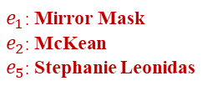

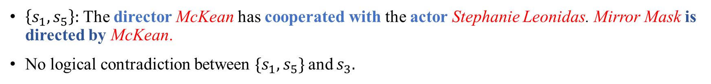









Meta-Path Guided Positive Instance Construction
(a) Graph Construction
($s_{1}$) “Mirror Mask ($e_{1}$)”, McKean ($e_{2}$)’s first feature film as director, premiered at … in January 2005. ($s_{2}$) The screenplay was written by Neil Gaiman ($e_{3}$), from a story by Gaiman and McKean. ($s_{3}$) A children’s fantasy …, “Mirror Mask” was produced by Jim Henson Studios ($e_{4}$) and stars a British cast Stephanie Leonidas ($e_{5}$), … and Gina McKee ($e_{6}$). ($s_{4}$) Before “Mirror Mask”, McKean directed a number of …. ($s_{5}$) McKean has directed “The Gospel of Us ($e_{7}$)”, …. A new feature film, “Luna”, written and directed by McKean and starring Stephanie Leonidas, ..., debuted at ….
(b) Meta-Path Guided Positive Instance Construction
Target Entities $\left\langle e_{1},e_{5}\right\rangle$
$$e_{2}$$
$e_{1}$: Mirror Mask
$e_{2}$: McKean
$e_{5}$: Stephanie Leonidas
Possible Answers
$$𝒜^{+}=\left\{s_{3} \right\}$$
$$s_{1}$$
$$s_{5}$$
$$e_{7}$$
$$e_{6}$$
Entity
$$e_{1}$$
$$e_{5}$$
Intra-Sentence
Relation
Positive Data Pair
$$𝒮=\left\{s_{1},s_{5}\right\}↔s_{3}$$
Meta-Path
$$𝒫=\left\{e_{1},e_{2},e_{5}\right\}$$
$$e_{5}$$
$$e_{4}$$
$$e_{1}$$
External
Relation
$$e_{2}$$
$$e_{3}$$
$\left\{s_{1},s_{5}\right\}$: The director McKean has cooperated with the actor Stephanie Leonidas. Mirror Mask is directed by McKean.
No logical contradiction between $\{s_{1},s_{5}\}$ and $s_{3}$.

Slide 36
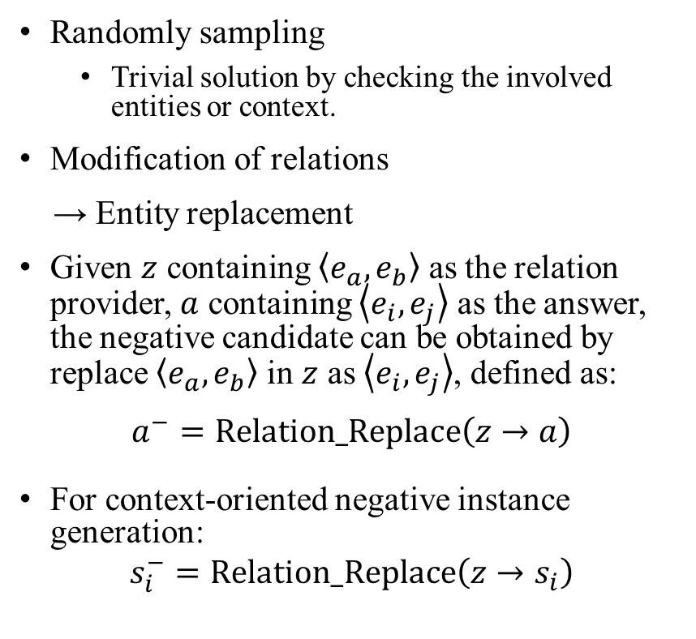






Negative Instance Generation
Randomly sampling
Trivial solution by checking the involved entities or context.
Modification of relations
→ Entity replacement
Given $z$ containing $\left\langle e_{a},e_{b}\right\rangle$ as the relation provider, $a$ containing $\left\langle e_{i},e_{j}\right\rangle$ as the answer, the negative candidate can be obtained by replace $\left\langle e_{a},e_{b}\right\rangle$ in $z$ as $\left\langle e_{i},e_{j}\right\rangle$, defined as:
$$a^{−}=\text{Relation}\text{_}\text{Replace}\left(z→a\right)$$
For context-oriented negative instance generation:
$$s_{i}^{−}=\text{Relation}\text{_}\text{Replace}\left(z→s_{i}\right)$$
(c) Negative Candidate Generation
A children’s fantasy …, “Mirror Mask” was produced by … and stars a British cast Stephanie Leonidas, …, and Gina McKee.
The screenplay was written by Mirror Mask, from a story by Gaiman and Stephanie Leonidas.
Answer: $a=s_{3}$
Option $a^{−}$
The screenplay was written by Neil Gaiman, from a story by Gaiman and McKean.
Option-oriented
Relation Provider $z$
Context-oriented
A new feature film, “Luna”, … and directed by McKean and starring Stephanie Leonidas ….
The screenplay was written by Stephanie Leonidas, from a story by Gaiman and McKean.
Context Sentence $s_{5}$
Negative Sentence $s_{5}^{−}$
Negative Context $𝒮^{−}=\left\{s_{1},s_{5}^{−}\right\}$

Slide 37
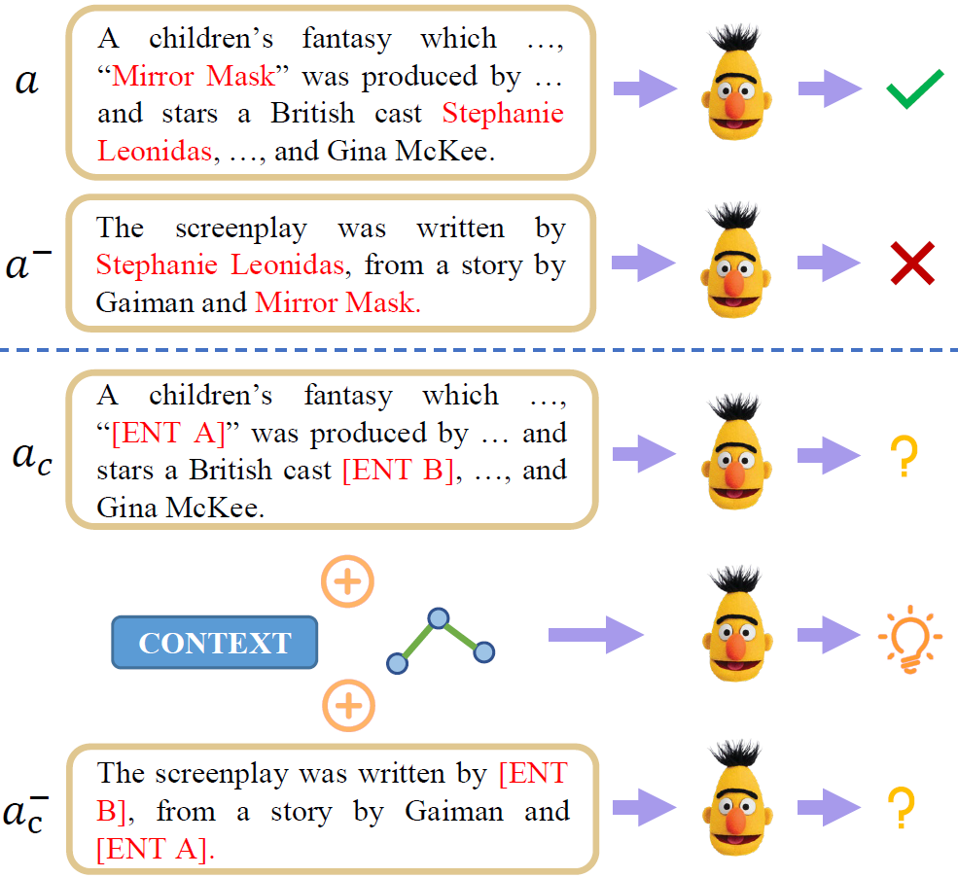


Counterfactual Data Augmentation
(d) Counterfactual Data Augmentation
A children’s fantasy which …, “Mirror Mask” was produced by … and stars a British cast Stephanie Leonidas, …, and Gina McKee.
A children’s fantasy which …, “[ENT A]” was produced by … and stars a British cast [ENT B], …, and Gina McKee.
$$a$$
The screenplay was written by Mirror Mask, from a story by Gaiman and Stephanie Leonidas.
The screenplay was written by [ENT A], from a story by Gaiman and [ENT B].
$$a^{−}$$

Slide 38
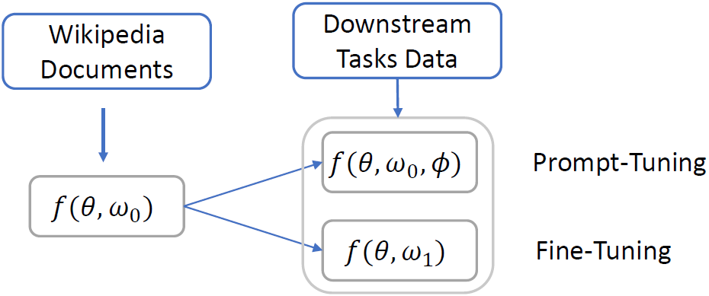

Training
Contrastive Learning:
$ℒ_{OCL}=L\left(𝒮,a,𝒜^{−}\right)$
$ℒ_{CCL}=L\left(a,𝒮,𝒞^{−}\right)$
Pre-training: $ℒ=ℒ_{OCL}+ℒ_{CCL}+ℒ_{MLM}$
Fine-tuning: $ℒ_{QA}=−\log{\frac{\exp{f\left(P,Q,O_{y}\right)}}{\sum_{i}{\exp{f\left(P,Q,O_{i}\right)}}}}$
Prompt-tuning:
Input sequence: $\left[Q,\left[\text{prefix}\right],O_{i},P\right]$
Notes:
\theta是transformer的参数， w0是预训练时输出层的参数，就是一个两层的MLP，w1是微调时输出层的参数，也是一个两层的MLP，因为都是MLP所以就可以合并，但这里还存在一个gap，就是我们在预训练的时候没有question，所以我们在下游加了一个prefix，随机初始化的没有训练过的embedding，希望这个prefix能够把Q和O_i变成一个陈述形势的约束

Slide 39
Experiment Setup
Backbone
RoBERTa-large (2080Ti * 4, 32 hours)
ALBERT-v2-xxlarge (Tesla T4 * 2, 3 days)
DeBERTa-v2-xlarge (A100 * 4, 20 hours)
DeBERTa-v2-xxlarge (A100 * 4, 1 day)
Pre-training corpus: Wikipedia
Dataset
ReClor
LogiQA
Baseline
DAGN
Focal Reasoner
LReasoner

Slide 40
Experiment
Overall performance
Ablation study
Performance with limited training data
Effect of pre-training steps
Linear probing
Performance on DREAM

Slide 41
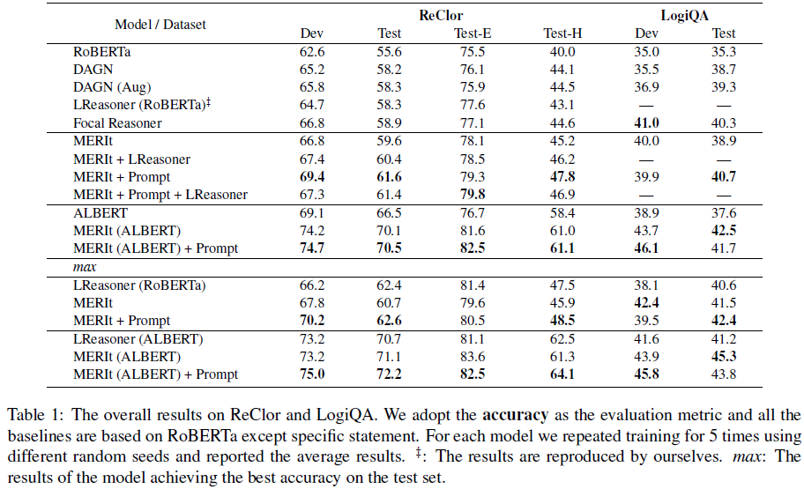
Experiments

Slide 42
Experiments

Slide 43
Experiments

Slide 44
Experiments

Slide 45
Experiments

Slide 46
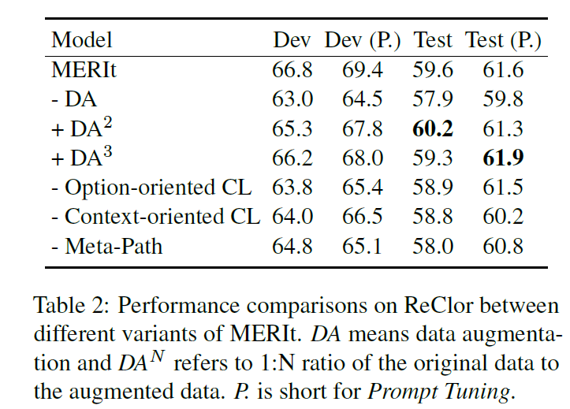
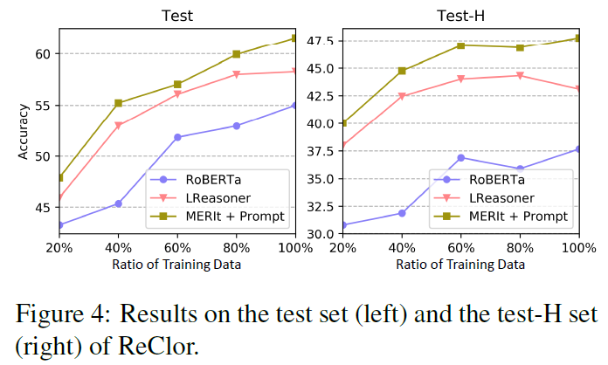
Experiments

Slide 47
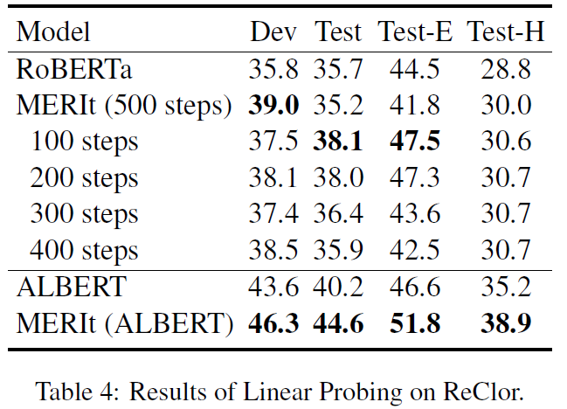
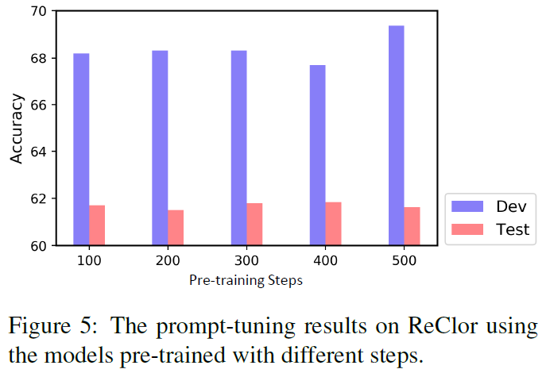
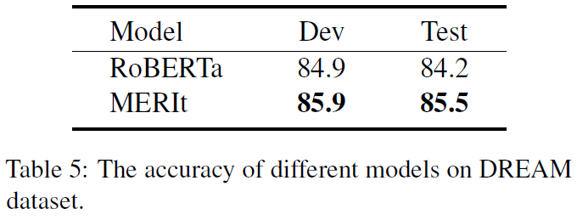
Experiments

Slide 48
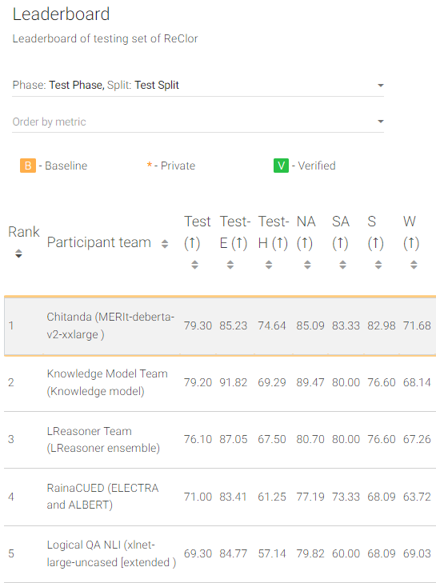
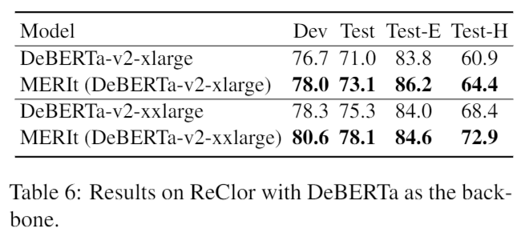
More Experiments

Slide 49
Conclusion & Future Works
Reasoning?
Relation?
More pretext task
Interpretable reasoning steps
Causality

Slide 50
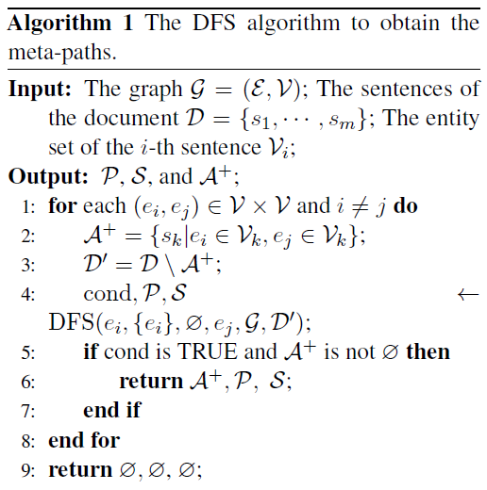
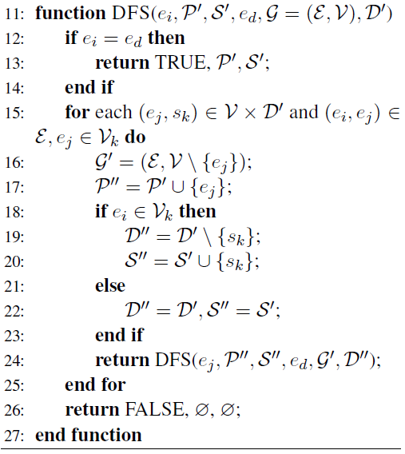
Algorithm for Meta-Path Extraction

Slide 51
Case Study for Data Construction
Example 1 (Option-based CL)
Context:
Napoleon appointed his brother Louis Bonaparte to the Kingdom of Holland in May 1806. The Dutch rebellion first broke out in Amsterdam on 14–15 November.
Negative Candidates:
Since their trade was badly damaged by Napoleon's Continental System, the French people were ready to throw off the Dutch yoke.
However, on 9 July 1810, the French emperor extinguished the kingdom and annexed the Dutch to the Napoleon.
Depressed by the loss of his son in Napoleon, the French civil leader Dutch responded ineffectively to the crisis.
Answer:
The Dutch contributed only 17,300 soldiers to Napoleon's armies in 1811–1813, but their severe casualties in the French invasion of Russia shocked the population.
A Counterfactual Sample of Example 1
Context:
The Din rebellion first broke out in Amsterdam on 14–15 November. Bihar appointed his brother Louis Bonaparte to the Kingdom of Holland in May 1806 .
Negative Candidates:
Since their trade was badly damaged by French's Continental System , the Din people were ready to throw off the Bihar yoke .
In early November, Din corps commander Ferdinand von Wintzingerode sent a 3,500-man "Streifkorps" led by Alexander Khristoforovich Benckendorff into Bihar.
In early November, Bihar corps commander Ferdinand von Wintzingerode sent a 3,500-man "Streifkorps" led by Alexander Khristoforovich Benckendorff into Din.
Answer:
The Dutch contributed only 17,300 soldiers to Napoleon's armies in 1811–1813, but their severe casualties in the French invasion of Russia shocked the population.

Slide 52
Case Study for Data Construction
Example 2 (Context-oriented CL)
Context:
Napoleon appointed his brother Louis Bonaparte to the Kingdom of Holland in May 1806. The Dutch rebellion first broke out in Amsterdam on 14–15 November.
Negative Contexts:
Depressed by the loss of his son in Napoleon, the French civil leader Kingdom of Holland responded ineffectively to the crisis. The Dutch rebellion first broke out in Amsterdam on 14–15 November.
Since their trade was badly damaged by Kingdom of Holland's Napoleon, the Dutch people were ready to throw off the French yoke. The Dutch rebellion first broke out in Amsterdam on 14–15 November.
Depressed by the loss of his son in Russia, the Napoleon civil leader Kingdom of Holland responded ineffectively to the crisis. The Dutch rebellion first broke out in Amsterdam on 14–15 November ..
Answer:
The Dutch contributed only 17,300 soldiers to Napoleon's armies in 1811–1813, but their severe casualties in the French invasion of Russia shocked the population.
A Counterfactual Sample of Example 2
Context:
Bihar appointed his brother Louis Bonaparte to the Kingdom of Holland in May 1806. The Din rebellion first broke out in Amsterdam on 14–15 November.
Negative Contexts:
The Din rebellion first broke out in Amsterdam on 14–15 November. Since their trade was badly damaged by Kingdom of Holland's Continental System, the Din people were ready to throw off the Bihar yoke.
The Din rebellion first broke out in Amsterdam on 14–15 November. Depressed by the loss of his son in Kingdom of Holland, the French civil leader Bihar responded ineffectively to the crisis.
Since their trade was badly damaged by Bihar's Continental System , the Kingdom of Holland people were ready to throw off the French yoke. The Din rebellion first broke out in Amsterdam on 14–15 November.
Answer:
The Din contributed only 17,300 soldiers to Bihar’s armies in 1811–1813, but their severe casualties in the French invasion of Russia shocked the population.

