Slide 1
2013 J. Phys. D: Appl. Phys
Single-layer graphene self-folding

Slide 2
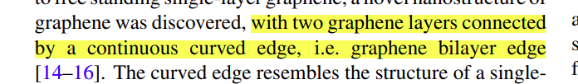
Shape of graphene bilayer edge
In this paper, an analytical model based on finite deformation beam theory [28] is developed to study the self folding of single-layer graphene, which can accurately predict the critical length of graphene for self-folding and the shape of the folded edge.

Slide 3
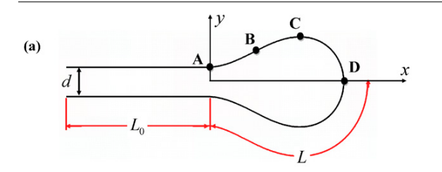
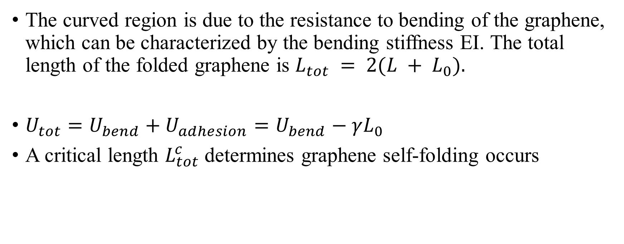
Schematic
The curved region is due to the resistance to bending of the graphene, which can be characterized by the bending stiffness EI. The total length of the folded graphene is $L_{tot} = 2(L + L_{0}).$
$U_{tot}=U_{bend}+U_{adhesion}=U_{bend}−γL_{0}$
A critical length $L_{tot}^{c}$ determines graphene self-folding occurs

Slide 4
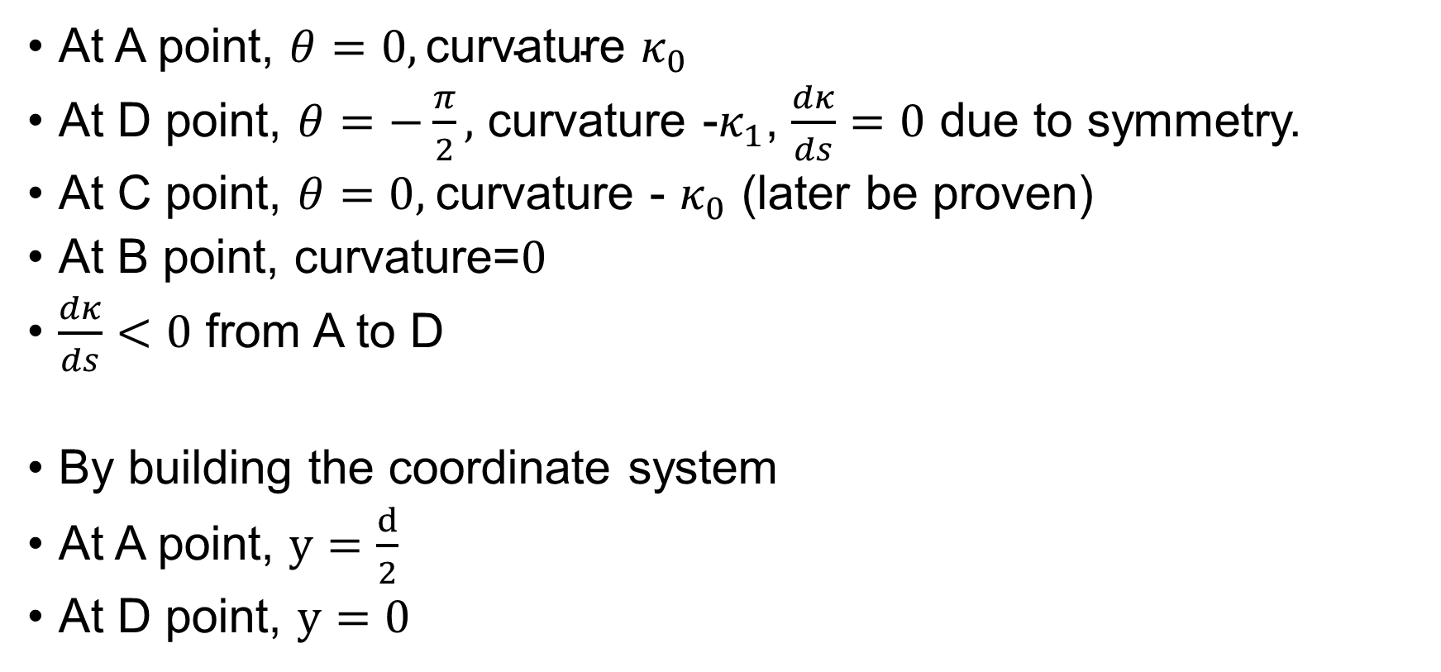
Boundary conditions
At A point, $θ=0,\text{curvature} κ_{0}$
At D point, $θ=−\frac{π}{2},$ curvature -$κ_{1}$, $\frac{dκ}{ds}=0$ due to symmetry.
At C point, $θ=0,$curvature - $κ_{0}$ (later be proven)
At B point, curvature=$0$
$\frac{dκ}{ds}<0$ from A to D
By building the coordinate system
At A point, $y=\frac{d}{2}$
At D point, $y=0$

Slide 5
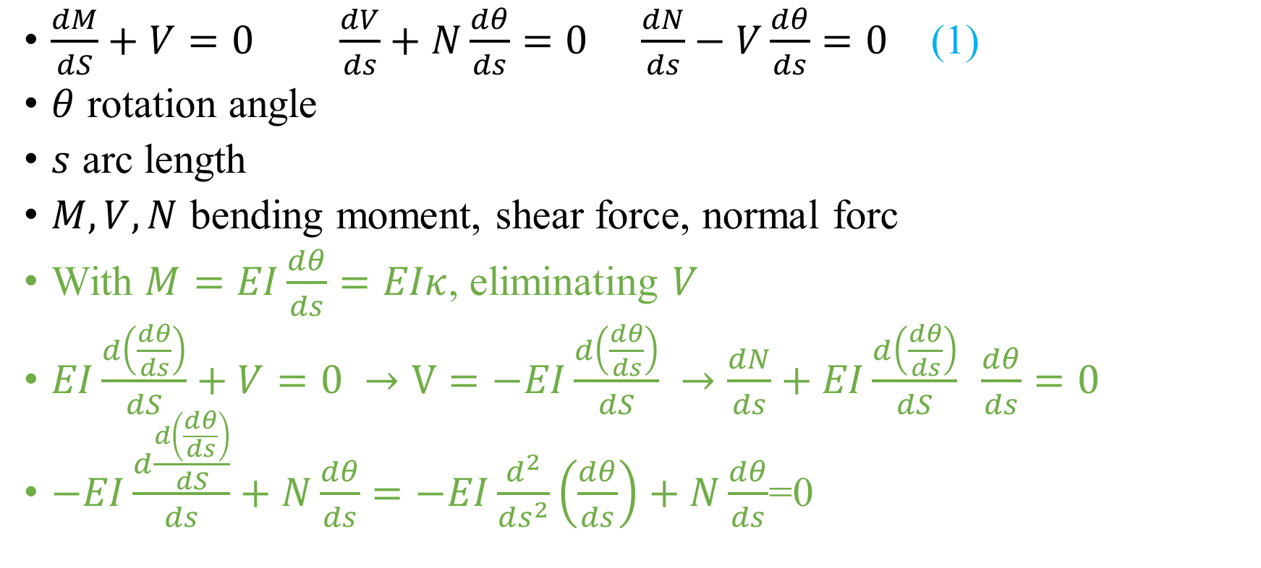
Top half of graphene
$\frac{dM}{dS}+V=0$ $\frac{dV}{ds}+N\frac{dθ}{ds}=0$ $\frac{dN}{ds}−V\frac{dθ}{ds}=0$ (1)
$θ$ rotation angle
$s$ arc length
$M,V,N$ bending moment, shear force, normal forc
With $M=EI\frac{dθ}{ds}=EIκ$, eliminating $V$
$EI\frac{d（\frac{dθ}{ds}）}{dS}+V=0 →V=−EI\frac{d（\frac{dθ}{ds}）}{dS} →\frac{dN}{ds}+EI\frac{d（\frac{dθ}{ds}）}{dS} \frac{dθ}{ds}=0$
$−EI\frac{d\frac{d（\frac{dθ}{ds}）}{dS}}{ds}+N\frac{dθ}{ds}=−EI\frac{d^{2}}{ds^{2}}（\frac{dθ}{ds}）+N\frac{dθ}{ds}$=0

Slide 6
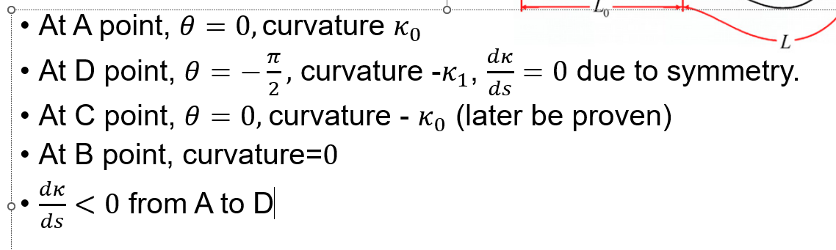
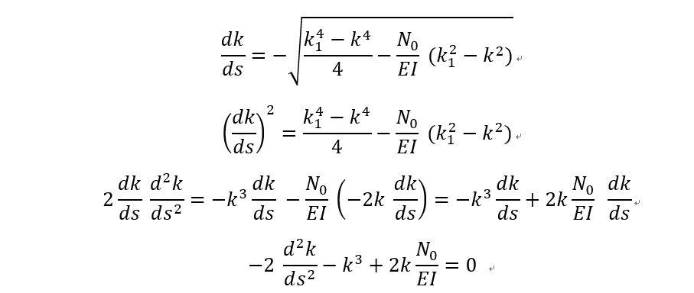
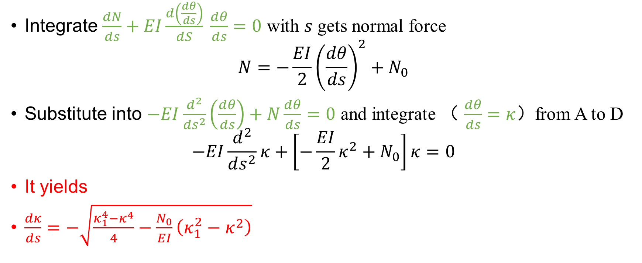
Integration
Integrate $\frac{dN}{ds}+EI\frac{d（\frac{dθ}{ds}）}{dS} \frac{dθ}{ds}=0$ with $s$ gets normal force
$$N=−\frac{EI}{2}{\left(\frac{dθ}{ds}\right)}^{2}+N_{0}$$
Substitute into $−EI\frac{d^{2}}{ds^{2}}（\frac{dθ}{ds}）+N\frac{dθ}{ds}=0$ and integrate （ $\frac{dθ}{ds}=κ$）from A to D
$$−EI\frac{d^{2}}{ds^{2}}κ+\left[−\frac{EI}{2}κ^{2}+N_{0}\right]κ=0$$
It yields
$\frac{dκ}{ds}=−\sqrt{\frac{κ_{1}^{4}−κ^{4}}{4}−\frac{N_{0}}{EI}\left(κ_{1}^{2}−κ^{2}\right)}$
Core Formula

Slide 7
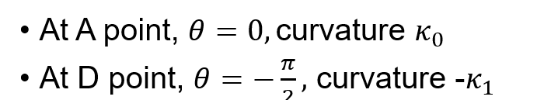
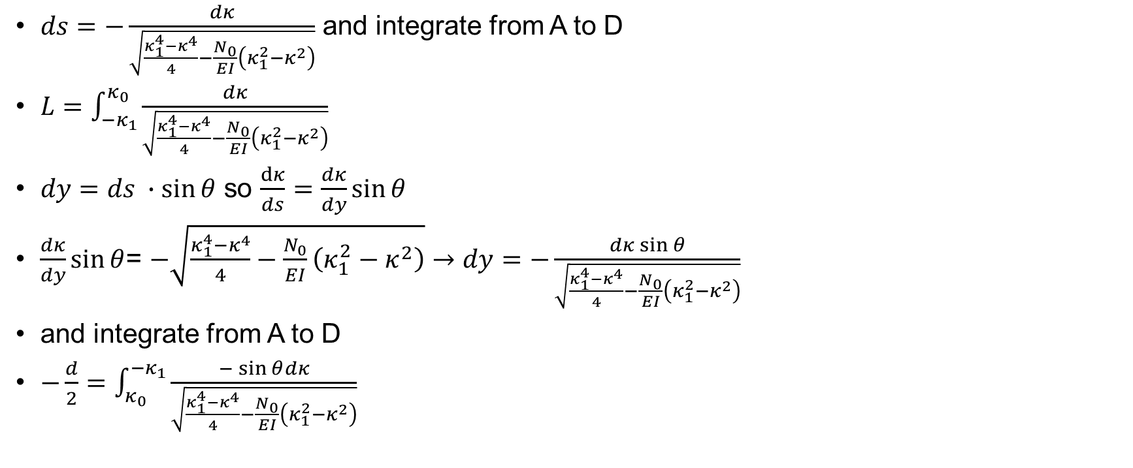
Integration
$ds=−\frac{dκ}{\sqrt{\frac{κ_{1}^{4}−κ^{4}}{4}−\frac{N_{0}}{EI}\left(κ_{1}^{2}−κ^{2}\right)}}$ and integrate from A to D
$L=\int_{−κ_{1}}^{κ_{0}}{\frac{dκ}{\sqrt{\frac{κ_{1}^{4}−κ^{4}}{4}−\frac{N_{0}}{EI}\left(κ_{1}^{2}−κ^{2}\right)}}}$
$dy=ds ∙\sin{θ}$ so $\frac{dκ}{ds}=\frac{dκ}{dy}\sin{θ}$
$\frac{dκ}{dy}\sin{θ}$= $−\sqrt{\frac{κ_{1}^{4}−κ^{4}}{4}−\frac{N_{0}}{EI}\left(κ_{1}^{2}−κ^{2}\right)}→dy=−\frac{dκ\sin{θ}}{\sqrt{\frac{κ_{1}^{4}−κ^{4}}{4}−\frac{N_{0}}{EI}\left(κ_{1}^{2}−κ^{2}\right)}}$
and integrate from A to D
$−\frac{d}{2}=\int_{κ_{0}}^{−κ_{1}}{\frac{−\sin{θ}dκ}{\sqrt{\frac{κ_{1}^{4}−κ^{4}}{4}−\frac{N_{0}}{EI}\left(κ_{1}^{2}−κ^{2}\right)}}}$

Slide 8
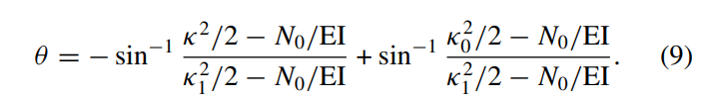
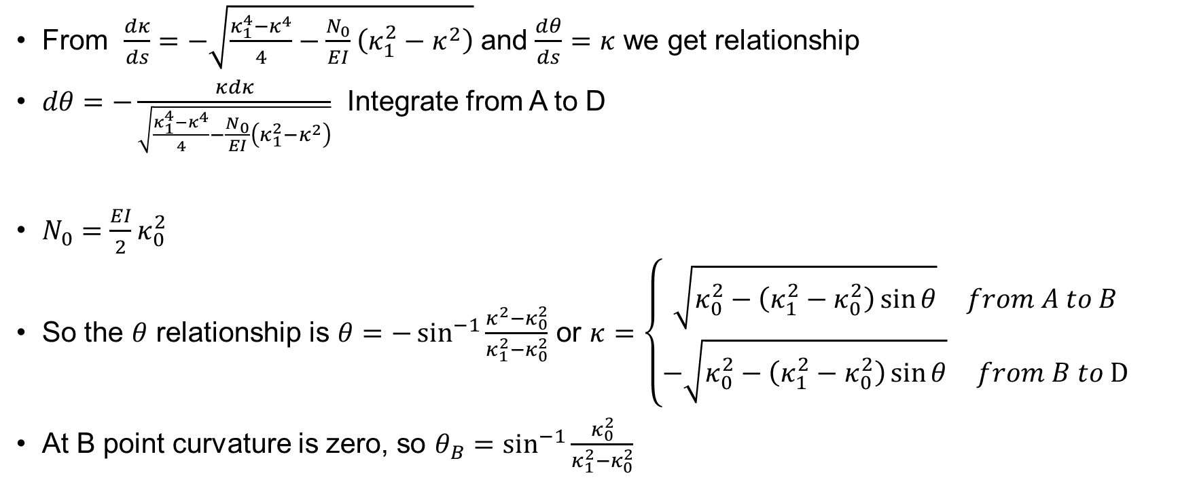
Integration
From $\frac{dκ}{ds}=−\sqrt{\frac{κ_{1}^{4}−κ^{4}}{4}−\frac{N_{0}}{EI}\left(κ_{1}^{2}−κ^{2}\right)}$ and $\frac{dθ}{ds}=κ$ we get relationship
$dθ=−\frac{κdκ}{\sqrt{\frac{κ_{1}^{4}−κ^{4}}{4}−\frac{N_{0}}{EI}\left(κ_{1}^{2}−κ^{2}\right)}}$ Integrate from A to D
$N_{0}=\frac{EI}{2}κ_{0}^{2}$
So the $θ$ relationship is $θ=−\sin^{−1}{\frac{κ^{2}−κ_{0}^{2}}{κ_{1}^{2}−κ_{0}^{2}}}$ or $κ=\left\{\begin{aligned}\sqrt{κ_{0}^{2}−\left(κ_{1}^{2}−κ_{0}^{2}\right)\sin{θ}} from A to B \\ −\sqrt{κ_{0}^{2}−\left(κ_{1}^{2}−κ_{0}^{2}\right)\sin{θ}} from B to D\end{aligned}\right.$
At B point curvature is zero, so $θ_{B}=\sin^{−1}{\frac{κ_{0}^{2}}{κ_{1}^{2}−κ_{0}^{2}}}$

Slide 9
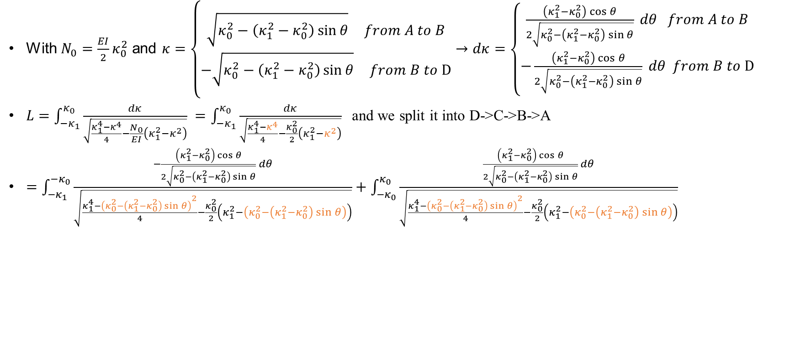
Simplify
With $N_{0}=\frac{EI}{2}κ_{0}^{2}$ and $κ=\left\{\begin{aligned}\sqrt{κ_{0}^{2}−\left(κ_{1}^{2}−κ_{0}^{2}\right)\sin{θ}} from A to B \\ −\sqrt{κ_{0}^{2}−\left(κ_{1}^{2}−κ_{0}^{2}\right)\sin{θ}} from B to D\end{aligned}→dκ=\left\{\begin{aligned}\frac{\left(κ_{1}^{2}−κ_{0}^{2}\right)\cos{θ}}{2\sqrt{κ_{0}^{2}−\left(κ_{1}^{2}−κ_{0}^{2}\right)\sin{θ}}} dθ from A to B \\ −\frac{\left(κ_{1}^{2}−κ_{0}^{2}\right)\cos{θ}}{2\sqrt{κ_{0}^{2}−\left(κ_{1}^{2}−κ_{0}^{2}\right)\sin{θ}}} dθ from B to D\end{aligned}\right.\right.$
$L=\int_{−κ_{1}}^{κ_{0}}{\frac{dκ}{\sqrt{\frac{κ_{1}^{4}−κ^{4}}{4}−\frac{N_{0}}{EI}\left(κ_{1}^{2}−κ^{2}\right)}}} =\int_{−κ_{1}}^{κ_{0}}{\frac{dκ}{\sqrt{\frac{κ_{1}^{4}−κ^{4}}{4}−\frac{κ_{0}^{2}}{2}\left(κ_{1}^{2}−κ^{2}\right)}}}$ and we split it into D->C->B->A
$=\int_{−κ_{1}}^{−κ_{0}}{\frac{−\frac{\left(κ_{1}^{2}−κ_{0}^{2}\right)\cos{θ}}{2\sqrt{κ_{0}^{2}−\left(κ_{1}^{2}−κ_{0}^{2}\right)\sin{θ}}} dθ}{\sqrt{\frac{κ_{1}^{4}−{\left(κ_{0}^{2}−\left(κ_{1}^{2}−κ_{0}^{2}\right)\sin{θ}\right)}^{2}}{4}−\frac{κ_{0}^{2}}{2}\left(κ_{1}^{2}−\left(κ_{0}^{2}−\left(κ_{1}^{2}−κ_{0}^{2}\right)\sin{θ}\right)\right)}}}+\int_{−κ_{0}}^{κ_{0}}{\frac{\frac{\left(κ_{1}^{2}−κ_{0}^{2}\right)\cos{θ}}{2\sqrt{κ_{0}^{2}−\left(κ_{1}^{2}−κ_{0}^{2}\right)\sin{θ}}} dθ}{\sqrt{\frac{κ_{1}^{4}−{\left(κ_{0}^{2}−\left(κ_{1}^{2}−κ_{0}^{2}\right)\sin{θ}\right)}^{2}}{4}−\frac{κ_{0}^{2}}{2}\left(κ_{1}^{2}−\left(κ_{0}^{2}−\left(κ_{1}^{2}−κ_{0}^{2}\right)\sin{θ}\right)\right)}}}$

Slide 10
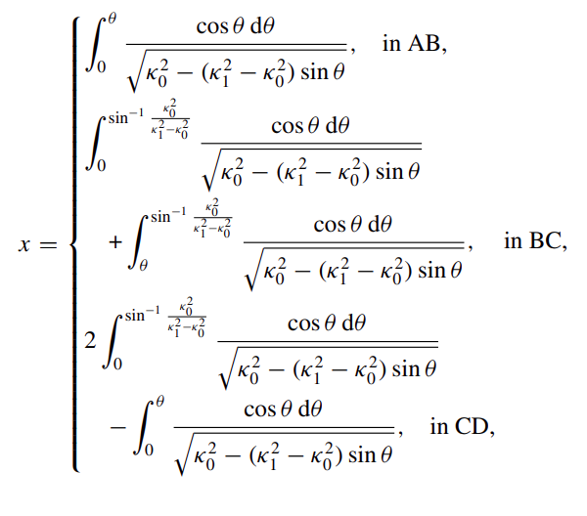
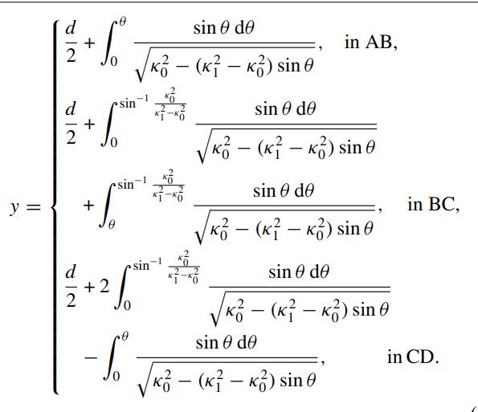

Computation
If $L$ and $d$ are given, we can compute $κ_{0}$ and $κ_{1}$ using numerical integration.
With similar ways we can express $x$ and $y$ as function of $θ$

Slide 11
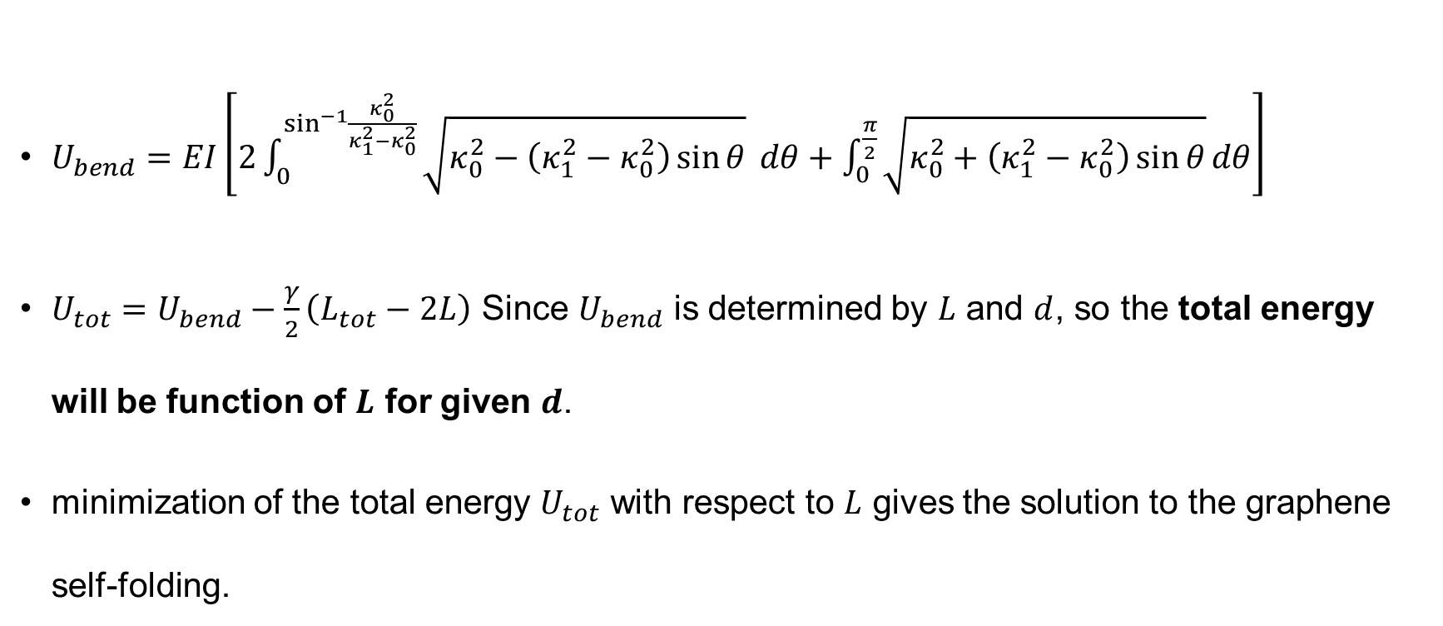
Energy
$U_{bend}=EI\left[2\int_{0}^{\sin^{−1}{\frac{κ_{0}^{2}}{κ_{1}^{2}−κ_{0}^{2}}}}{\sqrt{κ_{0}^{2}−\left(κ_{1}^{2}−κ_{0}^{2}\right)\sin{θ}}} dθ+\int_{0}^{\frac{π}{2}}{\sqrt{κ_{0}^{2}+\left(κ_{1}^{2}−κ_{0}^{2}\right)\sin{θ}}}dθ\right]$
$U_{tot}=U_{bend}−\frac{γ}{2}\left(L_{tot}−2L\right)$ Since $U_{bend}$ is determined by $L$ and $d$, so the total energy will be function of $L$ for given $d$.
minimization of the total energy $U_{tot}$ with respect to $L$ gives the solution to the graphene self-folding.

Slide 12
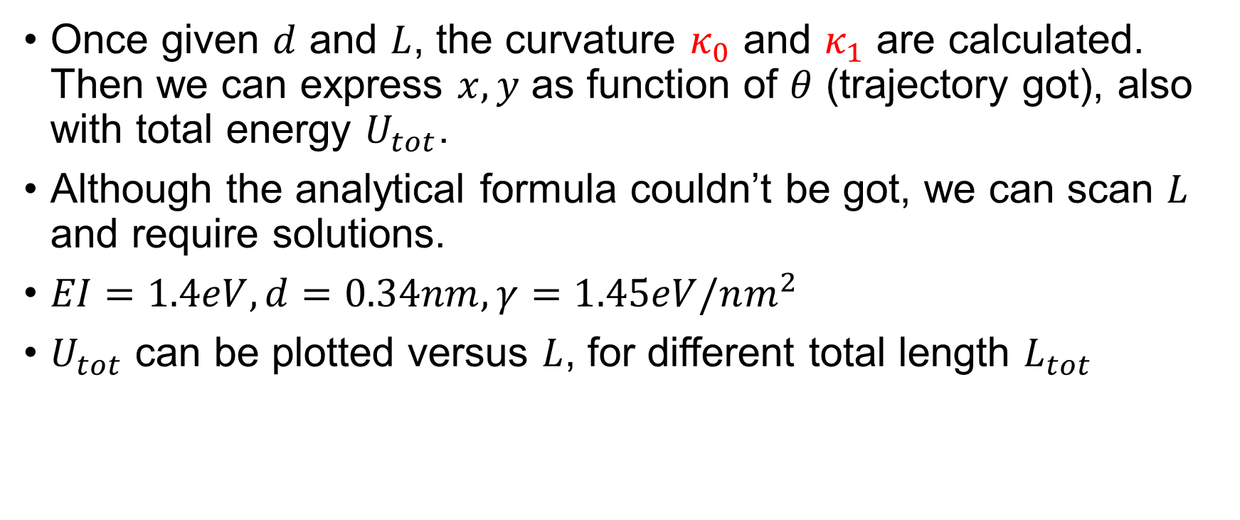
Summary
Once given $d$ and $L$, the curvature $κ_{0}$ and $κ_{1}$ are calculated. Then we can express $x,y$ as function of $θ$ (trajectory got), also with total energy $U_{tot}$.
Although the analytical formula couldn’t be got, we can scan $L$ and require solutions.
$EI=1.4eV,d=0.34nm,γ=1.45eV/nm^{2}$
$U_{tot}$ can be plotted versus $L$, for different total length $L_{tot}$

Slide 13
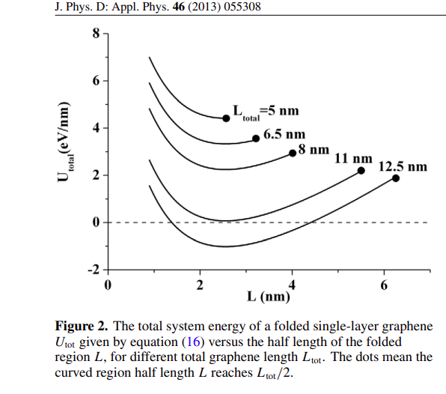
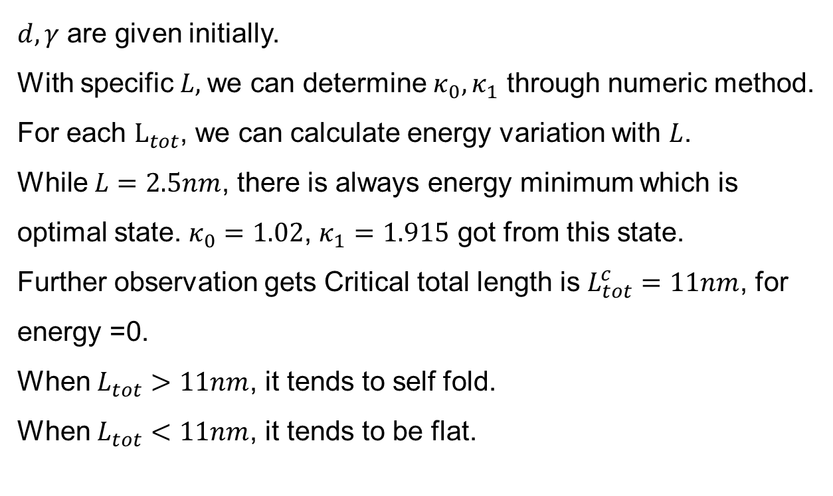
How to understand this chart
$d,γ$ are given initially.
With specific $L,$we can determine $κ_{0},κ_{1}$ through numeric method.
For each $L_{tot}$, we can calculate energy variation with $L$.
While $L=2.5nm$, there is always energy minimum which is optimal state.$κ_{0}=1.02$, $κ_{1}=1.915$ got from this state.
Further observation gets Critical total length is $L_{tot}^{c}=11nm$, for energy =0.
When $L_{tot}>11nm$, it tends to self fold.
When $L_{tot}<11nm$, it tends to be flat.

Slide 14
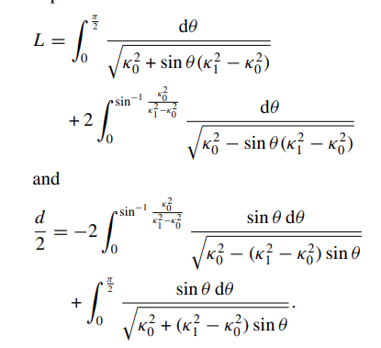
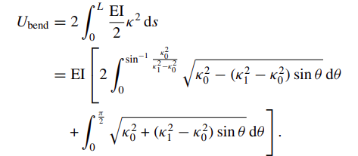

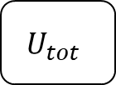
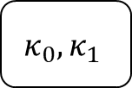
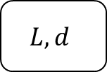
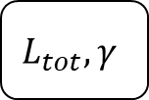

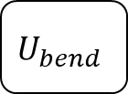
Process
$$x\left(θ\right),y\left(θ\right)$$
$$L,d$$
$$L_{tot},γ$$
$$κ_{0},κ_{1}$$
$$U_{bend}$$
$$U_{tot}$$

Slide 15
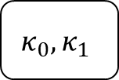
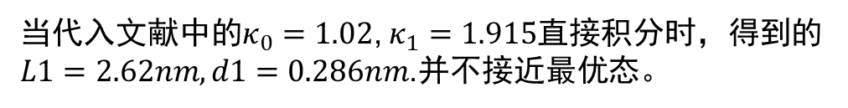

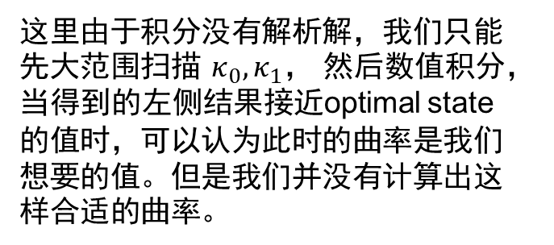

目前遇到的问题
Optimal state $d=0.34nm, L=2.5nm$
这里由于积分没有解析解，我们只能先大范围扫描$κ_{0},κ_{1}，$然后数值积分，当得到的左侧结果接近optimal state的值时，可以认为此时的曲率是我们想要的值。但是我们并没有计算出这样合适的曲率。
$$L,d$$
$$κ_{0},κ_{1}$$
当代入文献中的$κ_{0}=1.02$, $κ_{1}=1.915$直接积分时，得到的$L1=2.62nm,d1=0.286nm$.并不接近最优态。

Slide 16
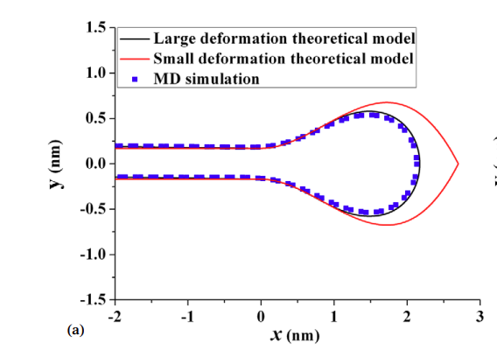

How to get profile
$x,y$ is function of $θ$ in our equations.
Once other parameters are given, we can use parametric equation to get relationship of $x,y$.

