Slide 1

TEAM MEMBERS
MEMBERS OF TEAM AURORA
TEAM AURORA
“None of us is as smart as all of us”
Gowtham.R- gowtham.raghavan@aspiresystems.biz
Manimaran.V – manimaran.venkat@aspiresystems.biz
Girishkumar .R– girish.ravi@aspiresystems.biz
Ponvizhi .U- ponvizhi.uday@aspiresystems.biz
Venkateshwaran.M – venkatesh.malai@aspiresystems.biz
Sandhya.S – sandhiya.sakthivel@aspiresystems.biz
Pooja.S – pooja.Sakthivel@aspiresystems.biz
Ranjith.R – Ranjith.ramasamy@aspiresystems.biz
Sriram.M– sriram.manis@aspiresystems.biz
Mohammed Irfan.S - irfan.sadiq@aspiresystems.biz
DATA MODEL FOR IRCTC

Slide 2
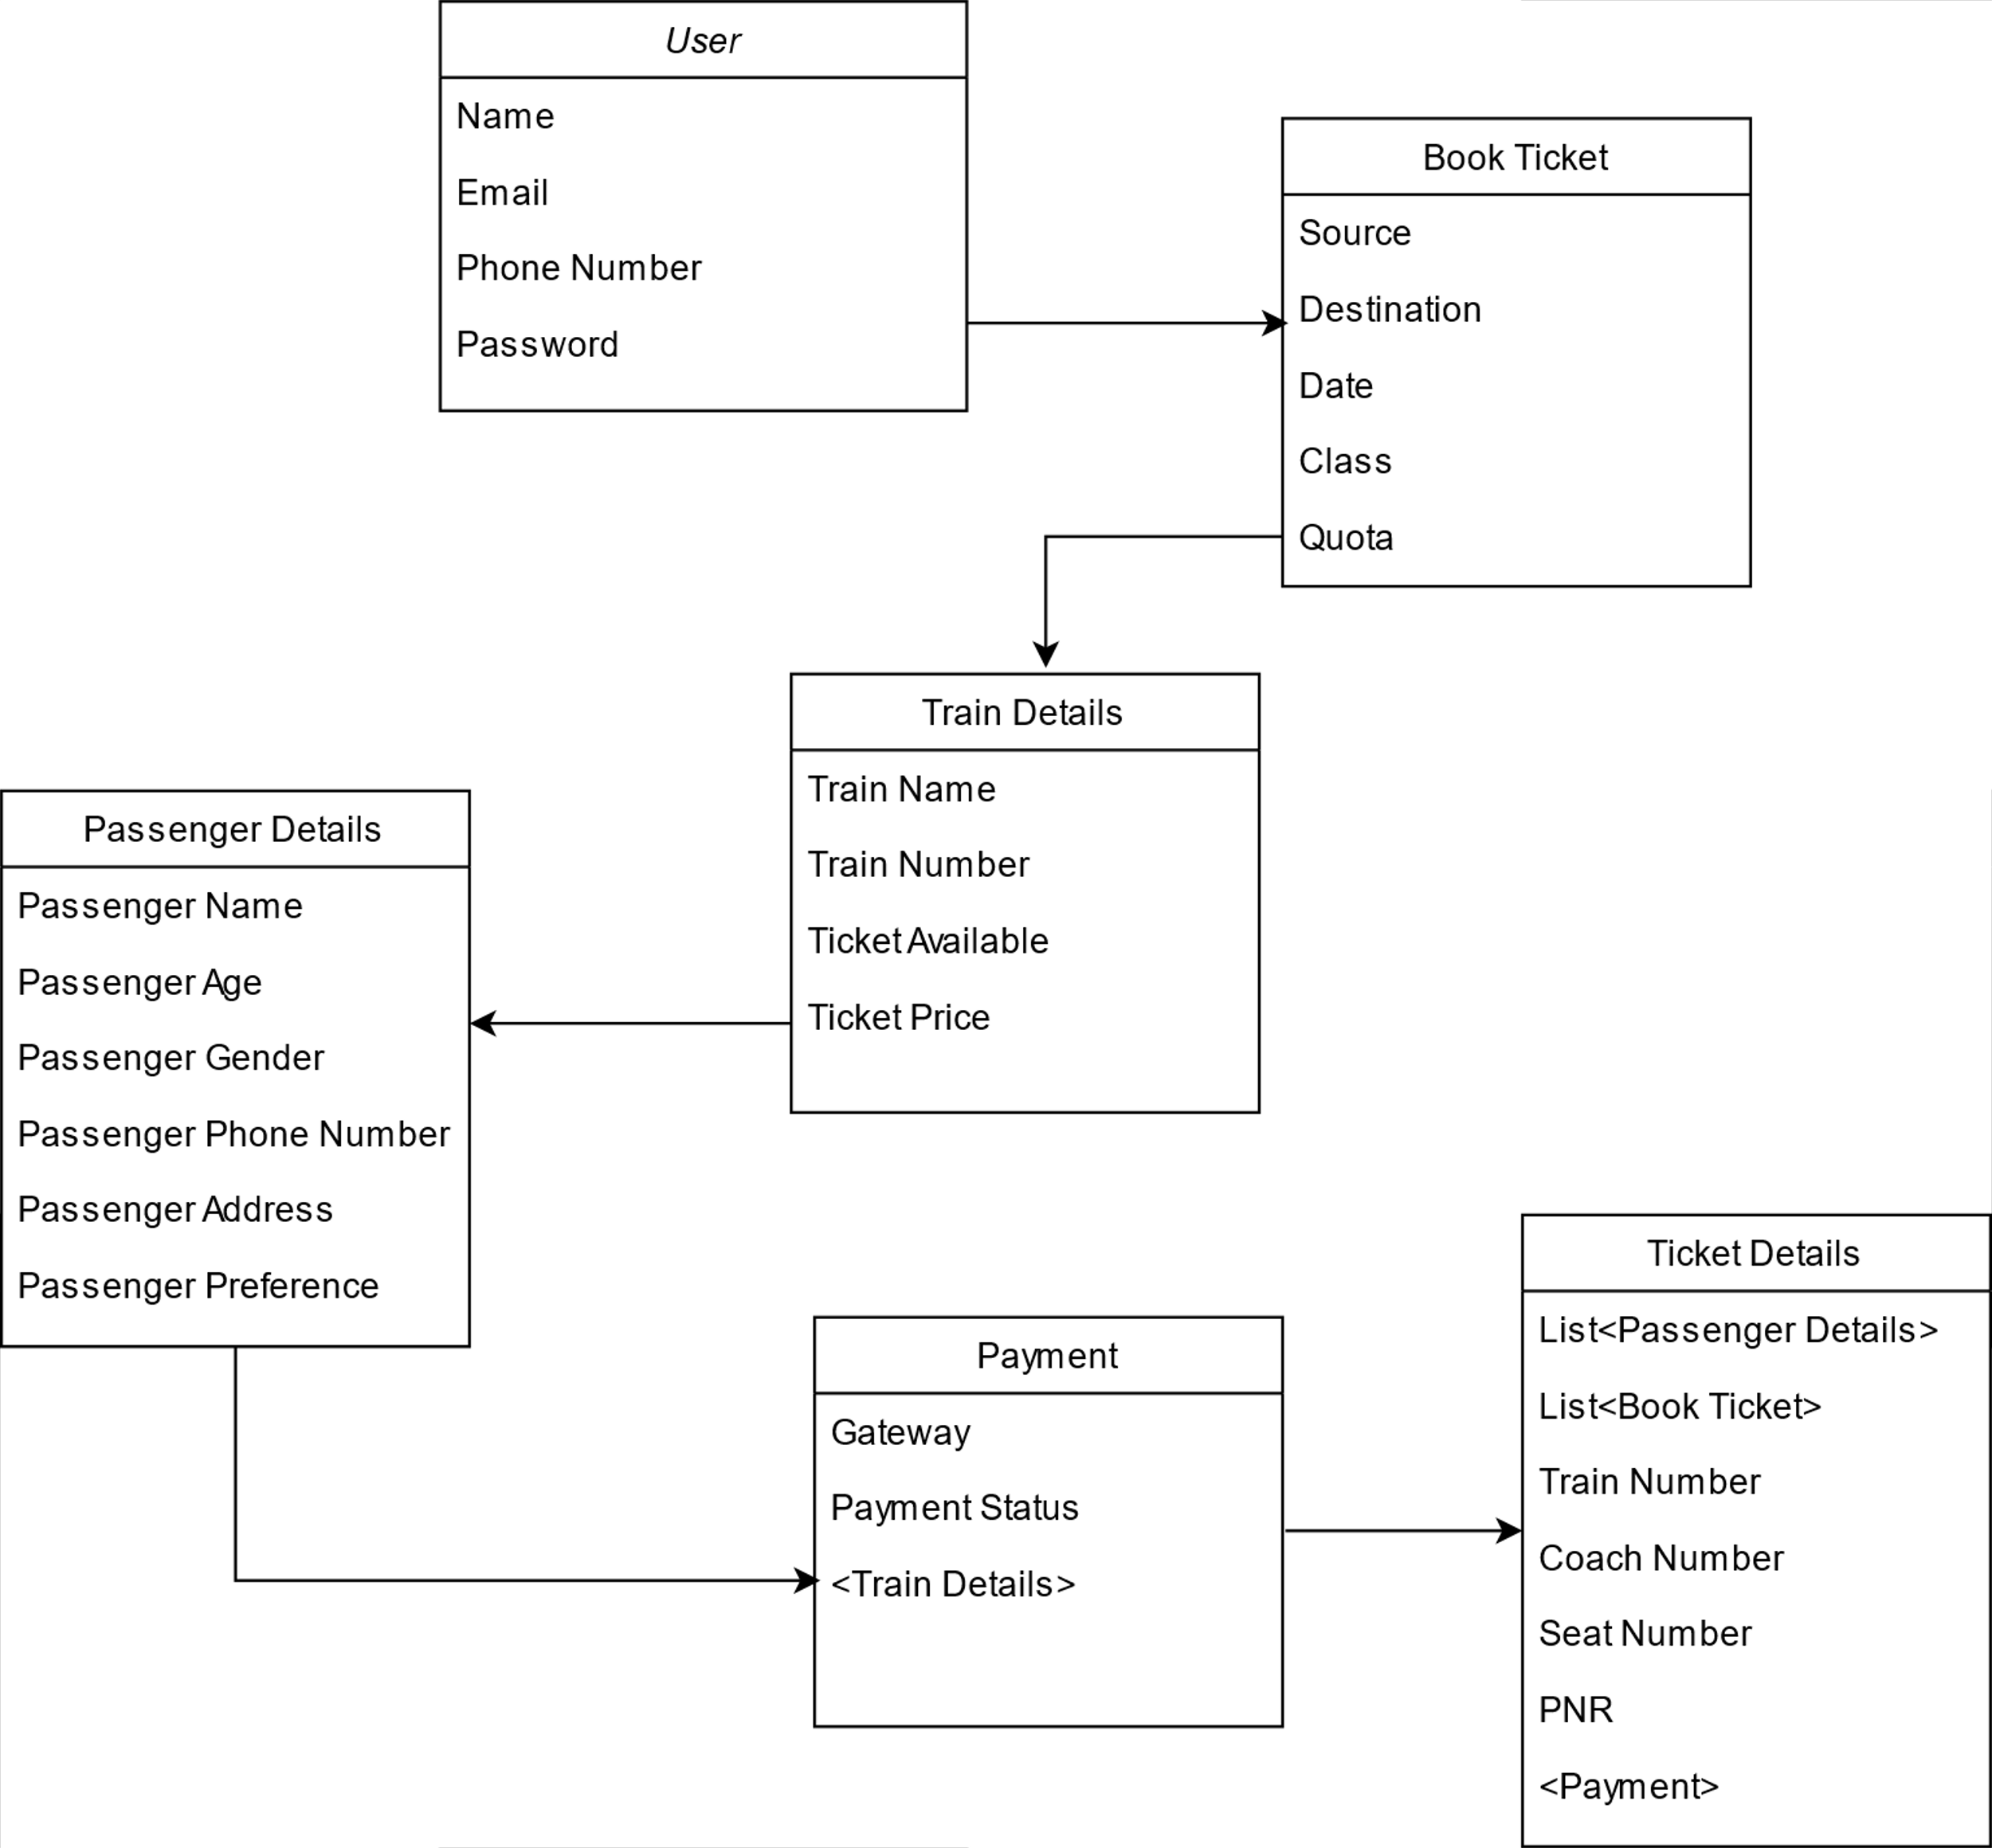

Slide 3
1
1
1
1
Book Ticket
USER
Book Ticket
USER
1
M
USER
Passenger Details
1
1
USER
Payment
1
1
USER
Ticket Details
1
M
Book Ticket
Train Details
1
M
Book Ticket
Passenger Details

Slide 4
1
1
1
1
Ticket Details
Book Ticket
1
M
Train Details
Passenger Details
1
1
Train Details
Payment
1
1
Train Details
Ticket Details
M
1
Passenger Details
Ticket Details
1
1
Payment
Ticket Details

Slide 5
