Slide 1


Introduction to Web Services
day month 2019
Vrijdag 13 april 2018
Alekhya Thumati
Richard van Emmerik

Slide 2


Introduction to Web Services 1/2
Who was first?
What are Web Services?
How do Web Services work?
Why Web Services?
Web Services Architecture

Slide 3
Introduction to Web Services 2/3
SOAP
WSDL
REST
Why REST?
How RESTful Services work

Slide 4
Introduction to Web Services 3/-
REST Architecture
REST Webservice
REST Methods
REST Frameworks
References
Questions

Slide 5

Who was first?
What company first proposed the web services concept?
Hewlett-Packard's e-Speak in 1999 was an enabler for e-services
Microsoft introduced the name "web services" in June 2000
MS "bet the company" on its web services strategy now every major vendor is a player

Slide 6

What are Web Services?
Web services are a standardized medium to propagate communication between the client and server applications on the World Wide Web.
Type of Web Services
SOAP web services
RESTful web services

Slide 7
How do webservices work?
A web service enables communication among various applications by using open standards such as HTML, XML, WSDL, and SOAP. Type of Web Services
A web service takes the help of
XML to tag the data
SOAP to transfer a message
WSDL to describe the availability of service

Slide 8
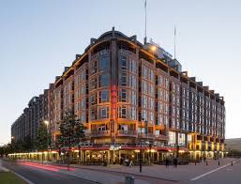
Why Web Services?
Exposing the Existing Function on the network - Web services allow you to expose the functionality of your existing code over the network using HTTP requests. Once it is exposed on the network, other applications can use the functionality of your program.
Interoperability - Web services allow various applications to talk to each other and share data and services among themselves Web services are used to make the application platform and technology independent.
Standardized Protocol- Web services use standardized industry standard protocol for the communication. standardization of protocol stack gives the business many advantages such as a wide range of choices, reduction in the cost due to competition, and increase in the quality.
Low Cost Communication - Web services use SOAP over HTTP protocol, so you can use your existing low-cost internet for implementing web services

Slide 9
Web Service Architecture 1/2
There are two ways to view the web service architecture
The first is to examine the individual roles of each web service actor
The second is to examine the emerging web service protocol stack

Slide 10
Web Service Architecture 2/3
Web Service Roles : There are three major roles within the web service architecture The first is to examine the individual roles of each web service actor.
Service Provider: Service provider is responsible for creating the web service and making it accessible to the client applications over the internet.
Service Requestor: Service requestor is basically any client application which is accessing the web service.
Service Registry: Service registry is act as the centralized directory for the web services which helps to find web services for client applications.

Slide 11
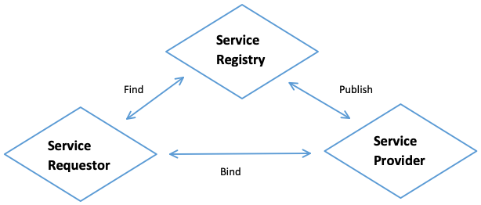
Web Service Architecture 3/4

Slide 12
Web Service Architecture 4/5
Web Service Protocol Stack
A second option for viewing the web service architecture is to examine the emerging web service protocol stack. The stack is still evolving, but currently has four main layers.
(Service)Transport Protocol: responsible for transporting messages between network applications
(XML) Messaging Protocol: responsible for encoding messages in a common XML format so that they can be understood at either end of a network connection
(Service) Description Protocol: used for describing the public interface to a specific Web service. The WSDL interface format is typically used for this purpose
(Service) Discovery Protocol: centralizes services into a common registry so that network Web services can publish their location and description, and makes it easy to discover what services are available on the network

Slide 13
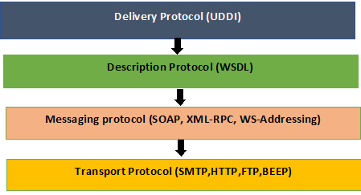
Web Service Architecture 5/-

Slide 14
SOAP
SOAP-simple object access protocol
Soap can interact with any other programming language
its a xml based protocol for accessing WebServices over internet
SOAP message has three parts
envelope – wraps entire message and contains header and body
header – optional element with additional info such as security or routing
body – application-specific data being communicated

Slide 15
SOAP
Advantages
Security
Language platform independent
Disadvantages
slow because of xml (xml has many standards)
supports only wsdl (not json ,cookies)

Slide 16

WSDL (WebServices Description language) 1/2
The XML Like web service description (remember slide 7…)
WSDL is meant to be read by applications
Ex: http://webservices.oorsprong.org/websamples.countryinfo/CountryInfoService.wso?WSDL

Slide 17
WSDL (WebServices Description language) 2/2
Soap Message :
<soapenv:Envelope xmlns:soapenv="http://schemas.xmlsoap.org/soap/envelope/" xmlns:web="http://www.oorsprong.org/websamples.countryinfo">
<soapenv:Header/>
<soapenv:Body>
<web:CapitalCity>
<web:sCountryISOCode>?</web:sCountryISOCode>
</web:CapitalCity>
</soapenv:Body></soapenv:Envelope>

Slide 18
REST 1/2
REST is an architecture of networked system .REST is an acronym stands for Representational state transfer
RESTful web services are light weight, highly scalable and maintainable and are very commonly used to create APIs for web-based applications
In a REST based architecture everything is a Resource. A resource is accessed via common interface based on the HTTP standard methods

Slide 19
REST 2/-
Representation of Resources
A resource in REST is a similar Object in Object Oriented Programming or is like an Entity in a Database.Resource can be represented as XML,JSON,XHTML,CSV
Ex: resource as JSON format
{
“id” :1,
“name” : ”ram”,
“designation”: “TL” }

Slide 20
Why REST? 1/2
Performance should be good
Scalable
Easy to build and maintain
Monitoring should be easy
Reliable
Easy to use and test

Slide 21
Why REST? 2/-
Rest imposes certain constraints to achieve above characteristics:
Uniform Interface
Addressable
Connectedness
Stateless
Cacheable

Slide 22
How RESTful Services work
In webservice world most of the operations fall under 4 types Http protocol methods:
Create --methods with POST
Return – methods with GET
Update – methods with PUT
Delete – methods with DELETE

Slide 23
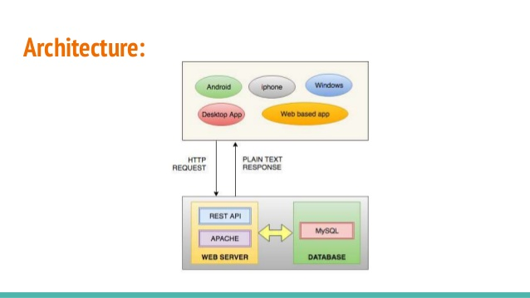
REST Architecture

Slide 24
REST Webservices
Statelessness:
No State can be stored on the server
Every HTTP request executes in complete isolation to the server
Simpler to design and evolve
Easier to use
Avoid using Http sessions and cookies

Slide 25
REST Methods
GET retrieving data from server
POST whenever we want to add new data
PUT whenever we want to UPDATE data
DELETE whenever we want to DELETE data
Response codes:
1xx -means 100 to 199
1xx- information based
2xx--Success
3xx- Redirection
4xx-Client error
5xx-Server error

Slide 26
REST Frameworks
Restlet(java)
Rest-open-uri(ruby on rails)
System.web.HTTPweb requests(.net)
Django(python)

Slide 27
References
https://github.com/typicode/json-server#install
Start JSON Server
json-server --watch db.json
Resources
http://localhost:3000/posts

Slide 28

Questions?

