Slide 1
Sales Analytics & ML Insights
Dataset: sales.csv | Records: 2823 | Columns: 29 | Generated: 2025-08-28 15:58

Slide 2
Dataset Overview
Rows: 2,823, Columns: 29
Numeric columns: 9 | Categorical: 15 | Datetime: 1
Top missing value rates: ORDERDATE: 81.0%

Slide 3
EDA Highlights
SALES != QUANTITY*PRICE in most rows (mean abs diff ≈ $1,060; exact match in 12.5% rows) — suggests discounts/taxes/shipping.
Sales outliers: 35.4% beyond IQR fences (upper≈$4,225).
Top Product Lines by revenue: Classic Cars ($9,675,244), Vintage Cars ($864,215), Motorcycles ($571,524)
Top Countries by revenue: USA ($9,323,255), France ($452,241), Spain ($394,806), Australia ($302,881), Italy ($171,408)
Peak month: NaT with total sales $9,650,465.
Deal size composition: Medium: 2405 (85.2%), Small: 310 (11.0%), Large: 108 (3.8%)

Slide 4
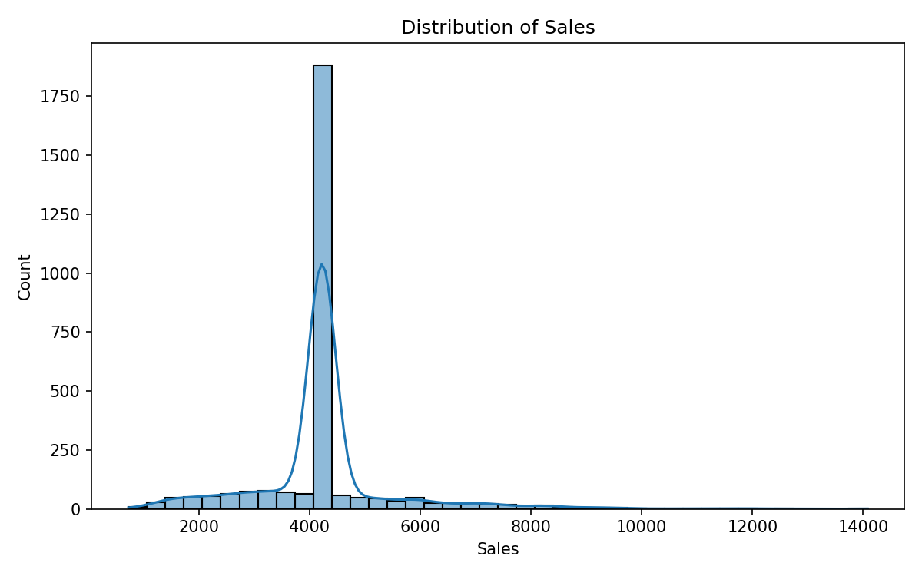
Distribution of Sales
Sales are right-skewed; long tail indicates presence of large orders.

Slide 5
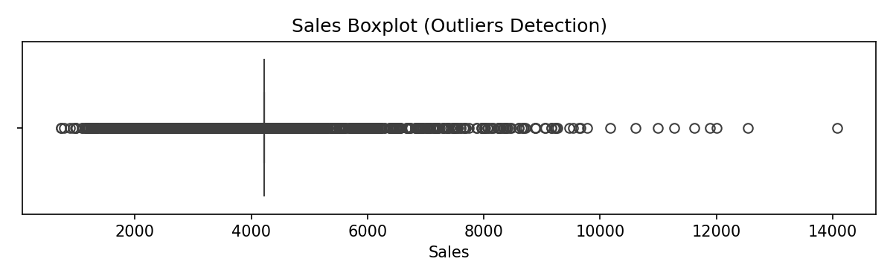
Sales Boxplot
Boxplot highlights outliers; consider robust metrics and caps for modeling.

Slide 6
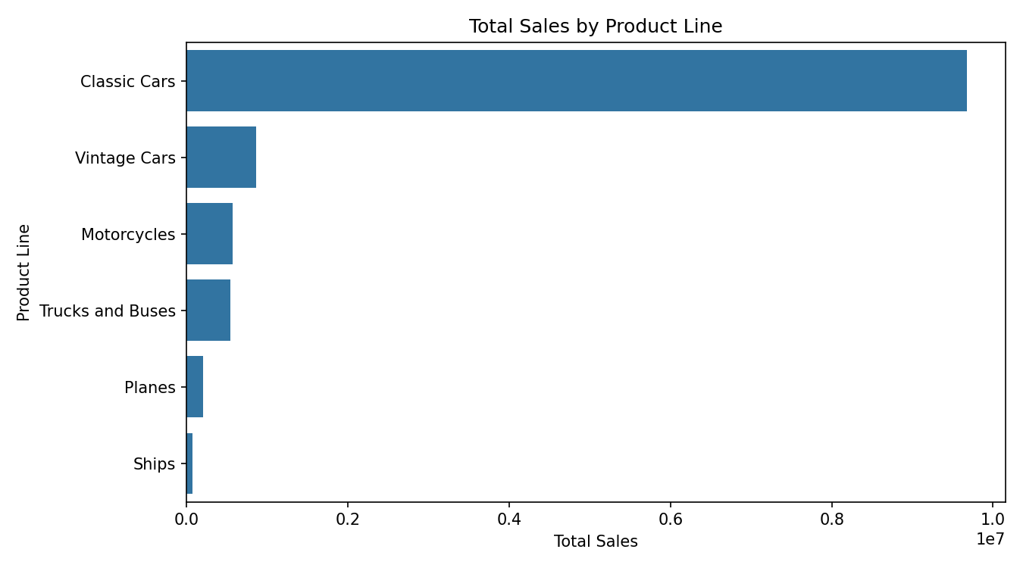
Sales by Product Line
Identifies top revenue-driving product categories.

Slide 7
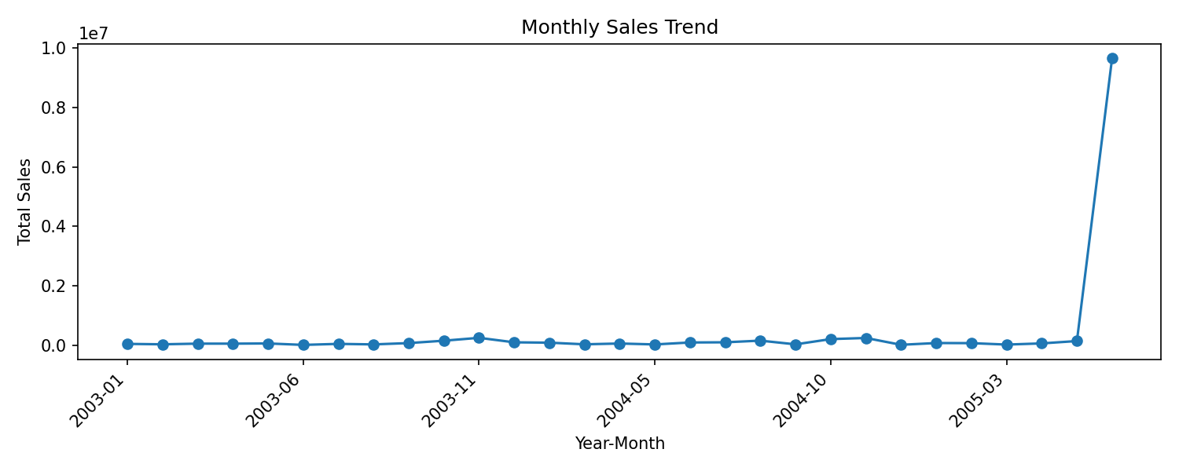
Monthly Sales Trend
Trend and seasonality insights for demand planning.

Slide 8
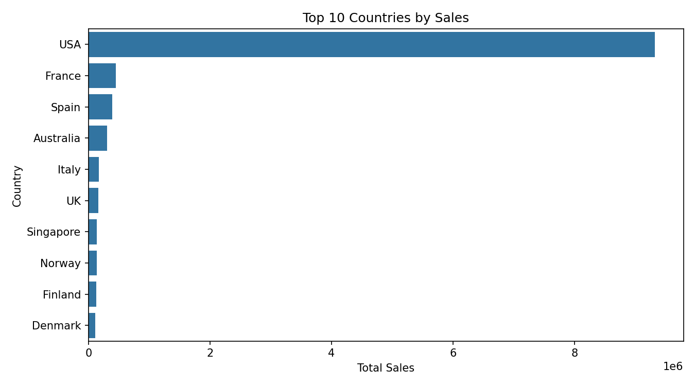
Top 10 Countries by Sales
Geographic revenue concentration across markets.

Slide 9
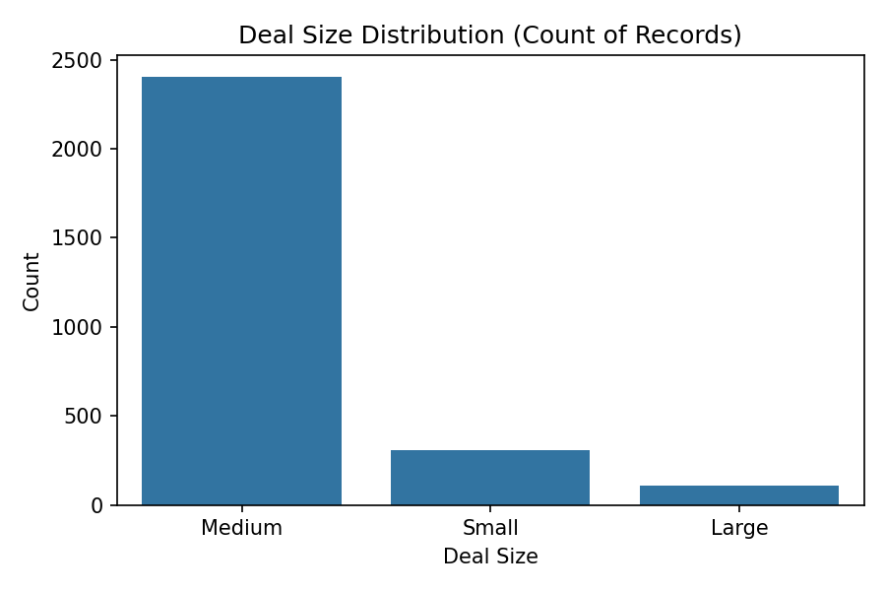
Deal Size Distribution
Class balance and volume by deal size.

Slide 10
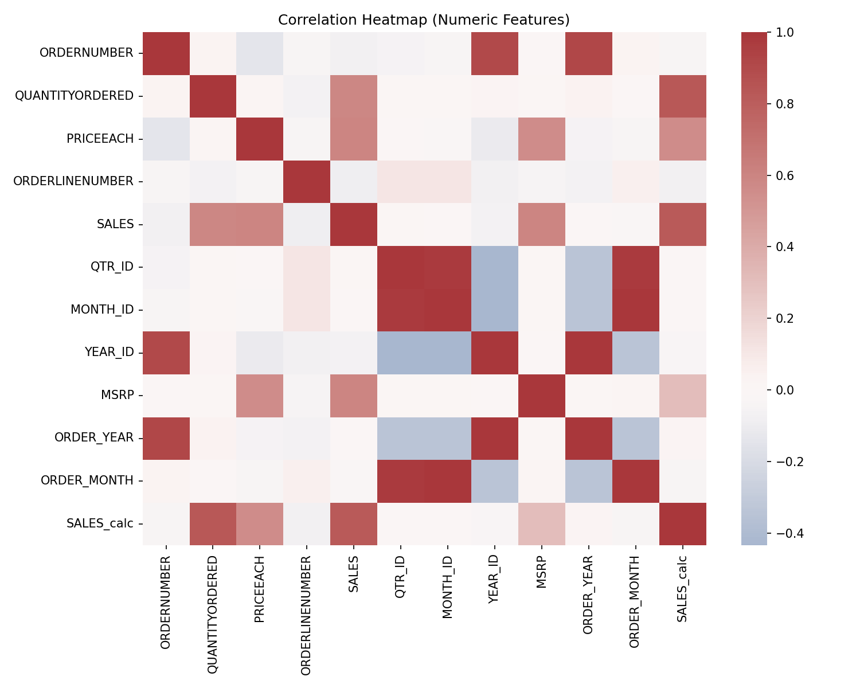
Correlation Heatmap
Relationships among numeric features to guide modeling.

Slide 11
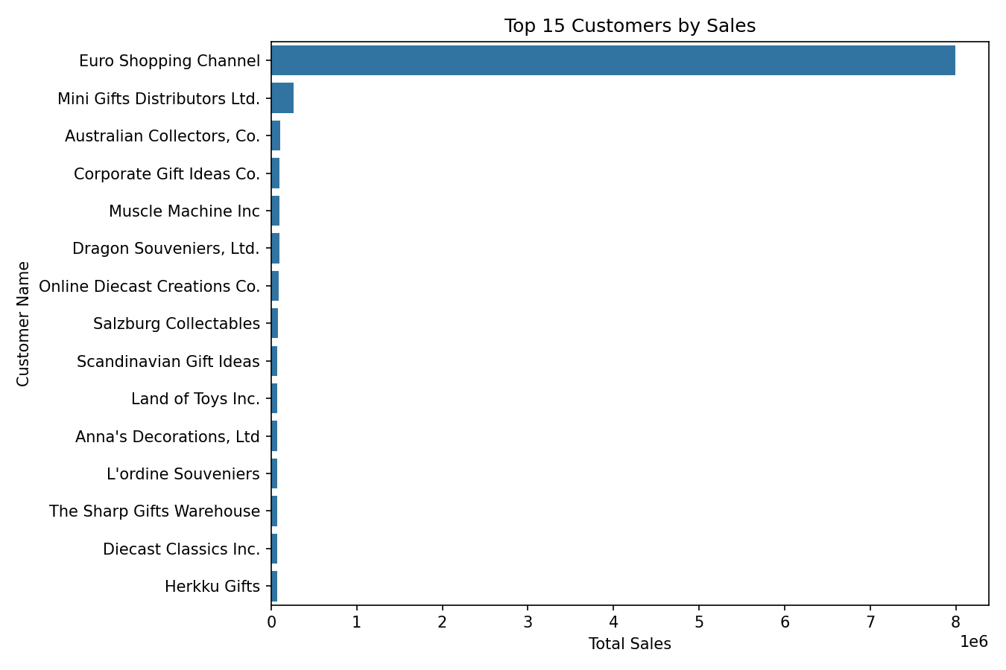
Top 15 Customers by Sales
Key accounts contributing the most revenue.

Slide 12
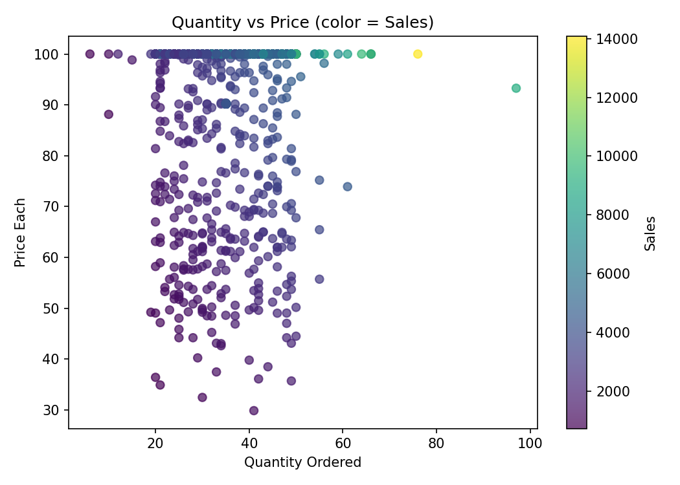
Quantity vs Price (colored by Sales)
Nonlinear interaction between quantity, price, and realized sales.

Slide 13
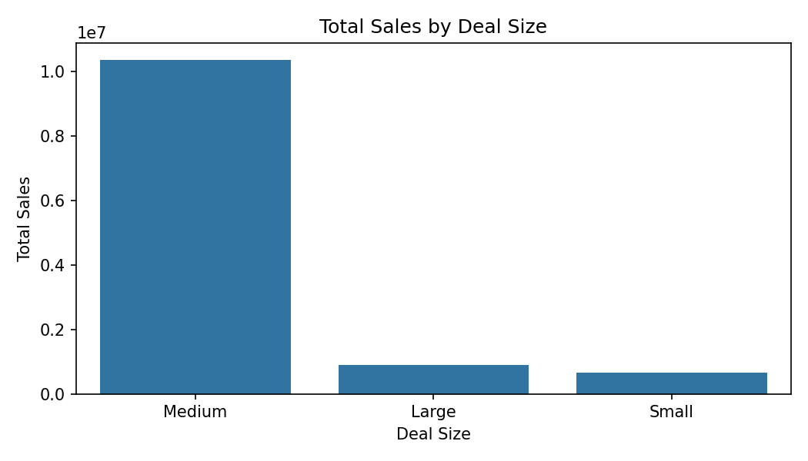
Total Sales by Deal Size
Revenue contribution by deal size tier.

Slide 14
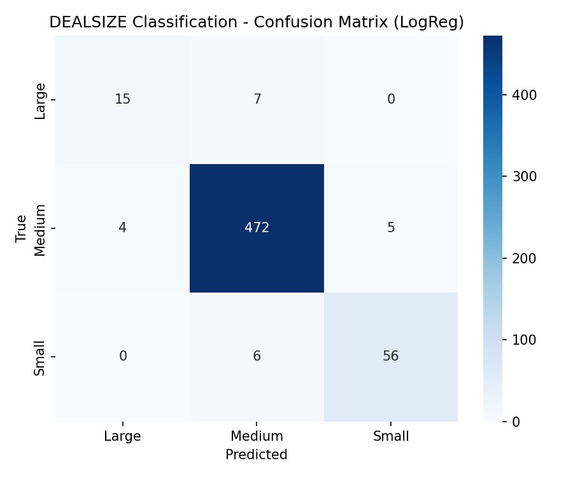
DEALSIZE Classification: Confusion Matrix
Model performance across classes; off-diagonals indicate misclassifications.

Slide 15
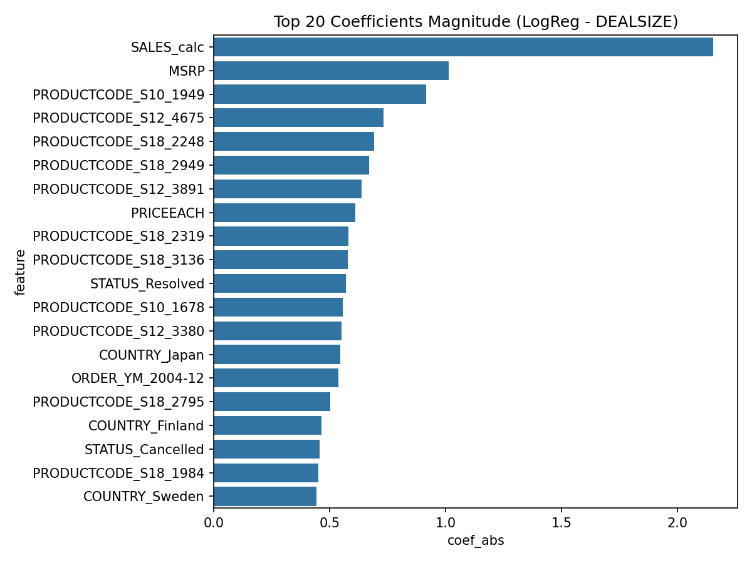
DEALSIZE Feature Importance
Most influential features for predicting deal size.

Slide 16
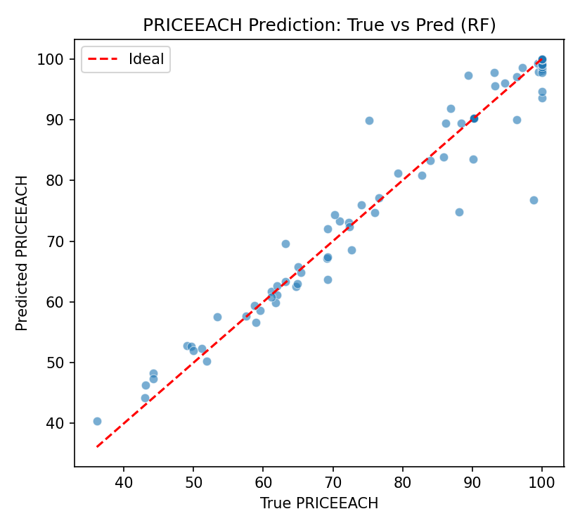
PRICEEACH: True vs Predicted
Fit quality for price prediction; points near diagonal are better.

Slide 17
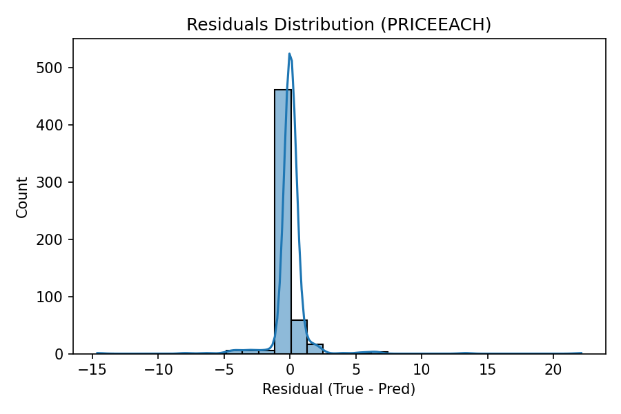
PRICEEACH Residuals
Error distribution; check bias and heteroscedasticity.

Slide 18
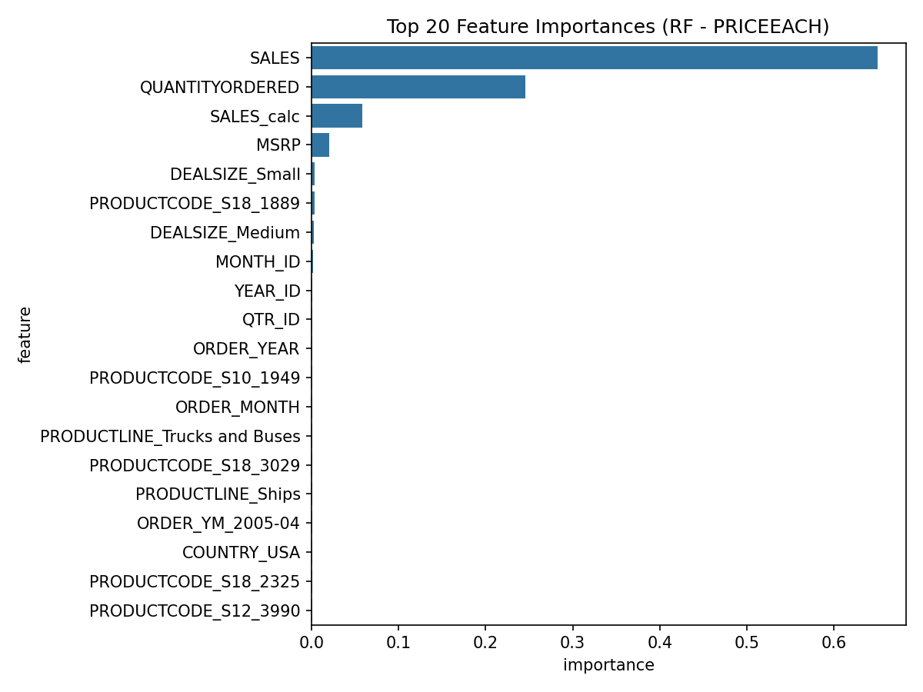
PRICEEACH Feature Importance
Key drivers impacting price prediction.

Slide 19
ML Results Summary
DEALSIZE classification best model: LogReg
Accuracy: 0.961 | Macro F1: 0.873
PRICEEACH regression best model: RF
R²: 0.971 | RMSE: 1.610

Slide 20
Key Insights
Focus on top product lines: Classic Cars, Vintage Cars, Motorcycles — they drive the majority of revenue.
Geographic concentration: USA, France, Spain, Australia, Italy dominate revenues; consider regional strategies.
Deal size distribution is dominated by 'Medium'; tailor promotions accordingly.
Seasonality detected with peak in NaT; align inventory and campaigns ahead of peak.
Reported SALES includes adjustments beyond QUANTITY*PRICE (discounts, tax, or shipping). Model and forecast on SALES directly.

Slide 21
Recommendations
Prioritize high-performing product lines and top countries with targeted campaigns.
Use SALES directly for forecasting given adjustments beyond QUANTITY*PRICE.
Handle outliers via winsorization or robust models to improve stability.
Balance deal-size classes (e.g., class weights) to improve classification performance.
Leverage monthly seasonality: ramp up inventory and marketing prior to peak months.

