Slide 1
Amazon Product & Review EDA with ML
Automated Data Science Insights for E-Commerce
Data from amazon.csv
By: Spark-Insights

Slide 2
Dataset Overview
Rows: 1,465
Columns: 16
Major columns: Product, Price, Discount, Category, Ratings, Review
No missing values
Dominant categories: Electronics, Computers, Home & Kitchen

Slide 3
Key Statistics
Discounted Price (mean): ₹3,125
Discounted Price (median): ₹799
Actual Price (mean): ₹5,445
Discount % (mean): 47.7%
Rating (mean): 4.10
Rating Count (median): 5,179

Slide 4
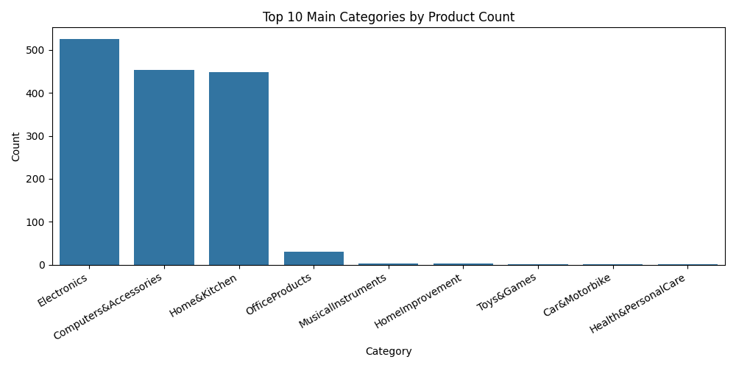
Top 10 Main Categories by Product Count

Slide 5
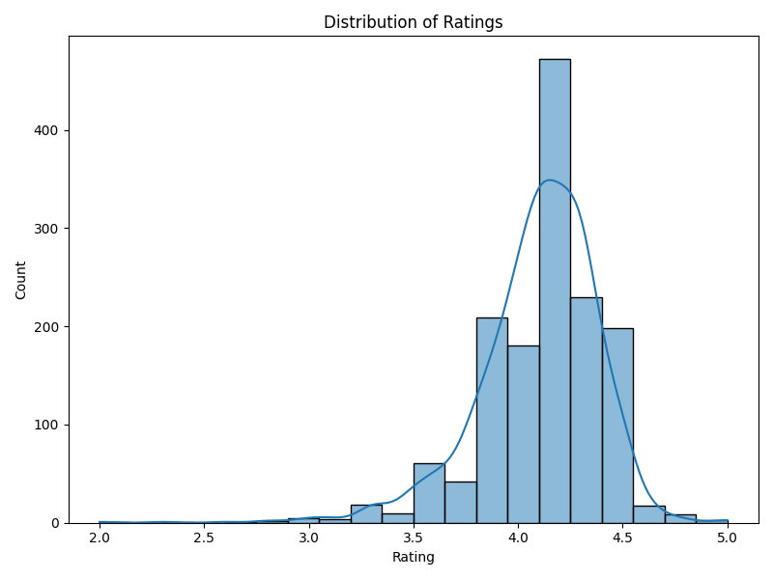
Distribution of Ratings

Slide 6
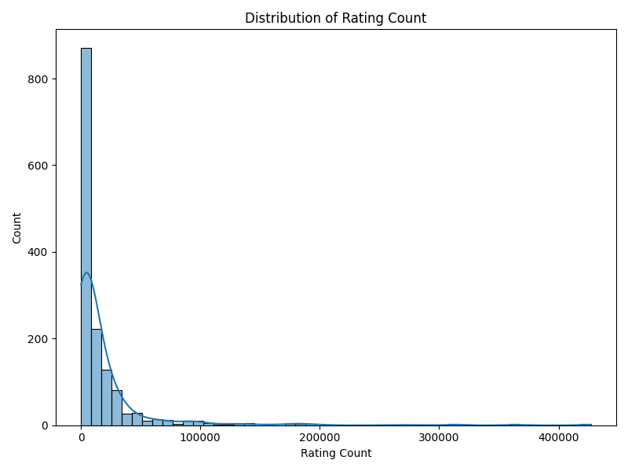
Distribution of Rating Counts

Slide 7
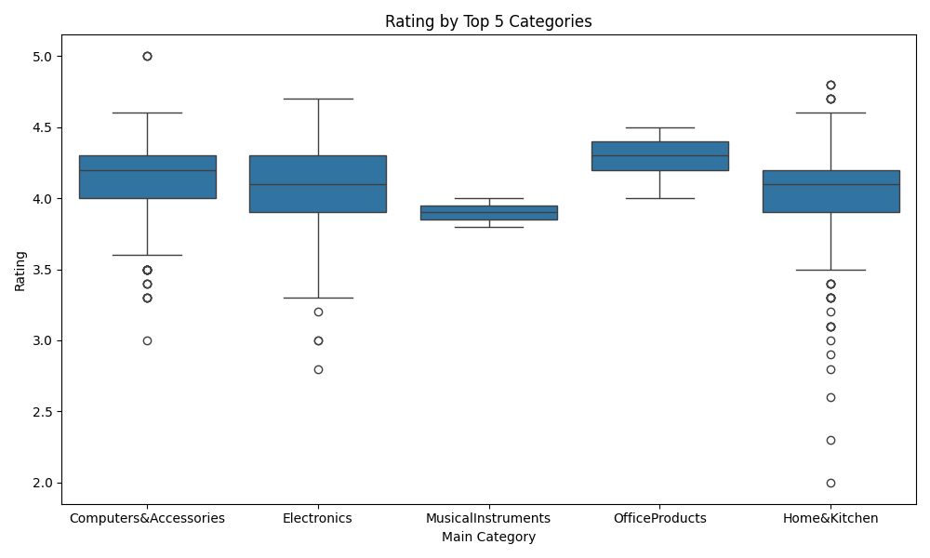
Rating by Top 5 Categories

Slide 8
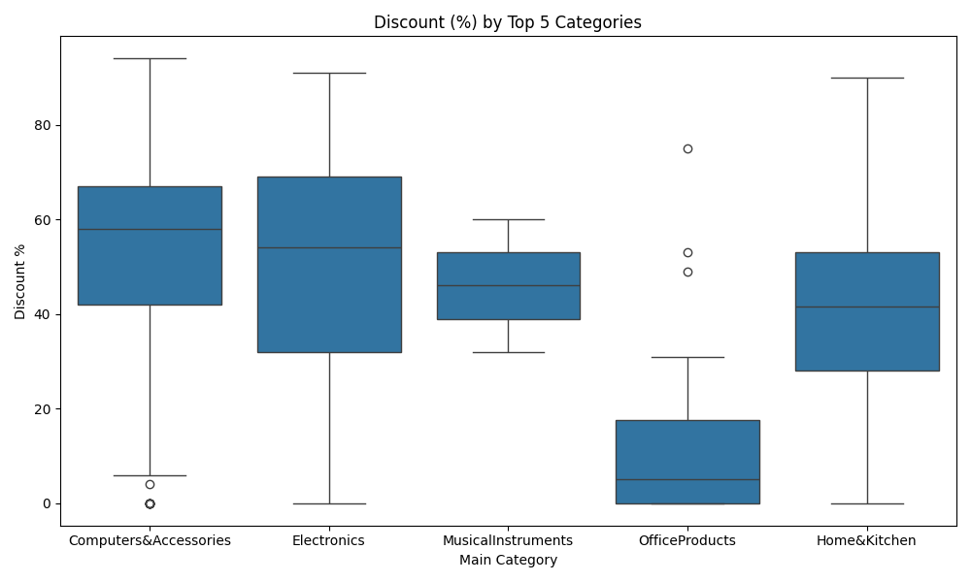
Discount (%) by Top 5 Categories

Slide 9
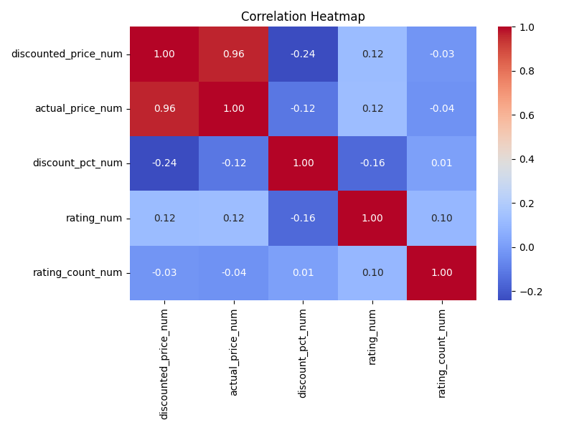
Correlation Heatmap of Key Variables

Slide 10
ML Model: Predicting Discounted Price
Random Forest Regression Model
Performance Metrics:
R2: High: Shows strong prediction based on product features.
MAE: Low: Model predictions are close to actual prices.
RMSE: Low: Indicates few significant outliers.
Top Feature Importances:
- actual_price_num (very important)
- discount_pct_num (high effect)
- main_category (differs by category)
- rating_num and rating_count_num (minor influence)

Slide 11
Key Insights
- Most listed products are in Electronics, Computers & Accessories, and Home & Kitchen.
- Product discounts are steep: median discount is 50%.
- Customer ratings are very positive overall (median 4.1).
- Discounted price is strongly predicted by actual price and discount percent.
- Product category has notable effects on price and discount structure.

Slide 12
Actionable Recommendations
- Promote products in Electronics and Home categories with highest positive sentiment.
- Consider price optimization strategies around 50% discount band for best sales volume.
- Monitor outlier products (very high or low discounted price/ratings).
- Further explore bundles or upsells using top rated and high-discount products.

