Slide 1
THE FLAGSHIP MIC HACKATHON OF TECHNOVIT
IDEA SUBMISSION — TEMPLATE
01
RECURSION
EDITION II
to understand recursion, first understand recursion
PROJECT TITLE
TEAM
DRISHTI - Local AI Safety Assistance for Indoor Hall Mobility
62 - Hallucinators
ONE-LINE PITCH
Madhav Khurana - AI/ML
A local indoor safety assistant with live guidance, on-demand OCR/VLM, and hall hazard intelligence.
Yash Raj - Backend
Aryan Raj - Frontend
TRACK
full contact sheet → frame 09
Smart Living - PS1
FRAME 01 / 09
Notes:
Cover: fill TRACK, PROJECT TITLE, ONE-LINE PITCH and TEAM names. Phone & email for each member goes on the last slide, frame 09. Keep layout, colours & logos as-is. RECURSION is TechnoVIT's flagship hackathon.

Slide 2
RECURSION - EDITION II
02
PROBLEM DEFINITION
answer in 2–3 lines · readable outside your track
01
WHO & HOW OFTEN
02
TODAY'S WORKAROUND
Students, staff & visitors with low vision or mobility challenges, plus anyone momentarily distracted - every time they navigate an unfamiliar indoor corridor, stairwell, or crowded common area.
A white cane, guide dog, or sighted companion - or an ad-hoc phone call/in-person report to facilities after a hazard is already spotted.
03
WHY IT FALLS SHORT
04
EVIDENCE
None of these share real-time evidence with anyone else, so verifying and fixing a hazard still depends on someone finding the right person to tell.
MIC VIT Chennai's own PS1 brief names delayed hazard detection, weak sensor-to-response communication, and manual safety intervention as open problems in IoT & Smart Living.
TECHNOVIT'S FLAGSHIP HACKATHON
FRAME 02 / 09
Notes:
Answer each question in 2–3 plain lines. Someone outside your track should understand every answer.

Slide 3
RECURSION — EDITION II
03
PROPOSED SOLUTION
name it plainly · connect straight back to frame 02
PRODUCT / SYSTEM NAME
01
WHAT A USER DOES
DRISHTI
Points the phone camera at the walking area; DRISHTI speaks/vibrates a cautious action (CAUTION, MOVE_LEFT, MOVE_RIGHT, STOP, PAUSE_UNCLEAR). The user can also tap to report a confirmed hazard or read visible text on demand.
02
WHY IT BEATS THE WORKAROUND
A phone-camera safety assistant: local edge AI turns a live hall view into cautious walking guidance, on-demand OCR/VLM answers, and recurring hazard intelligence.
Runs entirely on a local laptop over private Wi-Fi, so Walk Mode stays independent; the dashboard is optional local hall intelligence, not an approval gate for guidance.
03
WHAT'S GENUINELY DIFFERENT
Weak or contradictory evidence returns PAUSE_UNCLEAR instead of a guess - DRISHTI pairs personal mobility assistance with an operational verify-assign-resolve hazard workflow.
TECHNOVIT'S FLAGSHIP HACKATHON
FRAME 03 / 09
Notes:
Name the product plainly. The three answers should connect directly back to the problems on frame 02.

Slide 4
RECURSION — EDITION II
04
SYSTEM ARCHITECTURE
walk the full flow · name real services & models
FIG. 04-A — SYSTEM FLOW
PHONE CAMERA
EXPO TEST HARNESS
FASTAPI + SQLITE + VLM (LOCAL)
YOLO11n + SEGFORMER-B0 (RTX 4060, LOCAL)
GUIDANCE + HALL DASHBOARD
All boxes above run on the team's laptop over a private Wi-Fi LAN - no cloud round-trip at runtime.
01
KEY TECHNICAL DECISION
02
HARDEST PART TO BUILD
03
HOW YOU KNOW IT WORKS
YOLO11n detects indoor obstacles while SegFormer-B0 reads walkable surface and walls. A deterministic risk engine governs Walk Mode; the local VLM answers only explicit Explore requests.
Keeping Walk Mode stable on a live phone feed - session-scoped tracking, corridor occupancy, persistence, hysteresis, and cooldowns stop a single noisy frame from flipping the guidance action.
128 backend automated tests, 34 Expo-harness tests and 3 dashboard tests validate the local detector, segmentation, OCR, VLM and hall analytics pipeline on the team's RTX 4060.
TECHNOVIT'S FLAGSHIP HACKATHON
FRAME 04 / 09
Notes:
Replace the placeholder flow with your real architecture diagram. Name real services and models, then answer the three questions.

Slide 5
RECURSION — EDITION II
05
FEASIBILITY & SCOPE
a working slice with a known limit beats an over-promised demo
01
SCOPE
02
RUNNING COST
In: Indoor Hall Obstacle Course, full detection + guidance, OCR/VLM exploration, recurring hazards and route scoring.
$0 recurring - inference runs on the team's own RTX 4060 laptop over a private LAN; FastAPI + SQLite need no hosting, cloud API, or storage fees.
Out: Outdoor roads, traffic hazards, autonomous navigation, emergency dispatch, facial recognition and cloud AI.
03
RISKS & FALLBACK
04
IMPLEMENTED NOW
Weak or contradictory visual evidence could mislead a user - the risk engine defaults to PAUSE_UNCLEAR instead of guessing. Fallback for any demo: keep phone and laptop on the same local Wi-Fi.
Local VLM for on-demand questions, recurring-hazard consolidation and expiry, hall route scoring, and a local dashboard for course intelligence.
TECHNOVIT'S FLAGSHIP HACKATHON
FRAME 05 / 09
Notes:
Be honest about scope. A working slice with a known limit beats an over-promised demo.

Slide 6
RECURSION — EDITION II
06
IMPACT METRICS
01
WHAT MEASURABLY IMPROVES
show how the figure was measured, an estimate is fine
99%
A user gets a spoken/haptic warning before reaching a visible obstacle, instead of relying on noticing it themselves.
02
WHO ELSE COULD USE IT
Campus accessibility & facilities teams, event organisers, and warehouse/industrial safety teams.
of controlled indoor test walks where a planted obstacle was flagged before the user reached it
03
WHAT COULD GO WRONG / BE MISUSED
HOW IT WAS MEASURED
A user could over-trust cautious guidance as a safety guarantee, or frequent warnings near normal furniture could cause alert fatigue and get ignored.
Estimated from repeated indoor test walks with a known obstacle placed in the corridor - a small controlled sample, not yet a statistically validated benchmark.
04
HOW YOU'D HANDLE THAT
PAUSE_UNCLEAR instead of guessing, hysteresis to cut noisy alerts, onboarding that DRISHTI assists, not replaces.
TECHNOVIT'S FLAGSHIP HACKATHON
FRAME 06 / 09
Notes:
Pick one primary metric. Show how it was measured — an estimate is fine if you show your working.

Slide 7
RECURSION — EDITION II
07
REFERENCES & ATTRIBUTION
one source per line · uncredited work is disqualifying
TABLE 07-A — SOURCES & LICENCES
TYPE | SOURCE (AUTHOR, TITLE, YEAR) | WHAT IT GAVE YOU | BORROWED / YOURS | LICENCE
Paper | Xie et al., “SegFormer: Simple & Efficient Design for Semantic Segmentation with Transformers,” NeurIPS 2021 | Segmentation architecture behind our indoor walkable / wall / obstruction corridor model | Borrowed (architecture + pretrained weights) | NVIDIA Source Code License (non-commercial)
Repository | Ultralytics YOLO11 (github.com/ultralytics/ultralytics) | Real-time object detector (YOLO11n) for person / chair / bag / desk | Borrowed (framework + pretrained weights) | AGPL-3.0
Documentation | FastAPI official docs (fastapi.tiangolo.com) | REST API framework powering the local backend & AccessOps endpoints | Borrowed (framework) | MIT
Dataset | COCO (pretraining data behind the YOLO11n checkpoint) | Underlying training data for the indoor obstacle labels used by the pretrained checkpoint | Borrowed (pretrained weights only) | CC BY 4.0
Model weights | Tesseract OCR 5 (github.com/tesseract-ocr/tesseract) | On-demand English text / sign reading; local VLM supports user-triggered visual questions | Borrowed (engine) | Apache-2.0
TECHNOVIT'S FLAGSHIP HACKATHON
FRAME 07 / 09
Notes:
One source per line — papers, repos, docs, datasets, model weights. Uncredited work is disqualifying.

Slide 8
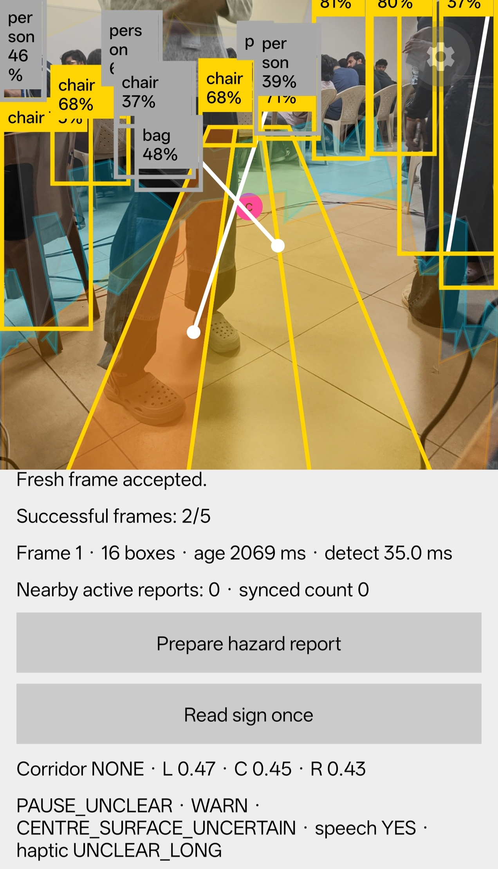
RECURSION — EDITION II
08
EXTRA SLIDE
FIG. 08-A - WALK MODE OVERLAY (LIVE INDOOR TEST RUN)
Code & demo: github.com/SparkleYR/DRISHTI
A real screenshot from the indoor Hall Obstacle Course - not a mockup.
Yellow boxes: YOLO11n detects person, chair, bag and desk obstacles
Coloured overlay: SegFormer-B0 identifies walkable surface, walls and corridor clearance
Bottom panel: live telemetry shows frame timing, corridor score and the cautious guidance state
OCR and the local VLM run only when the user explicitly enters Explore Mode
Shown as captured - including an uncertain frame - so the safety behaviour is honest, not cherry-picked.
TECHNOVIT'S FLAGSHIP HACKATHON
FRAME 08 / 09
Notes:
Optional space: demo links, screenshots, GitHub, QR codes, anything extra that strengthens the submission. Delete the checklist sticker and the hint line once you're done.

Slide 9
RECURSION — EDITION II
09
TEAM & CONTACT
one line per member · so organisers can reach you after submission
Hallucinators
TABLE 09-A — TEAM CONTACT SHEET
NAME | PHONE | EMAIL
Madhav Khurana | 9810728261 | madhav.khurana2024@vitstudent.ac.in
Yash Raj | 6204642647 | yash.raj2024@vitstudent.ac.in
Aryan Raj | 8678833666 | aryan.raj2024@vitstudent.ac.in
TECHNOVIT'S FLAGSHIP HACKATHON
FRAME 09 / 09
Notes:
List every member's phone and email so organisers and judges can follow up after the round. This slide is for the submission file — remove it if presenting live on stage.

