Slide 1
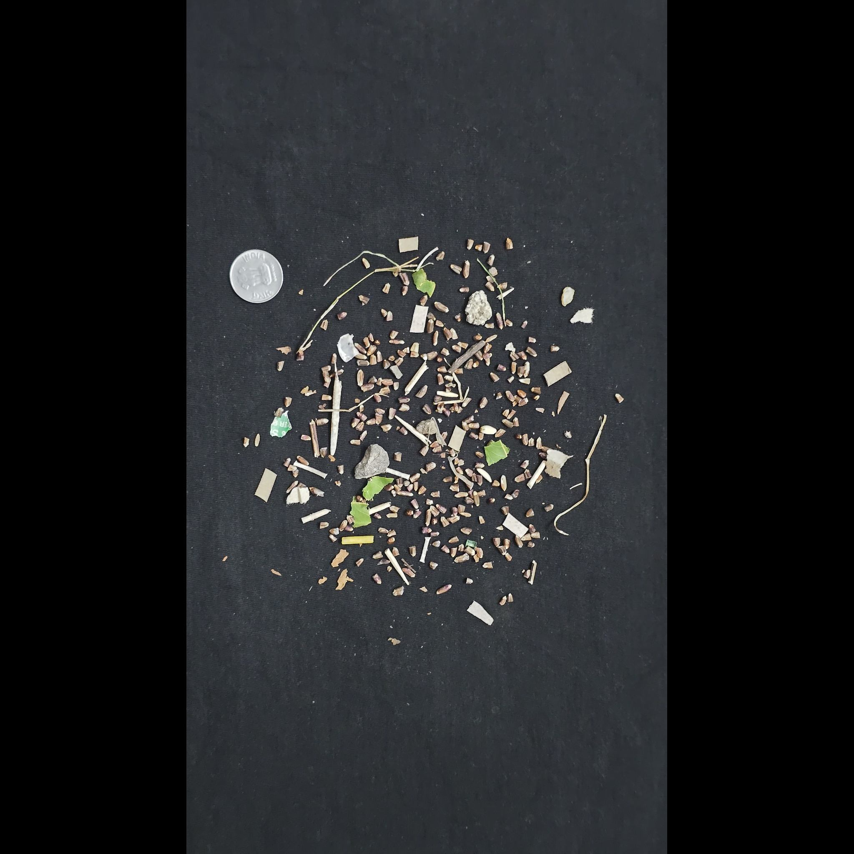

YieldnYarn
From photo evidence
to a recorded trade
Agriculture + textiles
Android seller app · Web marketplace
FACULTY PROJECT REVIEW / OCTOBER 2026
01
Notes:
Introduce the project as a locally running academic marketplace for agricultural produce and textiles. Sellers use the Android app; buyers, verifiers and administrators use the website. The contribution is connecting photo evidence, a reviewable quality decision, configurable pricing and recorded transactions. Explain that inference runs on the laptop, and that the review demonstrates an implemented prototype rather than production readiness. The cover uses original dataset photographs, not generated illustrations.
Sources and evidence:
https://huggingface.co/datasets/SamWithAi/Wheat_Grading_Dataset
https://huggingface.co/datasets/DefectSpectrum/Defect_Spectrum/tree/main/DS-Cotton-Fabric

Slide 2
Problem statement
How can small sellers turn stock and photos into
a trade a buyer can inspect and complete?
Quality is difficult to compare
A photograph needs a structured quality report and a review path.
Price needs an explanation
Grade and order size should visibly change the estimate.
Bulk demand exceeds one listing
A requirement may need stock from several sellers.
02
Notes:
The problem is not just displaying products. A buyer needs comparable quality evidence, an understandable price and enough quantity; a small seller needs a practical way to publish stock and respond to demand. In this project, agriculture and textiles share a workflow but have different units and quality rules. Photos alone cannot establish every physical quality attribute, so the quality decision must remain reviewable. Avoid claiming that all existing markets lack verification or negotiation; this is the practical problem addressed by this prototype.
Sources and evidence:
Repository implementation: backend-django, backend-fastapi, seller-app, web-app. Detailed faculty walkthrough: WEBSITE_DEMO.md.

Slide 3
Literature survey
Work / source | Contribution | Connection to this project
eNAM · official platform | Online agricultural trading and assaying | Quality evidence can inform a trading decision
Howard et al. · ICCV 2019 | MobileNetV3 efficient classification | Small backbone used for kernels and fabric patches
Fan et al. · CVPR 2022 | GrainSpace: fine-grained cereal recognition | Domain variation motivates independent photo checks
Related work informs the design; published benchmark scores are not reported as YieldnYarn results.
03
Notes:
eNAM provides an established agricultural trading context in which online bidding and quality assaying support transactions. MobileNetV3 provides an efficient image-classification backbone; the project uses its Small variant, but the paper’s benchmark results are not this project’s results. GrainSpace demonstrates the importance of fine-grained cereal recognition and changes between devices and domains. It is cited as related work, not as a training dataset used here. These sources establish separate marketplace and computer-vision foundations.
Sources and evidence:
https://enam.gov.in/stakeholders-Involved/traders
https://openaccess.thecvf.com/content_ICCV_2019/html/Howard_Searching_for_MobileNetV3_ICCV_2019_paper.html
https://openaccess.thecvf.com/content/CVPR2022/html/Fan_GrainSpace_A_Large-Scale_Dataset_for_Fine-Grained_and_Domain-Adaptive_Recognition_of_CVPR_2022_paper.html

Slide 4
Literature survey — defect inspection
Study | What it contributes | Use and boundary here
Bergmann et al. CVPR 2019 · MVTec AD | Real industrial anomaly benchmark with detailed defect labels | Literature reference; not the project training set
Yang et al. ECCV 2024 · Defect Spectrum | Defect datasets with richer semantic descriptions | Original cotton images used for independent integration rehearsal
Training source ≠ demonstration source
The implemented fabric grader uses TILDA-derived patches; demonstration photos test a different source.
04
Notes:
MVTec AD is an industrial anomaly-detection benchmark with object and texture images and pixel-level ground truth. Defect Spectrum provides a richer defect dataset and detailed semantics. The project’s independent fabric rehearsal uses original DS-Cotton-Fabric images distributed with Defect Spectrum, whereas the implemented fabric model was trained with TILDA-derived patches. Explain the distinction between literature, training source and demonstration input. Do not imply this project trained on MVTec AD or reproduced either paper’s benchmark.
Sources and evidence:
https://openaccess.thecvf.com/content_CVPR_2019/html/Bergmann_MVTec_AD_--_A_Comprehensive_Real-World_Dataset_for_Unsupervised_Anomaly_CVPR_2019_paper.html
https://www.ecva.net/papers/eccv_2024/papers_ECCV/papers/01105.pdf
https://huggingface.co/datasets/DefectSpectrum/Defect_Spectrum/tree/main/DS-Cotton-Fabric

Slide 5
Research gap
Connect recognition evidence to the decisions
that complete a marketplace workflow.
Photo evidence
Original files + quality scores
Reviewable decision
Uncertainty → human verifier
Recorded transaction
Price → stock → order
Scope of the gap: integrated academic workflow across agriculture and textiles; no claim of a new backbone.
05
Notes:
Frame this as an integration gap within the surveyed work, not a claim of globally unique research. The reviewed vision papers primarily establish recognition or anomaly-detection methods. eNAM establishes a different, agricultural trading and physical-assaying context. The prototype connects two product verticals, mobile capture, uncertain model outputs, a human review decision, a transparent price calculation and allocation or negotiation. The novel value claimed here is an implemented workflow in one local system; the project does not propose a new CNN architecture.
Sources and evidence:
https://enam.gov.in/stakeholders-Involved/traders
https://openaccess.thecvf.com/content/CVPR2022/html/Fan_GrainSpace_A_Large-Scale_Dataset_for_Fine-Grained_and_Domain-Adaptive_Recognition_of_CVPR_2022_paper.html
https://openaccess.thecvf.com/content_CVPR_2019/html/Bergmann_MVTec_AD_--_A_Comprehensive_Real-World_Dataset_for_Unsupervised_Anomaly_CVPR_2019_paper.html
Repository implementation: backend-django, backend-fastapi, seller-app, web-app. Detailed faculty walkthrough: WEBSITE_DEMO.md.

Slide 6
Objectives
01 Capture and synchronize seller stock
Android forms, original photos and locally retained work.
02 Make quality inspectable
Crop / fabric grading, confidence and human corrections.
03 Explain the estimated price
Market base × grade adjustment × quantity discount.
04 Complete buyer demand
Requirements, multiple sellers, negotiation and recorded orders.
05 Verify the local demonstration
Software checks, real dataset photos and persistent results.
06
Notes:
Present each objective as a deliverable with evidence. Mobile capture is represented by the installed seller app and its local persistence and synchronization implementation. Quality estimation is represented by two saved model checkpoints, persisted grading outputs and verifier decisions. Pricing is represented by configurable rules and the visible estimate. Trading is represented by bids, counter-offers, order allocations and stock reduction. Validation is represented by saved software-test receipts and original-photo rehearsals. These are prototype objectives, not promises of agronomic certification or commercial deployment.
Sources and evidence:
Repository implementation: backend-django, backend-fastapi, seller-app, web-app. Detailed faculty walkthrough: WEBSITE_DEMO.md.
.demo/readiness.json
.demo/presentation-build/workflow-proof.json — role-authenticated local API rehearsal, 8–9 October 2026; screenshot from the running website.

Slide 7
Implemented scope — four roles
Role | Primary interface | Implemented actions
Seller | Android app | Photos, listings, synchronization, offers and orders
Buyer | Website | Catalog, estimates, requirements, bids, orders, complaints
Verifier | Website | Photo queue, corrected scores, approve / send back
Administrator | Website | Categories, quality / price rules, prices, people, complaints
Agriculture: quintals and grain quality. Textiles: metres and visible fabric defects.
07
Notes:
The Android application is the seller interface. The website implements buyer, verifier and administrator workflows. A seller can publish stock, inspect grades and respond to offers. A buyer can browse, estimate prices, post a requirement, make offers, follow orders and report complaints. A verifier checks photos and can correct quality scores with a note. Administrators control vertical rules, market price entries, complaints and account status. Agriculture quantities use quintals and textile quantities use metres; attributes are not interchangeable.
Sources and evidence:
Repository implementation: backend-django, backend-fastapi, seller-app, web-app. Detailed faculty walkthrough: WEBSITE_DEMO.md.

Slide 8
Methodology
Android seller
Room + WorkManager
Django API :8000
Accounts · stock · orders
PostgreSQL
Marketplace records
Next.js web :3000
Buyer · verifier · admin
FastAPI :8001
Grade · price · allocate
Photos + checkpoints
Original media · two models
Runs locally on the laptop. The connected phone communicates with the laptop APIs.
08
Notes:
All diagram elements are manually authored, editable PowerPoint shapes and connectors. Android stores work with Room and schedules synchronization using WorkManager. The Next.js website provides buyer and staff interfaces. Django owns marketplace APIs and persistent transaction records. FastAPI handles computational grading, pricing and matching against the shared data model. PostgreSQL persists structured records; the laptop media store retains uploaded photos. MobileNetV3 checkpoints are loaded by the laptop’s compute service. The phone does not perform the model inference.
Sources and evidence:
Repository implementation: backend-django, backend-fastapi, seller-app, web-app. Detailed faculty walkthrough: WEBSITE_DEMO.md.
docker-compose.yml
start-demo.ps1

Slide 9
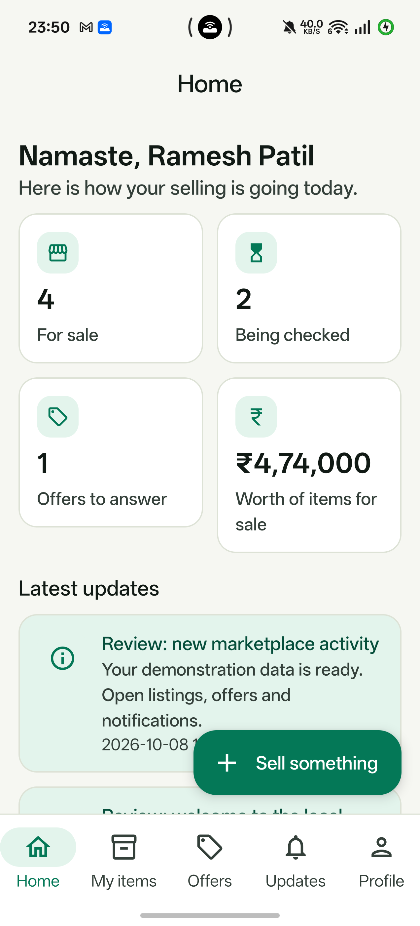
Methodology — mobile capture and sync
Capture
Category, product, quantity, place and original photos.
Retain
Room keeps local listing work and synchronization state.
Synchronize
WorkManager sends records and files to the laptop API.
Follow up
View checking status, offers and order updates.
09
Notes:
Use the actual physical-phone screenshot to introduce the seller entry point. Explain the form sequence: choose the vertical, crop or cloth, quantity, asking price and region; attach photos; save and synchronize. Room supports retained local records, WorkManager retries scheduled upload, and client UUIDs support idempotent listing submission. Do not demonstrate airplane mode during the faculty review unless the full retry path has been rehearsed on the connected phone. This screenshot is from the installed OPPO app; fresh presentation order proof was performed through role-authenticated APIs.
Sources and evidence:
Repository implementation: backend-django, backend-fastapi, seller-app, web-app. Detailed faculty walkthrough: WEBSITE_DEMO.md.
.demo/phone-yieldnyarn.png

Slide 10
Methodology — datasets and model training
Aspect | Wheat grader | Fabric grader
Training material | 7,139 segmented grain crops | 400 boxed fabric photographs
Recognition unit | Individual segmented particle | Good / defective image patch
Model input | 128 × 128 pixels | 96 × 96 pixels; grayscale
Documented training | 12 epochs; source-photo splits | 8 epochs; patch sampling
Shared backbone | MobileNetV3 Small | MobileNetV3 Small
Two shipped checkpoints. Training details describe the existing pipeline; no retraining was done for the review.
10
Notes:
The saved model pipeline uses timm MobileNetV3 Small with ImageNet initialization. For wheat, AgroAI source images are segmented into 7,139 labeled crops; labels include sound, damaged, foreign and covered grains. Deduplication and splitting by source photo reduce leakage between related crops. For fabric, 400 TILDA-format photographs and defect boxes provide good and defective patches. These are saved implementation facts and reports, not a training run performed during this review preparation. Shared training and serving utilities keep preprocessing and score definitions aligned.
Sources and evidence:
https://github.com/sachin235/AgroAI
https://github.com/sivasgitt/AI-Fabric-Defect-Detection
ml-training/README.md

Slide 11
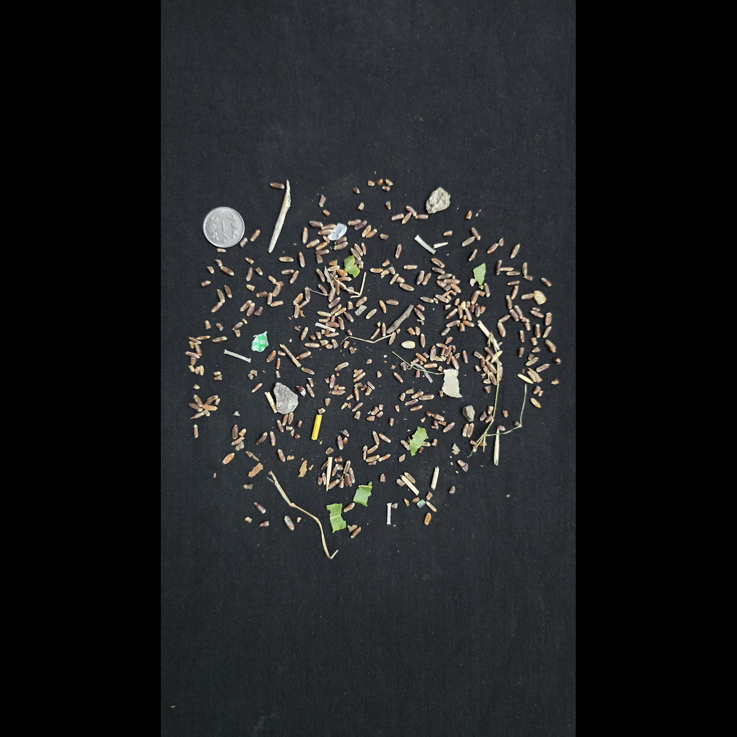
Methodology — wheat photo grading
1 Segment particles
Red-channel Otsu; maximum side 1,600 px.
2 Classify each crop
Sound, damaged, foreign or covered.
3 Aggregate and score
Quality = clip(1 − bad share / tolerance).
Tolerance: foreign share 10%; damaged share 25%. Higher quality scores mean fewer predicted problems.
11
Notes:
For full wheat photos, the serving pipeline reduces the maximum image side to 1,600 pixels and uses red-channel Otsu thresholding to isolate particles. Each retained particle is classified using the wheat MobileNetV3 Small checkpoint. Predicted foreign and covered material contribute to the foreign share. Predicted damaged material is assessed among sound and damaged grains. The application converts these shares into quality scores; it does not directly predict a laboratory certificate. This slide uses an original external dataset photograph to illustrate the input, not a fabricated segmentation overlay.
Sources and evidence:
https://huggingface.co/datasets/SamWithAi/Wheat_Grading_Dataset
backend-fastapi/grading
ml-training/README.md

Slide 12

Methodology — fabric patch grading
1 Tile the image
64 × 64 patches after long-side resize to 768 px.
2 Classify patches
Good, hole, object, oil spot or thread error.
3 Convert defect share
Quality = clip(1 − max(0, share − 2%) / 10%).
The defect share is a model estimate over patches; it is not laboratory ground truth or defect area.
12
Notes:
Fabric inference resizes the long side to 768 pixels and divides the image into non-overlapping 64 by 64 patches. Each patch is classified as good, hole, object, oil spot or thread error. The defective-patch share produces the visual-defect quality score. A 2% noise floor is subtracted before a 10% scoring tolerance is applied, so the quality reaches zero at 12% predicted bad patches. This is a fraction of classified patches, not a measured pixel area of physical damage. Moisture, GSM and thread count cannot be measured by this photo workflow.
Sources and evidence:
https://huggingface.co/datasets/DefectSpectrum/Defect_Spectrum/tree/main/DS-Cotton-Fabric
backend-fastapi/grading
ml-training/README.md

Slide 13
Methodology — grade and confidence
Quality scores
Weighted mean of attributes
Grade A / B / C
A ≥ 85% · B ≥ 65%
Current caps
Wheat 57.92%
Fabric 57.03%
Confidence
Capped by validation report
Human review
Required when below 80%
All current model outputs
require a verifier.
A high quality grade can still require verification. Confidence is not a calibrated probability of correctness.
13
Notes:
Quality and confidence are different quantities. The stored quality scores are combined using configured attribute weights. Agriculture currently uses 50% cleanliness and 50% whole-grain quality; moisture has zero weight. A weighted score of at least 0.85 maps to Grade A, at least 0.65 maps to Grade B, and lower scores map to Grade C. Separately, the implementation caps inference confidence at saved validation balanced accuracy. Both saved caps are below the 80% auto-approval threshold, so current AI outputs go to human review. Manual review confidence is a decision marker, not evidence of perfect model accuracy.
Sources and evidence:
Repository implementation: backend-django, backend-fastapi, seller-app, web-app. Detailed faculty walkthrough: WEBSITE_DEMO.md.
ml-training/reports/agriculture_grader_eval.json
ml-training/reports/textiles_grader_eval.json

Slide 14
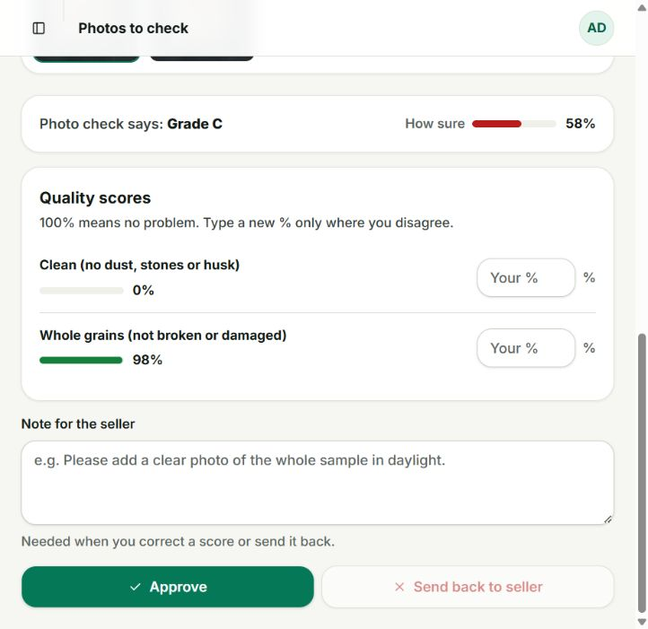
Methodology — human verification
Inspect the originals
Open each photo, then compare the reported scores.
Correct with a reason
Enter a percentage only where the reviewer disagrees.
Persist the decision
Approve for trading, or send back with a seller note.
14
Notes:
The screenshot shows an actual review form for independent wheat listing 77. The automatic cleanliness score is 0% while whole-grain quality rounds to 98%, and displayed confidence is 58%. A verifier can inspect each original photo, enter corrected percentages where they disagree, and add a note for the seller. The UI requires a note for corrections or sending an item back. Approval updates the listing’s quality decision; it does not retrain the model. Listing 77 remains pending so its automatic result can be demonstrated. A separate listing, number 85, was used for the approved transaction proof.
Sources and evidence:
http://localhost:3000/verifier/queue/77
.demo/real-images/grading-results.json; REAL_IMAGE_RESULTS.md; original dataset photo manifest and SHA-256 receipts.

Slide 15
Methodology — transparent pricing
Unit estimate = market base × grade × quantity
Agriculture grade | Price multiplier | Bulk quantity | Discount
Grade A | 1.10 | 0+ quintals | 0%
Grade B | 1.00 | 50+ quintals | 2%
Grade C | 0.88 | 200+ quintals | 5%
Total = rounded unit estimate × quantity. Use the largest eligible bulk tier.
15
Notes:
The price estimate uses a market base value multiplied by a quality adjustment and a quantity adjustment. The current agriculture rules add 10% for Grade A, 0% for Grade B and subtract 12% for Grade C. Bulk discounts are tiered: 0% from zero, 2% at 50 units and 5% at 200 units. Only the highest reached quantity tier applies; discounts are not added together. The website can configure different rules for textiles. This is an estimate, separate from a seller’s asking price or a negotiated transaction price.
Sources and evidence:
Repository implementation: backend-django, backend-fastapi, seller-app, web-app. Detailed faculty walkthrough: WEBSITE_DEMO.md.
WEBSITE_DEMO.md: price rules and calculation walkthrough

Slide 16
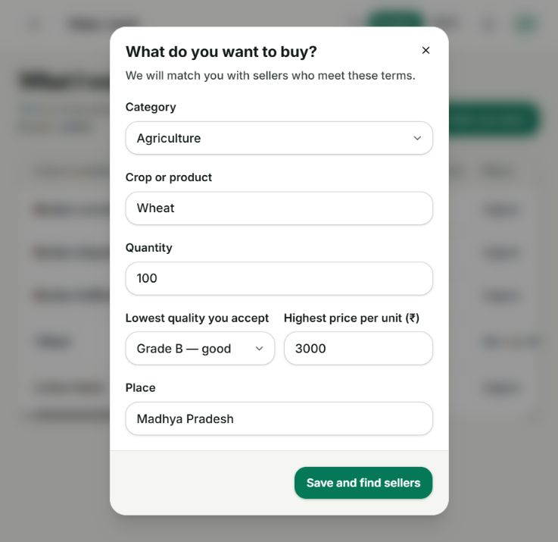
Methodology — express a buyer requirement
Specify the demand
Wheat · 100 quintals · Grade B.
Set acceptable terms
Maximum ₹3,000 per unit · Madhya Pradesh.
Find sellers
Eligible stock can be combined into one allocation result.
Screenshot: filled form before submission. Saved allocation evidence is shown separately in Results.
16
Notes:
This is a filled demonstration form, not proof of a submitted new requirement. The intended faculty input is Agriculture, Wheat, 100 quintals, Grade B, maximum price 3,000 per unit and Madhya Pradesh. Saving starts the buyer requirement workflow and finds eligible stock. The detailed guide lists existing prepared stock and explains what an allocation means. A requirement asks for quantity and acceptable conditions; it differs from bidding on one selected listing. State whether a result is fully fulfilled or has a shortfall instead of promising that every request will match.
Sources and evidence:
http://localhost:3000/buyer/requirements
WEBSITE_DEMO.md

Slide 17
Methodology — allocate across sellers
Filter stock
Grade · price · location
Rank candidates
Lowest price; reputation tie
Allocate quantity
Take min(stock, remaining)
Return allocations, total and any shortfall
Example: demand 60 q → seller 1 supplies 40 q + seller 2 supplies 20 q.
This is deterministic greedy allocation; the project does not claim a globally optimal matching algorithm.
17
Notes:
The compute service uses a deterministic greedy allocation algorithm. It filters listings against the requested grade and applicable price and location constraints, then sorts eligible candidates by unit price ascending. Seller reputation is a tie-break when prices are equal. It allocates the lesser of available stock and the remaining demand, continuing until fulfilled or candidates are exhausted. The response includes allocations, total price, fulfillment and shortfall. Call this a implemented greedy strategy, not a globally optimal supply-chain optimizer or learned matching model.
Sources and evidence:
backend-fastapi/matching/allocation.py
backend-fastapi/matching/router.py

Slide 18
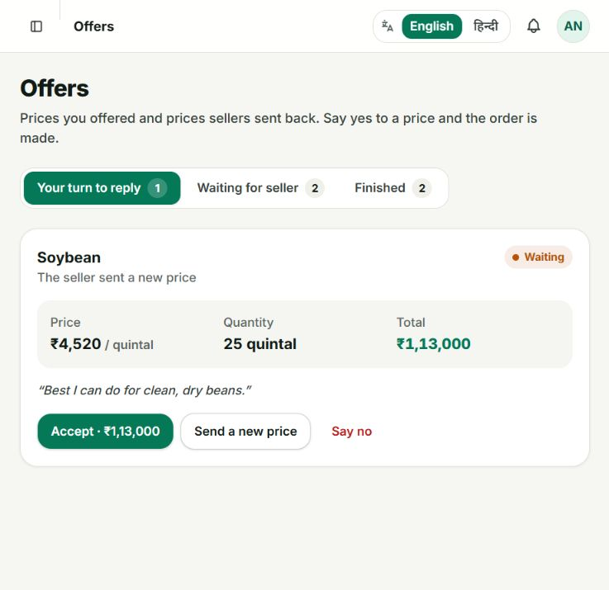
Implementation — offers and counter-offers
Buyer proposes
Choose a listing, quantity and unit price.
Seller responds
Accept, reject or propose a counter price.
Buyer decides
A counter must be accepted before it becomes an order.
Prepared website example: 25 q × ₹4,520 = ₹1,13,000; counter is awaiting a buyer decision.
18
Notes:
The screenshot is an existing prepared soybean offer for 25 quintals at a seller counter price of 4,520, totaling 113,000. It shows that the buyer can accept or reject the counter. The buyer’s original bid and the seller’s response are recorded as negotiation states. Accepting the applicable offer or counter creates a transaction record according to the workflow. Use this slide to explain the control flow, then show the newly captured wheat order proof later. Do not accidentally accept the seeded soybean counter just to illustrate the buttons.
Sources and evidence:
http://localhost:3000/buyer/bids
WEBSITE_DEMO.md

Slide 19
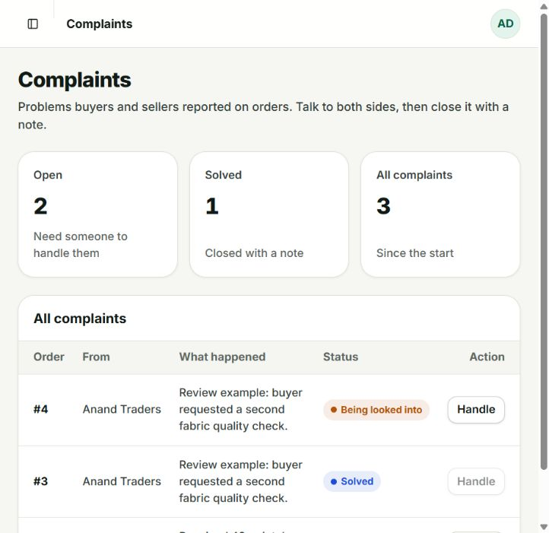
Implementation — orders and complaints
Order record
Product, seller allocation, quantity, amount and status.
Buyer complaint
Describe a grade, quantity or quality problem.
Staff resolution
Inspect and close the case with a recorded note.
Evidence type: seeded complaint states in the running local database.
19
Notes:
The screenshot shows actual local seeded complaint records: an open quantity-shortage case on order 1, an under-review fabric case on order 4 and a resolved fabric case on order 3. Buyers can report grade mismatch, quantity shortage, quality defects or another issue and provide a description. Administrators inspect the record and close it with a note. This evidence demonstrates the prepared workflow states and UI; it is not a fresh complaint on presentation order 20. No payment settlement, physical logistics or automatic refund is claimed.
Sources and evidence:
http://localhost:3000/admin/disputes
backend-django/disputes/models.py
WEBSITE_DEMO.md

Slide 20
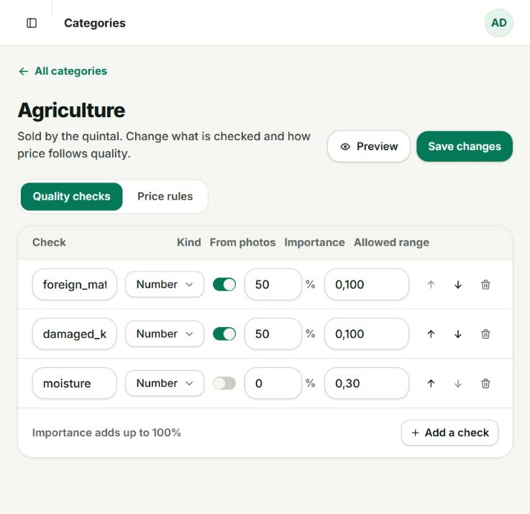
Implementation — configurable quality checks
Per-category attributes
Names, types, ranges and photo-analysis flags.
Explicit weights
Agriculture: 50% cleanliness + 50% whole grains.
Capability boundary
A configuration switch does not train a new visual measurement.
20
Notes:
The agriculture configuration screenshot shows three attributes. Foreign matter and damaged kernels each have 50% importance and are enabled for photo analysis. Moisture is configured as a non-photo attribute with zero weight in the current grade. Attribute labels, type, allowed range and importance can be edited, added, reordered or removed using the category editor. Do not imply enabling a switch teaches the model a new visual attribute; model capability depends on the trained pipeline. Administrators can preview and save configuration, while the current screenshot is a read-only capture of saved rules.
Sources and evidence:
http://localhost:3000/admin/verticals/1
WEBSITE_DEMO.md

Slide 21
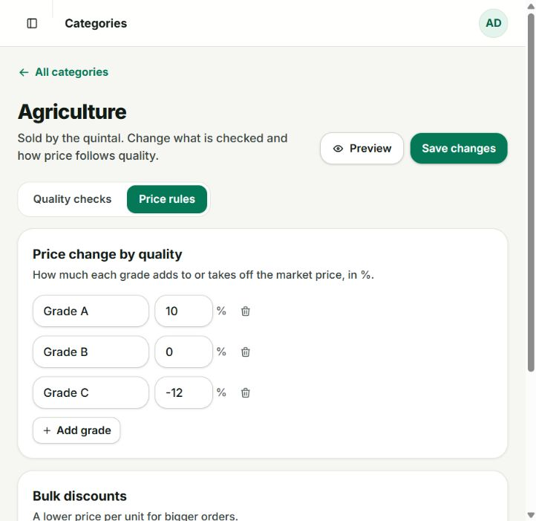
Implementation — price rules and records
Grade adjustments
A +10% · B 0% · C −12%.
Bulk tiers
50 q: 2% off · 200 q: 5% off.
Price records
Manual or feed-labeled sources; local history supports the demo.
21
Notes:
This screenshot shows the saved grade adjustments and agriculture quantity tiers. A separate Market prices page supports manually entered records and identifies feed-sourced records. The local demonstration database includes prepared price history to make trends visible, so the review does not depend on a live external feed. Administrative configuration changes are reflected in the buyer estimate after saving. The appendix gives a reversible before-and-after demonstration using a distinct Faculty Demo Wheat price entry. An estimate is explanatory and does not automatically force the seller’s transaction price.
Sources and evidence:
http://localhost:3000/admin/verticals/1
http://localhost:3000/admin/pricing
WEBSITE_DEMO.md

Slide 22
Results
Local integration is demonstrable;
model reliability needs a separate assessment.
Evidence | Observed result | What it establishes
Local readiness checks | 34 / 34 passed | Services and selected API routes
Android core suite | 34 passed; 1 skipped | Executed core cases passed
Android live-backend case | 1 passed | Client used the live backend
Browser run receipt | Passed | Website flow; count not claimed
Saved run receipts from the review preparation. These counts are not classification accuracy.
22
Notes:
Read the counters as software evidence, not model-accuracy evidence. The saved readiness run records 34 checks passing. The Android core receipt contains 35 test cases, zero failures and errors, and one skipped case: 34 cases executed successfully. A separate live-backend Android test passed. Eight real-photo grading cases and original-file receipts provide additional integration evidence. The browser run receipt records a passed status but does not persist a count, so no browser test count is claimed here. This review preparation did not rerun the complete training or all historical suites.
Sources and evidence:
.demo/readiness.json
.demo/android-core-tests.json
.demo/android-live-test.json
.demo/playwright-results/.last-run.json

Slide 23
Results — original photos preserved
15 / 15
Original files verified on phone and backend
Dataset originals
Public source + file manifest
Phone album
Pictures/YieldnYarnReal
Stored + served media
SHA-256 matches
File integrity proves preservation of inputs; it does not prove correct quality predictions.
23
Notes:
The independent inputs were transferred to the physical phone album Pictures/YieldnYarnReal. The transfer receipt verifies 15 original files by SHA-256. The backend integrity receipt verifies the same 15 originals in storage and over their HTTP media URLs. This guards against a demonstration accidentally using thumbnails or generated substitute images. The grading rehearsal contains eight cases: three independent wheat pairs, four independent fabric pairs and one green-sheet reference. The reference overlaps a documented training-source collection and therefore is not an independent accuracy test.
Sources and evidence:
.demo/real-images/phone-transfer.json
.demo/real-images/backend-image-integrity.json
.demo/real-images/manifest.json
.demo/real-images/grading-results.json; REAL_IMAGE_RESULTS.md; original dataset photo manifest and SHA-256 receipts.

Slide 24
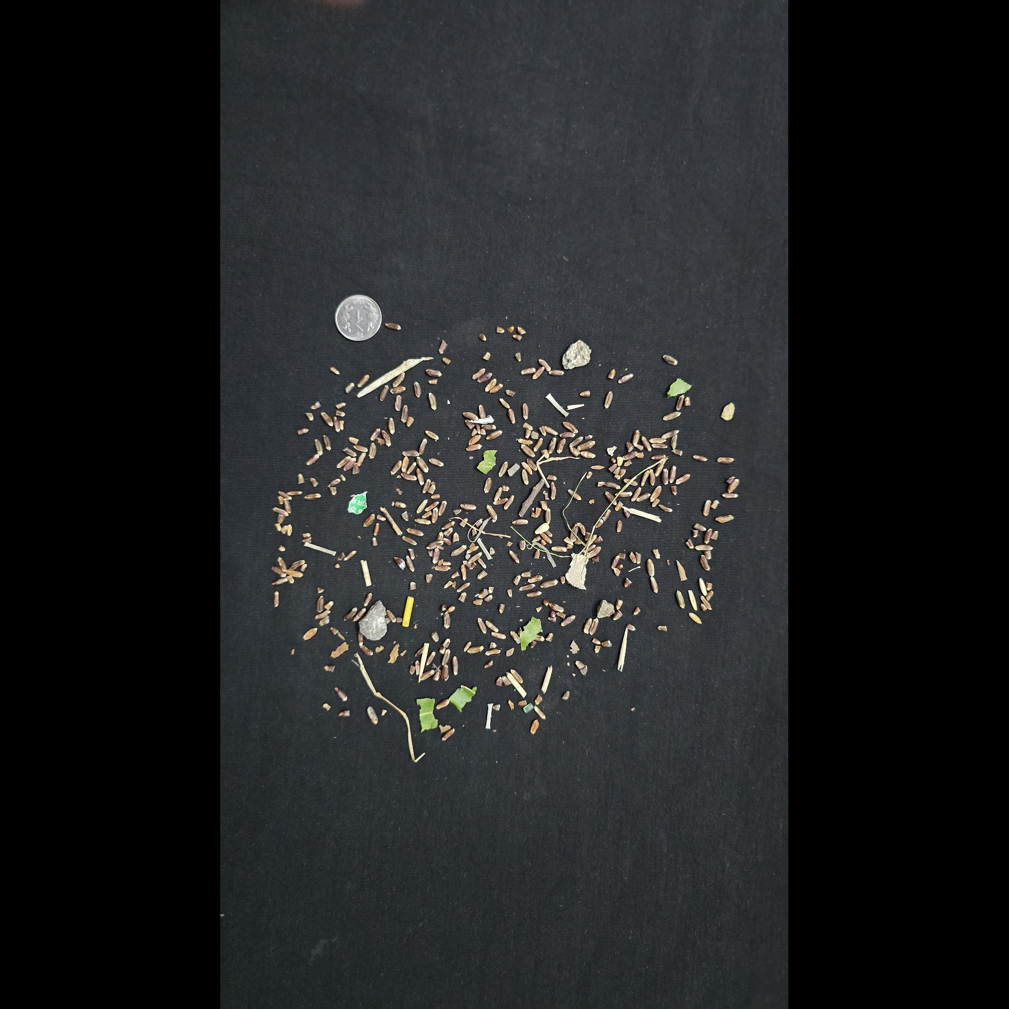
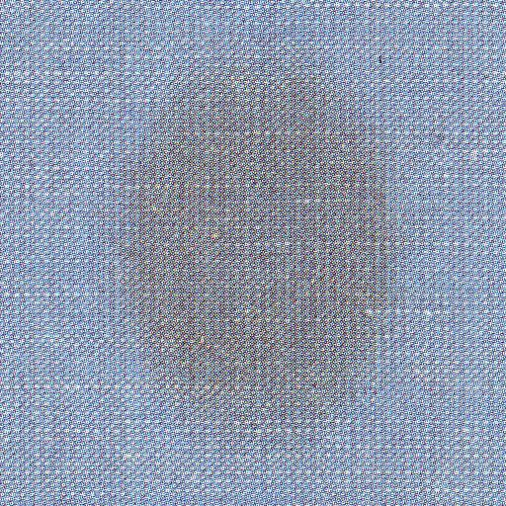
Results — real-world input rehearsal
8 cases
3 wheat pairs
4 fabric pairs
1 source-overlap reference
Original dataset images. This is an integration rehearsal, not a representative model benchmark.
24
Notes:
Show that these are genuine source photographs with backgrounds and visible fabric structures unlike the project’s training-source examples. Three wheat pairs come from Wheat_Grading_Dataset, and four fabric pairs come from the original Defect Spectrum cotton collection. The eighth case is the AgroAI green-sheet reference and is deliberately labeled as overlapping the documented training source. The number eight describes workflow exercises, not a representative or statistically valid accuracy benchmark. The saved raw response for each case records scores, confidence, grade and required verification.
Sources and evidence:
https://huggingface.co/datasets/SamWithAi/Wheat_Grading_Dataset
https://huggingface.co/datasets/DefectSpectrum/Defect_Spectrum/tree/main/DS-Cotton-Fabric
https://github.com/sachin235/AgroAI
.demo/real-images/grading-results.json; REAL_IMAGE_RESULTS.md; original dataset photo manifest and SHA-256 receipts.

Slide 25
Results — saved model validation
57–58%
Balanced accuracy limits
automatic confidence.
These are saved validation results,
not new independent-photo accuracy.
Metric: item balanced accuracy (%) from the existing model reports. Native chart data is editable.
25
Notes:
The native chart reports item-level balanced accuracy from the saved validation JSON: 57.92% for the wheat model and 57.03% for the fabric model. Balanced accuracy is the metric used for the current confidence caps. Item accuracy is 71.09% and 70.07%, respectively; those figures should not be described as full-photo grading accuracy. Wheat sample evaluation includes 40 synthetic whole-sample images made from held-out kernels, while fabric validation includes 40 photos. No fresh retraining or benchmark reproduction was performed for this deck.
Sources and evidence:
ml-training/reports/agriculture_grader_eval.json
ml-training/reports/textiles_grader_eval.json

Slide 26
Results — precision does not equal recall
Missed defects remain
a major limitation.
Photo-level flagging and
patch-level recall measure
different things.
Saved held-out fabric report. 100% photo flagging in that set is not general accuracy.
26
Notes:
The saved fabric validation reports 84.8% defective-patch precision, 40.2% defective-patch recall and 1.87% false alarms among good patches. All defect-containing photos in this particular 40-photo held-out set were flagged, but that photo-level fact does not imply all defective patches were found or that performance generalizes to other sources. Explain precision as how often a predicted defective patch is actually defective, and recall as how much of the labeled defect material is detected. The observed low recall is a material limitation.
Sources and evidence:
ml-training/reports/textiles_grader_eval.json

Slide 27
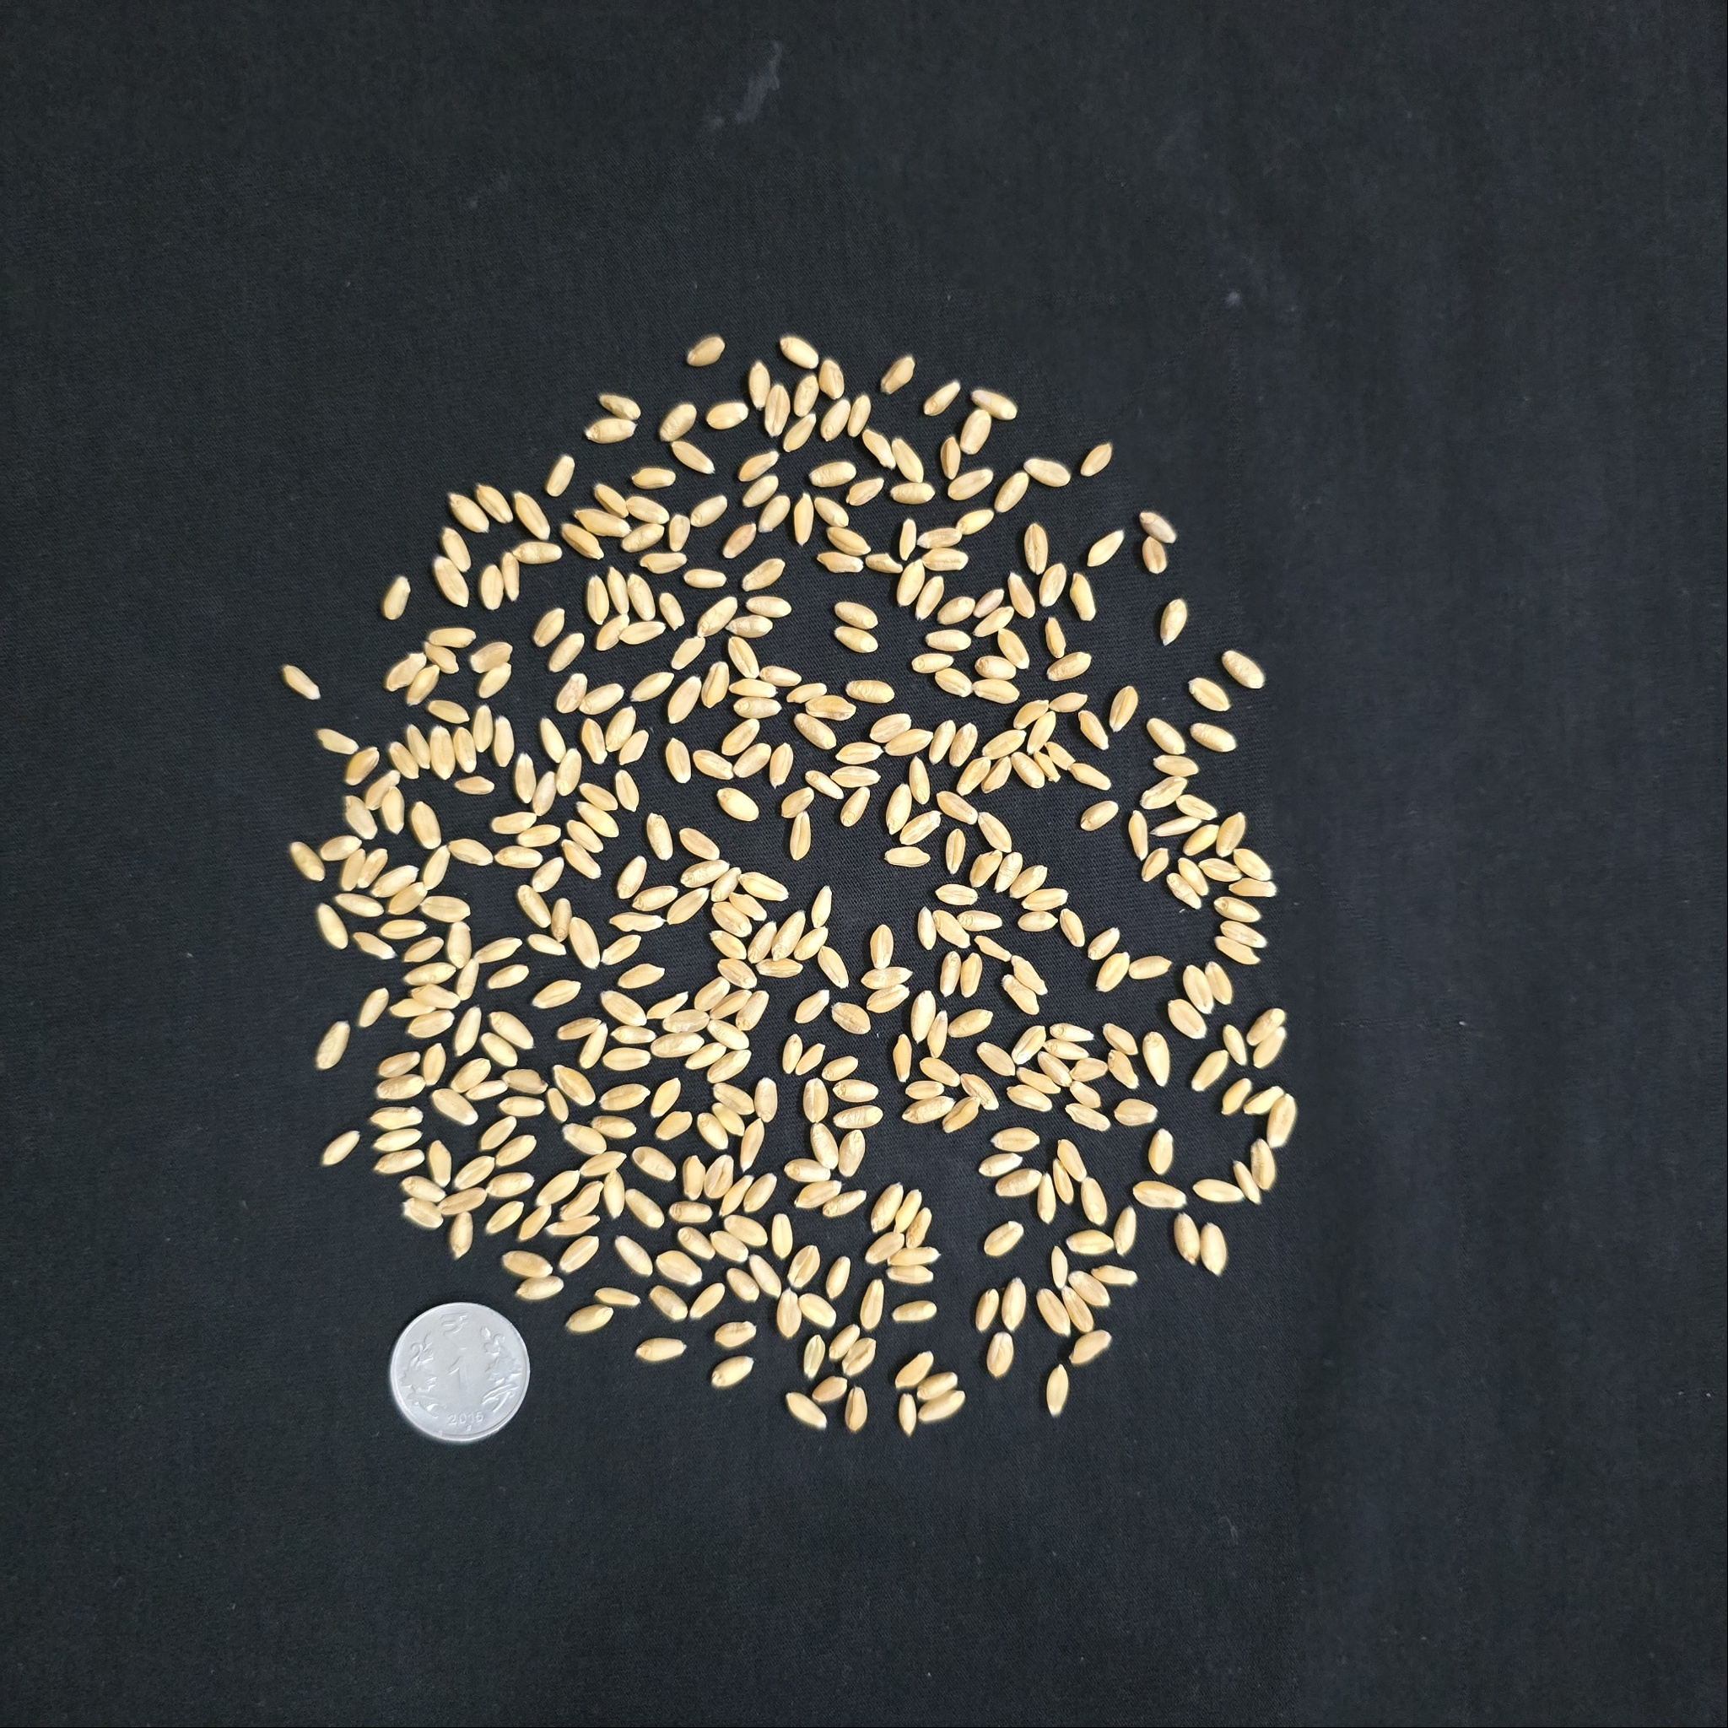
Results — wheat exposes a failure case
Automatic output: Grade C
Quality measure | Model score
Cleanliness | 0%
Whole-grain quality | 97.5%
Weighted quality | 48.75%
Confidence | 57.92% → review
Source-A response: 48.9% predicted foreign share. This is an observed mismatch, not a laboratory measurement.
27
Notes:
This original source-A photo produced a predicted foreign share of 48.9% despite the grain sample’s apparent cleanliness. The response converted that into 0% cleanliness quality; whole-grain quality was 97.5%. With equal weights, the combined quality is 48.75%, Grade C. Confidence was capped at 57.92% and the case was correctly routed for review. Do not equate the source dataset’s letter label directly with the app’s Grade A/B/C thresholds, or claim a causal diagnosis from a visual inspection. Background or domain differences are plausible contributors, not an established cause.
Sources and evidence:
https://huggingface.co/datasets/SamWithAi/Wheat_Grading_Dataset
.demo/real-images/grading-results.json; REAL_IMAGE_RESULTS.md; original dataset photo manifest and SHA-256 receipts.

Slide 28


Results — fabric predictions vary
Hole: 6.2% bad patches
57.5% quality · Grade C
Oil: 14.9% bad patches
0% quality · Grade C
Both require a human decision. The predicted patch share is not the ground-truth defect area.
28
Notes:
The hole example yields a 6.2% predicted bad-patch share and 57.5% visual-defect quality, leading to Grade C. The oil example yields a 14.9% predicted bad-patch share and zero visual-defect quality. Confidence is low, including 50.83% on the oil case, so these cases also remain in the review queue. These values are predictions rather than annotated defect-area measurements. Only a small set of external source photos was exercised; avoid ranking the model’s general ability to detect holes versus oil from one example of each.
Sources and evidence:
https://huggingface.co/datasets/DefectSpectrum/Defect_Spectrum/tree/main/DS-Cotton-Fabric
.demo/real-images/grading-results.json; REAL_IMAGE_RESULTS.md; original dataset photo manifest and SHA-256 receipts.

Slide 29
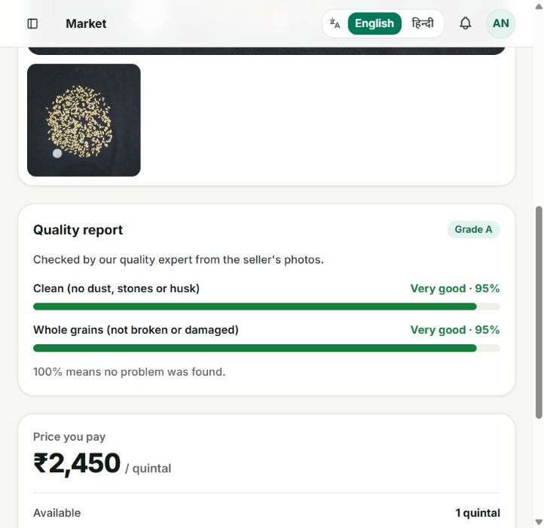
Results — a human decision was persisted
AI decision
Grade C · 57.92% confidence · queued.
Illustrative human correction
95% cleanliness + 95% whole-grain quality.
Persisted outcome
Grade A · ACTIVE · listing #85.
Manual percentages demonstrate the review workflow; they are not new model performance measurements.
29
Notes:
A new presentation-evidence listing 85 was created with two original source-A wheat photos and two quintals of stock. Its automatic output was Grade C at 57.92% confidence and it entered the verification queue. A role-authenticated verifier API call supplied illustrative corrected quality scores of 95% for each attribute, producing Grade A and an active listing. This demonstrates persistence of a human decision, not an accuracy improvement or an independently measured 95% ground truth. The response’s confidence value of one is a manual-review marker, not 100% AI accuracy.
Sources and evidence:
.demo/presentation-build/workflow-proof.json — role-authenticated local API rehearsal, 8–9 October 2026; screenshot from the running website.
http://localhost:3000/buyer/catalog/85

Slide 30
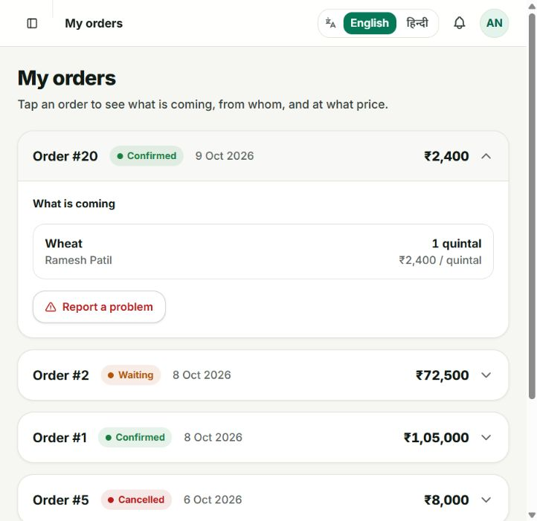
Results — negotiated order and stock
₹2,300 → ₹2,400
Buyer offer → seller counter → buyer acceptance.
Order #20: CONFIRMED
1 quintal × ₹2,400 = ₹2,400.
Stock: 2 q → 1 q
Remaining listing stayed ACTIVE.
Fresh local API integration proof; the screenshot shows the persisted website order.
30
Notes:
This is the fresh transaction proof in the local presentation rehearsal. The buyer offered 2,300 for one quintal from listing 85. The seller countered at 2,400. The buyer accepted the counter, creating order 20 with CONFIRMED status and total 2,400. The same listing’s stock decreased from two quintals to one. These steps were performed through separately role-authenticated API calls, then the website was used to inspect the persisted order. This proves integrated application behavior; it does not demonstrate physical delivery, payment settlement or the complete phone UI negotiation sequence.
Sources and evidence:
.demo/presentation-build/workflow-proof.json — role-authenticated local API rehearsal, 8–9 October 2026; screenshot from the running website.
http://localhost:3000/buyer/orders

Slide 31
Results — multi-seller allocation
Allocation | Quantity | Unit price | Amount
Listing 72 | 40 q | ₹2,000 | ₹80,000
Listing 73 | 20 q | ₹2,000 | ₹40,000
Total | 60 q | — | ₹1,20,000
Fully fulfilled · 2 allocations · 0 q shortfall
Evidence type: saved integration response; these temporary listings and order are no longer in the live demo database.
31
Notes:
The saved earlier integration receipt shows a requirement fulfilled by two listings. Listing 72 supplied 40 quintals and listing 73 supplied 20 quintals, both at 2,000 per unit, yielding a 60-quintal total and 120,000 total price. The receipt explicitly records fully_fulfilled true and zero shortfall. Those temporary records were later cleaned from the prepared database; therefore this is a retained integration receipt rather than a current website order screenshot. The allocation table is editable and displays the arithmetic directly.
Sources and evidence:
.demo/photo-and-matching.json — saved multi_seller_match integration response; temporary sample records later cleaned.

Slide 32
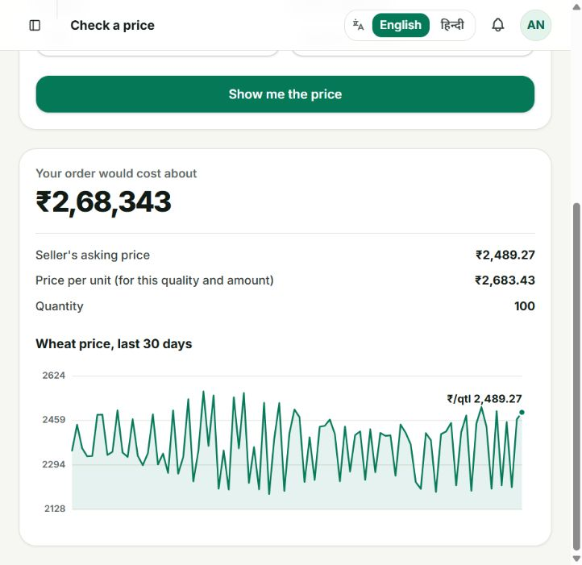
Results — price calculation visible on screen
₹2,489.27 × 1.10 × 0.98
= ₹2,683.43 / quintal
100 quintals
= ₹2,68,343
Observed website result. Local prepared price history keeps the review independent of feed availability.
32
Notes:
The actual buyer estimate screenshot was captured after selecting Wheat, 100 units and Grade A. The displayed base is 2,489.27, the Grade A multiplier is 1.10 and the reached bulk tier is 2% off. Multiplying gives 2,683.43306, rounded to 2,683.43 per unit. The total is the rounded unit value times 100, or 268,343. The screen also displays prepared 30-day Wheat history. The UI calls the baseline seller’s asking price, while the compute estimate uses the selected base and configured adjustments; explain the actual calculation without claiming a fresh external market-feed measurement.
Sources and evidence:
http://localhost:3000/buyer/estimate
.demo/presentation-build/assets/estimate-full.jpg
WEBSITE_DEMO.md

Slide 33
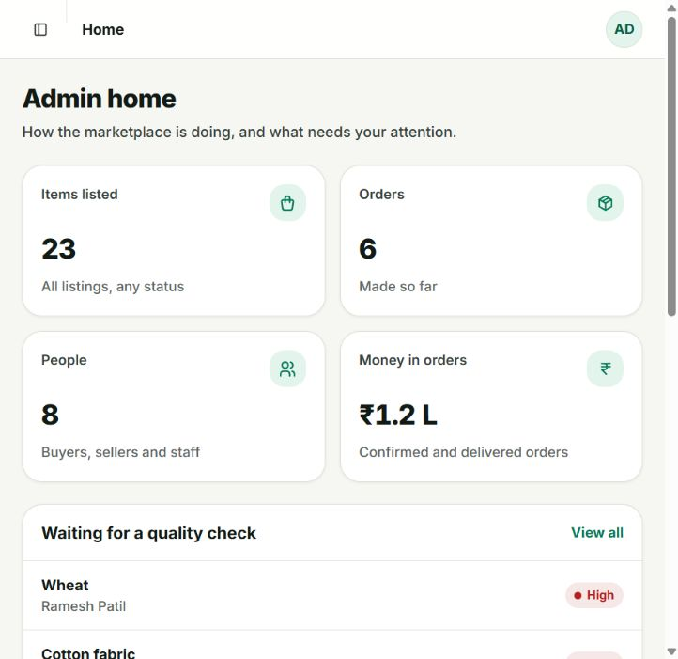
Results — marketplace state is inspectable
23 listings
Across all statuses; includes pending real-photo cases.
6 orders
Includes the newly confirmed presentation order.
8 people
Prepared buyer, seller and staff accounts.
Snapshot of the local academic demonstration database, not production usage statistics.
33
Notes:
The actual administrator dashboard now shows 23 listings across statuses, six orders and eight people. It also surfaces pending quality checks and open complaints. These are local database records for a faculty demonstration, including seeded examples and the fresh presentation listing and order. The dashboard’s rounded money-in-orders value is not used as a performance metric. A healthy local demo means the user can trace records across the interfaces, not that all listings are approved or every seeded case is a new verified transaction.
Sources and evidence:
http://localhost:3000/admin/dashboard — captured during presentation preparation.

Slide 34
Limitations
Model reliability
Low confidence, weak recalls and external-source mismatches require human review.
Measurement scope
Photos support visible quality; moisture and GSM are not inferred.
Demonstration scope
Small input rehearsal, local data and prepared price history.
Transaction scope
Orders and complaints are recorded; payments and physical delivery are not demonstrated.
34
Notes:
The current inference caps mean automatic approval is unavailable: a verifier is needed even for Grade A outputs. Saved balanced accuracy is modest, damaged-grain recall is weak and the fabric model misses many defective patches. Independent inputs expose transfer problems; the photo rehearsal is too small to establish general accuracy. Moisture and GSM require other measurements. The demo uses prepared prices and in-app notification records; Firebase push is not configured. Payment settlement, delivery logistics and commercial scale are outside the demonstrated scope. Present these boundaries candidly, without shifting the review into new development or security work.
Sources and evidence:
.demo/real-images/grading-results.json; REAL_IMAGE_RESULTS.md; original dataset photo manifest and SHA-256 receipts.
ml-training/reports
DEMO_GUIDE.md

Slide 35
Conclusions
An implemented workflow,
with quality decisions open to review.
Demonstrated
Original photos → grade → human decision → price → order → stock update.
Learned
Integration passed; model predictions still need careful human judgment.
35
Notes:
The prototype achieves an inspectable local workflow across seller capture, quality analysis, human verification, price calculation, requirements, negotiation and persistent order records. The strongest fresh evidence is listing 85 and order 20, because both the decision and stock movement can be inspected. The strongest scientific conclusion is more limited: successful integration does not make the grader reliable under changing inputs. The project’s human-review path is therefore essential to the current demonstration. Do not describe the prototype as a replacement for laboratory quality certification.
Sources and evidence:
Repository implementation: backend-django, backend-fastapi, seller-app, web-app. Detailed faculty walkthrough: WEBSITE_DEMO.md.
.demo/presentation-build/workflow-proof.json — role-authenticated local API rehearsal, 8–9 October 2026; screenshot from the running website.
.demo/real-images/grading-results.json; REAL_IMAGE_RESULTS.md; original dataset photo manifest and SHA-256 receipts.

Slide 36
Faculty demonstration — exact route sequence
Step | Go to / action | Explain
1 · Seller | Phone → Home → Sell Something | Photo capture, local retention, checking status
2 · Verifier | /verifier/queue/77 | Original photo, low confidence, correction controls
3 · Buyer | /buyer/catalog/85 → /buyer/orders | Approved quality; order #20 and ₹2,400
4 · Buyer | /buyer/estimate → /buyer/requirements | Transparent calculation and bulk demand
5 · Admin | /admin/verticals/1 → /admin/disputes | Configuration and prepared complaint states
Use localhost:3000 on the laptop. Detailed exact field entries and role credentials are in WEBSITE_DEMO.md.
36
Notes:
Use the slide as the live demonstration agenda; WEBSITE_DEMO.md provides all field values, optional edits and recovery steps. First run start-demo.ps1 and confirm the phone reaches the laptop. On the phone use the existing seller account and show the real-photo album. On the staff website open verifier listing 77 without changing it to illustrate the failure case, then show already approved listing 85 and order 20 as persisted proof. Use separate browser windows for buyer and staff roles if possible so sessions do not replace one another. The planned 100-quintal requirement may reserve real demo stock; do not submit it repeatedly.
Sources and evidence:
start-demo.ps1
WEBSITE_DEMO.md
FACULTY_DEMO.md

Slide 37
References — literature
eNAM. Official trader information: online trading and quality assaying.
Howard et al. Searching for MobileNetV3. ICCV, 2019.
Fan et al. GrainSpace. CVPR, 2022.
Bergmann et al. MVTec AD. CVPR, 2019.
Yang et al. Defect Spectrum. ECCV, 2024.
Primary-source URLs and source-specific explanations are included in the speaker notes.
37
Notes:
The literature survey uses primary papers and official platform material. eNAM is cited for quality-assayed online agricultural trading. Howard and colleagues introduce MobileNetV3, used as the existing backbone. Fan and colleagues introduce GrainSpace and grain-recognition domain concerns. Bergmann and colleagues introduce MVTec AD. Yang and colleagues introduce Defect Spectrum at ECCV 2024. The project does not borrow these papers’ benchmark metrics as its own results. Full verified links are recorded below and in the relevant slide notes.
Sources and evidence:
https://enam.gov.in/stakeholders-Involved/traders
https://openaccess.thecvf.com/content_ICCV_2019/html/Howard_Searching_for_MobileNetV3_ICCV_2019_paper.html
https://openaccess.thecvf.com/content/CVPR2022/html/Fan_GrainSpace_A_Large-Scale_Dataset_for_Fine-Grained_and_Domain-Adaptive_Recognition_of_CVPR_2022_paper.html
https://openaccess.thecvf.com/content_CVPR_2019/html/Bergmann_MVTec_AD_--_A_Comprehensive_Real-World_Dataset_for_Unsupervised_Anomaly_CVPR_2019_paper.html
https://www.ecva.net/papers/eccv_2024/papers_ECCV/papers/01105.pdf

Slide 38
References — data and local proof
Source category | Traceable evidence
Training sources | AgroAI grain images; TILDA-format fabric images / boxes
Independent rehearsal | Wheat_Grading_Dataset; original DS-Cotton-Fabric images
Measured ML reports | ml-training/reports/*_grader_eval.json
Application proof | workflow-proof.json; photo-and-matching.json; readiness.json
Companion demonstration guide | WEBSITE_DEMO.md; FACULTY_DEMO.md; REAL_IMAGE_RESULTS.md
Full public URLs and local evidence paths are in notes on the relevant slides.
38
Notes:
Use the source manifest to trace original photos. Wheat demonstration inputs come from the public Wheat_Grading_Dataset distribution. Fabric inputs come from original Defect Spectrum cotton images. AgroAI and the TILDA-format repository are the documented training-source collections. Local JSON receipts are the evidence for file integrity, software checks, photo grades and transaction behavior. WEBSITE_DEMO.md is the companion faculty walkthrough. These references make the presentation reproducible without inventing a test dataset, a new training run or unsupported accuracy.
Sources and evidence:
https://huggingface.co/datasets/SamWithAi/Wheat_Grading_Dataset
https://huggingface.co/datasets/DefectSpectrum/Defect_Spectrum/tree/main/DS-Cotton-Fabric
https://github.com/sachin235/AgroAI
https://github.com/sivasgitt/AI-Fabric-Defect-Detection
.demo/real-images/grading-results.json; REAL_IMAGE_RESULTS.md; original dataset photo manifest and SHA-256 receipts.
.demo/presentation-build/workflow-proof.json — role-authenticated local API rehearsal, 8–9 October 2026; screenshot from the running website.

Slide 39
Appendix — persistent data relationships
User
Seller / buyer / staff
Listing
Stock + price + status
Photo + grading
Evidence + review decision
Requirement / bid
Demand or negotiation
Order + allocations
Quantity per source listing
Dispute
Issue + staff resolution
Conceptual relationships, not a complete ER schema. All diagram elements remain editable.
39
Notes:
This is a conceptual relationship diagram manually built from native PowerPoint shapes. A user publishes listings. Photos and grading results are associated with listings, and verifier decisions update their quality state. A buyer requirement can be fulfilled through order allocations referencing multiple listings. Bids are related to one listing and can lead to an order after acceptance. An order has allocation lines and can receive a dispute record. The drawing emphasizes what to trace during a viva; it is not a complete database schema or a claim that every relationship has the same cardinality.
Sources and evidence:
backend-django/*/models.py
backend-fastapi/db.py

Slide 40
Appendix — show configuration affecting price
Action | Exact input / page | Expected estimate
Baseline | Buyer estimate: Faculty Demo Wheat 100 q · Grade B · base ₹2,500 | ₹2,450 / q ₹2,45,000 total
Change one rule | Admin → Agriculture → Price rules Grade B: 0% → 5% → Save changes | ₹2,572.50 / q ₹2,57,250 total
Restore | Grade B: 5% → 0% → Save changes Recalculate the same buyer input | ₹2,450 / q ₹2,45,000 total
Planned live demonstration with expected arithmetic. Restore the baseline rule after showing the change.
40
Notes:
This is a planned reversible faculty exercise, not a fresh result captured in this deck. Use the separately prepared Faculty Demo Wheat base price of 2,500. On the buyer estimate form enter Agriculture, Faculty Demo Wheat, 100 and Grade B. Baseline is 2,450 per unit and 245,000 total because the 50-unit tier gives 2% off. As administrator, open Agriculture Price rules and change only the Grade B percentage from zero to five, then save. Recalculate the same buyer inputs: expected 2,572.50 per unit and 257,250 total. Restore Grade B to zero and save after the demonstration.
Sources and evidence:
WEBSITE_DEMO.md — Before, change, observe, restore

