Slide 1
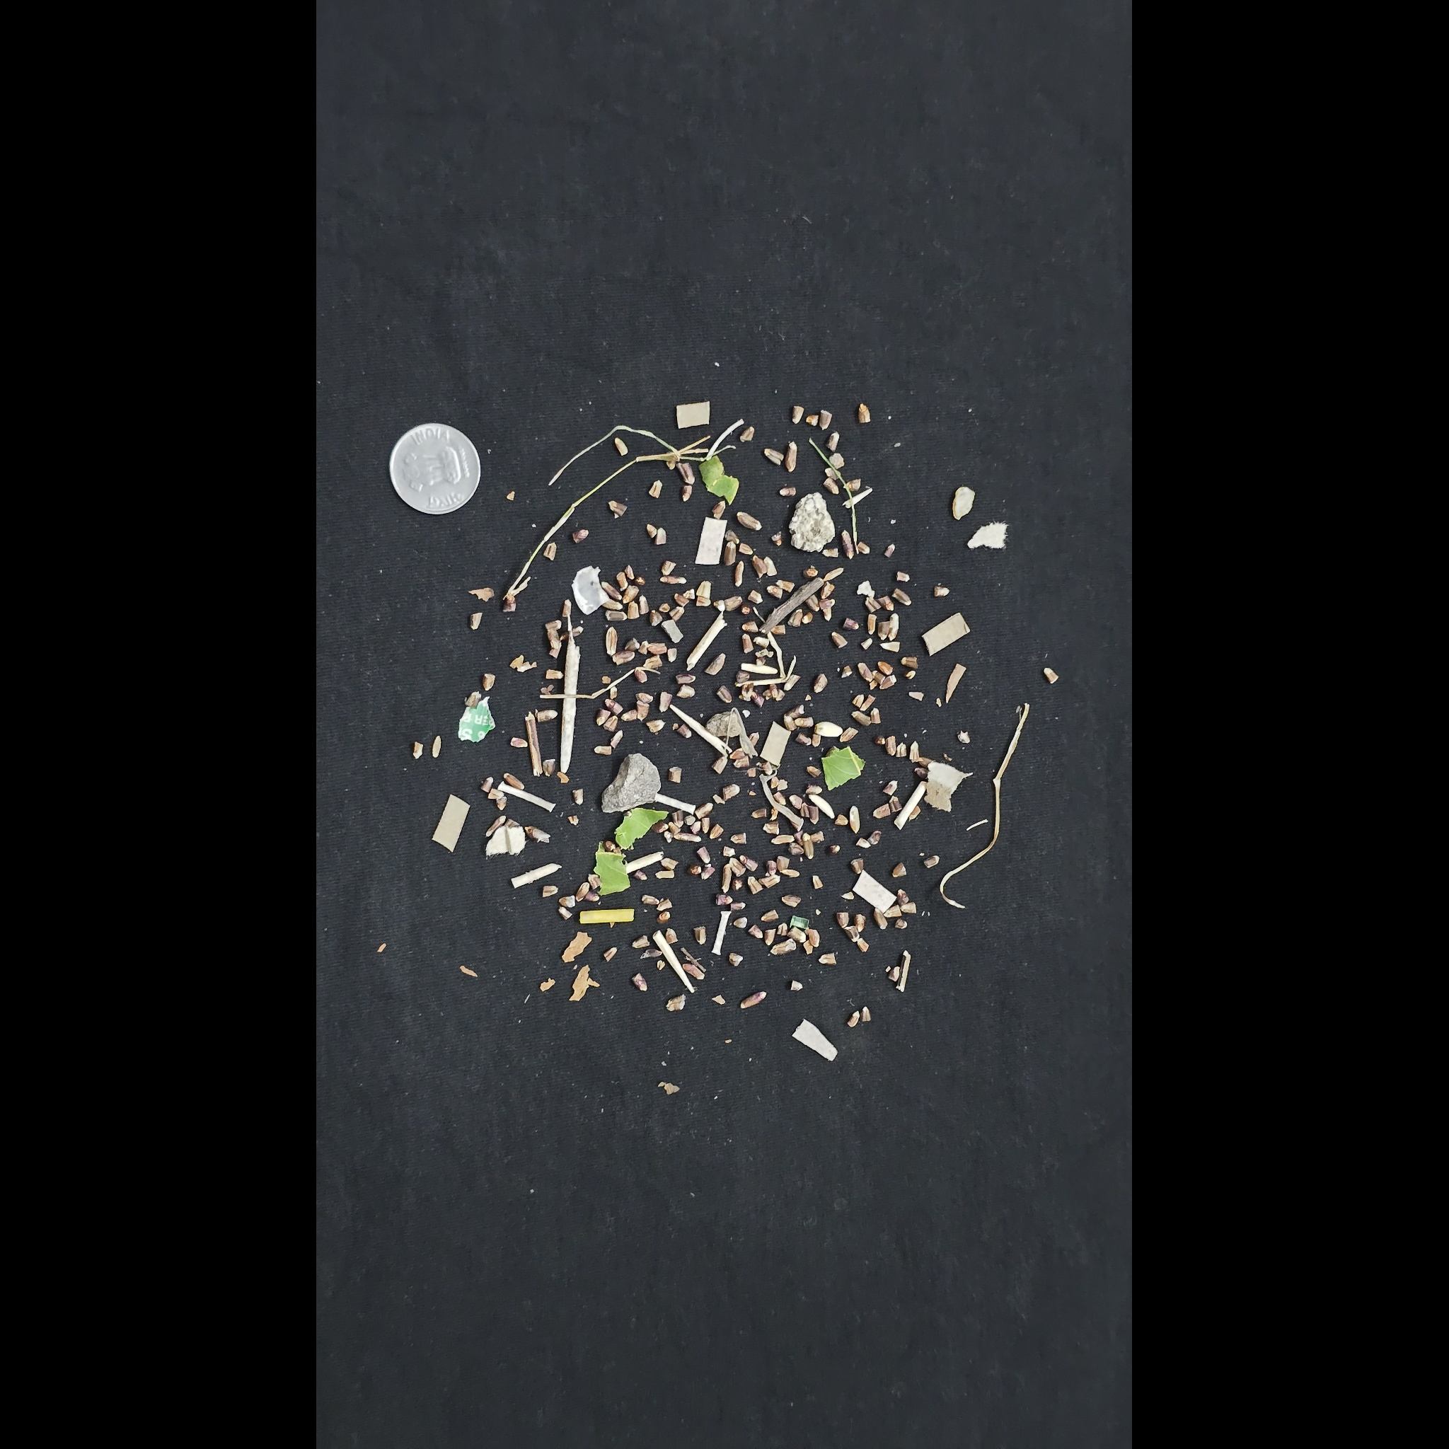
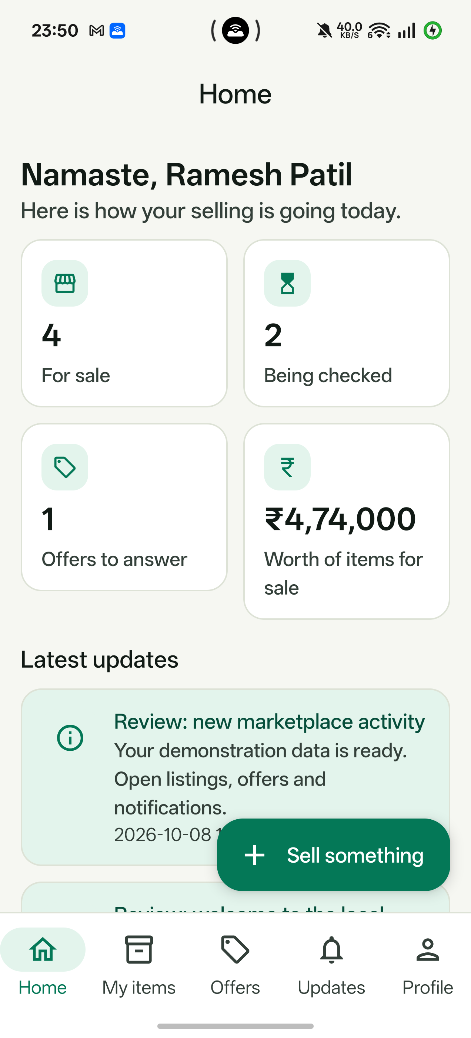

YieldnYarn
A local marketplace for
crops and cloth
Photo-assisted quality review, transparent price
estimates and recorded buyer–seller transactions.
Role | Implemented interface
Seller | Android: stock, photos
Buyer | Web: demand, orders
Verifier | Web: quality review
Admin | Web: rules, complaints
Faculty review · October 2026 · Laptop services + connected Android phone
01
Notes:
YieldnYarn
Introduce the project as a locally running academic marketplace for agricultural produce and textiles. Sellers use the Android app; buyers, verifiers and administrators use the website. The contribution is connecting photo evidence, a reviewable quality decision, configurable pricing and recorded transactions. Explain that inference runs on the laptop, and that the review demonstrates an implemented prototype rather than production readiness. The cover uses original dataset photographs, not generated illustrations.
Implemented scope — four roles
The Android application is the seller interface. The website implements buyer, verifier and administrator workflows. A seller can publish stock, inspect grades and respond to offers. A buyer can browse, estimate prices, post a requirement, make offers, follow orders and report complaints. A verifier checks photos and can correct quality scores with a note. Administrators control vertical rules, market price entries, complaints and account status. Agriculture quantities use quintals and textile quantities use metres; attributes are not interchangeable.
Methodology — mobile capture and sync
Use the actual physical-phone screenshot to introduce the seller entry point. Explain the form sequence: choose the vertical, crop or cloth, quantity, asking price and region; attach photos; save and synchronize. Room supports retained local records, WorkManager retries scheduled upload, and client UUIDs support idempotent listing submission. Do not demonstrate airplane mode during the faculty review unless the full retry path has been rehearsed on the connected phone. This screenshot is from the installed OPPO app; fresh presentation order proof was performed through role-authenticated APIs.
Sources and evidence:
https://huggingface.co/datasets/SamWithAi/Wheat_Grading_Dataset
https://huggingface.co/datasets/DefectSpectrum/Defect_Spectrum/tree/main/DS-Cotton-Fabric
Repository implementation: backend-django, backend-fastapi, seller-app, web-app. Detailed faculty walkthrough: WEBSITE_DEMO.md.
.demo/phone-yieldnyarn.png

Slide 2
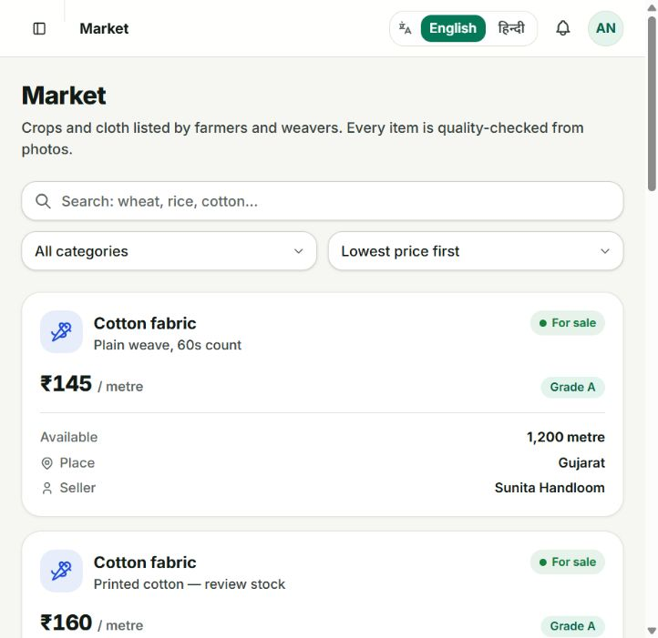
Problem statement
Comparable quality
A buyer needs inspectable evidence of cleanliness, grain damage or fabric defects. A photo needs a structured report and a human review path.
Explainable pricing
Grade and quantity should visibly change the estimate. Buyers and sellers also need a way to negotiate a transaction price.
Bulk demand and limited stock
One seller may not hold the requested amount. The marketplace must combine eligible stock and report any unfilled quantity.
Project aim: connect seller evidence, quality, price and available stock to a recorded trade.
02
Notes:
Problem statement
The problem is not just displaying products. A buyer needs comparable quality evidence, an understandable price and enough quantity; a small seller needs a practical way to publish stock and respond to demand. In this project, agriculture and textiles share a workflow but have different units and quality rules. Photos alone cannot establish every physical quality attribute, so the quality decision must remain reviewable. Avoid claiming that all existing markets lack verification or negotiation; this is the practical problem addressed by this prototype.
Sources and evidence:
Repository implementation: backend-django, backend-fastapi, seller-app, web-app. Detailed faculty walkthrough: WEBSITE_DEMO.md.

Slide 3
Literature survey
Work / source | Contribution | Relevance and boundary
eNAM · official platform | Online agricultural trading and quality assaying | Quality evidence supports trade; a different mandi / agricultural context
Howard et al. · ICCV 2019 | MobileNetV3 efficient classification backbone | Small variant used here; paper benchmarks are not project accuracy
Fan et al. · CVPR 2022 | GrainSpace: fine-grained cereal recognition | Device / domain variation motivates independent input checks
Bergmann et al. · CVPR 2019 | MVTec AD industrial anomaly benchmark | Related inspection research; not a project training dataset
Yang et al. · ECCV 2024 | Defect Spectrum with rich defect semantics | Original cotton images used for rehearsal; training uses TILDA
These works establish recognition or trading foundations; YieldnYarn connects them in one reviewable workflow.
03
Notes:
Literature survey
eNAM provides an established agricultural trading context in which online bidding and quality assaying support transactions. MobileNetV3 provides an efficient image-classification backbone; the project uses its Small variant, but the paper’s benchmark results are not this project’s results. GrainSpace demonstrates the importance of fine-grained cereal recognition and changes between devices and domains. It is cited as related work, not as a training dataset used here. These sources establish separate marketplace and computer-vision foundations.
Literature survey — defect inspection
MVTec AD is an industrial anomaly-detection benchmark with object and texture images and pixel-level ground truth. Defect Spectrum provides a richer defect dataset and detailed semantics. The project’s independent fabric rehearsal uses original DS-Cotton-Fabric images distributed with Defect Spectrum, whereas the implemented fabric model was trained with TILDA-derived patches. Explain the distinction between literature, training source and demonstration input. Do not imply this project trained on MVTec AD or reproduced either paper’s benchmark.
References — literature
The literature survey uses primary papers and official platform material. eNAM is cited for quality-assayed online agricultural trading. Howard and colleagues introduce MobileNetV3, used as the existing backbone. Fan and colleagues introduce GrainSpace and grain-recognition domain concerns. Bergmann and colleagues introduce MVTec AD. Yang and colleagues introduce Defect Spectrum at ECCV 2024. The project does not borrow these papers’ benchmark metrics as its own results. Full verified links are recorded below and in the relevant slide notes.
Sources and evidence:
https://enam.gov.in/stakeholders-Involved/traders
https://openaccess.thecvf.com/content_ICCV_2019/html/Howard_Searching_for_MobileNetV3_ICCV_2019_paper.html
https://openaccess.thecvf.com/content/CVPR2022/html/Fan_GrainSpace_A_Large-Scale_Dataset_for_Fine-Grained_and_Domain-Adaptive_Recognition_of_CVPR_2022_paper.html
https://openaccess.thecvf.com/content_CVPR_2019/html/Bergmann_MVTec_AD_--_A_Comprehensive_Real-World_Dataset_for_Unsupervised_Anomaly_CVPR_2019_paper.html
https://www.ecva.net/papers/eccv_2024/papers_ECCV/papers/01105.pdf
https://huggingface.co/datasets/DefectSpectrum/Defect_Spectrum/tree/main/DS-Cotton-Fabric

Slide 4
Research gap & objectives
Research gap
Objectives
Within the surveyed work, recognition evidence and marketplace decisions are separate concerns. The prototype connects photo analysis, human review, pricing and transactions across agriculture and textiles.
01 Capture and synchronize stock
Android records, original photos, Room and WorkManager.
02 Make quality inspectable
Two graders, confidence, verifier corrections and notes.
03 Explain the estimate
Project contribution
Market base × grade adjustment × bulk discount.
An implemented local workflow using existing computer-vision models. The contribution is the integration and the inspectable decision path; no new CNN backbone is claimed.
04 Fulfil buyer demand
Requirements, multiple sellers, offers and order records.
05 Verify the local workflow
Software checks, real dataset photos and persisted proof.
Scope: academic prototype with visible quality decisions, not laboratory certification.
04
Notes:
Research gap
Frame this as an integration gap within the surveyed work, not a claim of globally unique research. The reviewed vision papers primarily establish recognition or anomaly-detection methods. eNAM establishes a different, agricultural trading and physical-assaying context. The prototype connects two product verticals, mobile capture, uncertain model outputs, a human review decision, a transparent price calculation and allocation or negotiation. The novel value claimed here is an implemented workflow in one local system; the project does not propose a new CNN architecture.
Objectives
Present each objective as a deliverable with evidence. Mobile capture is represented by the installed seller app and its local persistence and synchronization implementation. Quality estimation is represented by two saved model checkpoints, persisted grading outputs and verifier decisions. Pricing is represented by configurable rules and the visible estimate. Trading is represented by bids, counter-offers, order allocations and stock reduction. Validation is represented by saved software-test receipts and original-photo rehearsals. These are prototype objectives, not promises of agronomic certification or commercial deployment.
Sources and evidence:
https://enam.gov.in/stakeholders-Involved/traders
https://openaccess.thecvf.com/content/CVPR2022/html/Fan_GrainSpace_A_Large-Scale_Dataset_for_Fine-Grained_and_Domain-Adaptive_Recognition_of_CVPR_2022_paper.html
https://openaccess.thecvf.com/content_CVPR_2019/html/Bergmann_MVTec_AD_--_A_Comprehensive_Real-World_Dataset_for_Unsupervised_Anomaly_CVPR_2019_paper.html
Repository implementation: backend-django, backend-fastapi, seller-app, web-app. Detailed faculty walkthrough: WEBSITE_DEMO.md.
.demo/readiness.json
.demo/presentation-build/workflow-proof.json — role-authenticated local API rehearsal, 8–9 October 2026; screenshot from the running website.

Slide 5
Methodology — architecture and data flow
Android seller
Room + WorkManager
Django API
:8000 · stock / orders
PostgreSQL
Persistent records
Seller capture and sync
Choose product, quantity, place and price; attach photos. Room retains local work. WorkManager sends records and files to the laptop APIs.
Next.js web
:3000 · buyer / staff
FastAPI
:8001 · compute
Photos + models
Originals / checkpoints
Service responsibilities
Django records marketplace state. FastAPI grades photos, estimates prices and allocates stock. Inference runs on the laptop, not on the phone.
Data relationships
User → listing → photos / grading → order allocations → dispute
A requirement can draw stock from several listings; a bid negotiates one listing.
Local endpoints and conceptual relationships; all architecture elements are editable PowerPoint shapes.
05
Notes:
Methodology
All diagram elements are manually authored, editable PowerPoint shapes and connectors. Android stores work with Room and schedules synchronization using WorkManager. The Next.js website provides buyer and staff interfaces. Django owns marketplace APIs and persistent transaction records. FastAPI handles computational grading, pricing and matching against the shared data model. PostgreSQL persists structured records; the laptop media store retains uploaded photos. MobileNetV3 checkpoints are loaded by the laptop’s compute service. The phone does not perform the model inference.
Appendix — persistent data relationships
This is a conceptual relationship diagram manually built from native PowerPoint shapes. A user publishes listings. Photos and grading results are associated with listings, and verifier decisions update their quality state. A buyer requirement can be fulfilled through order allocations referencing multiple listings. Bids are related to one listing and can lead to an order after acceptance. An order has allocation lines and can receive a dispute record. The drawing emphasizes what to trace during a viva; it is not a complete database schema or a claim that every relationship has the same cardinality.
Sources and evidence:
Repository implementation: backend-django, backend-fastapi, seller-app, web-app. Detailed faculty walkthrough: WEBSITE_DEMO.md.
docker-compose.yml
start-demo.ps1
backend-django/*/models.py
backend-fastapi/db.py

Slide 6
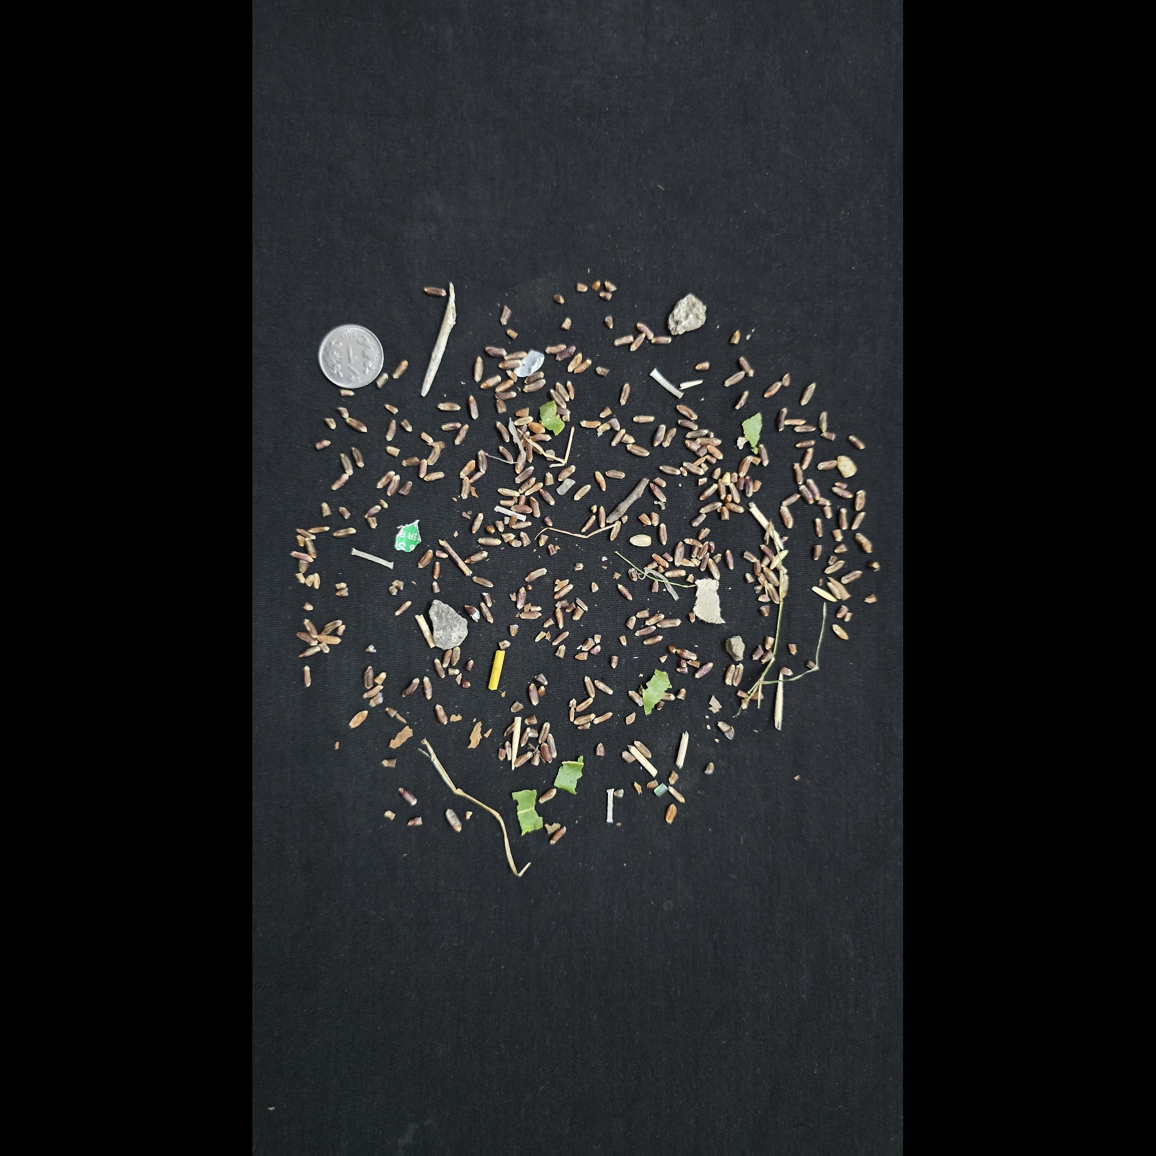

Methodology — datasets, training and inference
Aspect | Wheat grader | Fabric grader
Training data | 7,139 grain crops (AgroAI) | 400 boxed TILDA-format photos
Model input | 128 × 128; individual particles | 96 × 96; grayscale patches
Training | 12 epochs; split by source photo | 8 epochs; boxed-patch sampling
Backbone | MobileNetV3 Small (ImageNet) | MobileNetV3 Small (ImageNet)
Wheat inference
Fabric inference
Resize to max side 1,600 px.
Otsu threshold → particles.
Classify sound, damaged,
foreign and covered items.
Aggregate predicted bad shares.
Resize long side to 768 px.
Tile into 64 × 64 patches.
Classify good, hole, object,
oil spot and thread error.
Aggregate defective-patch share.
Existing checkpoints and saved training pipeline. Photos shown are original external dataset inputs.
06
Notes:
Methodology — datasets and model training
The saved model pipeline uses timm MobileNetV3 Small with ImageNet initialization. For wheat, AgroAI source images are segmented into 7,139 labeled crops; labels include sound, damaged, foreign and covered grains. Deduplication and splitting by source photo reduce leakage between related crops. For fabric, 400 TILDA-format photographs and defect boxes provide good and defective patches. These are saved implementation facts and reports, not a training run performed during this review preparation. Shared training and serving utilities keep preprocessing and score definitions aligned.
Methodology — wheat photo grading
For full wheat photos, the serving pipeline reduces the maximum image side to 1,600 pixels and uses red-channel Otsu thresholding to isolate particles. Each retained particle is classified using the wheat MobileNetV3 Small checkpoint. Predicted foreign and covered material contribute to the foreign share. Predicted damaged material is assessed among sound and damaged grains. The application converts these shares into quality scores; it does not directly predict a laboratory certificate. This slide uses an original external dataset photograph to illustrate the input, not a fabricated segmentation overlay.
Methodology — fabric patch grading
Fabric inference resizes the long side to 768 pixels and divides the image into non-overlapping 64 by 64 patches. Each patch is classified as good, hole, object, oil spot or thread error. The defective-patch share produces the visual-defect quality score. A 2% noise floor is subtracted before a 10% scoring tolerance is applied, so the quality reaches zero at 12% predicted bad patches. This is a fraction of classified patches, not a measured pixel area of physical damage. Moisture, GSM and thread count cannot be measured by this photo workflow.
Sources and evidence:
https://github.com/sachin235/AgroAI
https://github.com/sivasgitt/AI-Fabric-Defect-Detection
ml-training/README.md
https://huggingface.co/datasets/SamWithAi/Wheat_Grading_Dataset
backend-fastapi/grading
https://huggingface.co/datasets/DefectSpectrum/Defect_Spectrum/tree/main/DS-Cotton-Fabric

Slide 7
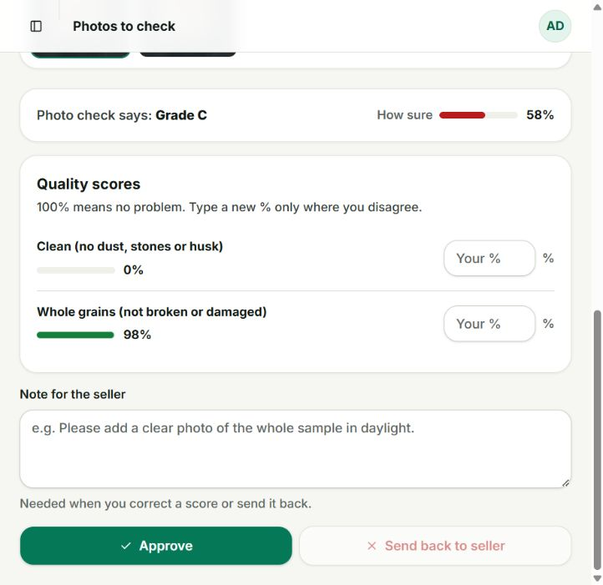
Methodology — quality, confidence and human review
Quality scores: higher means fewer problems
Wheat: clip(1 − bad share / tolerance)
Foreign tolerance 10%; damaged tolerance 25%.
Fabric: clip(1 − max(0, bad share − 2%) / 10%).
Weighted grade
Agriculture: 50% cleanliness + 50% whole grains.
Textiles: visual-defect quality; GSM has zero weight.
Grade A
Score ≥ 85%
Grade B
65% to <85%
Grade C
Score <65%
Confidence caps: wheat 57.92%; fabric 57.03%.
Below 80% → all current AI outputs need review.
Correct with a note; approve or send back.
Manual confidence records a human decision.
Moisture and GSM are not inferred from photos. Quality and confidence are separate quantities.
07
Notes:
Methodology — grade and confidence
Quality and confidence are different quantities. The stored quality scores are combined using configured attribute weights. Agriculture currently uses 50% cleanliness and 50% whole-grain quality; moisture has zero weight. A weighted score of at least 0.85 maps to Grade A, at least 0.65 maps to Grade B, and lower scores map to Grade C. Separately, the implementation caps inference confidence at saved validation balanced accuracy. Both saved caps are below the 80% auto-approval threshold, so current AI outputs go to human review. Manual review confidence is a decision marker, not evidence of perfect model accuracy.
Methodology — human verification
The screenshot shows an actual review form for independent wheat listing 77. The automatic cleanliness score is 0% while whole-grain quality rounds to 98%, and displayed confidence is 58%. A verifier can inspect each original photo, enter corrected percentages where they disagree, and add a note for the seller. The UI requires a note for corrections or sending an item back. Approval updates the listing’s quality decision; it does not retrain the model. Listing 77 remains pending so its automatic result can be demonstrated. A separate listing, number 85, was used for the approved transaction proof.
Sources and evidence:
Repository implementation: backend-django, backend-fastapi, seller-app, web-app. Detailed faculty walkthrough: WEBSITE_DEMO.md.
ml-training/reports/agriculture_grader_eval.json
ml-training/reports/textiles_grader_eval.json
http://localhost:3000/verifier/queue/77
.demo/real-images/grading-results.json; REAL_IMAGE_RESULTS.md; original dataset photo manifest and SHA-256 receipts.

Slide 8
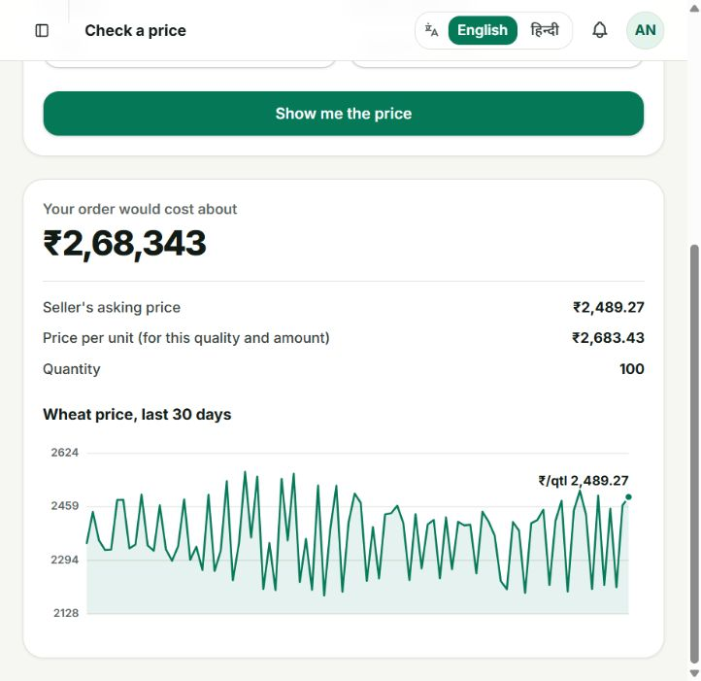
Methodology — pricing and multi-seller matching
Unit estimate = base × grade × quantity
Grade | Multiplier | Agriculture quantity | Discount
A | 1.10 | 0+ q | 0%
B | 1.00 | 50+ q | 2%
C | 0.88 | 200+ q | 5%
Matching a buyer requirement
1 Filter active stock by grade, price and location.
2 Sort by unit price; reputation breaks equal-price ties.
3 Fill from each seller until demand is met.
Return allocations, total and any shortfall.
Example demand: Wheat · 100 q · Grade B
Maximum ₹3,000 / q · Madhya Pradesh
Highest reached bulk tier applies. Observed estimate: ₹2,489.27 × 1.10 × 0.98 = ₹2,683.43 / q; 100 q = ₹2,68,343.
08
Notes:
Methodology — transparent pricing
The price estimate uses a market base value multiplied by a quality adjustment and a quantity adjustment. The current agriculture rules add 10% for Grade A, 0% for Grade B and subtract 12% for Grade C. Bulk discounts are tiered: 0% from zero, 2% at 50 units and 5% at 200 units. Only the highest reached quantity tier applies; discounts are not added together. The website can configure different rules for textiles. This is an estimate, separate from a seller’s asking price or a negotiated transaction price.
Methodology — express a buyer requirement
This is a filled demonstration form, not proof of a submitted new requirement. The intended faculty input is Agriculture, Wheat, 100 quintals, Grade B, maximum price 3,000 per unit and Madhya Pradesh. Saving starts the buyer requirement workflow and finds eligible stock. The detailed guide lists existing prepared stock and explains what an allocation means. A requirement asks for quantity and acceptable conditions; it differs from bidding on one selected listing. State whether a result is fully fulfilled or has a shortfall instead of promising that every request will match.
Methodology — allocate across sellers
The compute service uses a deterministic greedy allocation algorithm. It filters listings against the requested grade and applicable price and location constraints, then sorts eligible candidates by unit price ascending. Seller reputation is a tie-break when prices are equal. It allocates the lesser of available stock and the remaining demand, continuing until fulfilled or candidates are exhausted. The response includes allocations, total price, fulfillment and shortfall. Call this a implemented greedy strategy, not a globally optimal supply-chain optimizer or learned matching model.
Implementation — price rules and records
This screenshot shows the saved grade adjustments and agriculture quantity tiers. A separate Market prices page supports manually entered records and identifies feed-sourced records. The local demonstration database includes prepared price history to make trends visible, so the review does not depend on a live external feed. Administrative configuration changes are reflected in the buyer estimate after saving. The appendix gives a reversible before-and-after demonstration using a distinct Faculty Demo Wheat price entry. An estimate is explanatory and does not automatically force the seller’s transaction price.
Results — price calculation visible on screen
The actual buyer estimate screenshot was captured after selecting Wheat, 100 units and Grade A. The displayed base is 2,489.27, the Grade A multiplier is 1.10 and the reached bulk tier is 2% off. Multiplying gives 2,683.43306, rounded to 2,683.43 per unit. The total is the rounded unit value times 100, or 268,343. The screen also displays prepared 30-day Wheat history. The UI calls the baseline seller’s asking price, while the compute estimate uses the selected base and configured adjustments; explain the actual calculation without claiming a fresh external market-feed measurement.
Appendix — show configuration affecting price
This is a planned reversible faculty exercise, not a fresh result captured in this deck. Use the separately prepared Faculty Demo Wheat base price of 2,500. On the buyer estimate form enter Agriculture, Faculty Demo Wheat, 100 and Grade B. Baseline is 2,450 per unit and 245,000 total because the 50-unit tier gives 2% off. As administrator, open Agriculture Price rules and change only the Grade B percentage from zero to five, then save. Recalculate the same buyer inputs: expected 2,572.50 per unit and 257,250 total. Restore Grade B to zero and save after the demonstration.
Sources and evidence:
Repository implementation: backend-django, backend-fastapi, seller-app, web-app. Detailed faculty walkthrough: WEBSITE_DEMO.md.
WEBSITE_DEMO.md: price rules and calculation walkthrough
http://localhost:3000/buyer/requirements
WEBSITE_DEMO.md
backend-fastapi/matching/allocation.py
backend-fastapi/matching/router.py
http://localhost:3000/admin/verticals/1
http://localhost:3000/admin/pricing
http://localhost:3000/buyer/estimate
.demo/presentation-build/assets/estimate-full.jpg
WEBSITE_DEMO.md — Before, change, observe, restore

Slide 9
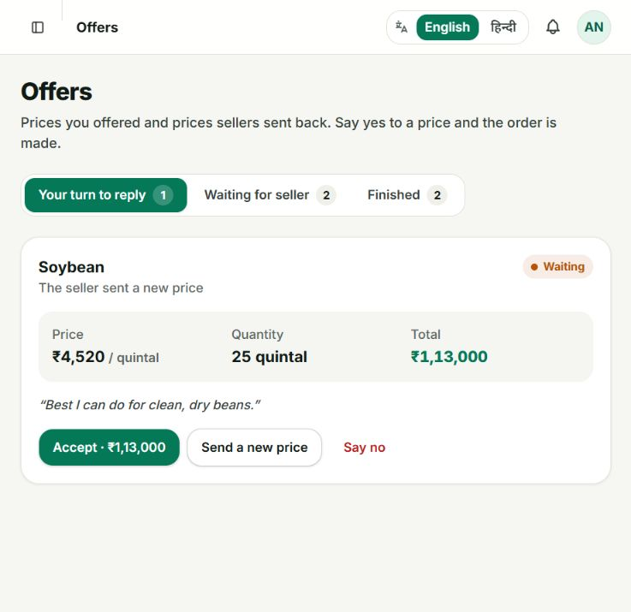
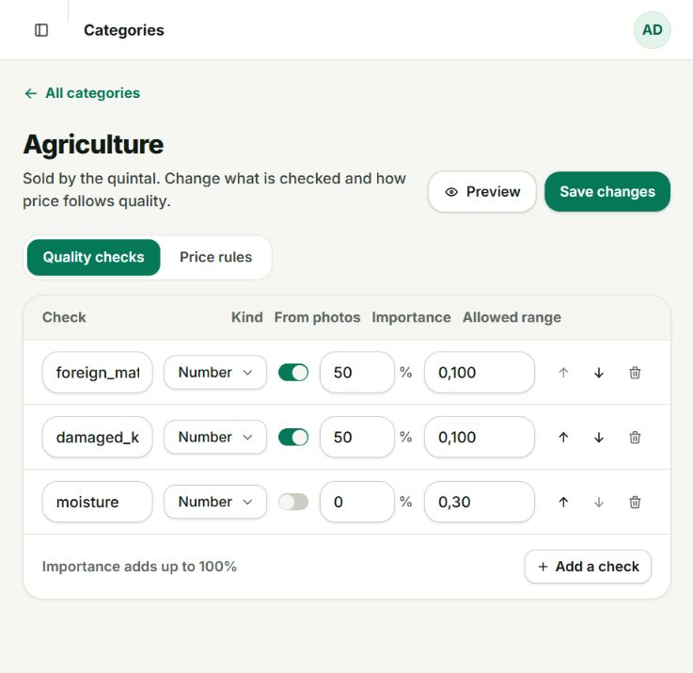
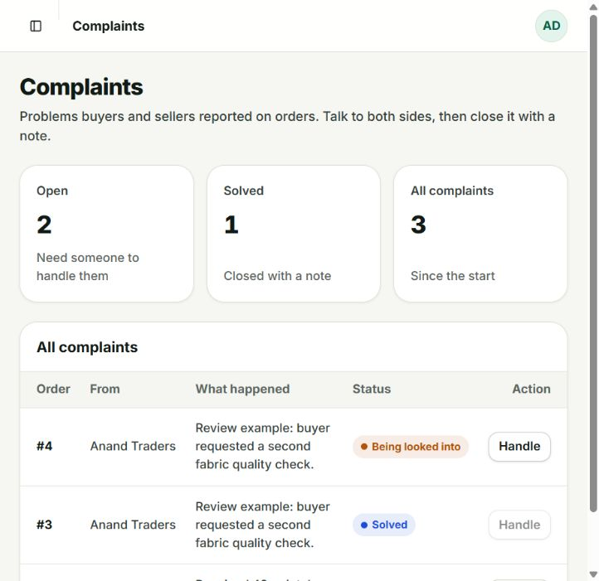
Implementation — buyer and staff workflows
Offers and orders
Quality configuration
Complaints
Buyer offers; seller accepts,
rejects or counters. Acceptance
creates an order, stock movement,
and allocation / status records.
Edit attributes, ranges, weights
and photo-analysis flags. Grade
and bulk rules change estimates;
new flags do not train the model.
Report grade, quantity or quality
issues. Staff close with a note.
Seeded states show open, under
review and resolved complaints.
Other screens: catalog / filters, requirements, market prices, people, inbox, and English / Hindi buyer screens.
09
Notes:
Implementation — offers and counter-offers
The screenshot is an existing prepared soybean offer for 25 quintals at a seller counter price of 4,520, totaling 113,000. It shows that the buyer can accept or reject the counter. The buyer’s original bid and the seller’s response are recorded as negotiation states. Accepting the applicable offer or counter creates a transaction record according to the workflow. Use this slide to explain the control flow, then show the newly captured wheat order proof later. Do not accidentally accept the seeded soybean counter just to illustrate the buttons.
Implementation — orders and complaints
The screenshot shows actual local seeded complaint records: an open quantity-shortage case on order 1, an under-review fabric case on order 4 and a resolved fabric case on order 3. Buyers can report grade mismatch, quantity shortage, quality defects or another issue and provide a description. Administrators inspect the record and close it with a note. This evidence demonstrates the prepared workflow states and UI; it is not a fresh complaint on presentation order 20. No payment settlement, physical logistics or automatic refund is claimed.
Implementation — configurable quality checks
The agriculture configuration screenshot shows three attributes. Foreign matter and damaged kernels each have 50% importance and are enabled for photo analysis. Moisture is configured as a non-photo attribute with zero weight in the current grade. Attribute labels, type, allowed range and importance can be edited, added, reordered or removed using the category editor. Do not imply enabling a switch teaches the model a new visual attribute; model capability depends on the trained pipeline. Administrators can preview and save configuration, while the current screenshot is a read-only capture of saved rules.
Faculty demonstration — exact route sequence
Use the slide as the live demonstration agenda; WEBSITE_DEMO.md provides all field values, optional edits and recovery steps. First run start-demo.ps1 and confirm the phone reaches the laptop. On the phone use the existing seller account and show the real-photo album. On the staff website open verifier listing 77 without changing it to illustrate the failure case, then show already approved listing 85 and order 20 as persisted proof. Use separate browser windows for buyer and staff roles if possible so sessions do not replace one another. The planned 100-quintal requirement may reserve real demo stock; do not submit it repeatedly.
Sources and evidence:
http://localhost:3000/buyer/bids
WEBSITE_DEMO.md
http://localhost:3000/admin/disputes
backend-django/disputes/models.py
http://localhost:3000/admin/verticals/1
start-demo.ps1
FACULTY_DEMO.md

Slide 10
Results — saved model validation
Item balanced accuracy (%)
Fabric patch metrics (%)
Item accuracy: wheat 71.09%; fabric 70.07%.
Wheat damaged-class recall: 22.86%.
Share MAE: foreign 2.55 pp; damaged 12.52 pp.
Defects were flagged in all defect-containing
photos in this held-out set, while patch recall
was 40.2%: many defective patches were missed.
Saved validation, not a fresh benchmark. Wheat sample tests use synthetic held-out-kernel photos; fabric uses 40 held-out photos.
10
Notes:
Results — saved model validation
The native chart reports item-level balanced accuracy from the saved validation JSON: 57.92% for the wheat model and 57.03% for the fabric model. Balanced accuracy is the metric used for the current confidence caps. Item accuracy is 71.09% and 70.07%, respectively; those figures should not be described as full-photo grading accuracy. Wheat sample evaluation includes 40 synthetic whole-sample images made from held-out kernels, while fabric validation includes 40 photos. No fresh retraining or benchmark reproduction was performed for this deck.
Results — precision does not equal recall
The saved fabric validation reports 84.8% defective-patch precision, 40.2% defective-patch recall and 1.87% false alarms among good patches. All defect-containing photos in this particular 40-photo held-out set were flagged, but that photo-level fact does not imply all defective patches were found or that performance generalizes to other sources. Explain precision as how often a predicted defective patch is actually defective, and recall as how much of the labeled defect material is detected. The observed low recall is a material limitation.
Sources and evidence:
ml-training/reports/agriculture_grader_eval.json
ml-training/reports/textiles_grader_eval.json

Slide 11
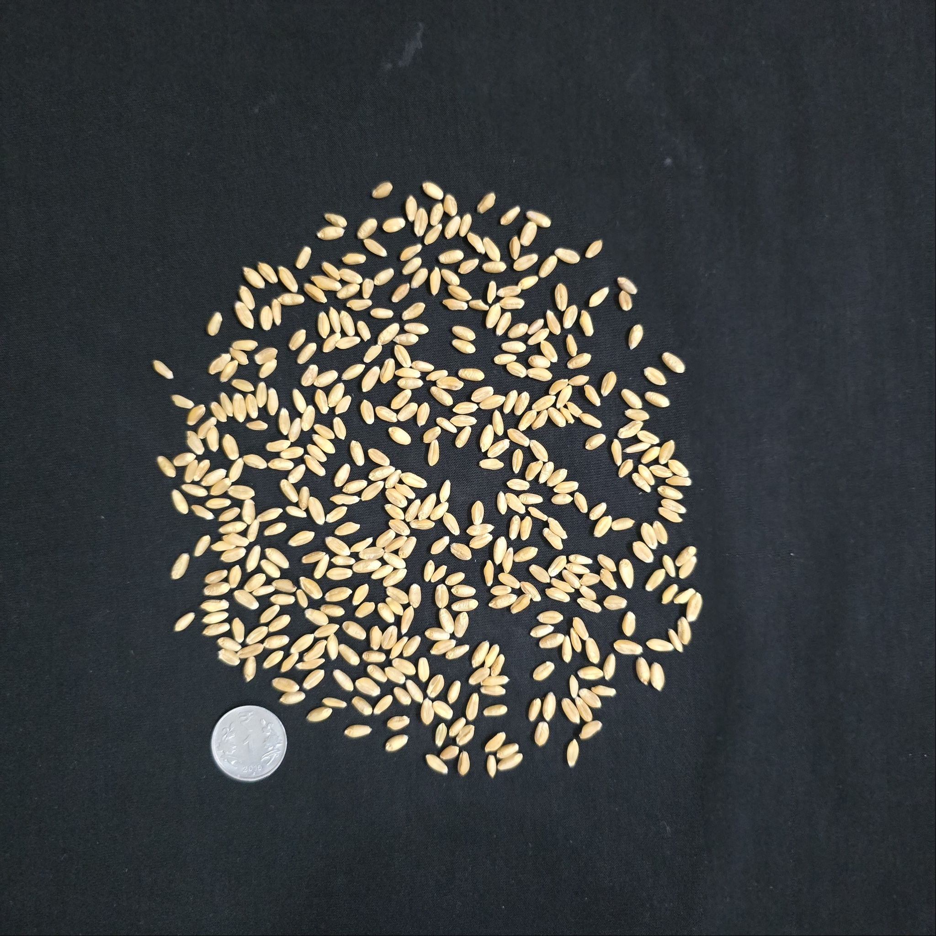


Results — independent real-photo observations
Wheat source A
Fabric hole
Fabric oil
Predicted foreign share: 48.9%.
Clean 0%; whole grains 97.5%.
Weighted score: 48.75% → C.
Confidence: 57.92% → review.
Apparently clean grains were
misread on this external input.
Bad patches: 6.2%.
Quality: 57.5% → Grade C.
Requires verification.
Share is a patch prediction,
not a physical defect-area label.
Bad patches: 14.9%.
Quality: 0% → Grade C.
Confidence: 50.83% → review.
One small rehearsal cannot
establish general accuracy.
8 cases: 3 wheat pairs, 4 fabric pairs and 1 training-source-overlap reference; a workflow rehearsal, not an accuracy benchmark.
11
Notes:
Results — real-world input rehearsal
Show that these are genuine source photographs with backgrounds and visible fabric structures unlike the project’s training-source examples. Three wheat pairs come from Wheat_Grading_Dataset, and four fabric pairs come from the original Defect Spectrum cotton collection. The eighth case is the AgroAI green-sheet reference and is deliberately labeled as overlapping the documented training source. The number eight describes workflow exercises, not a representative or statistically valid accuracy benchmark. The saved raw response for each case records scores, confidence, grade and required verification.
Results — wheat exposes a failure case
This original source-A photo produced a predicted foreign share of 48.9% despite the grain sample’s apparent cleanliness. The response converted that into 0% cleanliness quality; whole-grain quality was 97.5%. With equal weights, the combined quality is 48.75%, Grade C. Confidence was capped at 57.92% and the case was correctly routed for review. Do not equate the source dataset’s letter label directly with the app’s Grade A/B/C thresholds, or claim a causal diagnosis from a visual inspection. Background or domain differences are plausible contributors, not an established cause.
Results — fabric predictions vary
The hole example yields a 6.2% predicted bad-patch share and 57.5% visual-defect quality, leading to Grade C. The oil example yields a 14.9% predicted bad-patch share and zero visual-defect quality. Confidence is low, including 50.83% on the oil case, so these cases also remain in the review queue. These values are predictions rather than annotated defect-area measurements. Only a small set of external source photos was exercised; avoid ranking the model’s general ability to detect holes versus oil from one example of each.
Sources and evidence:
https://huggingface.co/datasets/SamWithAi/Wheat_Grading_Dataset
https://huggingface.co/datasets/DefectSpectrum/Defect_Spectrum/tree/main/DS-Cotton-Fabric
https://github.com/sachin235/AgroAI
.demo/real-images/grading-results.json; REAL_IMAGE_RESULTS.md; original dataset photo manifest and SHA-256 receipts.

Slide 12
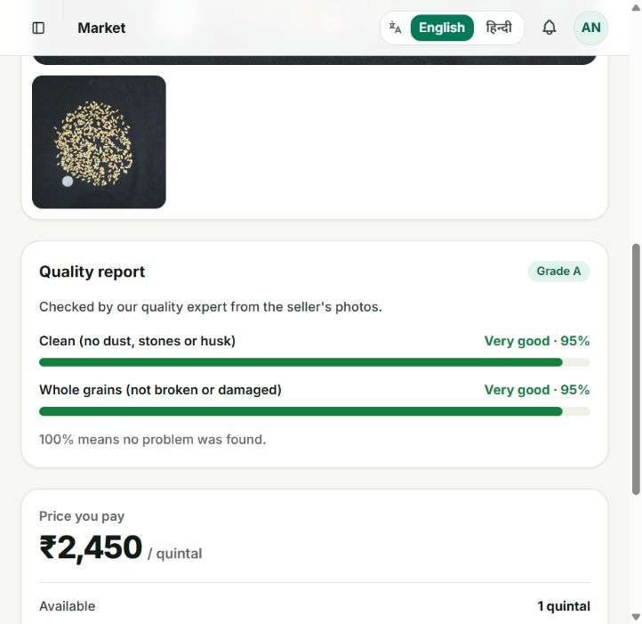
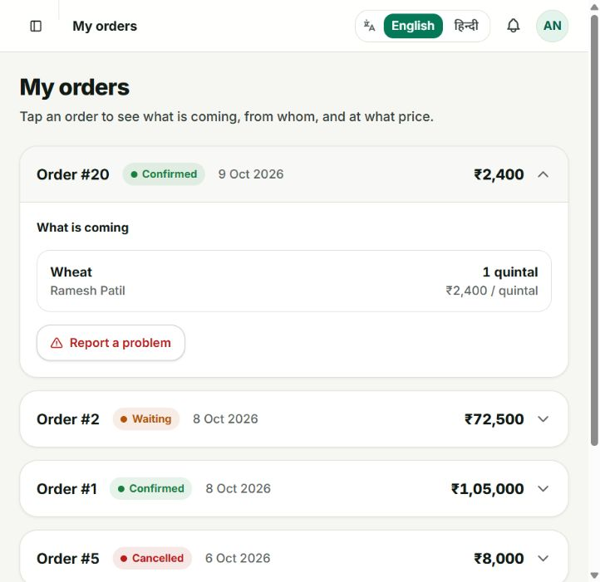
Results — verified quality, negotiated order and stock
Human decision persisted · listing #85
Order #20 confirmed · ₹2,400
AI Grade C → illustrative 95% + 95% correction.
Grade A → ACTIVE; stock now 1 q.
Human scores demonstrate review, not AI accuracy.
₹2,300 bid → ₹2,400 counter → acceptance.
Order #20: 1 q × ₹2,400; stock 2 q → 1 q.
API steps; website confirms persistent records.
Actual local integration proof. Manual review validates the application workflow; payment and physical delivery are outside this proof.
12
Notes:
Results — a human decision was persisted
A new presentation-evidence listing 85 was created with two original source-A wheat photos and two quintals of stock. Its automatic output was Grade C at 57.92% confidence and it entered the verification queue. A role-authenticated verifier API call supplied illustrative corrected quality scores of 95% for each attribute, producing Grade A and an active listing. This demonstrates persistence of a human decision, not an accuracy improvement or an independently measured 95% ground truth. The response’s confidence value of one is a manual-review marker, not 100% AI accuracy.
Results — negotiated order and stock
This is the fresh transaction proof in the local presentation rehearsal. The buyer offered 2,300 for one quintal from listing 85. The seller countered at 2,400. The buyer accepted the counter, creating order 20 with CONFIRMED status and total 2,400. The same listing’s stock decreased from two quintals to one. These steps were performed through separately role-authenticated API calls, then the website was used to inspect the persisted order. This proves integrated application behavior; it does not demonstrate physical delivery, payment settlement or the complete phone UI negotiation sequence.
Sources and evidence:
.demo/presentation-build/workflow-proof.json — role-authenticated local API rehearsal, 8–9 October 2026; screenshot from the running website.
http://localhost:3000/buyer/catalog/85
http://localhost:3000/buyer/orders

Slide 13
Results — software checks, file integrity and allocation
Software evidence | Observed result | What it verifies
Local readiness | 34 / 34 passed | Services and selected API workflows
Android core suite | 34 passed; 1 skipped | Executed core cases have no failures
Android live-backend case | 1 passed | App client reached the real backend
Browser rehearsal | Passed; no count claimed | Saved receipt records a successful run
Saved allocation at ₹2,000 / q
Original files and local state
Source | Qty (q) | Amount
Listing 72 | 40 | ₹80,000
Listing 73 | 20 | ₹40,000
Total | 60 | ₹1,20,000
15 / 15 original photos verified by SHA-256
on the phone and in stored / HTTP-served media.
Phone album: Pictures/YieldnYarnReal.
Current snapshot: 23 listings, 6 orders, 8 people.
Allocation receipt: 2 sources, fully fulfilled,
0 q shortfall; temporary sample records cleaned.
Software and file checks verify integration, not grading accuracy. Multi-seller result is a retained earlier integration receipt.
13
Notes:
Results
Read the counters as software evidence, not model-accuracy evidence. The saved readiness run records 34 checks passing. The Android core receipt contains 35 test cases, zero failures and errors, and one skipped case: 34 cases executed successfully. A separate live-backend Android test passed. Eight real-photo grading cases and original-file receipts provide additional integration evidence. The browser run receipt records a passed status but does not persist a count, so no browser test count is claimed here. This review preparation did not rerun the complete training or all historical suites.
Results — original photos preserved
The independent inputs were transferred to the physical phone album Pictures/YieldnYarnReal. The transfer receipt verifies 15 original files by SHA-256. The backend integrity receipt verifies the same 15 originals in storage and over their HTTP media URLs. This guards against a demonstration accidentally using thumbnails or generated substitute images. The grading rehearsal contains eight cases: three independent wheat pairs, four independent fabric pairs and one green-sheet reference. The reference overlaps a documented training-source collection and therefore is not an independent accuracy test.
Results — multi-seller allocation
The saved earlier integration receipt shows a requirement fulfilled by two listings. Listing 72 supplied 40 quintals and listing 73 supplied 20 quintals, both at 2,000 per unit, yielding a 60-quintal total and 120,000 total price. The receipt explicitly records fully_fulfilled true and zero shortfall. Those temporary records were later cleaned from the prepared database; therefore this is a retained integration receipt rather than a current website order screenshot. The allocation table is editable and displays the arithmetic directly.
Results — marketplace state is inspectable
The actual administrator dashboard now shows 23 listings across statuses, six orders and eight people. It also surfaces pending quality checks and open complaints. These are local database records for a faculty demonstration, including seeded examples and the fresh presentation listing and order. The dashboard’s rounded money-in-orders value is not used as a performance metric. A healthy local demo means the user can trace records across the interfaces, not that all listings are approved or every seeded case is a new verified transaction.
Sources and evidence:
.demo/readiness.json
.demo/android-core-tests.json
.demo/android-live-test.json
.demo/playwright-results/.last-run.json
.demo/real-images/phone-transfer.json
.demo/real-images/backend-image-integrity.json
.demo/real-images/manifest.json
.demo/real-images/grading-results.json; REAL_IMAGE_RESULTS.md; original dataset photo manifest and SHA-256 receipts.
.demo/photo-and-matching.json — saved multi_seller_match integration response; temporary sample records later cleaned.
http://localhost:3000/admin/dashboard — captured during presentation preparation.

Slide 14
Conclusion, limitations & references
Demonstrated outcome
Practical limits
Original photos → quality review → price / negotiation → order → stock update.
Agriculture and textiles share configurable rules. Multi-seller demand, recorded orders and staff complaints complete the local workflow.
Low confidence and weak recall require a verifier. Photos do not measure moisture or GSM. The small input rehearsal uses prepared local prices; Firebase push is not configured. Payments, delivery and commercial scale are outside the demonstrated scope.
Live demo: phone → verifier → catalog / order → estimate / requirements → admin
References
eNAM official trader information · Howard et al., MobileNetV3 (ICCV 2019) · Fan et al., GrainSpace (CVPR 2022)
Bergmann et al., MVTec AD (CVPR 2019) · Yang et al., Defect Spectrum (ECCV 2024)
Data: AgroAI; TILDA-format fabric data; Wheat_Grading_Dataset; original DS-Cotton-Fabric
Local proof: model evaluation JSON, workflow-proof.json, photo-and-matching.json and software-test receipts
Detailed methodology, dataset provenance, source URLs, exact demo fields and review evidence are retained in the speaker notes.
14
Notes:
Limitations
The current inference caps mean automatic approval is unavailable: a verifier is needed even for Grade A outputs. Saved balanced accuracy is modest, damaged-grain recall is weak and the fabric model misses many defective patches. Independent inputs expose transfer problems; the photo rehearsal is too small to establish general accuracy. Moisture and GSM require other measurements. The demo uses prepared prices and in-app notification records; Firebase push is not configured. Payment settlement, delivery logistics and commercial scale are outside the demonstrated scope. Present these boundaries candidly, without shifting the review into new development or security work.
Conclusions
The prototype achieves an inspectable local workflow across seller capture, quality analysis, human verification, price calculation, requirements, negotiation and persistent order records. The strongest fresh evidence is listing 85 and order 20, because both the decision and stock movement can be inspected. The strongest scientific conclusion is more limited: successful integration does not make the grader reliable under changing inputs. The project’s human-review path is therefore essential to the current demonstration. Do not describe the prototype as a replacement for laboratory quality certification.
References — data and local proof
Use the source manifest to trace original photos. Wheat demonstration inputs come from the public Wheat_Grading_Dataset distribution. Fabric inputs come from original Defect Spectrum cotton images. AgroAI and the TILDA-format repository are the documented training-source collections. Local JSON receipts are the evidence for file integrity, software checks, photo grades and transaction behavior. WEBSITE_DEMO.md is the companion faculty walkthrough. These references make the presentation reproducible without inventing a test dataset, a new training run or unsupported accuracy.
Sources and evidence:
.demo/real-images/grading-results.json; REAL_IMAGE_RESULTS.md; original dataset photo manifest and SHA-256 receipts.
ml-training/reports
DEMO_GUIDE.md
Repository implementation: backend-django, backend-fastapi, seller-app, web-app. Detailed faculty walkthrough: WEBSITE_DEMO.md.
.demo/presentation-build/workflow-proof.json — role-authenticated local API rehearsal, 8–9 October 2026; screenshot from the running website.
https://huggingface.co/datasets/SamWithAi/Wheat_Grading_Dataset
https://huggingface.co/datasets/DefectSpectrum/Defect_Spectrum/tree/main/DS-Cotton-Fabric
https://github.com/sachin235/AgroAI
https://github.com/sivasgitt/AI-Fabric-Defect-Detection

