Slide 1
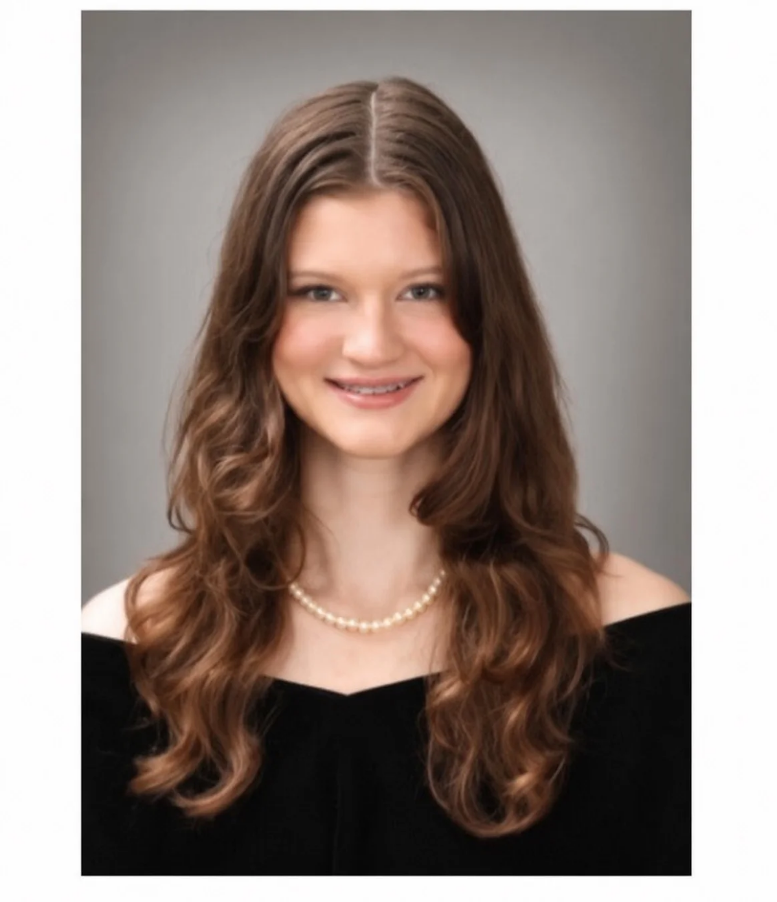
Hayli
FOUNDER & OWNER-OPERATOR
(850) 426-8479
owner@sparkling-standard.com · sparkling-standard.com

Slide 2
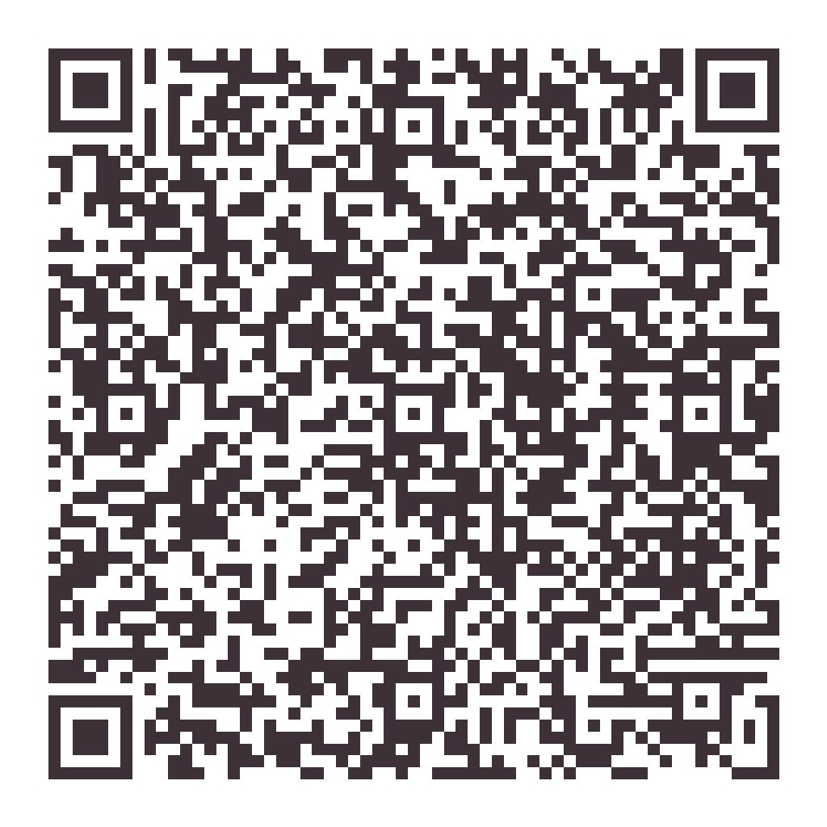
A note from Hayli
When your home needs a hand, I answer personally — and the details stay done.
Weekly, biweekly or monthly
The same careful standard
Hayli confirms every request
Scan me

