Slide 1
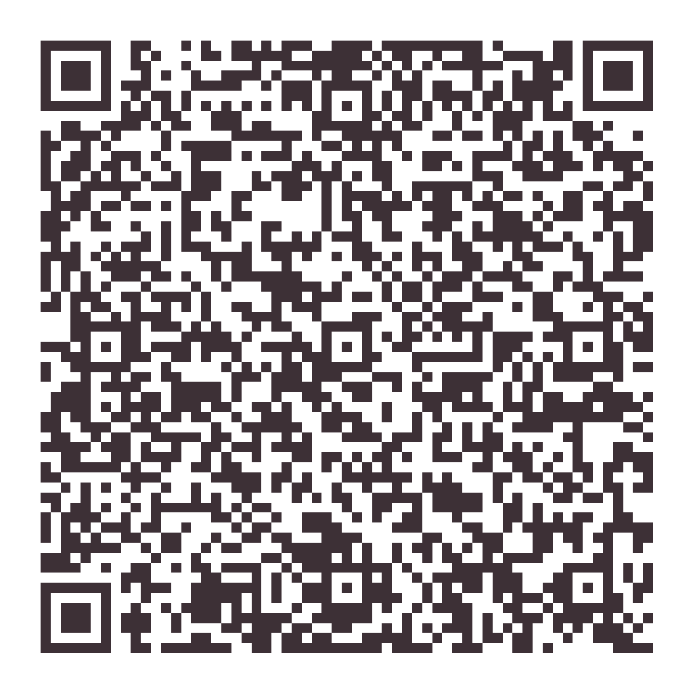
Keep this note.
Ways I can help your home.
✓ Recurring house cleaning
✓ Deep cleaning
✓ Move-in / move-out
✓ Short-term rentals
✓ Commercial spaces · Churches
Owner-operated by Hayli
Every request is confirmed personally, and the details stay done visit after visit.
(850) 426-8479
owner@sparkling-standard.com
sparkling-standard.com
Scan me

