Slide 1

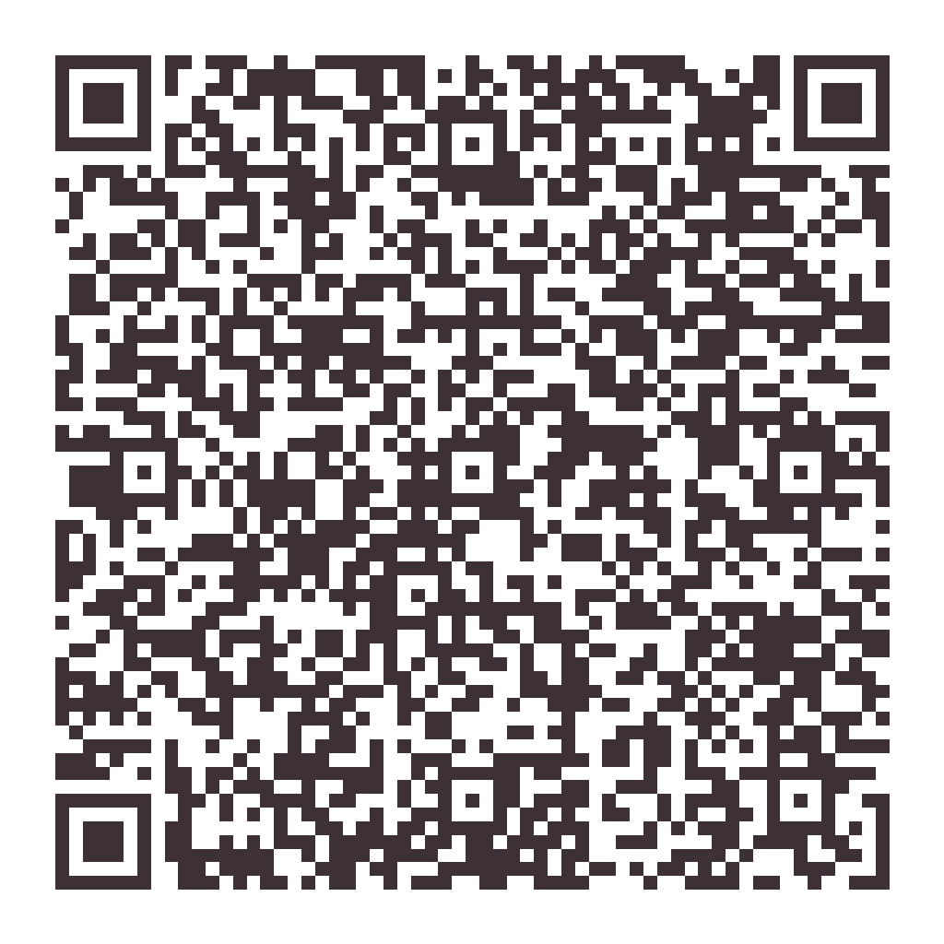
Hello,
neighbor!
Let me take care of your home.
Recurring house cleaning in this neighborhood — with the details most cleaners skip.
✓ Weekly, biweekly or monthly plans
✓ Honest estimates built from real labor hours
✓ Every request confirmed by Hayli
Call or text
(850) 426-8479
sparkling-standard.com
Scan me

