Slide 1
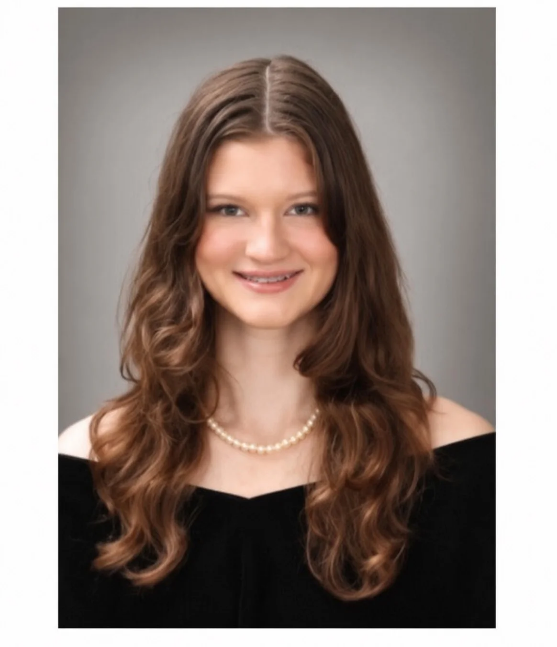
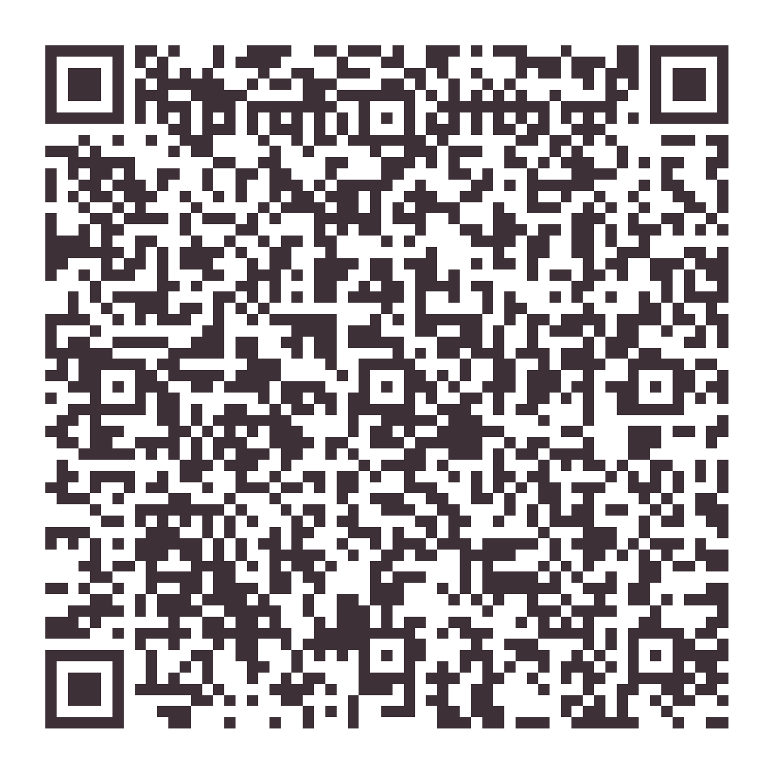
PENSACOLA · CANTONMENT
OWNER-OPERATED
The Details Are Our Standard.
Recurring house cleaning in Pensacola and Cantonment — weekly, biweekly or monthly.
01 Estimates built from real labor hours
02 The details most cleaners skip, every visit
03 Hayli confirms every request personally
NOW SCHEDULING IN YOUR NEIGHBORHOOD
Hayli
Founder & Owner-Operator
Serving Pensacola, Cantonment and surrounding communities within about an hour of Cantonment, with select nearby service into Alabama.
(850) 426-8479
owner@sparkling-standard.com
sparkling-standard.com
Seven days a week · 8:00 AM – 6:00 PM
SCAN FOR A FREE INSTANT ESTIMATE

