Slide 1
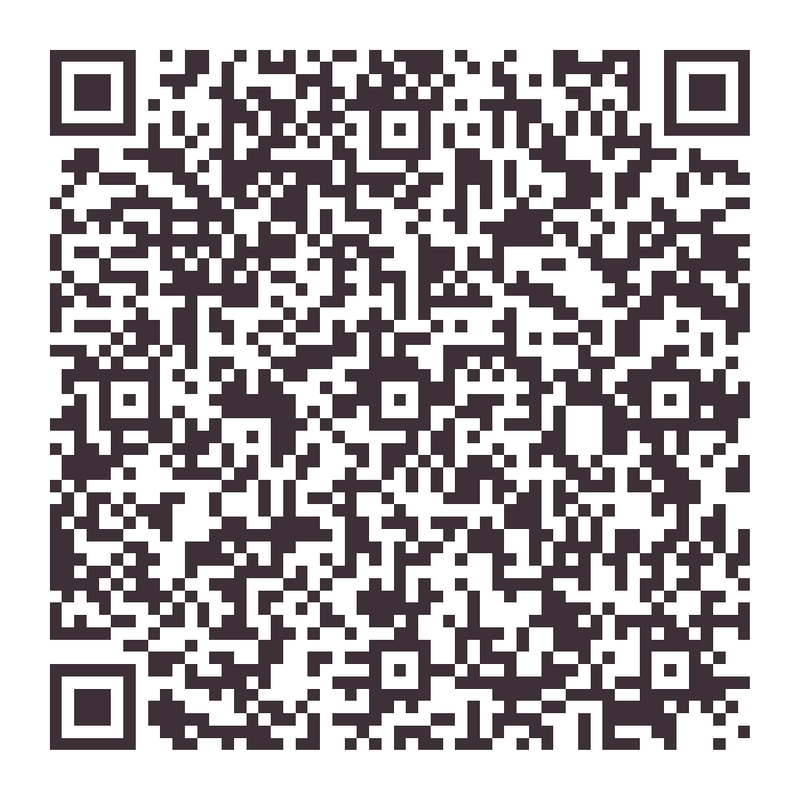
Let's get your price.
Scan me
Answer a few questions about your home and see your proposed price instantly.
No obligation. Hayli confirms every request personally before anything is scheduled.
(850) 426-8479

