Slide 1
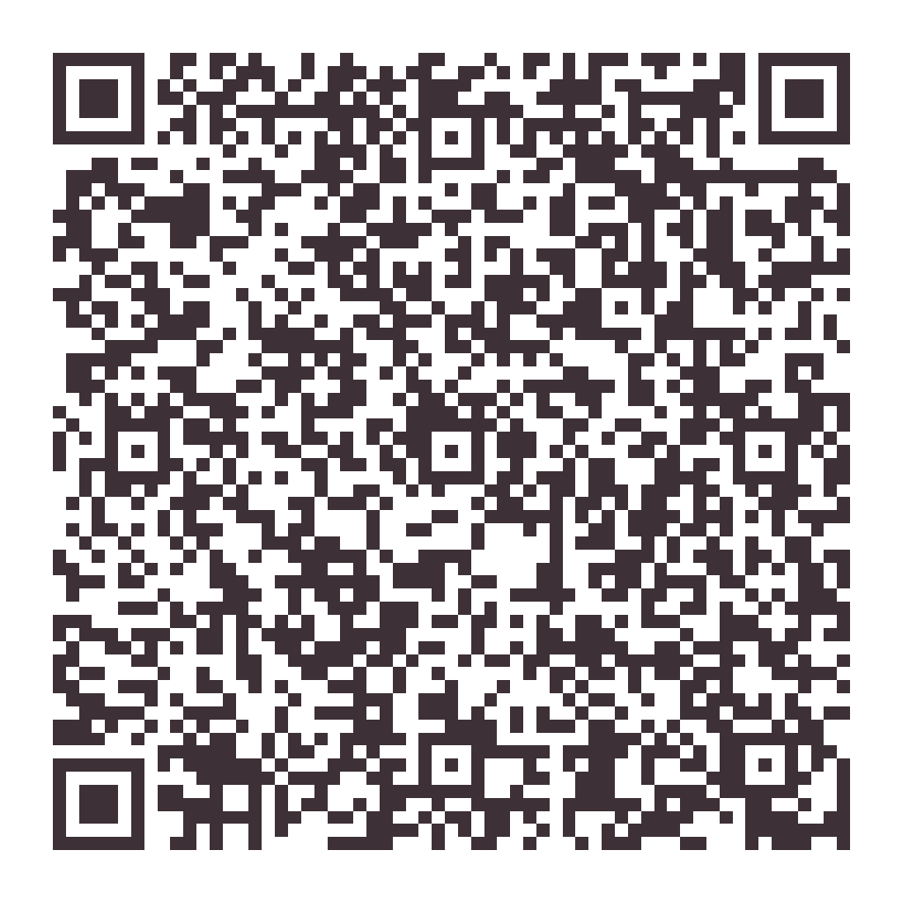
FOR REALTORS
Move-out cleaning, scheduled around closings.
☐ Move-in / move-out cleaning
☐ Confirmed personally by Hayli
MOVE-OUT PAGE
(850) 426-8479
owner@sparkling-standard.com · sparkling-standard.com

