Slide 1

Global ALM-Community <<Meeting Title>>
<<PRESENTER>>, <<ROLE>>

Slide 2
Thanks to our Sponsors!
1

Slide 3
Thanks to our Sponsors!
2

Slide 4
Thanks to our Sponsors!
3

Slide 5

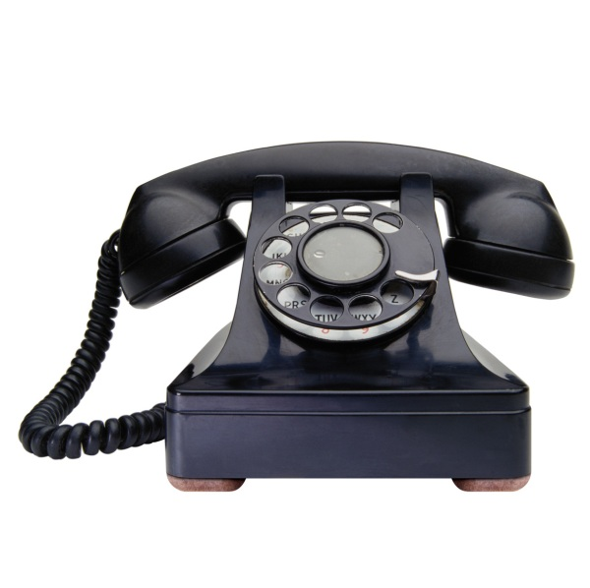

Introduction:
30 minutes in length.

Slide 6



Open Source ALM Library:
Your
Standards Team
InstantALM
Standards Lib
Your
Standards Lib
Massive cost savings for any organisation!

Slide 7
Enterprise SEPG Model
Enterprise SEPG
Business Unit 1
Business Unit 2
Business Unit 3

Slide 8
Scaling up to city
.NET UG
Test SIG
DevOps
BA Agile
Agile
Melbourne SEPG
Company 1
Company 2
Company 3
Stephan Dekker, SDLC Architect

Slide 9
Scaling up to country
Australia SEPG
Perth
Melbourne
Sydney
Stephan Dekker, SDLC Architect

Slide 10
Scaling up to global
Global SEPG
Perth
Perth
Perth
Perth
Perth
Perth
Australia
New Zeeland
India
Stephan Dekker, SDLC Architect

Slide 11
But… But… But…
No two organisations
are the same!
Stephan Dekker, SDLC Architect

Slide 12
Assumption: 80-20 Rule
Many (80%) standards are actually the same across organisations.
For the other 20% there is a solution.
Because in fact:
the open source world already solved it!
Stephan Dekker, SDLC Architect

Slide 13
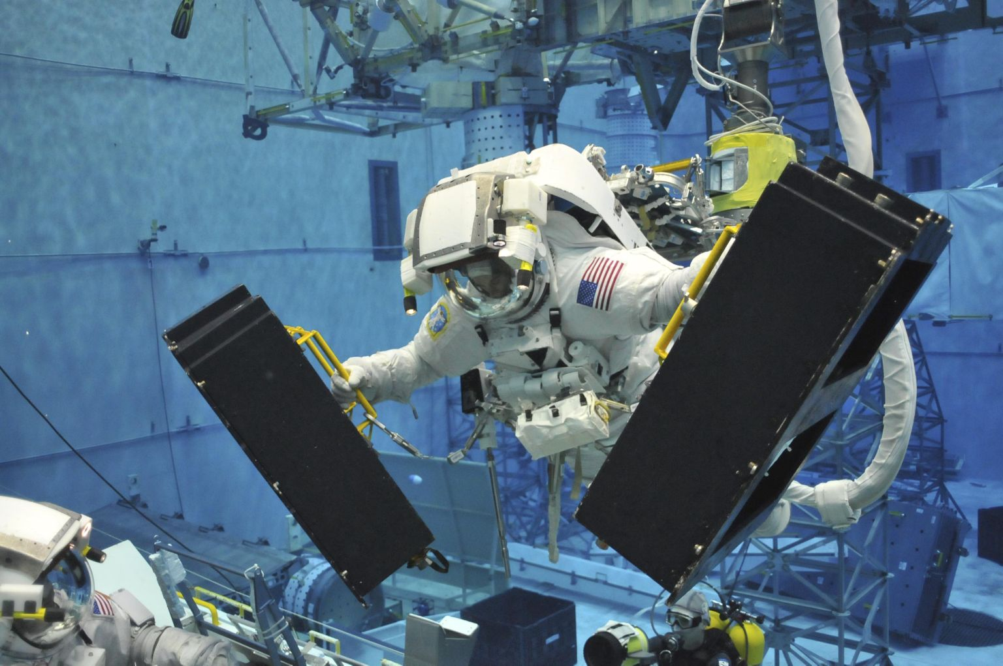
Customize
The great thing about Open Source:
If you don’t like a module, improve it!
Stephan Dekker, SDLC Architect

Slide 14
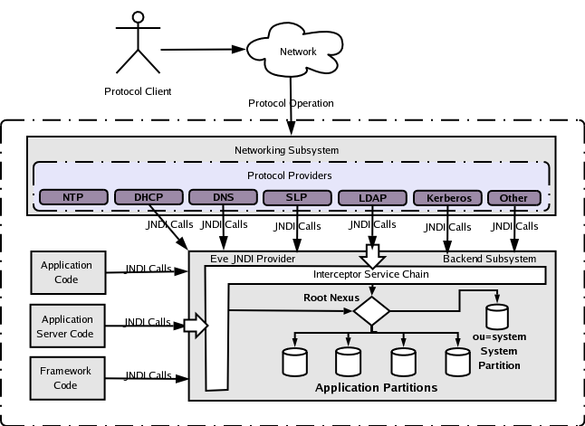
Apache web server:
Stephan Dekker, SDLC Architect

Slide 15
My Improved web server:
DNS
Stephan Dekker, SDLC Architect

Slide 16

Enterprise Standards Library
Enterprise Standards Lib
Generic
Content
Generic
Content
Generic
Content
Generic
Content
Generic
Content
Generic
Content
Generic
Content
Generic
Content
Generic
Content
Generic
Content
Generic
Content
Generic
Content
Generic
Content
Generic
Content
Generic
Content
Business Unit 1 Customisation
Business Unit 2
Customisation
Business Unit 3
Customisation
Stephan Dekker, SDLC Architect

Slide 17
Adopting the standards
Your
Standards Team
InstantALM
Standards Lib
Your
Standards Lib
Stephan Dekker, SDLC Architect

Slide 18

Contribute
Everyone is updating the
single standards lib
Stephan Dekker, SDLC Architect

Slide 19

Get updates
Keep receiving approved enhancements*
InstantALM
Standards Lib
Your
Standards Lib
* Manual Merging is required when updating customized modules
Stephan Dekker, SDLC Architect

Slide 20
References
Description: | URL:
Standards Library: | http://www.instantalm.org
Community Portal: | http://www.alm-community.org
Meetings: | http://meetup.alm-community.org
Stephan Dekker, SDLC Architect

