Slide 1
Media Notes
Sparks-Lu
Last updated: 2/2/2020

Slide 2
References
https://helgeklein.com/blog/2017/12/browser-video-codecs-formats-hardware-acceleration/
https://www.fourcc.org/codecs.php

Slide 3
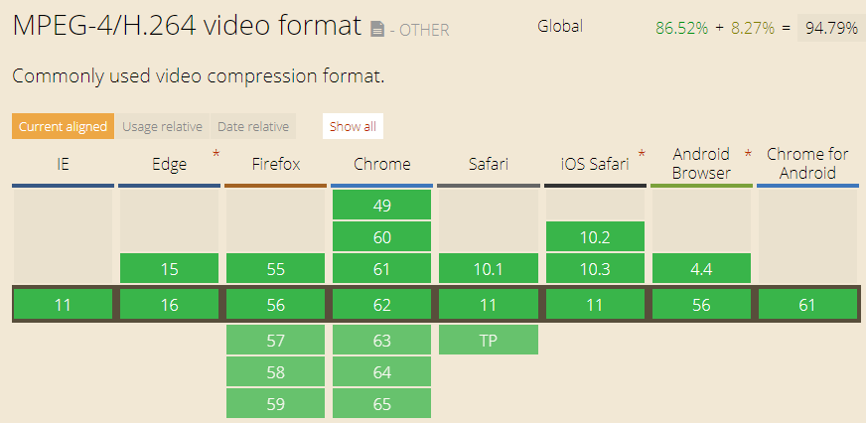
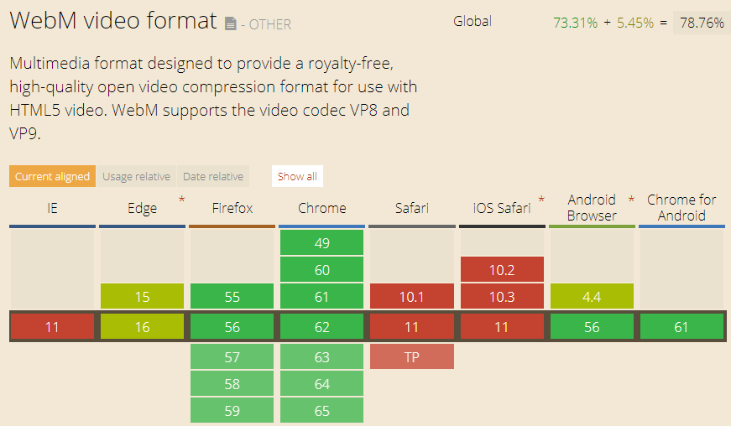
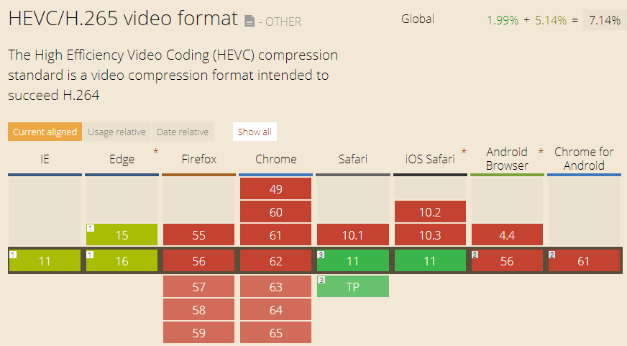
Video Container Format
MP4
audio encoding: AAC, MP3
video encoding: H.264 (AVC), H.265(HEVC)
not royalty-free
WebM
audio encoding: Ogg Vorbis
video encoding: VP8, VP9
royalty-free

Slide 4
FourCC
Intro
Short for “Four Character Code”
An identifier for a video codec, compression format, color, or pixel format used in a media file.
Video Codecs by FourCC
H264
X264
XVID

Slide 5
FFMPEG
Options
ffmpeg -codecs // List install codecs
ffmpeg -fomats
ffmpeg -decoders
ffmpeg -encoders
ffmpeg -filters
ffmpeg -y // overwrite without confirmation
Change video codec to h264
ffmpeg -i in.mpg -c:v libx264 out.mp4

