Slide 1
WeChat Notes
Sparks Lu
Last updated: 2020-2-6

Slide 2
Login by Scan QR Code

Slide 3
References
https://developers.weixin.qq.com/doc/oplatform/Website_App/WeChat_Login/Wechat_Login.html
https://blog.csdn.net/zl1zl2zl3/article/details/84261398

Slide 4
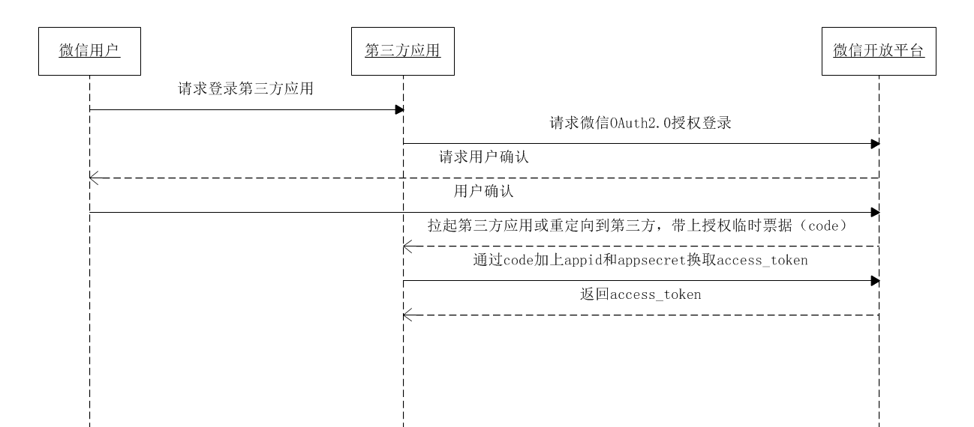
Process

Slide 5
WeChat Applet

Slide 6
Framework 1/3
View: WXML/WXSS
Data binding
Behavior binding
Logic: JavaScript
https://mp.weixin.qq.com
WXSS: WeiXin Style Sheet
WXML: WeiXin XML

Slide 7
Framework 2/3
declaration of data
Page({
data: {
var-name: value
},
function-name: function() {
}
onLoad: function() {
}
})
{{var-name}}
<view bindtap=”function-name”>
Binding data
declaration of behavior
Binding behavior
Logic
View

Slide 8
Framework 3/3
Navigate Among Pages
wx.navigateTo({
url: '../logs/logs'
})

Slide 9
Components
View Container
Basic Content
From
view
icon
form
button
input
scroll-view
text
checkbox
radio
picker
swiper
progress
picker-view
slider
switch
label
Miscellaneous
Media
map
audio
canvas
image
Navigation
navigator
contact-button
video

Slide 10
API
Network
Media
File
wx.request
wx.chooseImage
wx.saveFile
wx.uploadFile
wx.previewImage
wx.getSavedFileList
wx.downloadFile
wx.startRecord
wx.getSavedFileInfo
wx.stopRecord
wx.connectSocket
wx.playVoice
wx.removeSavedFile
wx.onSocketOpen
wx.pauseVoice
wx.openDocument
wx.stopVoice
wx.onSocketError
wx.getBackgroundAudioPlayerState
Storage
wx.sendSocketMessage
wx.playBackgroundAudio
wx.onSocketMessage
wx.pauseBackgroundAudio
Location
wx.seekBackgroundAudio
wx.closeSocket
wx.stopBackgroundAudio
Device
wx.onSocketClose
wx.onBackgroundAudioPlay
UI
wx.onBackgroundAudioPause
wx.onBackgroundAudioStop
Wechat
wx.chooseVideo

Slide 11
JSSDK
微信内网页开发工具包

Slide 12
Reference
https://developers.weixin.qq.com/doc/offiaccount/OA_Web_Apps/JS-SDK.html
https://pay.weixin.qq.com/wiki/doc/api/index.html

Slide 13
Prepare
在微信公众平台中绑定域名
前端引入相关JS文件
分享好友
通过config接口注入权限验证配置
分享朋友圈

Slide 14
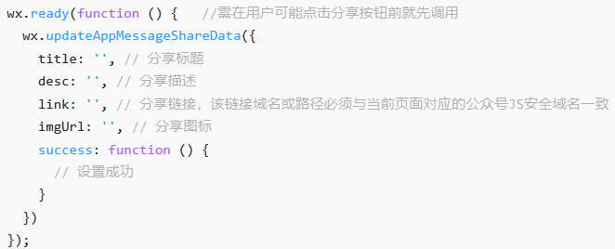
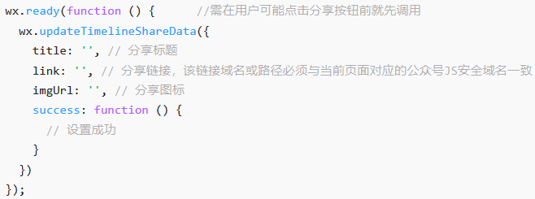
Share

Slide 15
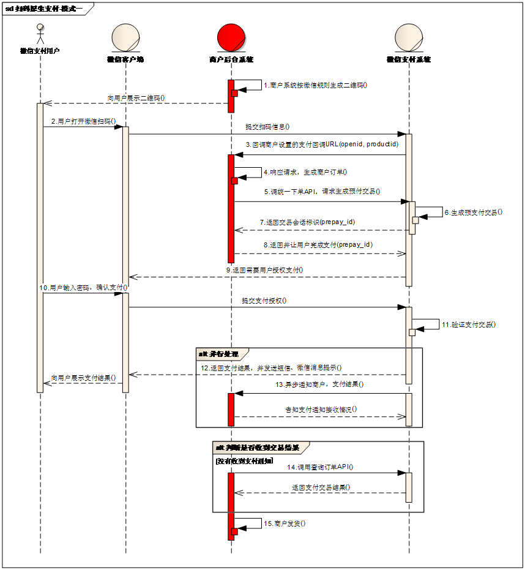
Pay
扫码支付

Slide 16
JSSDK
wx.config({
debug: true, // 开启调试模式,调用的所有api的返回值会在客户端alert出来，若要查看传入的参数，可以在pc端打开，参数信息会通过log打出，仅在pc端时才会打印。
appId: '', // 必填，公众号的唯一标识
timestamp: , // 必填，生成签名的时间戳
nonceStr: '', // 必填，生成签名的随机串
signature: '',// 必填，签名
jsApiList: [] // 必填，需要使用的JS接口列表
});
获取access token
https://developers.weixin.qq.com/doc/offiaccount/Basic_Information/Get_access_token.html
获取jsapi ticket
https://api.weixin.qq.com/cgi-bin/ticket/getticket?access_token=ACCESS_TOKEN&type=jsapi
签名

