Slide 1
Leap Motion Notes
Sparks Lu
Last updated: 2016-2

Slide 2
Overview
Introduction
SDK v2.3
Leapmotion.com
Support Windows/Linux/OS X
Use optical sensors and infrared light
150 degree FOV
Range: 25~600mm
Native and WebSocket interface

Slide 3
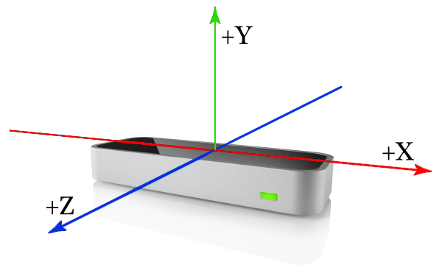
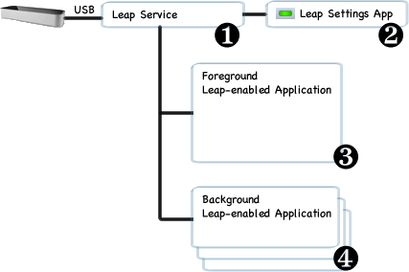
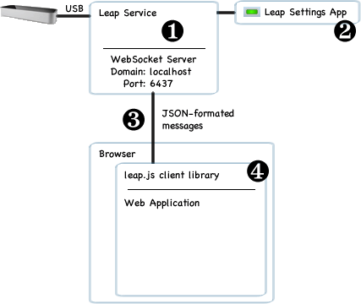
API Overview
Right-handed Cartesian coordinate system

Slide 4
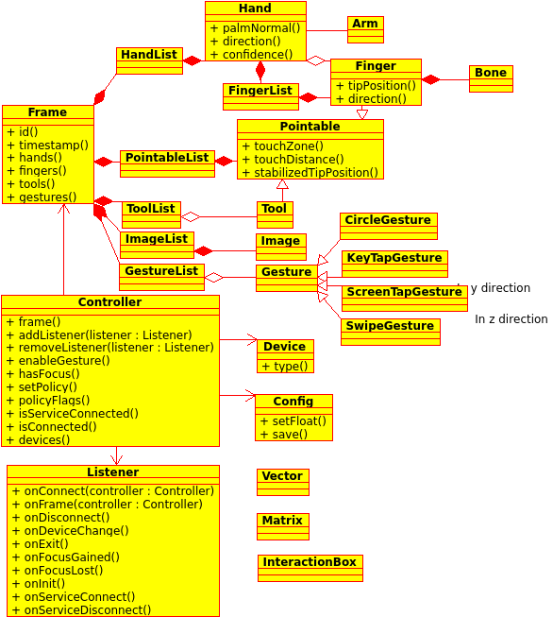
Classes

Slide 5
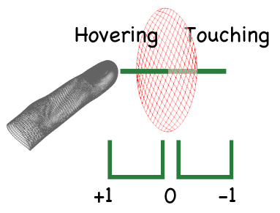
Virtual Touch Surface
Right-handed Cartesian coordinate system

