Slide 1
Docker Notes
Sparks Lu
Last updated: 12/24/2019

Slide 2
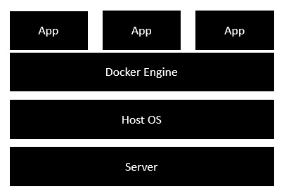
Intro
Concept
Docker: a platform to build, share, and run applications with containers
container: a running process
Docker image: everything needed to run an application
Dokerfile: describe how to assemble a private filesystem for a container
Install
Docker for Windows
https://github.com/docker/toolbox/releases
Start “Docker Quickstart Terminal”
Linux
sudo apt install apt-transport-https ca-certificates curl gnupg-agent software-properties-common
curl -fsSL https://download.docker.com/linux/ubuntu/gpg | sudo apt-key add -
Test install: docker run hello-world

Slide 3
Components
Docker Compose
Bundle a multi-container application into a single app
docker-compose --version
Docker Machine
Create Docker hosts both locally and in the cloud
docker-machine --version
Kitematic
Docker CLI Client
Docker Compose
Docker Machine
Docker Engine

Slide 4
Working Logic
Docker Client
Docker Daemon
contact
pull from Docker Hub
create a new container
stream output

Slide 5
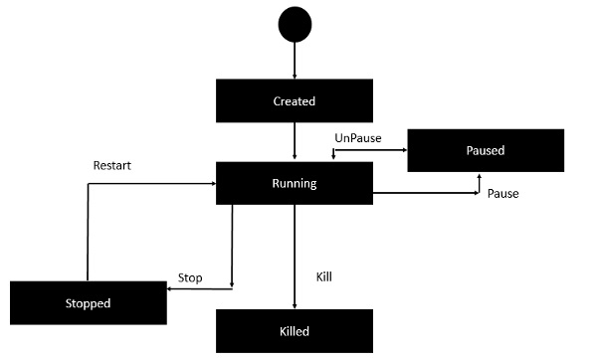
Container Lifecycle

Slide 6
Docker Commands
docker commands
docker version/info
docker pull busybox // pull busy image from docker registry
docker run {image-name} // create a new container and run an image
-it // interactive
-p {port-number-host}:{port-number-container}
docker images // list installed images
docker image build -t {image-name} .
docker container run --name {container-name} {image-name}
docker container rm --force {container-name}
docker rmi {image- id}
docker inspect {image-name}
docker ps // list containers
-a // list all
docker history {image-id}
docker top/stats/attach/pause/unpause/kill/stop/rm {container-id}
service docker start/stop // stop Docker daemon
docker network ls, docker network inspect {name}

Slide 7
Docker Machine Commands
docker-compose commands
docker-machine create -d virtualbox dev
eval $(docker-machine env dev)
docker-machine ls
docker-machine ip default

Slide 8
Docker Compose Commands
Intro
Used to run multiple containers as a single service
docker-compose commands
docker-compose.yml
docker-compose build
docker-compose up -d // Start up processes
docker-compose run web env // show env variables
docker-compose logs // show logs
docker-compose down // Shut down processes

Slide 9
Dockerfile
Commands
FROM // from which you want to base your image with
WORKDIR
COPY
RUN
CMD
CMD [“echo”, “Image created”]
MAINTAINER // mail address
ENV {key1}={value1}
WORKDIR {dirname}
Build
docker build -t {image-name}:{tag-name} dir
-t: with tag
Public respositories
Docker Hub
#This is a sample Image
FROM ubuntu
MAINTAINER demousr@gmail.com
RUN apt-get update
RUN apt-get install –y nginx
CMD [“echo”,”Image created”]

Slide 10
References
https://www.tutorialspoint.com/docker/

