Slide 1
DSP Notes
Sparks Lu
Last updated: 6/4/2019

Slide 2
Abbreviations
VISA Video, Imaging, Speech, Audio
xDAIS eXpress DSP Algorithm Interoperability Standard
xDM eXpress Digital Media
CE Codec Engine
DVEVM Digital Video EValuation Module

Slide 3
Davinci
DSP + ARM

Slide 4
CCS (Code Composer Studio)

Slide 5
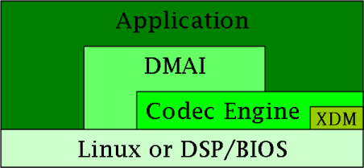
DMAI (Davinci Multimedia Application Interface)
Concept

Slide 6
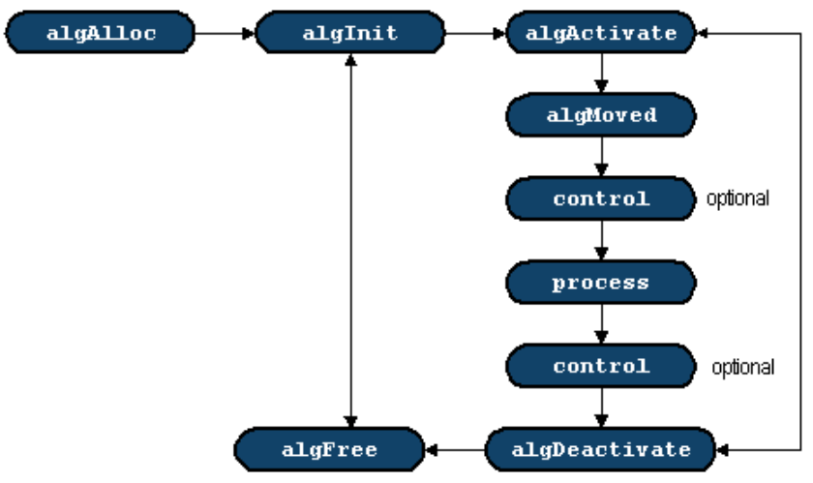
xDM
Concept

Slide 7
CE (Codec Engine)
Concept
algorithm engine

Slide 8
DVSDK (Digital Video SDK)

