Slide 1
internal to iOS UI
Sparks Lu
2015-12-12

Slide 2
agenda
UI Authoring
Runtime Engine
Controls
Design Pattern

Slide 3
UI authoring

Slide 4
concepts
Interface Builder
.nib, .xib
Storyboard
Storyboards are the recommended way to design app’s user interface.
Segue: transition from one view controller to another.
Interface with codes
Outlet
a property of an object that references another object
The connection between an object and its outlets is archived in a nib file.
type qualifier: IBOutlet
Actions

Slide 5
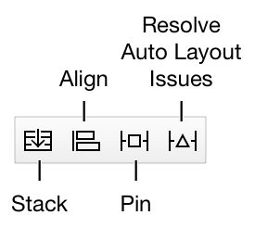
Auto Layout
Constraint-Based
Auto layout defines your user interface using a series of constraints.
Constraints typically represent a relationship between two views.
Auto Layout Using Stack Views
A single stack view defines a row or column of user interface elements.
axis, orientation, distribution, alignment, spacing
Equation
Each constraint represents a single equation
Equation instead of assignment
Auto Layout Attributes
leading, trailing, top, bottom, width, height, center x, center y
NSLayoutAttribute enum
Working with Constraints in Interface Builder
Control-click and drag

Slide 6
Multi-lingual

Slide 7
runtime engine

Slide 8
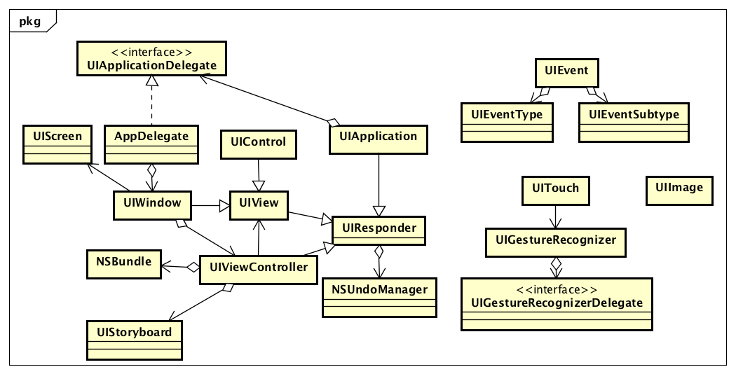
Class diagram in UI Kit

Slide 9
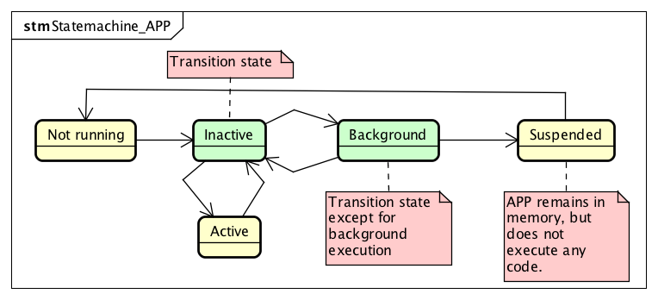
Application lifecycle

Slide 10
event handling
Responder Chain
iOS passes events along the responder chain until being handled.
UIEventType
UIEventTypeTouches, UIEventTypeMotion, UIEventTypeRemoteControl, UIEventTypePresses
UIEventSubtype
UIEventSubtypeNone, UIEventSubtypeMotionShake

Slide 11
touch event handling
Basic
Touch event is delivered to the view object in which the event occurred.
Any touch event not handled by the view are forwarded down the responder chain for processing.
Touch Phase
UITouchPhaseBegan, UITouchPhaseMoved, UITouchPhaseStationary, UITouchPhaseEnded, UITouchPhaseCancelled
Touch Type
UITouchTypeDirect, UITouchTypeIndirect, UITouchTypeStylus

Slide 12
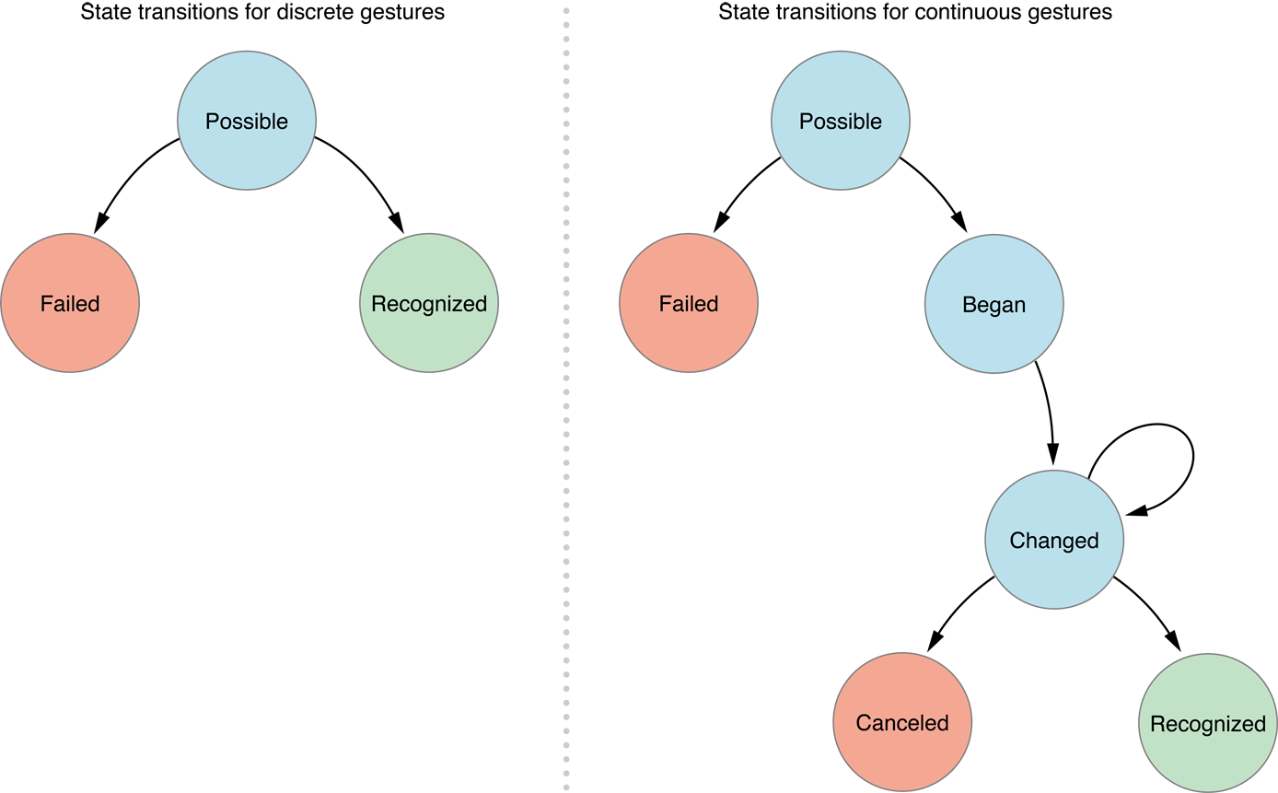
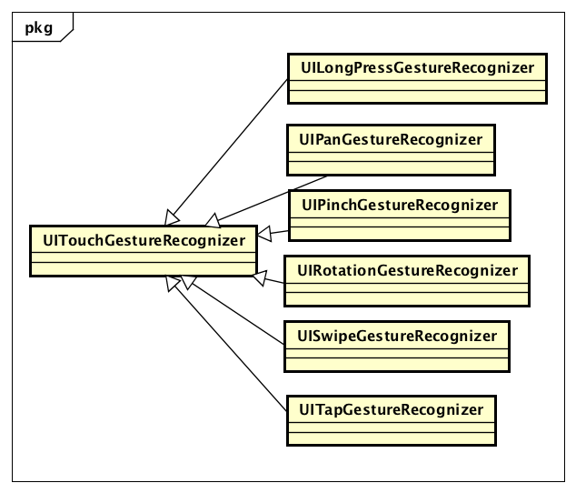
gesture Recognizer - Concept
Gesture
Discrete or continuous
Gesture Recognizer
Convert low-level event into higher-level actions
Interpret touches to determine whether they correspond to a specific gesture such as swipe, pinch, or rotation.
Gesture Recognizer State
UIGestureRecognizerStatePossible, UIGestureRecognizerStateBegan, UIGestureRecognizerStateChanges, UIGestureRecognizerStateEnded, UIGestureRecognizerStateCancelled, UIGestureRecognizerStateFailed
Delivery
A window delivers touch events to a gesture recogniser before it delivers them to the hit-tested view attached to the gesture recogniser.

Slide 13
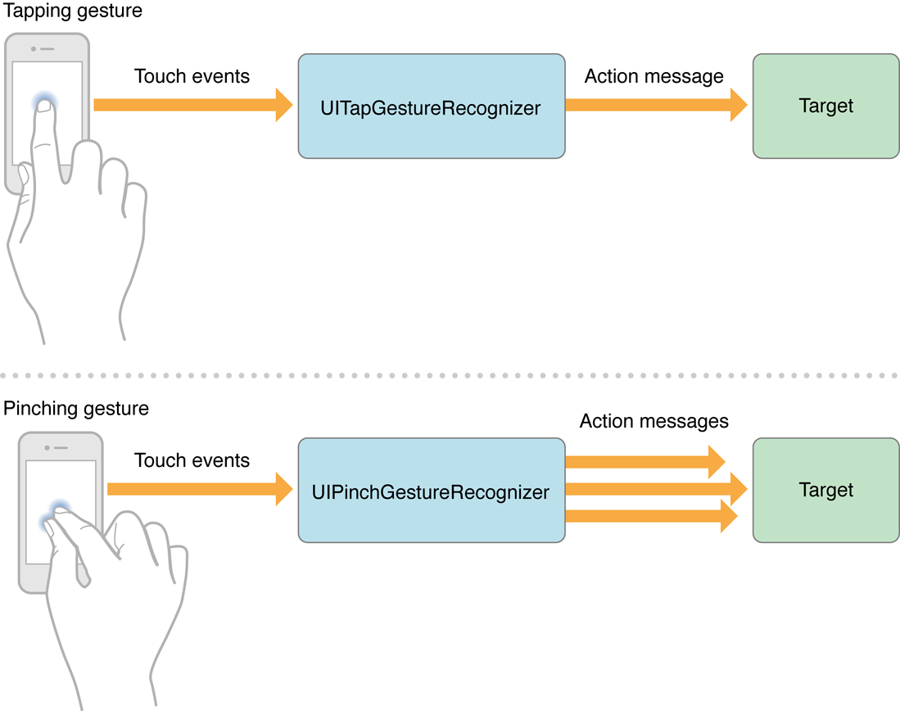
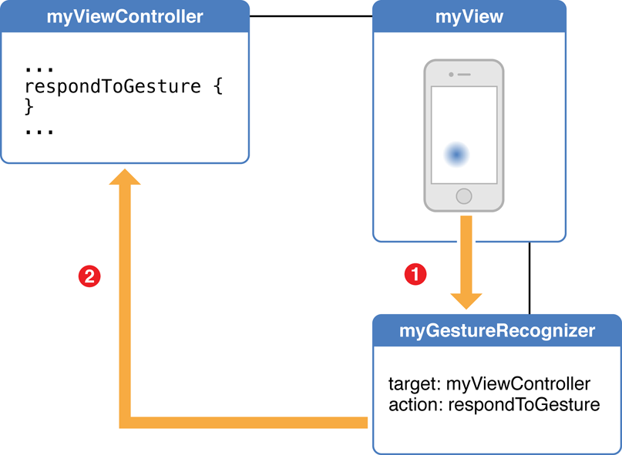
Gesture recognizer - usage
Create a gesture recognizer instance
Create a sub-class of UIGestureRecognizer
Configure the gesture recognizer with a target and an action
Implement touchesBegan/touchesMoved/touchesEnded/touchesCancelled
Attach one or more gesture recognizers to a view
Custom Gesture Recognizer
Implement the action method

Slide 14
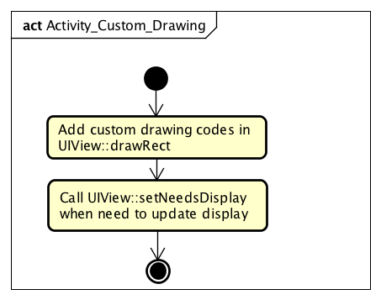
Custom Drawing
Process

Slide 15
Animation
Tween animation
[UIView animateWithDuration]
[UIView beginAnimations] [UIView setAnimationXXX] … [UIView commitAnimations]
Animatable UIView properties: frame, bounds, center, transform, alpha, backgroundColor, contentStretch
Frame-by-frame Animation
[UIImageView startAnimating]

Slide 16
controls

Slide 17
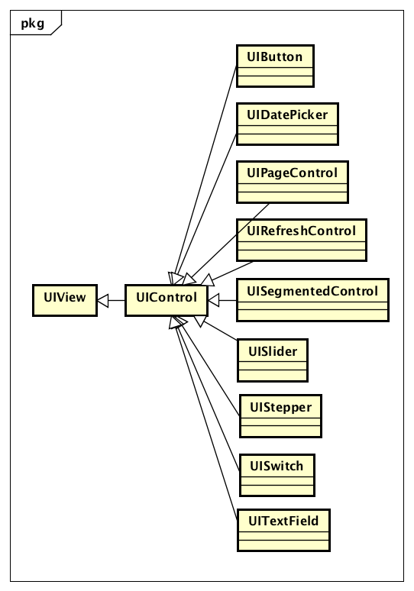
class diagram

Slide 18
data types
UIControlState
UIControlStateNormal, UIControlStateHighlighted, UIControlStateDisabled, UIControlStateSelected, UIControlStateFocused, UIControlStateApplication, UIControlStateReserved
UIControlEvents
UIControlEventTouchDown, UIControlEventTouchDownRepeat, UIControlEventTouchDragInside, UIControlEventTouchDragOutside, UIControlEventTouchDragEnter, UIControlEventTouchDragExit, UIControlEventTouchUpInside, UIControlEventTouchUpOutside, UIControlEventTouchCancel, UIControlEventValueChanged, UIControlEventPrimaryActionTriggered, UIControlEventEditingDidBegin, UIControlEventEditingChanged, UIControlEventEditingDidEnd, UIControlEventEditingDidEndOnExit, UIControlEventAllTouchEvents, UIControlEventAllEditingEvents, UIControlEventApplicationReserved, UIControlEventSystemReserved, UIControlEventAllEvents

Slide 19
design pattern

Slide 20
Class clusters
Class cluster | Public superclasses
NSData | NSData
 | NSMutableData
NSArray | NSArray
 | NSMutableArray
NSDictionary | NSDictionary
 | NSMutableDictionary
NSString | NSString
 | NSMutableString
Based on Abstract Factory design pattern

Slide 21
Delegate

Slide 22
Target-action

Slide 23
Others

Slide 24
Program sandbox
Folders for a program
Documents
Library
Tmp
NSBundle

Slide 25
File operation

