Slide 1
Bootstrap Notes
Sparks Lu
Last updated: 8/8/2019

Slide 2
Basic
Install
npm install bootstrap
What's in
CSS
<link rel="stylesheet" href="https://maxcdn.bootstrapcdn.com/bootstrap/4.0.0/css/bootstrap.min.css" integrity="sha384-Gn5384xqQ1aoWXA+058RXPxPg6fy4IWvTNh0E263XmFcJlSAwiGgFAW/dAiS6JXm" crossorigin="anonymous">
JS
<script src="https://code.jquery.com/jquery-3.2.1.slim.min.js" integrity="sha384-KJ3o2DKtIkvYIK3UENzmM7KCkRr/rE9/Qpg6aAZGJwFDMVNA/GpGFF93hXpG5KkN" crossorigin="anonymous"></script>
<script src="https://cdnjs.cloudflare.com/ajax/libs/popper.js/1.12.9/umd/popper.min.js" integrity="sha384-ApNbgh9B+Y1QKtv3Rn7W3mgPxhU9K/ScQsAP7hUibX39j7fakFPskvXusvfa0b4Q" crossorigin="anonymous"></script>
<script src="https://maxcdn.bootstrapcdn.com/bootstrap/4.0.0/js/bootstrap.min.js" integrity="sha384-JZR6Spejh4U02d8jOt6vLEHfe/JQGiRRSQQxSfFWpi1MquVdAyjUar5+76PVCmYl" crossorigin="anonymous"></script>

Slide 3
Introduction
<!doctype html>
<html lang="en">
<head>
<!-- Required meta tags -->
<meta charset="utf-8">
<meta name="viewport" content="width=device-width, initial-scale=1, shrink-to-fit=no">
<!-- Bootstrap CSS -->
<link rel="stylesheet" href="https://stackpath.bootstrapcdn.com/bootstrap/4.3.1/css/bootstrap.min.css" integrity="sha384-ggOyR0iXCbMQv3Xipma34MD+dH/1fQ784/j6cY/iJTQUOhcWr7x9JvoRxT2MZw1T" crossorigin="anonymous">
<title>Hello, world!</title>
</head>
<body>
<h1>Hello, world!</h1>
<!-- Optional JavaScript -->
<!-- jQuery first, then Popper.js, then Bootstrap JS -->
<script src="https://code.jquery.com/jquery-3.3.1.slim.min.js" integrity="sha384-q8i/X+965DzO0rT7abK41JStQIAqVgRVzpbzo5smXKp4YfRvH+8abtTE1Pi6jizo" crossorigin="anonymous"></script>
<script src="https://cdnjs.cloudflare.com/ajax/libs/popper.js/1.14.7/umd/popper.min.js" integrity="sha384-UO2eT0CpHqdSJQ6hJty5KVphtPhzWj9WO1clHTMGa3JDZwrnQq4sF86dIHNDz0W1" crossorigin="anonymous"></script>
<script src="https://stackpath.bootstrapcdn.com/bootstrap/4.3.1/js/bootstrap.min.js" integrity="sha384-JjSmVgyd0p3pXB1rRibZUAYoIIy6OrQ6VrjIEaFf/nJGzIxFDsf4x0xIM+B07jRM" crossorigin="anonymous"></script>
</body>
</html>
General
front-end component library
Components
bootstrap.css
jquery.js, popper.js, bootstrap.js
Features
responsive grid system
browser compatibility

Slide 4
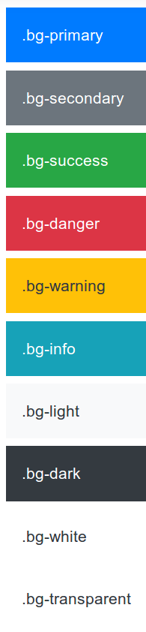
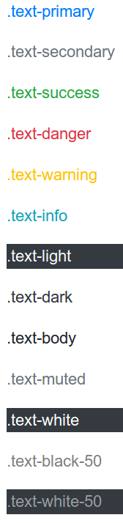
Utilities 1/2
Colors
.text-primary .text-dark .text-light ...
.bg-primary .bg-dark .bg-light ...
Position
.position-static .position-relative .position-absolute .position-fixed .position-sticky .fixed-top .fixed-bottom
Sizing
.w-25 .w-50 .w-75 .w-100 .w-auto
.h-25 .h-50 .h-75 .h-100 .h-auto
Display
.d-none .d-inline .d-inline-block .d-block .d-table .d-table-cell .d-table-row .d-flex .d-inline-flex
.d-print-xxx
Borders
.border .border-left .border-right .border-top .border-bottom .border-0 .border-left-0 ...
.border-primary ...
.rounded .rounded-top .rounded-circle .rounded-pill .rounded-0

Slide 5
Utilities 2/2
Float
.float-left .float-right .float-none
Overflow
.overflow-auto .overflow-hidden
Spacing
{property}{sides}-{size}
property: m (margin), p(padding) sides: t b l r x y size: 0, 1 (0.25), 2 (0.5), 3 (1.0), 4 (1.5), 5 (3.0), auto
Text Alignment
.text-left .text-right .text-center
.text-wrap .text-nowrap
Shadows (off by default)
.shadow .shadow-none
Clearfix
clear float effects of children
Close
close behavior for button
Stretched link
.stretched-link: make its containing block clickable

Slide 6
Layout
Container
full width: .container-fluid
responsive breakpoints
Grid
built with flexbox, fully responsive
container -> row -> col-xxx
col-xs (extra small), col-sm (small), col-md (medium), col-lg (large), col-xl (extra large)
.w-100: new line
gutters:

Slide 7
Content
Image
.img-fluid.max-width: 100%
height: auto
.img-thumbnail
.rounded
.float-left, .float-right, .mx-auto

Slide 8
Components 1/3
Button
.btn .btn-primary .btn-info ...
.btn-outline-*
.btn-lg .btn-sm .btn-block
Button group
.btn-group
.btn-toolbar
Dropdowns
.dropdown .dropdown-toggle .dropdown-menu .dropdown-item
.dropup .dropright .dropleft
.active .disabled
Forms
.form-group .form-control .form-text .form-check-label .form-check .form-check-input .form-check-label .form-check-inline
placeholder readonly
Input group
.input-group

Slide 9
Components 2/3
List group
.list-group .list-group-item .list-group-item-action
.active .disabled .list-group-horizontal
Modal
.modal
Nav
.nav .nav-item .nav-link .nav-tabs .nav-pills .navbar
.active .disabled
Pagination
.pagination .page-item .page-link
Popover
Progress
.progress .progress-bar .progress-bar-striped .progress-bar-animated
Spinner
.spinner-border .spinner-grow
Toast
.toast .toast-header .toast-body
Tooltip
data-toggle=”tooltip”

Slide 10
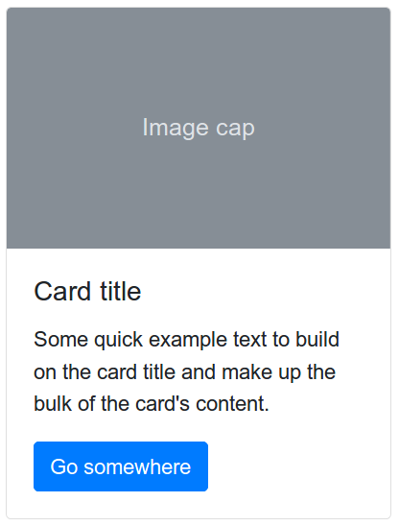
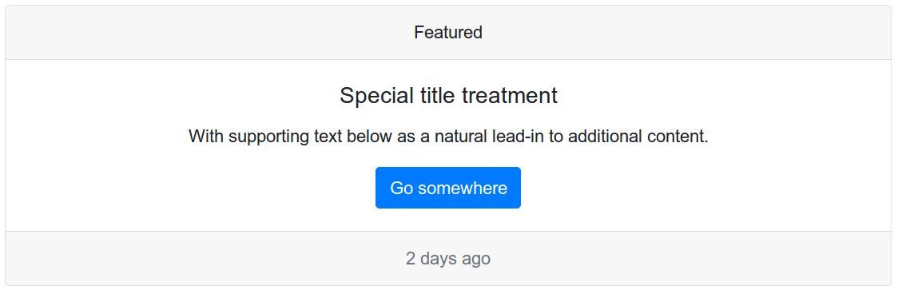
Components 3/3
Alert
.alert .alert-warning .alert-success .alert-danger ...
Badge
.badge .badge-warning .badge-success, .badge-danger
.badge-pill // more rounded
Card
composed of an image as top and others as body, including title, subtitle, texts, and links
.card
.card-img-top .card-header .card-body .card-footer .card-title .card-subtitle .card-text .card-link .card-img-overlay
.card-group .card-deck .card-columns
Carousel
.carousel .carousel-item .carousel-contro-prev .carousel-control-next .carousel-indicators .carousel-caption .carousel-fade
Collapse
.collapse .collapse.show .multi-collapse
Accordion
.accordion
Jumbotron
.jumbotron
Scrollspy

