Slide 1
Electron Notes
Sparks Lu
Last updated: 9/25/2018

Slide 2
Overview
Construct desktop UI application using web technology
Node.js runtime for backend
Chromium for frontend

Slide 3
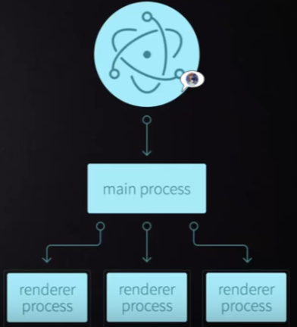
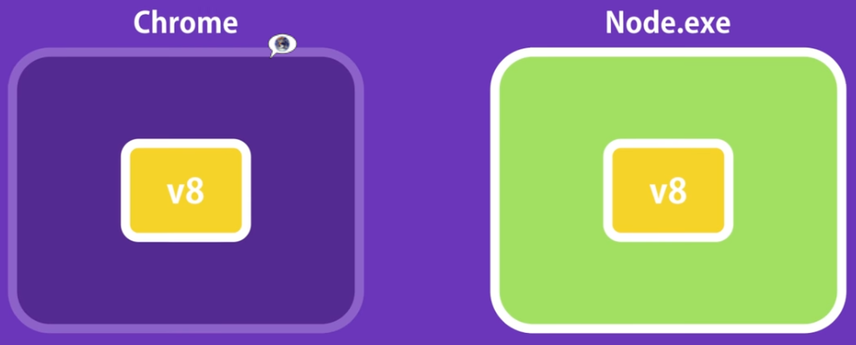
Theory
Processes
Main Process
package.json
Create BrowserWindow instances to run web pages
Renderer Process
Each web page runs its own isolated process

Slide 4
Install
Steps
Install Node.js
npm install -g electron
npm install electron -save
electron .

Slide 5
Create Application
Steps
npm init -y
Initialize npm
package.json was created as the result
npm install electron --save-dev
Install electron locally
touch index.js
npx electron index.js
Launch application
npm start

Slide 6
THANKS
谢谢聆听

