Slide 1
JSON Notes
Sparks Lu
Last Updated: 10/8/2018

Slide 2
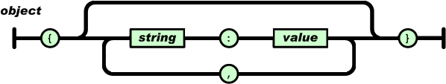
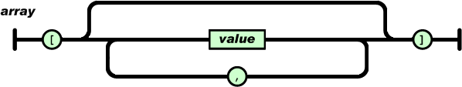
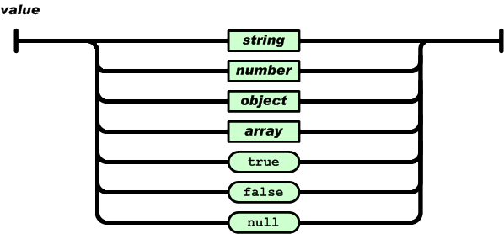
Concept
{
"pi": 3.141,
"happy": true,
"name": "Niels",
"nothing": null,
"answer": {
"everything": 42
},
"list": [1, 0, 2],
"object": {
"currency": "USD",
"value": 42.99
}
}

Slide 3
C++ Library
Ref
https://github.com/nlohmann/json
JSON for Modern C++
#include <nlohmann/json.hpp>
// for convenience
using json = nlohmann::json;
json j;
j["pi"] = 3.141;
j.push_back("foo");
auto j3 = json::parse("{ \"happy\": true, \"pi\": 3.141 }");
std::string s = j.dump();

Slide 4
THANKS
谢谢聆听

