Slide 1
Vue Notes
Sparks Lu
Last updated: 8/16/2019

Slide 2
Introdution
Progressive JS framework that focuses on building UI
React
AngularJS

Slide 3
Install
Methods
Include the <script> tag in the html file (cdnjs)
Install using NPM
curl -sL https://deb.nodesource.com/setup_12.x | sudo -E bash -
sudo apt install nodejs npm
nodejs -v
sudo npm install -g cnpm --registry=https://registry.npm.taobao.org
Use the vue-cli tool along with Webpack
sudo cnpm install -g @vue/cli // Install vue-cli globally
vue --version
vue init webpack myapp
npm run dev
npm run build // Build application to production
Install using the client-side package manager
Vim Support
https://github.com/posva/vim-vue
Vundle: Plugin 'posva/vim-vue'

Slide 4
Config
vue ui
Drop console when release:
build/webpack.prod.conf.js
new UglifyJsPlugin({
uglifyOptions: {
compress: {
warnings: false,
drop_debugger: true,
drop_console: true // 打包之后关闭console.log
}
},

Slide 5

Debug
npm run dev
Vue-devtools
Install
git clone https://github.com/vuejs/vue-devtools
cd vue-devtools
cnpm install
npm run build
open chrome://extensions/ in Chrome
打开“开发者模式”
Select vue-devtools/shells/chrome folder
Use
Open vue debug page (localhost:8080)
F12, Vue tab

Slide 6
Binding
Description | Data | Computed | Watcher
Store variables | Store local variables | Can be static, derived from other variables, or can be static functions | Does not store variables - only watches them.
React to variable value changes | Y | Y | Y
Cached? | Y | Y | N/A
Scope | Local to component | Local to component, but can derive/make calculations with variables from props, store, etc. | Can watch local or store variables and react to changes
Can be referred by <template> | Y e.g. {{ myName }} | Y {{ myCalcName }} | N/A
Can be referred by <script> methods | Y this.myName | Y this.myCalcName | N/A
Perform action when value changes | N | N | Y
Consequence of a value change | Change UI to react to change | Change UI | Perform action - local/vuex
Can change other variable values | N | Y | Y
Vue
el
Bind to HTML element
data
Bind data
computed
Bind computed data
cached
methods
Bind method

Slide 7
Directives
Bind with HTML
v-text
v-html
explain data as HTML
v-model
HTMl element value <-> Vue model
<input v-model=”message” placeholder=”edit me”>
Conditional or loop rendering
v-show
v-if/v-else/v-else-if
v-for
Event binding
v-on
<button v-on:click=”...”></button>, <input v-on:keyup.enter=”...”></input>
v-resize
v-resize:throttle, v-resize:debounce
class or style binding
v-bind:class=”...”, v-bind:style=”...”, v-bind:src=”...”,v-bind:href=”...”
v-pre
v-clock
v-once

Slide 8
Component
Global registration
Vue.component('component-name', {data: ..., props: ..., template: ...})
HTML component
Encapsulate and reuse
data: must be function

Slide 9
Props
Concept
one-way-down binding
When the parent property update, it will flow down to the child.
But not the other way around

Slide 10
Additional Tools & Plugins
vue-router
vue-resource
vuex
Store
vue-async-data
vue-validator
vue-devtools
Chrome extension, Firefox addon
vue-touch

Slide 11
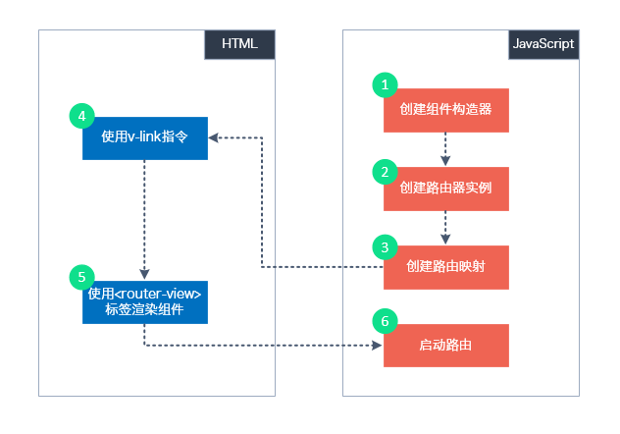
Single Page Application
Command
vue init webpack {appname}
Structure
index.html
src
App.vue
main.js
components/

Slide 12
Vue Router
import Vue from 'vue'
import VueRouter from 'vue-router'
Vue.use(VueRouter)
Install
npm install vue-router --save
Vue.use(VueRouter)
this.$router
router object
navigate to a new route
this.$router.push('route-name')
this.$router.replace({ path: 'name'})
this.$router.go(-1/1)
this.$route
<router-link>
<router-link to=”home”>Home</router-link>
<router-view>
Vue router puts the content which match current url
router.js
routes: [{path: 'url1', name: 'name1', component: 'component1'}]

Slide 13
Vue-i18n
const messages = {
en: {
message: {
hello: '{msg} world'
}
}
}
https://github.com/kazupon/vue-i18n
vue add i18n
Formatting
Named formatting
List formatting
HTML formatting
Custom formatting
Pluralization
$tc()
Datetime localization
$d()
Number formatting
<i18n-n :value=”...”></i18n>
v-t
better performance than $t
npm i --save-dev @kazupon/vue-i18n-loader
vue-cli-plugin-i18n
BabelEdit: translation editor
<p>{{ $t('message.hello', { msg: 'hello' }) }}</p>
<p>{{ $t('message.hello', ['hello']) }}</p>
<p v-html="$t('message.hello')"></p>
const i18n = new VueI18n({
locale: 'ja',
fallbackLocale: 'en',
messages
})

Slide 14
Axios
axios.post('/user', {
firstName: 'Fred', // 参数 firstName
lastName: 'Flintstone' // 参数 lastName
})
.then(function (response) {
console.log(response);
})
.catch(function (error) {
console.log(error);
});
npm install axios vue-axios
request
get, post
response
axios.interceptors.request.use(...)
axios.interceptors.response.use(...)
Serialize
default: json
axios.get('/user?ID=12345')
.then(function (response) {
console.log(response);
})
.catch(function (error) {
console.log(error);
});
response:
- data: {}
- status
- statusText
- headers: {}
- config: {}

Slide 15
Window
window.addEventListener('resize', funcName)
window.removeEventListener('resize', funcName)
window.innerWidth, window.innerHeight

Slide 16
Element UI
https://element.eleme.cn
$msgbox(options)
$alert(message, title, options)
$confirm(message, title, options)
$prompt(message, title, options) // prompt input

Slide 17
Plugin
Vuetify
Install
vue add vuetify
npm install vuetify --save
Ref
https://vuetifyjs.com
Vue-element-admin
vue-resize-directive
npm install vue-resize-directive --save
import resize from 'vue-resize-directive'

Slide 18
Module System
Webpack

Slide 19
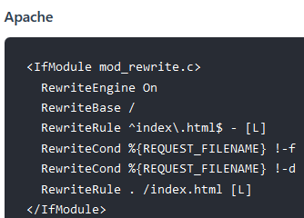
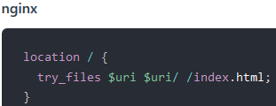

Issues and Solutions
Array value change
this.$set(array, index, newValue)
array[index] = newValue, change will not be detected
<select> in IE
If use customized bg image, default image is also shown
.select::-ms-expand {
display: none;
}
History mode

Slide 20
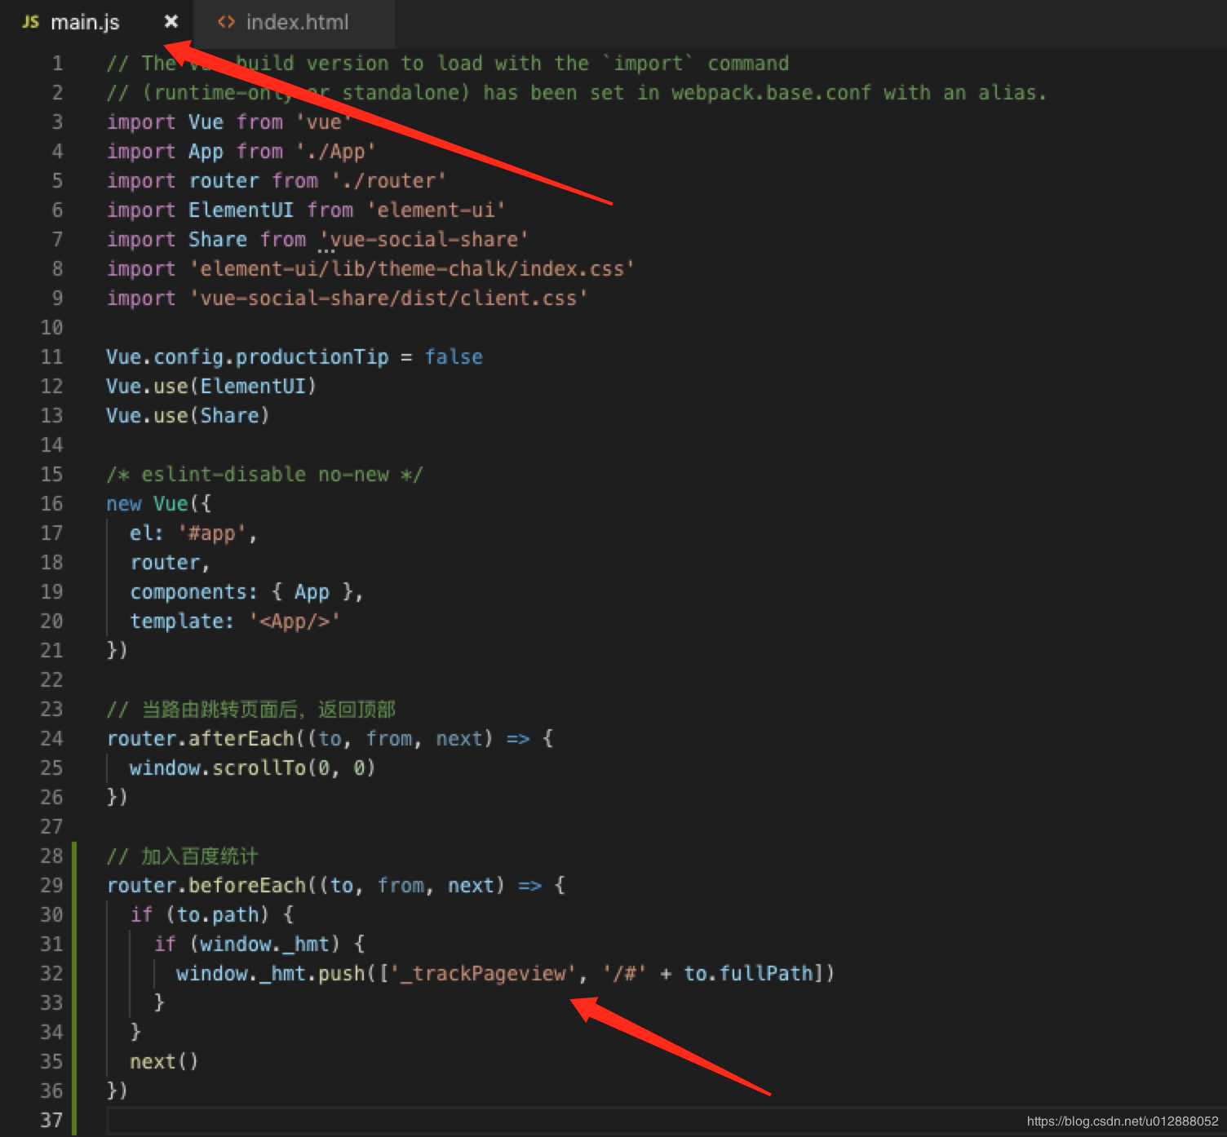
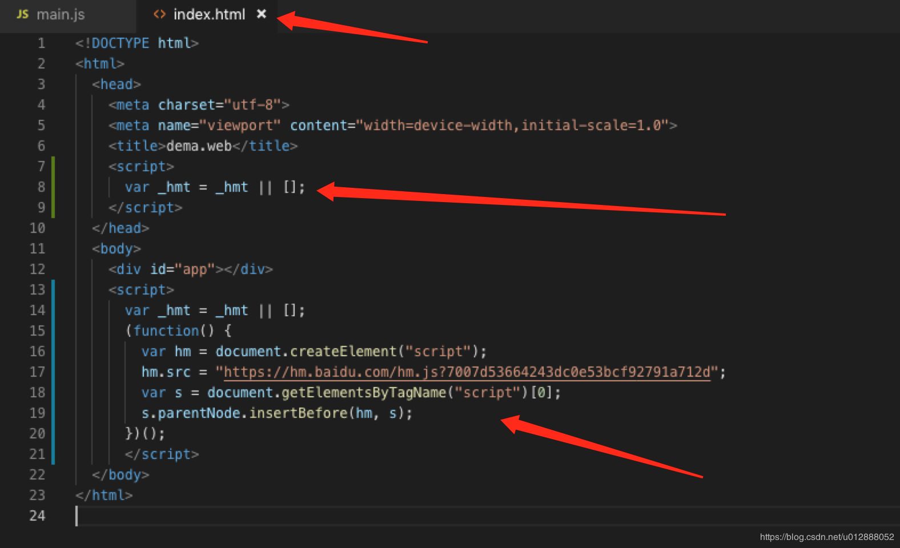
Add Baidu Tongji
References
https://blog.csdn.net/u012888052/article/details/93195909
Steps:
modify index.html
modify src/main.js

Slide 21
THANKS
谢谢聆听

