Slide 1
Docker Notes
Sparks Lu
Last updated: 1/30/2020

Slide 2
References
Dockerfile
https://docs.docker.com/develop/develop-images/dockerfile_best-practices/

Slide 3
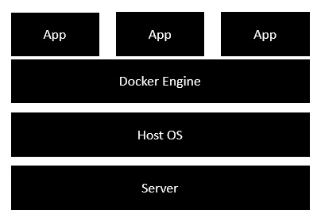
Intro
Concept
Docker: a platform to build, share, and run applications with containers
container: a running process
Docker image: everything needed to run an application
Dokerfile: describe how to assemble a private filesystem for a container
Install
Docker for Windows
https://github.com/docker/toolbox/releases
Start “Docker Quickstart Terminal”
Ubuntu Linux
sudo apt install apt-transport-https ca-certificates curl gnupg-agent software-properties-common
curl -fsSL https://download.docker.com/linux/ubuntu/gpg | sudo apt-key add -
CentOS
Test install: docker run hello-world

Slide 4
Install on Ubuntu16.04 (1)
Install Docker Engine - Community (deb)
Download and install .deb for docker-ce docker-ce-cli, and containerd.io from https://download.docker.com/linux/ubuntu/dists/
sudo docker run hello-world # test installation
Install Docker
sudo apt install docker.io
Install Docker Compose
sudo curl -L "https://github.com/docker/compose/releases/download/1.25.3/docker-compose-$(uname -s)-$(uname -m)" -o /usr/local/bin/docker-compose # slow
sudo curl -L https://get.daocloud.io/docker/compose/releases/download/1.25.3/docker-compose-`uname -s`-`uname -m` -o /usr/local/bin/docker-compose
sudo chmod +x /usr/local/bin/docker-compose
docker-compose --version # test installation

Slide 5
Install On Ubuntu 16.04 (2)
Install Docker Machine
Download docker-machine from https://github.com/docker/machine/releases/download/
docker-machine --version # test installation
wget -q https://www.virtualbox.org/download/oracle_vbox_2016.asc -O- | sudo apt-key add -
wget -q https://www.virtualbox.org/download/oracle_vbox.asc -O- | sudo apt-key add -
sudo sh -c 'echo "deb http://download.virtualbox.org/virtualbox/debian $(lsb_release -sc) contrib" >> /etc/apt/sources.list.d/virtualbox.list'
sudo apt update
sudo apt install virtualbox

Slide 6
Install On Aliyun Ubuntu 16.04 (3)
Docker Engine
sudo curl -fsSL https://get.docker.com | bash -s docker --mirror Aliyun
sudo -E sh -c 'apt-get install -y -qq --no-install-recommends docker-ce >/dev/null'
sudo -E sh -c 'docker version'
sudo docker run hello-world # test install

Slide 7
Install on CentOS
References
https://www.digitalocean.com/community/tutorials/how-to-install-and-use-docker-compose-on-centos-7
Install docker
sudo yum check-update
sudo yum install -y yum-utils device-mapper-persistent-data lvm2
sudo vim /usr/bin/yum-config-manager
modify first line from #/usr/bin/python to /usr/bin/python?
sudo yum-config-manager --add-repo https://download.docker.com/linux/centos/docker-ce.repo
sudo yum install docker
Install docker-compose
sudo curl -L "https://github.com/docker/compose/releases/download/1.23.2/docker-compose-$(uname -s)-$(uname -m)" -o /usr/local/bin/docker-compose
Or download directly from https://github.com/docker/compose/releases
sudo curl -L https://get.daocloud.io/docker/compose/releases/download/1.25.3/docker-compose-`uname -s`-`uname -m` -o /usr/local/bin/docker-compose
sudo chmod +x /usr/local/bin/docker-compose
docker-compose --version
Start
systemctl start docker.service

Slide 8
Components
Docker Compose
Bundle a multi-container application into a single app
docker-compose --version
Docker Machine
Create Docker hosts both locally and in the cloud
docker-machine --version
Kitematic
Docker CLI Client
Docker Compose
Docker Machine
Docker Engine

Slide 9
Working Logic
Docker Client
Docker Daemon
contact
pull from Docker Hub
create a new container
stream output

Slide 10
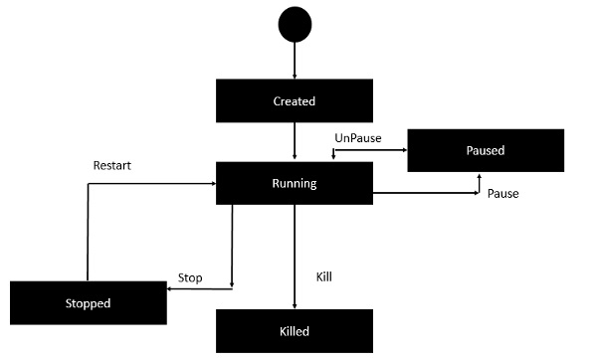
Container Lifecycle

Slide 11
Docker
docker commands
docker version/info
docker pull busybox // pull busy image from docker registry
docker run {image-name} // create a new container and run an image
-it // interactive
-p {port-number-host}:{port-number-container}
-d // daemon mode
--restart=always
docker images // list installed images
docker image build -t {image-name} .
docker container run --name {container-name} {image-name}
docker container rm --force {container-name}
docker rmi {image-id}
docker inspect {image-name}
docker ps // list containers
-a // list all
docker history {image-id}
docker top/stats/attach/pause/unpause/kill/stop/rm {container-id}
service docker start/stop // stop Docker daemon
docker network ls, docker network inspect {name}
docker exec -it <container_name> /bin/bash
docker volume ls, docker volume inspect {volume-name}, docker volume rm {volume-name}, docker volume prune

Slide 12
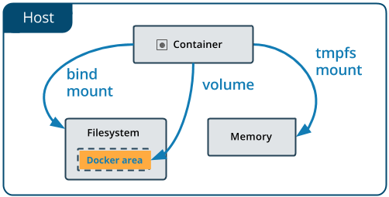
Docker Volume
Concept
Volumes in image are added when run container.
Volume data is preserved across runs.
Commands
docker volume ls

Slide 13
Dockerfile
#This is a sample Image
FROM ubuntu
MAINTAINER demousr@gmail.com
RUN apt-get update
RUN apt-get install –y nginx
CMD [“echo”,”Image created”]
Intro
Tells docker how to build an image
Build
docker build -t {image-name}:{tag-name} dir
-t: with tag
Command | Explanation | Notes
FROM | Specify what image to pull from the Docker Hub repository
WORKDIR | Work dir in container | WORKDIR {dirname}
COPY | Copy local files into container. Preferred than “ADD”
RUN | Mainly used to install new package
CMD | Specify the commands to run within the container. Only one CMD can be executed per Dockerfile. | CMD [“echo”, “Image created”]
MAINTAINER
ENV | Set environment variable | ENV {key1}={value1}
EXPOSE | Indicates the ports on which a container listens for
ENTRYPOINT | Set the image's main command
VOLUME | Expose storage area

Slide 14
Docker Compose
Intro
Used to run multiple containers as a single service
https://docs.docker.com/compose/compose-file/
docker-compose commands
docker-compose build
docker-compose up -d // create and start containers
-d: in daemon mode
docker-compose down // Stop and remove containers, networks, images and volumes
docker-compose run web env // show env variables
docker-compose logs // show logs
docker-compose ps // list containers
docker-compose images // list images
docker-compose -h // show help
docker-compose.yml
ports {host}:{container}, ports {container}
expose
ports are not exposed to host machine, only exposed to linked services
volumes:
path-based volume
- /host/path:/container/path
named volume
named_volume_name: /container/path
the volume will get saved to /var/lib/docker/volumes/named_volume_name/_data
create a volume only
- /container/path
command
override default command in Dockerfile

Slide 15
Docker Machine
docker-machine commands
docker-machine create -d virtualbox {machine-name}
-d/--driver: which provider the machine should be created on (VirtualBox, DigitalOcean, AWS, etc.)
eval $(docker-machine env dev)
docker-machine ls
docker-machine ip default
docker-machine start {docker-machine-name}
eval "$(docker-machine env dev)" # make a machine active

Slide 16
Alpine
Intro
a minimal docker image based on Alpine Linux with a complete package index and only 5MB in size

Slide 17
References
https://www.tutorialspoint.com/docker/

