Slide 1
Free Royal-Free Music Resources
Sparks Lu
Last updated: 3/27/2020

Slide 2
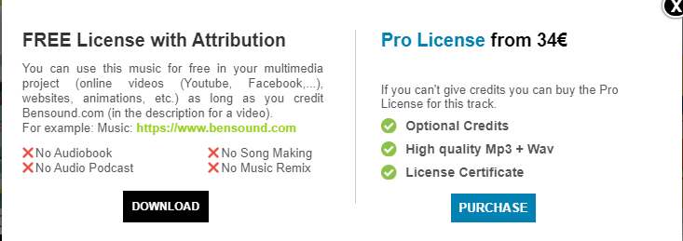
List
https://www.premiumbeat.com/
Standard: $49, Premium: $199
https://www.premiumbeat.com/royalty-free-music?freeTracks=true
10
https://www.bensound.com/
https://soundcloud.com/freebmusic
https://www.epidemicsound.com/
https://www.youtube.com/audiolibrary/
https://www.fesliyanstudios.com/royalty-free-music
https://www.motionelements.com/music
https://www.ashamaluevmusic.com/royalty-free-music
https://www.melodyloops.com/music/free/

Slide 3
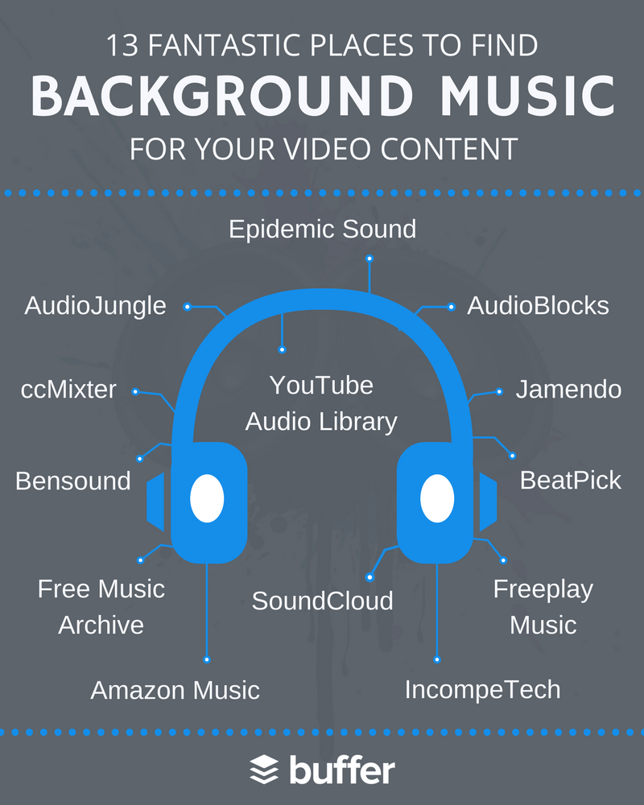
References
https://buffer.com/library/background-music-video
https://www.wordstream.com/blog/ws/2018/06/14/royalty-free-background-music

