Slide 1
AR Notes
单击此处添加副标题
Last updated: 10/9/2021

Slide 2
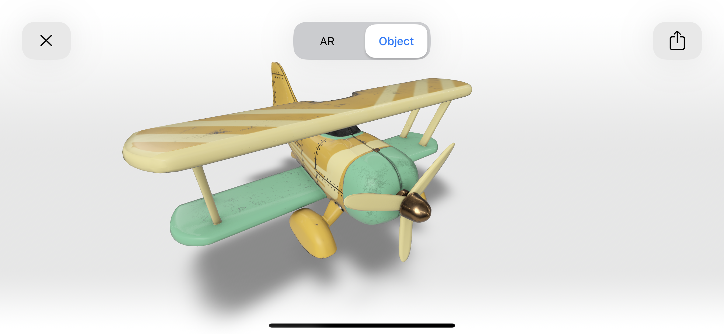
AR in iOS
References
  https://developer.apple.com/augmented-reality/
AR Quick Look
USDZ file format
  USD (Universal Scene Description)

