Slide 1
Cordova Notes
Sparks Lu
Last updated: 12/15/2021

Slide 2
Intro
References
https://github.com/apache/cordova
https://cordova.apache.org/
https://www.tutorialspoint.com/cordova/
Concept
a platform for building hybrid mobile applications using HTML, CSS and JavaScript.
limitations
Slow performance
cross-browser compatibility
Development Setup
Node.js, npm
node -v, cnpm -v
cnpm i -g cordova, cordova -v
Android SDK
XCode

Slide 3
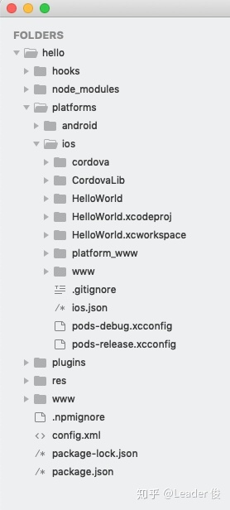
Workflow
Create project
cordova create {proj_folder} {default_reverse_domain_name} {app_title}
eg. cordova create CordovaProj io.cordova.hellocordova CordovaApp
Add platform (Windows admin)
cordova platform add android@9.0.0 --save
cordova platform add IOS --save
cordova platform rm android
cordova platform add browser
cordova platform ls
Install requirements
cordova requirements
check requirements for platforms
Build (time-consuming)
cordova build android
Test/Run
cordova emulate android
cordova run android --nobuild
Debug
cordova serve

Slide 4
Development
Plugins
cordova plugin search camera
cordova plugin add cordova-plugin-camera
cordova plugin ls
Common Plugins
Battery, Camera, Device
Dialogs
File
Geolocation
Inappbrowser
Media, Media Capture
Network information
Screen Orientation, Splash screen, Status bar
Vibration
Whitelist
Events
deviceReady
pause, resume
backbutton, menubutton, searchbutton ,startcallbutton, endcallbutton, volumedownbutton, volumeupbutton
addEventListener
CSP meta tag
script-src
defines which scripts can be executed by the app
’self’ - allows scripts from the same origin like www/js/index.js
http://cdn.jsdelivr.net/vue/1.0.16/vue.js - allows the Vue.js library
’unsafe-eval’ - allows unsafe dynamic code evaluation since parts of the Vue.js library code use strings to generate functions
connect-src

Slide 5
Debug
Android
cordova serve android
http://localhost:8000/android/www/index.html#/
DevTools
cordova run android
edge://inspect/#devices
chrome://inspect/#devices
click “inspect”

Slide 6
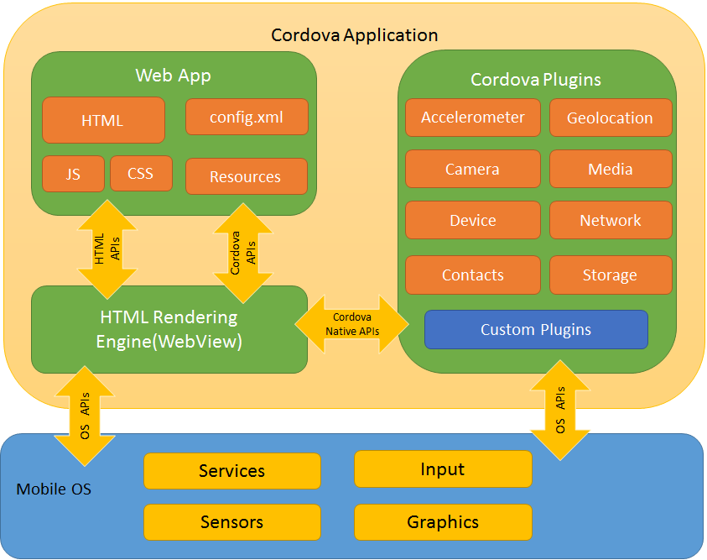
Architecture
Components
Web App
WebView
Plugins
interface for Cordova and native components
A plugin exposes a Javascript API for native SDK functionality.

Slide 7
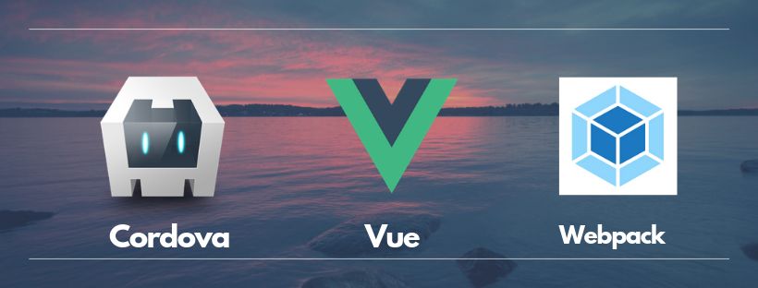
Cordova + Vue
References
https://blog.toast38coza.me/building-a-mobile-app-with-vuejs-cordova-webpack-and-framework-7/
https://coligo.io/building-a-mobile-app-with-cordova-vuejs/
http://kartsims.github.io/vue-cordova/
Steps
vue init webpack mobileapp
cd mobileapp
cnpm install -g cordova
cordova create tmp
mv tmp/config.xml
mv tmp/www .
cordova platform add android@9.0.0
modify config\index.js
replace “dist” with “www”
update value of “build.assetsPublicPath” from “/” to “./”
npm run build
cordova run android
modify package.json, add to “scripts” section
"bcra": "npm run build && cordova run android",
"cra": "cordova run android"
npm run cra

Slide 8
Cordova Plugins
Harware
Vibration
cordova plugin add https://git-wip-us.apache.org/repos/asf/cordova-plugin-vibration.git
navigator.notification.beep(quantity);
navigator.notification.vibrate(duration);
Visual notification
cordova plugin add cordova-plugin-dialogs
navigator.notification.alert("This is a Cordova Alert()", myCallback, "Alert Test", "Click Me");

Slide 9
Issues & Solutions
java.lang.SecurityException: Injecting to another application requires INJECT_EVENTS permission
Turn on “USB调试（安全设置）”

