Slide 1
DepthMap Notes
单击此处添加副标题
Last updated: 10/17/2021

Slide 2
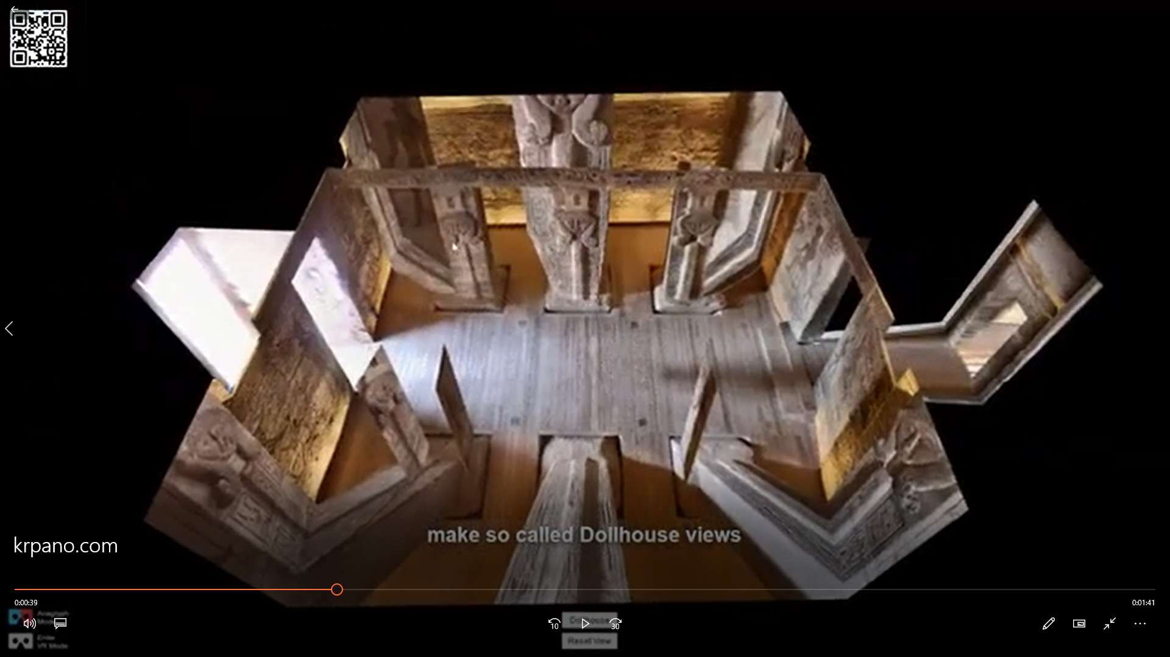
Meaning of Depthmap for Panorama
Meanings
Move in all directions
Dollhouse views
Nice 3D transitions
Full VR support (stereo images)

Slide 3

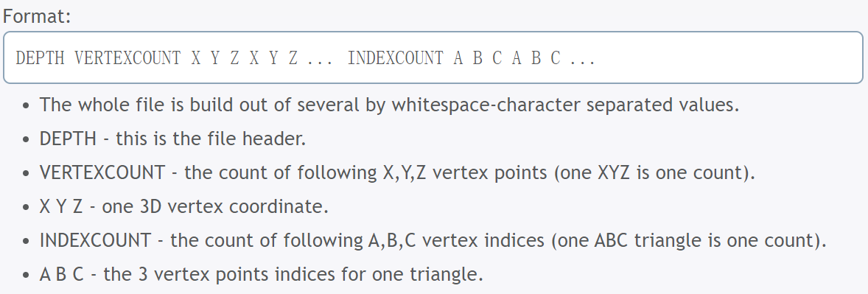
Krpano Implementation
References
https://krpano.com/docu/xml/?#depthmap
Source of depthmap
gray-scale image for pixel depth
3D model (.obj, .stl, .depth)
.depth (krpano depth format)
https://krpano.com/docu/depth-file-format/

Slide 4
Everpano
References
https://everpano.com/
Drawback
operation too complicated

Slide 5
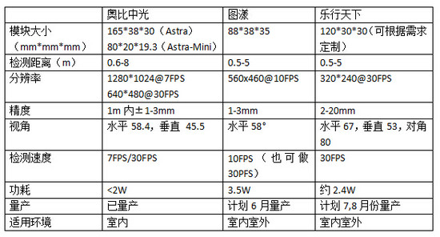
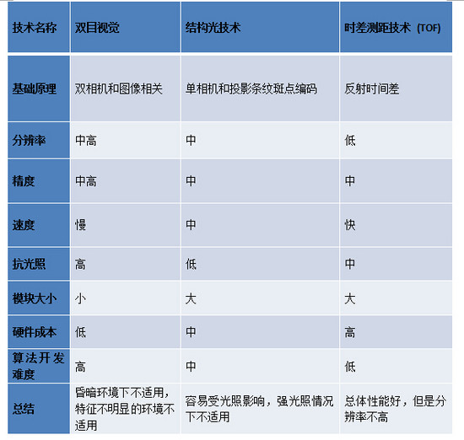
Depth Sensor
References

