Slide 1
OpenSceneGraph Notes
Last updated: 12/14/2021
Sparks Lu

Slide 2
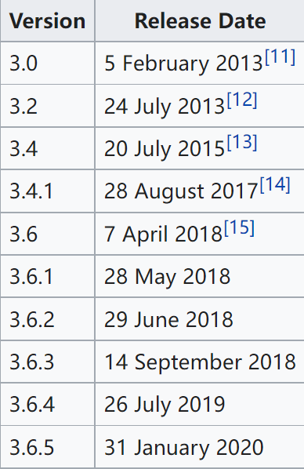
References
https://en.wikipedia.org/wiki/OpenSceneGraph
github.com/openscenegraph/OpenSceneGraph

Slide 3
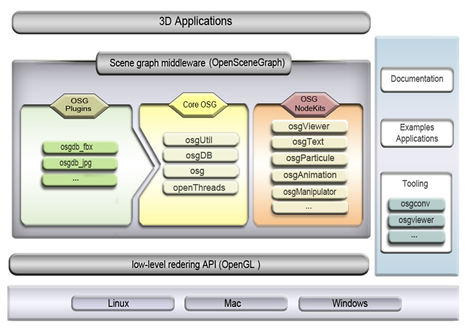
Intro
Concept
open-source 3D graphics API
written in C++ using OpenGL
supports Windows, Linux, macOS, Android, iOS
succeeded by VulkanSceneGraph from 2021
license: LGPL based

Slide 4
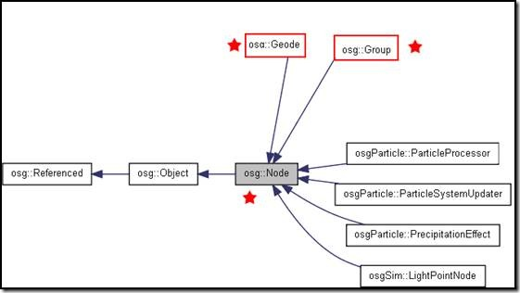
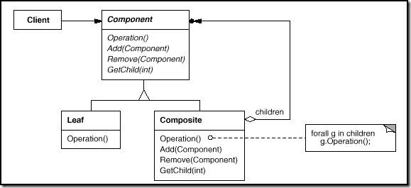
Classses

Slide 5
Files
osgconv
Convert standard 3D formats into OSG native format
osgconv cow.obj cow.ive
Suffix | Explanation | Note
.osg | OpenSceneGraph scene
.osgb | OpenSceneGraph binary scene data
.osgt | OpenSceneGraph ascii scene data
.ive | OpenSceneGraph native binary data

