Slide 1
WebXR Notes
微幻科技（北京）有限公司
最后更新：7/13/2022

Slide 2
References
https://developer.mozilla.org/en-US/docs/Web/API/WebXR_Device_API
https://developer.mozilla.org/en-US/docs/Web/API/WebXR_Device_API/Fundamentals
https://immersive-web.github.io/webxr-samples/

Slide 3

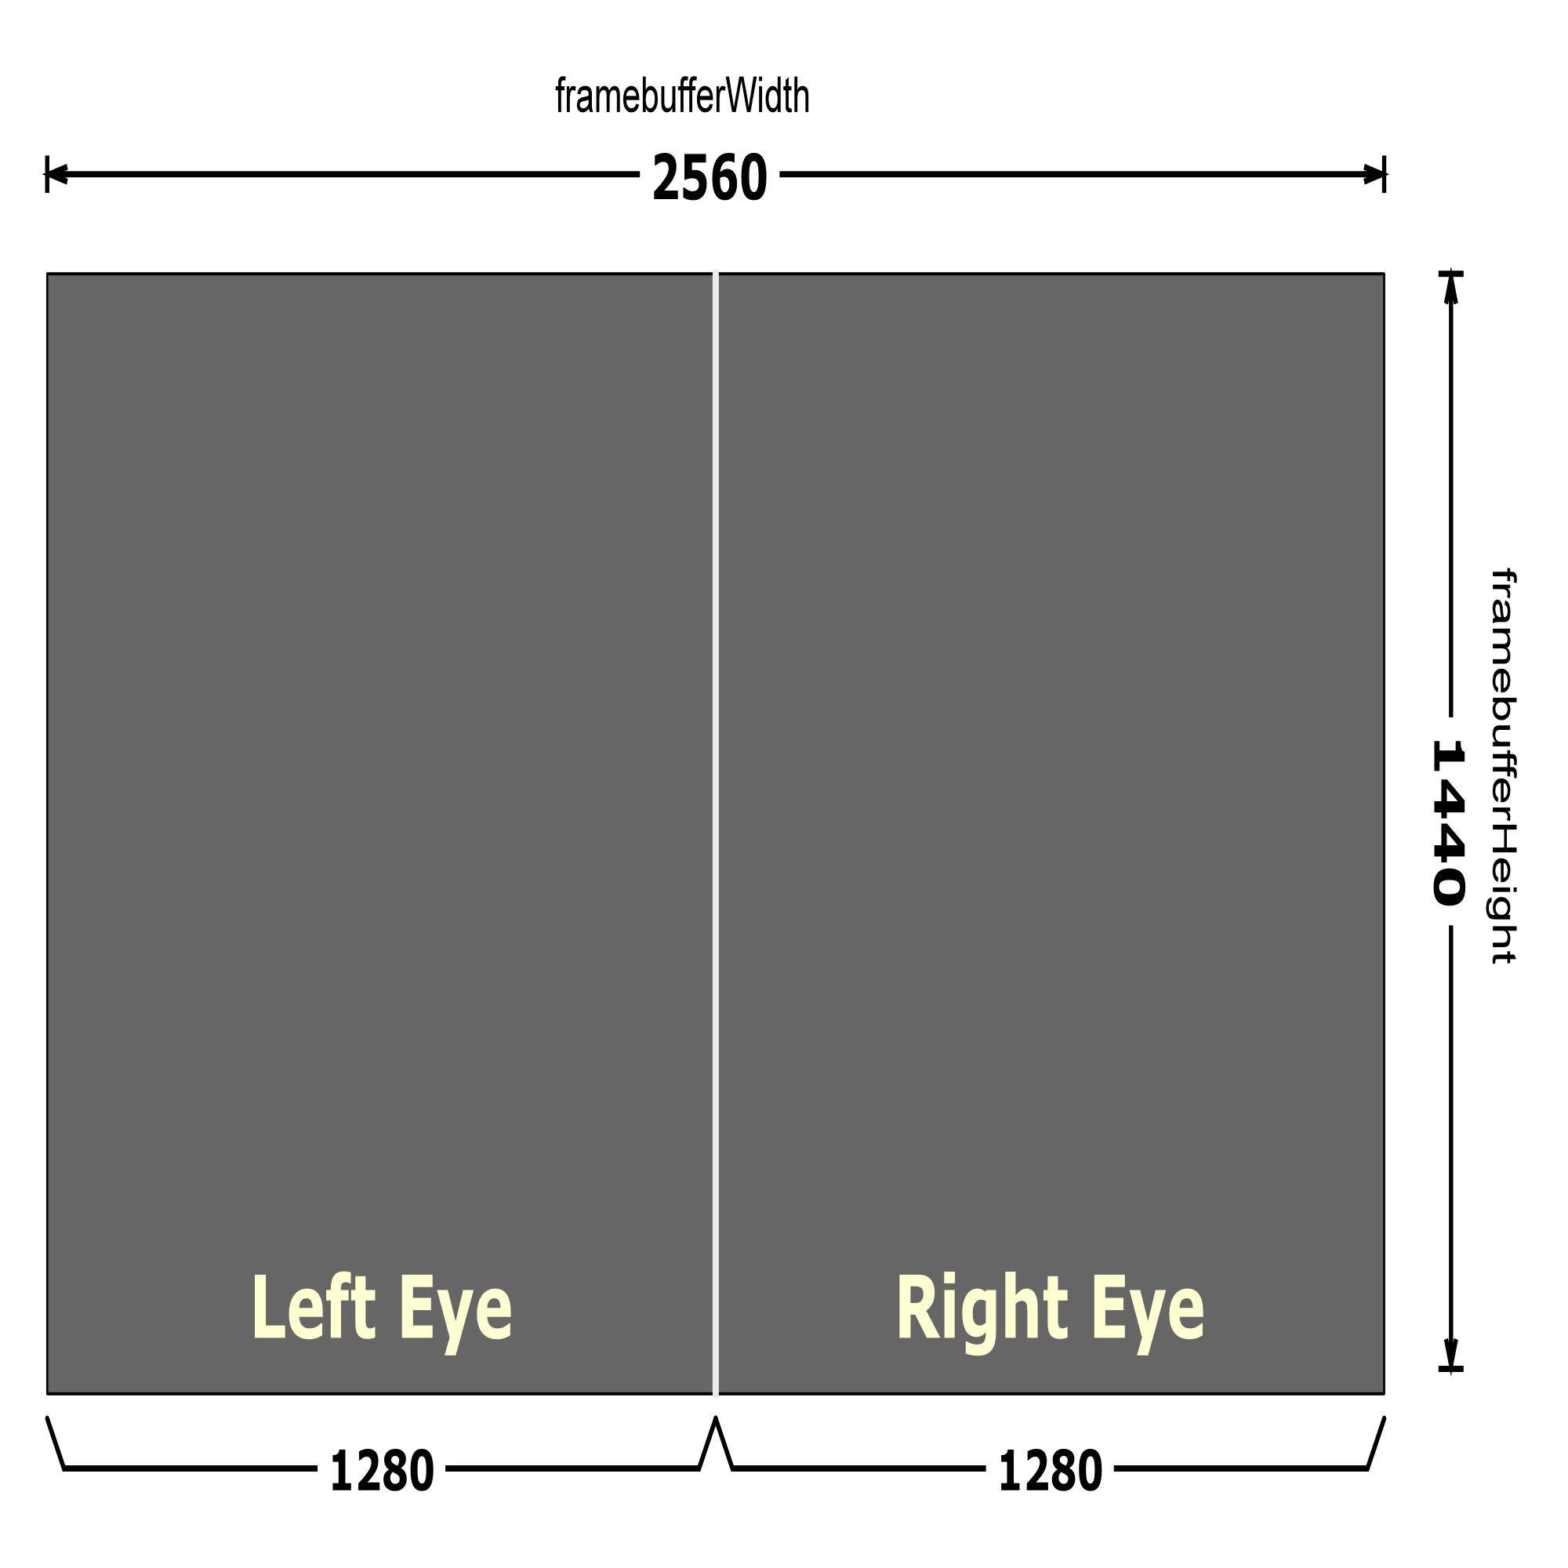
Concept
What’s it
API for web content and apps to use to interface with mixed reality hardware such as VR headsets and glasses with integrated augmented reality features.
What does it provide
Find compatible VR or AR output devices
Render a 3D scene to the device at an appropriate frame rate
(Optionally) mirror the output to a 2D display
Create vectors representing the movements of input controls

Slide 4
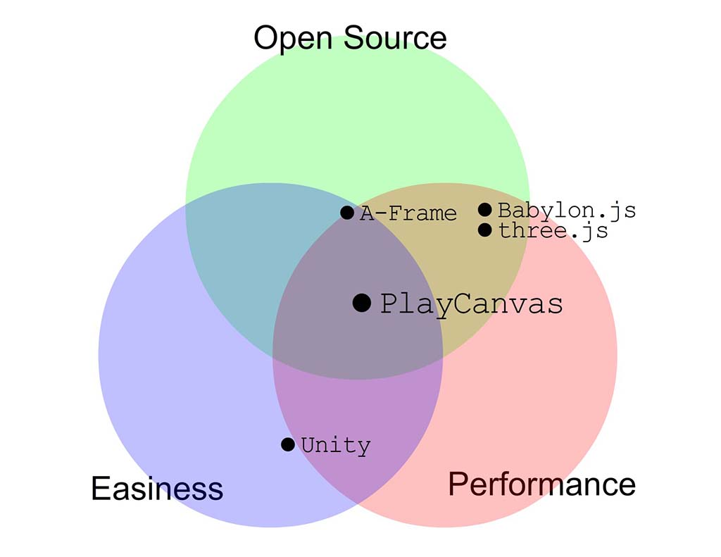
Engine

Slide 5
Three.js
References
https://threejs.org/docs/index.html?q=vr#manual/en/introduction/How-to-create-VR-content
Steps

