Slide 1
Noraml Estimation
Sparks Lu
Last updated: 9/9/2019

Slide 2
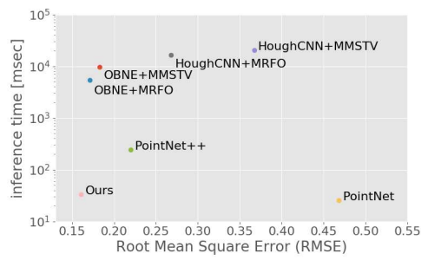
Overview
Regression methods
Smooth sharp features
Estimation quality depends a lot on the size of the neighborhood used for regression
MLS (Moving Least Squares) LKR (Local Kernel Regression)
Based on preliminary normal estimation
Compute an implicit surface and estimate normals as the gradient of the surface

Slide 3
Unoriented Normal Estimation
Tangetial plane
Compute a tangential plane of each 3D point
Use PCA of its neighboring points

Slide 4
RHT (Randomized Hough Transform)
Theory
Consider the filled Hough transform accumulator as an image of the discrete probability distribution of possible normals
Use the maximum of the distribution as the estimated one

