Slide 1
PCL (Point Cloud Library)
Sparks Lu
Last updated: 2019-9

Slide 2
References
Www.pointclouds.org
https://github.com/PointCloudLibrary/pcl
Pcl-users.org
<Introduction to the Point Cloud Library> (IAS13)

Slide 3
Introduction

Slide 4
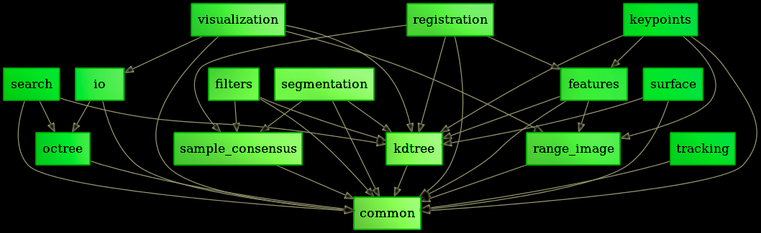
Info
Collection of libraries focused on point cloud processing
License: BSD
Started: 2010

Slide 5
Install
sudo apt install libpcl-dev
pip install python-pcl

Slide 6
Dependencies
Point Cloud Library
Boost

Slide 7
Building Blocks
Features
Filters
Keypoints
Registration
Segmentation
Sample Consensus
Surface
Range Image
I/O
People
Simulation
Out of Core
Visualization
Segmentation
2D
ML
Recognition
Kdtree
Octree

Slide 8
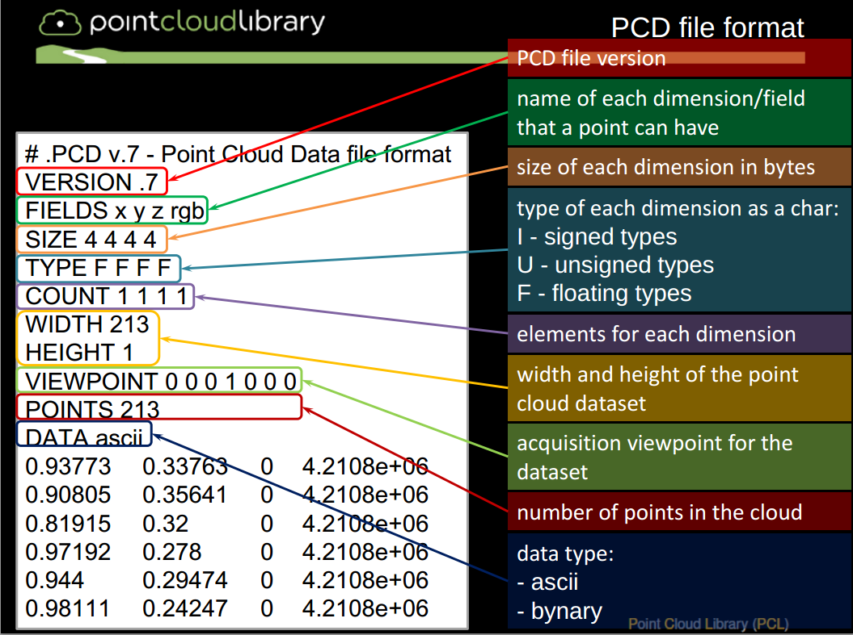
PCD (Point Cloud Data)

Slide 9
Registration

Slide 10
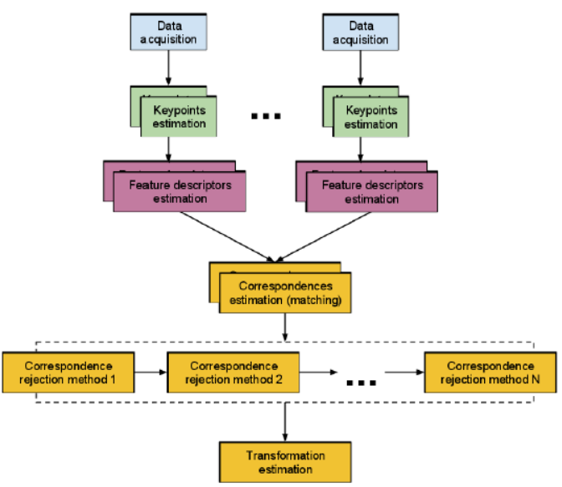
Pipeline

