Slide 1
Python Notes
Sparks Lu
Last updated: 1/14/2021

Slide 2
Fundamental

Slide 3
Install
Ubuntu 18.04
sudo add-apt-repository ppa:deadsnakes/ppa
sudo apt update
sudo apt install software-properties-common
sudo apt install python3.9
sudo apt install python3.9-distutils
If not do this
ImportError: cannot import name 'sysconfig' from 'distutils' (/usr/lib/python3.9/distutils/__init__.py)
sudo python3.9 -m pip install --upgrade pip setuptools wheel
ModuleNotFoundError: No module named 'pkg_resources'

Slide 4
Basic 1/2
dir(object), help(object.method), type(object), isinstance(obj, class)
Debug
python -m pdb a.py
Documentation
pep257 tool
Test
assert expression, error_argument
Testing framework: py.test
coverage
Log
import logging
Profile
python -m cProfile -s time a.py
%timeit (in iPython)
File encoding
# -*- coding: <encoding name> -*-
import logging
logger = logging.getLogger(__name__)
logger.setLevel(logging.INFO)
logger.info('timeout')

Slide 5
Basic 2/2
Pip
sudo apt install python-pip
pip search <package_name>
pip install numpy== // list available versions
Mirror
Linux: ~/.pip/pip.conf
Windows: C:\ProgramData\pip\pip.ini
pip show pip
python -m pip install --upgrade pip
pip install a.whl
ipython
Install ipython in each virtualenv
pip install ipython
history, %hist, %logstart
[global]
index-url=https://mirrors.aliyun.com/pypi/simple
[install]
trusted-host=mirrors.aliyun.com
[global]
index-url=https://mirrors.tencentyun.com/pypi/simple
[install]
trusted-host=mirrors.tencentyun.com

Slide 6
Virtualenv, VirtualenvWrapper
Linux Install
sudo apt install virtualenv virtualenvwrapper
sudo python3 -m pip install setuptools
sudo python3 -m pip install virtualenvwrapper --trusted-host mirrors.aliyun.com
Modify ~/.bashrc
export WORKON_HOME=~/.virtualenvs
export PROJECT_HOME=~/workspace
export VIRTUALENVWRAPPER_PYTHON=/usr/bin/python3
source /usr/local/bin/virtualenvwrapper.sh
source ~/.bashrc
Windows Install
pip install virtualenvwrapper-win
https://github.com/davidmarble/virtualenvwrapper-win
scripts\activate.bat
Usage
Use original pip source instead of aliyun source
mkvirtualenv py3 --python=/usr/bin/python3
mkvirtualenv py3.9 --python=/usr/bin/python3.9
lsvirtualenv
workon {virtualenv}
deactivate
rmvirtualenv
Error handling
python3 -m pip install --upgrade pip setuptools wheel
ModuleNotFoundError: No module named 'pkg_resources'

Slide 7
Jupyter Notebook
Intro
web-based environment that enables interactive computing in notebook documents.
pip install --upgrade --force-reinstall --no-cache-dir jupyter
jupyter notebook
start a web server which can be accessed via http://localhost:8888
jupyter notebook list
list running notebook
extensions
pip install jupyter_contrib_nbextensions
jupyter contrib nbextension install --user # install js and css files
Conovert .ipynb to .py
pip install ipynb-py-convert
ipynb-py-convert examples/plot.py examples/plot.ipynb
ipynb-py-convert examples/plot.ipynb examples/plot.py
ipython
run fn.ipynb

Slide 8
Anaconda
Install Anaconda
https://mirrors.tuna.tsinghua.edu.cn/anaconda/archive/
Anaconda2 includes python 2.7, Anaconda3 includes python 3.7
Anaconda3-2020.11-Linux-x86_64.sh python3.8.5
Generate $HOME/.condarc
conda config --set show_channel_urls yes
Configure Tsinghua mirror
conda info #check
Create virtualenv
conda create -n py3.8 python=3.8
conda activate py3.8
conda deactivate
conda env remove --name py3.8
conda info --envs
Package management
conda update -n base -c defaults conda
conda update --all
conda list # list package
conda list -e >requirements.txt
conda install --file requirements.txt
conda search package
conda install -y package=version
conda remove package
conda install -c conda-forge opencv
conda install -c conda-forge matplotlib
Docker
http://www.science.smith.edu/dftwiki/index.php/Tutorial:_Docker_Anaconda_Python_--_4#Option_2:_Dockerfile
#.condarc
channels:
- defaults
show_channel_urls: true
default_channels:
- https://mirrors.tuna.tsinghua.edu.cn/anaconda/pkgs/main
- https://mirrors.tuna.tsinghua.edu.cn/anaconda/pkgs/free
- https://mirrors.tuna.tsinghua.edu.cn/anaconda/pkgs/r
custom_channels:
conda-forge: https://mirrors.tuna.tsinghua.edu.cn/anaconda/cloud
msys2: https://mirrors.tuna.tsinghua.edu.cn/anaconda/cloud
bioconda: https://mirrors.tuna.tsinghua.edu.cn/anaconda/cloud
menpo: https://mirrors.tuna.tsinghua.edu.cn/anaconda/cloud
pytorch: https://mirrors.tuna.tsinghua.edu.cn/anaconda/cloud
simpleitk: https://mirrors.tuna.tsinghua.edu.cn/anaconda/cloud

Slide 9
Conda
Channels
conda config --show channels
conda remove --channnel https://conda.anaconda.org/
conda config --add channels conda-forge
conda config --add channels https://mirrors.ustc.edu.cn/anaconda/pkgs/free/
conda config --add channels http://mirrors.tuna.tsinghua.edu.cn/anaconda/cloud/msys2/free/
conda config --add channels http://mirrors.tuna.tsinghua.edu.cn/anaconda/cloud/conda-forge/
conda config --add channels http://mirrors.tuna.tsinghua.edu.cn/anaconda/pkgs/free/
conda config --set show_channel_urls yes

Slide 10
Static Analysis
Pylint
Configuration
pylint --generate-rcfile > .pylintrc
.pylintrc
extension-pkg-whitelist=cv2
disable=print-statement, invalid-name
Flake8
Config
~/.config/flake8

Slide 11
Deploy
# setup.py
from setuptools import setup
from Cython.Build import cythonize
setup( ext_modules=cythonize('module.py')
)
Obfuscate
pip install pyarmor
pyarmor obfuscate foo.py
Build for other platforms different from current host
pyarmor download
pyarmor obfuscate --platform <platform-name> a.py
--restrict=0
Obfuscate whole package
pyarmor obfuscate --recursive --output dist/pkg pkg/__init__.py
Cythonize
Create setup.py
python ./setup.py build_ext --inplace
output .so file, which can be used by python transparently

Slide 12
Vim Support
Vundle
git clone https://github.com/VundleVim/Vundle.vim.git ~/.vim/bundle/Vundle.vim
Edit .vimrc (Refer to https://github.com/VundleVim/Vundle.vim)
Launch vim. Run “:PluginInstall”
Plugins
syntastic
Add “Plugin 'vim-syntastic/syntastic'” to .vimrc
Add “Plugin 'nvie/vim-flake8'” to .vimrc
let python_highlight_all=1
syntax on
sudo apt install flake8
NERDTree
Add “Plugin 'scrooloose/nerdtree'” to .vimrc
fugutive
Add “Plugin 'tpope/vim-fugitive'” to .vimrc
YouCompleteMe
git clone https://github.com/Valloric/YouCompleteMe.git ~/.vim/bundle/
cd ~/.vim/bundle/YouCompleteMe/
git submodule update --init --recursive (may fail because of network restriction)
python ./install.py
Add “Bundle 'Valloric/YouCompleteMe'” to .vimrc
virtualenv support: create .ycm_extra_conf.py
taglist
set statusline+=%#warningmsg#
set statusline+=%{SyntasticStatuslineFlag()}
set statusline+=%*
let g:syntastic_always_populate_loc_list = 1
let g:syntastic_auto_loc_list = 2
let g:syntastic_check_on_open = 1
let g:syntastic_check_on_wq = 0
" see :h syntastic-loclist-callback
function! SyntasticCheckHook(errors)
if !empty(a:errors)
let g:syntastic_loc_list_height = min([len(a:errors), 10])
endif
endfunction
def Settings( **kwargs ):
return {
'interpreter_path': '/path/to/virtual/environment/python'
}

Slide 13
Data Types
Built-in type
bool, bytearray, bytes, complex, dict, float, frozenset, int, list, set (unique), slice, str, tuple
repr() // Convert into string
eval() // Parser data from string
Pass-by-object-reference
Assignment: binding a name with an object
Sort
sort dict by value
sorted(d.items(), key = lambda x: x[1], reverse = reverse)
enum
from enum import Enum, IntEnum
class Status(IntEnum):
S1 = 0
Status.S1 == 0 (true)

Slide 14
String, Bytes
String to bytes
str.encode(sz)
Bytes to string
sz = bytes.decode()

Slide 15
Property
get
@property
def prop(self):
set
@{prop}.setter
def prop(self, value):

Slide 16
Utils
from datetime import date, time, datetime
time
time.gmtime(), time.localtime(), time.asctime(), time.strftime('%Y-%M-%d-%H:%M:%S')
date
today = date.today(), today.day today.month today.year today.weekday
datetime
dt = datetime.now(), dt.date(), dt.time(), dt.year, dt.month, dt.day, dt.hour, dt.minute, dt.second
to/from string
datetime.datetime.now().strftime('...')
datetime.strptime(sz, '%Y%m%d%H%M%S')
to/from timestamp
mtime = path.stat().st_mtime, dt = datetime.fromtimestamp(mtime)
timedelta
dt1 = datetime.now() + timedelta(days=1, hours=1)
Functools
partial
generate a new function with arguments already filled in
from functools import partial
def mul(a, b):
return a * b
func1 = partial(mul, 3)
val = func1(2)

Slide 17
Multiprocess 1/3
multiprocessing.Process
Process(target=f, args=(...))
start(), join(), is_alive(), terminate(), exitcode
def process1(name, seconds):
...
def main():
p = mp.Process(target=process1, args=('p1', 3))
p.start()
p.join()

Slide 18
Multiprocess 2/3
multiprocessing.Pool
Pool(process_cnt)
map(f, [iterables])
def f(x):
time.sleep(x)
return x*x
def main():
pool = mp.Pool(mp.cpu_count())
results = pool.map(f, range(10))
pool.close()
pool.join()
print(results)

Slide 19
Multiprocess 3/3
Inter-Process Communication
multiprocessing.Lock()
acquire(), release()
multiprocessing.Value, multiprocessing.Array
os.getpid(), os.getppid()
multiprocessing.cpu_count()
multiprocessing.set_start_method('spawn'/'fork'/'forkserver')
spawn: Windows default, slow
fork: Unix default
concurrent.futures.ProcessPoolExecutor (3.2+)

Slide 20
Thread
thread.start_new_thread(func, args)
threading
activeCount(), currentThread(), enumerate()
threading.Thread class
t = threading.Thread(target=fn, args=(arg1, ))
run(), start(), join(), isAlive(), getName(), setName()
threading.Lock
acquire(), release()
Queue
get(), put(), qsize(), empty(), full()

Slide 21
Modules
NumPy
Pandas
Matplotlib, seaborn
SciPy, statsmodels
lxml

Slide 22
File Operation
Open
f = open('fn', 'mode')
PDF
pip install fpdf
remove, copy, get size
import shutil
shutil.move(fn_src, fn_dst)
shutil.copy(src, dst)
shutil.copyfile(fn_src, fn_dst)
shutil.copytree(src_dir, dst_dir)
os.remove(fn)
os.path.getsize(fn)
os.path.abspath(fn)
os.path.exists(fn)
Temp file and folder
import tempfile
tempfile.gettempdir()
tempfile.TemporaryFile()
file compare
import filecmp
filecmp.cmp(fn1, fn2)
file modification time
os.stat(fn).st_mtime

Slide 23
Propcess
popen
import os
os.popen('cmd')
subproces
call
import subprocess
subprocess.call([cmd, param1, ...])
Popen
cmd = ''
sp = subprocess.Popen(cmd)
Popen(["/usr/bin/git", "commit", "-m", "Fixes a bug."])
result = sp.wait()

Slide 24
JSON
import json
Deserialize json-format string to python object (list, dict)
json.loads(str, encoding)
Serialize python object (list, dict) to json-format string
json.dumps(obj)
Deserialize json file stream to python object (list, dict)
json.load(fp)
Serialize python object (list, dict) to json-format file stream
json.dump(obj, fp)
JSONEncoder
JSONDecoder
import jsonpickle
str = jsonpickle.encode(obj)
obj = jsonpickle.decode(str)

Slide 25
Serialize & Deserialize
json
jsonpickle
pickle
dill
dill extends python’s pickle module for serializing and de-serializing python objects to the majority of the built-in python types
API compatible with pickle

Slide 26
Exception
try:
statements
except Exception as e:
print(str(e))
Catch exception
try
except
else // no exception
finally
Raise exception
raise
Built-in exception
Exception
SystemExit
StandardError
StopIteration
ArithmeticError
OverflowError
IOError

Slide 27
Argparse
import argparse
import argparse
parser = argparse.ArgumentParser()
parser.add_argument('-v', type=int/str)
args = parser.parse_args()
print(args.echo)

Slide 28
SQLite3
import sqlite3
conn = sqlite3.connect(fn_db)
cursor = conn.cursor()
q = 'select ...'
cursor.execute(q)
record = cursor.fetchall()
cursor.close()

Slide 29
SQL Server
Refer
https://datatofish.com/how-to-connect-python-to-sql-server-using-pyodbc/#:~:text=%20Steps%20to%20Connect%20Python%20to%20SQL%20Server,is%20stored.%20You%20can%20find%20the...%20More%20
https://www.guru99.com/sql-server-create-user.html#:~:text=Create%20User%20using%20SQL%20Server%20Management%20Studio%201,Right-click%20the%20Users%20folder%20then%20choose%20%22New%20User%E2%80%A6%22
Install SQL Server
Configure SQL Server
Install DBeaver
pyodbc
sudo apt install unixodbc-dev
pip install pyodbc
import pyodbc
connect
Server: SELECT @@SERVERNAME
Database:
import pyodbc
conn = pyodbc.connect(driver='{SQL Server}',
server=’47.105.68.219’,
database='Detkit_NewKJ350',
user='sa',
password='VHTech#4710568219')
cursor = conn.cursor()
# cursor.execute('SELECT * FROM database_name.table')
sql_query = pd.read_sql_query('SELECT * FROM TestDB.dbo.Person',conn)
for row in cursor:
print(row)

Slide 30
Itertools
itertools.count(start, step)
itertools.cycle(‘ABCD’) => ‘A’, ‘B’, ‘C’, ‘D’, ‘A’, ...
itertools.repeat(elem, [,n]) => elem, elem, ...
Permutation
perm = itertools.permutation([1, 2, 3], 2) // P32
for p in list(perm):
print p
Combination
comb = list(itertools.combination([1, 2, 3], 2))
Product
prod = list(itertools.product(‘AB’, [1, 2])) => [(‘A’, 1), (‘A’, 2), (‘B’, 1), (‘B’, 2)]

Slide 31
Random
import random
random.randint(a, b) // [a, b]
random.shuffle(list)

Slide 32
Misc
Read input from keyboard
x = input('Enter a number: ')
System info
multiprocessing.cpu_count()
pip install psutil
cpu_count(), cpu_percent()
virtual_memory() (total, available, percent, ...)
psutil.swap_memory()
sys.float_info.epsilon
os.environ.get()
Version comparison
from packing import version
version.parse(skimage.__version__) < verse.parse('0.16.0')
Formatter
yapf
pip install yapf
yapf input.py >output.py
https://github.com/google/yapf
black
pip install git+git://github.com/psf/black
black input.py
https://github.com/psf/black

Slide 33
FAQ
ImportError: cannot import name 'json' from 'itsdangerous'
Upgrade the Flask to latest version > 2
https://itsmycode.com/importerror-cannot-import-name-json-from-itsdangerous/

Slide 34
Packages

Slide 35
Web
import requests
headers={'user-agent': 'myapp/1.0.0'}
cookies=dict(cookies-are='working')
payload = {'key1': 'value1', 'key2': 'value2'}
r = requests.get('http://www.baidu.com', headers=headers, cookies=cookies, params=payload)
r.status_code/r.encoding/r.url/r.headers/r.text/r.json/r.raw
files = {'file': open('a.xls', rb)}
r = requests.post('http://httpbin.org/post', data={'key': 'value'}, files=files)
# Basic authentication
r = requests.get('https://api.github.com/user', auth=HTTPBasicAuth('user', 'pass'))
r = requests.get('http://httpbin.org/digest-auth/auth/user/pass', auth=HTTPDigestAuth('user', 'pass'))
requests
https://2.python-requests.org/en/master/user/quickstart/#make-a-request
pip install requests
requests.code.ok
- get(url, params=payload, headers={'user-agent': 'aaa'}, cookies=cookies, timeout=sec)
- post(url, data={'key', 'value'})
- post(url, files={'file': ('fn', open('fn', 'rb'))})
- put(url, data={'key', 'value'})
- head(url)
- options(url)
- r.status_code
- r.text
- r.encoding
- r.content
- r.raw
- r.headers
- r.cookies
- r.url
- r.history
- r.json()
Post encoding types:
- application/x-www-form-urlencoded
- multipart/form-data
- application/json
- text/xml

Slide 36
NumPy 1/2
import numpy as np
array
np.genfromtxt('filename', delimiter=',', usecolos=(), dtype=str)
np.zeros()/np.ones()/np.empty()/np.identity()/np.matrix(arr), np.isnan()
np.random.randn(count), np.random.randint(low, high, size)
np.sum(arr), np.mean(arr), np.std(arr), np.var(arr), np.min(arr), np.max(arr), np.argmin(arr), np.argmax(arr)
np.dot(arr1, arr2)
np.c_(arr1, arr2) // Concatenate two arrays
np.reshape()
Boolean arrays
arr.any(), arr.all()
Set operation
arr.sort(), np.unique(arr), np.intersect1d(arr1, arr2), np.union1d(arr1, arr2),np.split(arr, separator_arr, axis)

Slide 37
NumPy 2/2
Element-wise array functions
np.sqrt(arr), np.exp(arr), np.modf(arr), np.fabs(arr), np.sqrt(arr), np.square(arr), np.sign(arr), np.log(arr), np.ceil(arr), np.floor(arr), np.rint(arr), np.isnan(arr), np.sin(arr), np.cos(arr), np.tan(arr)
np.maximum(arr1, arr2), np.add(arr1, arr2), np.subtract(arr1, arr2), np.multiply(arr1, arr2), np.divide(arr1, arr2), np.power(arr1, arr2), np.minimum(arr1, arr2), np.greater(arr1, arr2), np.less(arr1, arr2)
np.isin(x, list)
np.where(cond, x, y)
Other Functions
numpy.set_printoptions(threshold=sys.maxsize) # print all elments in array

Slide 38
Pandas 1
import pandas as pd
counts = pd.Series(['a', 'b', 'c'])
counts
counts.index
counts.values
data = pd.DataFrame({'column1': [1, 2, 3], 'column2': [1, 2, 3]})
data
data.values
data.shape
data = pd.read_csv('a.csv')
Data analysis and manipulation library
Data types
pandas.Series (1D)
unique(), value_counts(), is_in(list), isnull(), dropna(), fillna(), map(func)
plot()
pandas.DataFrame (2D)
read_csv('a.csv', index_col=''), read_table('a.csv', sep=''), read_excel(), to_csv('a.csv')
ExcelFile('a.xls') (xlrd/openpyxl), parse('sheetName')
df.sum(), mean(), describe(), head(n)
drop_duplicates(), apply(), applymap(), astype()
index, columns, loc(), iloc(), ix(), groupby('column').mean(), corr(), cov()
drop('columnName'), dropna(axis=, subset=), fillna(value), reset_index(drop=True), rename(columns={‘oldName’: ‘newName’}), sort_values([colName]), merge(df2, how)
Can be looked on as dictionary
df.iloc[row_no]
pandas.Panel
pandas.Panel4D
DB
read_sql('sql_str', con=dbconn)
read_sql_table()
read_sql_query()
Datetime
to_datetime(df)

Slide 39
Pandas 2
Export to Excel
import pandas as pd
list1 = [10,20,30,40]
list2 = [40,30,20,10]
col1 = "X"
col2 = "Y"
data = pd.DataFrame({col1:list1,col2:list2})
data.to_excel('sample_data.xlsx', sheet_name='sheet1', index=False)

Slide 40
SciPy
signal
ndimage
(n-dimension image)
stats
optimize
cluster
sparse
spatial
fftpack
integrate
odr
(Orthogonal distance regression)
special
constants
interpolate
io
linalg
(linear algebra)
References: https://docs.scipy.org/doc/scipy/reference/tutorial/index.html

Slide 41
Matplotlib
Install
sudo apt-get install python3.9-tk // python version MUST match
Configure
matplotlib.matplotlib_fname()
sudo apt install python3-tk
matplotlib.use('TkAgg')
import matplotlib.pyplot as plt
plt.title(text), plt.xlabel(), plt.ylabel(), plt.xticks(), plt.yticks(), plt.legend()
plt.imshow(arr, cmap=plt.cm.gray), plt.imshow(img[..., ::-1])
plt.show()
plt.plot(), plt.subplot(), fig, ax = plt.subplots(), plt.clf()
plt.hist(), plt.pcolor(),plt.colorbar(), plt.scatter(x, y, color)
plt.axis('off')
plt.savefig('a.png')
plt.get_backend()
Figure
fig = plt.figure(figsize=(w,h))
ax = fig.add_subplot()
ax.matshow(matrix)
Unicode support
Copy simhei.ttf from C:\Windows\Fonts\ to Linux /usr/share/fonts/custom
sudo fc-cache -fv
rm -rf ~/.cache/matplotlib
fc-list :lang=zh
matplotlib.rcParams['font.family'] = 'SimHei'

Slide 42
Seaborn
Basic
pip install seaborn
import seaborn as sns
It's a kind of enhancement of matplotlib.
heatmap()

Slide 43
xml
Basic
import xml.etree.ElementTree as ET
parser = ET.XMLParser(encoding='utf-8')
tree = ET.parse(fn, parser=parser)
root = tree.getroot()
for elem in root.findall(./level1/level2):
attrib = elem.attrib['attrib_name']

Slide 44
HTML
beautifulSoup
pip install beautifulsoup4

Slide 45
Progress Bar
tqdm
from tqdm import tqdm
for i in tqdm(range(int(5000000)), desc="Progress"):
pass

Slide 46
GUI
import tkinter as tk
root = tk.Tk()
app = Application(master=root)
app.master.title('Title')
app.master.geometry('800x600')
app.mainloop()
class Application(tk.Frame):
def __init__(self):
super().__init__(self)
self.pack()
btn = tk.Button(self, text='', command=cmd)
btn.grid(row=r, column=c, columnspan=cs)
Tkinter
import tkinter
Tkinter._test()
Tk() // return root widget
destroy()
Frame
mainloop()
Reference
http://infohost.nmt.edu/tcc/help/pubs/tkinter/web/index.html

Slide 47
Serial I/O
import serial
ser = serial.Serial('/dev/ttyUSB0', 19200, timeout=1)
print(ser.name)
ser.write(b'hello')
ser.close()
pip install pyserial
class serial.Serial
Properties
port, baudrate, bytesize, parity, stopbits, timeout, write_timeout, is_open, in_waiting, out_waiting,
Method
open(), close(), read(), readline(), write(), flush(), reset_input_buffer(), reset_output_buffer()
Constants
BAUDRATES, BYTESIZES, PARITIES, STOPBITS, PARITY_NONE, STOPBITS_ONE, SEVENBITS
Exceptions
serial.SerialException, serial.SerialTimeoutException
Tools
serial.tools.list_ports
comports()
List ports
python -m serial.tools.list_ports -v
Access ports
python -m serial.tools.miniterm <port_name>

Slide 48
Graphics and Game
Pygame Zero
pip install pgzero
pgzrun game.py
draw()
screen
clear()
draw.circle()
update()
on_key_down(key, mod, unicode)
on_key_up(key, mod)
on_mouse_down(pos, button)
on_mouse_up(pos, button)
on_mouse_move(pos, rel, buttons)
mouse
LEFT/MIDDLE/RIGHT
keys
BACKSPACE/TAB/ESC/...
keymods
LSHIFT/ALT/...

Slide 49
NetworkX
Usage
import networkx as nx
G = nx.Graph()
DG = nx.DiGraph()
directed graph
MG = nx.MultiGraph()
allow multiple edges between any pair of nodes
nx.connected_components(G)
nx.peterson_graph()
nx.draw(G, with_labels=True)
Graph
-nodes
-edges
- adj[obj] # list adjacent nodes
- degree[obj] # list number of edges incident to obj
- remove_node(obj)
- remove_edge(edge)
- add_node(obj)
- add_nodes_from([obj_list])
- add_edge(edge_start, edge_end)
- add_edges_from([edges])
- add_weighted_edges_from([edges])
- clear()
- number_of_nodes()
- number_of_edges()
DiGraph
- out_edges()
- in_edges()
- predecessors()
- sucessors()

Slide 50
Drawing
from PIL import Image, ImageDraw
im = Image.new('RGB', (500, 300), (128, 128, 128))
draw = ImageDraw.Draw(im)
draw.ellipse((100, 100, 150, 200), fill=(255, 0, 0), outline=(0, 0, 0))
draw.rectangle((200, 100, 300, 200), fill=(0, 192, 192), outline=(255, 255, 255))
draw.line((350, 200, 450, 100), fill=(255, 255, 0), width=10)
im.save('imagedraw.jpg', quality=95)

Slide 51
QRCode
Genration
pip install qrcode
img = qrcode.make(string1) // img: PIL.Image
img.show()
img.save('fn.png')
Read
detector = cv.QRCodeDetector()
data, bbox, straight_qrcode = detector.detectAndDecode(img)

Slide 52
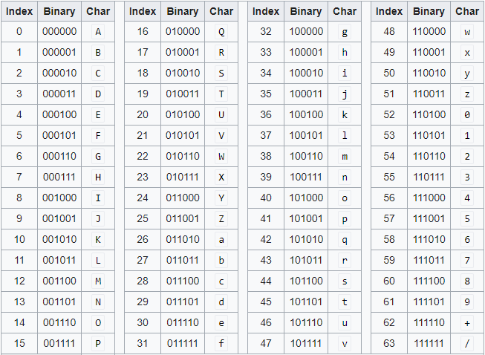
Base64
import base64
Encode
bytes_base64 = base64.encodebytes(str.encode('ascii'))
str_b64 = base64.encodestring(bytes_img)
bytes_base64 = base64.encode(file_input, file_output)
Decode
bytes = base64.decodebytes(bytes_base64).decode('ascii')
base64.decode(file_input, file_output)
data_decoded = base64.b64decode(str_b64)
data_decoded = base64.decodestring(str_b64)
Theory
Get the ASCII value of each character in the string.
Compute the 8-bit binary equivalent of the ASCII values
Convert the 8-bit characters chunk into chunks of 6 bits by re-grouping the digits
Convert the 6-bit binary groups to their respective decimal values.
Use the Base64 encoding table to align the respective Base64 values for each decimal value.

Slide 53
Hashlib
import hashlib
Construct hash object
ho = hashlib.md5()
ho = hashlib.sha1()
Feed bytes to hash object
ho.update(b'string')
ho.update(sz.encode('utf-8'))
Get secure hash
d = ho.digest()
hd = ho.hexdigest()
ho.digest_size, ho.block_size
Construct hash object
Invoke update() to feed bytes into hash object
Invoke digest() or hexdigest() to get secure hash of all bytes fed to it

Slide 54
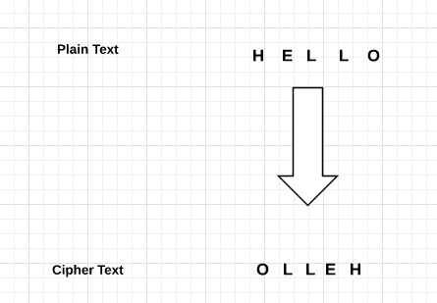
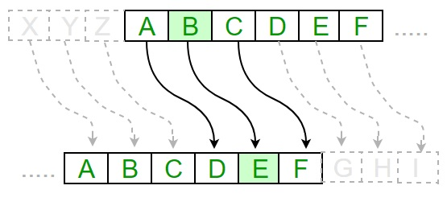
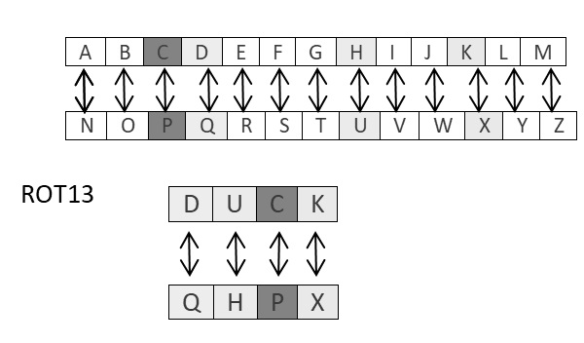
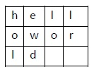
Cryptography 1/3
pip install cryptography
fernet.Fernet
Types
reverse cipher
Caesar cipher
ROT13
Transposition cipher
Base64
Affine cipher
Monoalphabetic cipher (substitute using a dict)
simple substitution cipher
Vignere cipher (polyalphabetic cipher)
Symmetric cryptography (secret key cryptography)
DES (Data Encryption Standard) pyDES
Asymmetric cryptography (public key cryptography)
one key for encryption, another key for decryption
RSA
References
https://www.tutorialspoint.com/cryptography_with_python/cryptography_with_python_quick_guide.htm

Slide 55
Cryptography 2/3
BLOCK_SIZE = 16
S>pad = lambda s: s + (BLOCK_SIZE - len(s) % BLOCK_SIZE) * chr(BLOCK_SIZE - len(s) % BLOCK_SIZE)
S>unpad = lambda s: s[:-ord(s[len(s) - 1:])]
def encrypt(raw, password):
private_key = hashlib.sha256(password.encode("utf-8")).digest()
raw = pad(raw)
iv = Random.new().read(AES.block_size)
cipher = AES.new(private_key, AES.MODE_CBC, iv)
return base64.b64encode(iv + cipher.encrypt(raw))
def decrypt(enc, password):
private_key = hashlib.sha256(password.encode("utf-8")).digest()
enc = base64.b64decode(enc)
iv = enc[:16]
cipher = AES.new(private_key, AES.MODE_CBC, iv)
return unpad(cipher.decrypt(enc[16:]))
AES
对称加密算法，只有一个密钥，这个密钥既用来加密，也用于解密
AES is a block cipher.
The key size can be 128/192/256 bits.
Encrypts data in blocks of 128 bits each.
加密方式有五种：ECB, CBC, CTR, CFB, OFB
CBC加密需要一个十六位的key(密钥)和一个十六位iv(偏移量)
ECB加密不需要iv
pycrypto
references
https://www.quickprogrammingtips.com/python/aes-256-encryption-and-decryption-in-python.html
pip install pycrypto
pycryptodomex
references
https://devrescue.com/simple-python-aes-encryption-example/
pip install pycryptodomex
encryption
generate a 128, 192, or 256 bit key
use the key to generate the AES cipher
use the cipher to encrypt the data
decryption
generate a 128, 192, or 256 bit key
use the key to generate the AES cipher
use the cipher to decrypt the data
key = get_random_bytes(16) #must be 16, 24 or 32 bytes long
cipher = AES.new(key, AES.MODE_EAX)
ciphertext, tag = cipher.encrypt_and_digest(data)

Slide 56
Cryptography 3/3
RSA（Rivest-Shamir-Adleman）
包含两个密钥的公共密钥加密，一个是公开密钥,另一个是私有密钥
Pycryptodome
pip install pycryptodomex

Slide 57
Mechanize
Info
https://github.com/python-mechanize/mechanize
Automate interaction with HTTP web servers

Slide 58
Baidu AI
pip install baidu-aip
AipSpeech
client = AipSpeech(APP_ID, API_KEY, SECRET_KEY)
result =client.synthesis(txt, 'zh', 1, {'spd': 5, 'pit': 5, 'vol': 5, 'per': 0})
result: mp3 data
client.setConnectionTimeoutInMillis()
client.setSocketTimeoutInMillis()
max text length: 1024 bytes

Slide 59
Zip, Unzip
import zipfile
with zipfile.ZipFile(path_to_zip_file, 'r') as zip_ref:
zip_ref.extractall(directory_to_extract_to)

Slide 60
tqdm (console progress bar)
Usage
from tqdm import tqdm
for i in tqdm(range(1000)):

Slide 61
filetype
Usage
import filetype
f_type = filetype.guess(fn)
f_type.mime.find(‘image’)

Slide 62
GeoIP
pygeoip

Slide 63
Bluetooth
References
https://medium.com/analytics-vidhya/how-to-use-connect-bluetooth-in-python-from-scartch-to-bosch-glm-50-c-in-window-e75d8206fab4
https://pybluez.readthedocs.io/en/latest/index.html
PyBluez
pip install PyBluez
classes: BluetoothSocket, DeviceDiscoverer
functions: advertise_service
discover_services(lookup_names=True, lookup_class=True)
return: list of (address, name, class) tuples
find_service(name, uuid, address)
lookup_name, stop_advertising
Native python sockets
hciconfig
# pip install PyBluez
import bluetooth
nearby_devices = bluetooth.discover_devices(lookup_names=True, lookup_class=True)
print('Found BT devices:')
for device in nearby_devices:
print("\t{}".format(device))

Slide 64
Mail
import getpass, imaplib
M = imaplib.IMAP4()
M.login(getpass.getuser(), getpass.getpass())
M.select()
typ, data = M.search(None, 'ALL')
for num in data[0].split():
typ, data = M.fetch(num, '(RFC822)')
print('Message %s\n%s\n' % (num, data[0][1]))
M.close()
M.logout()
IMAP (Internet Mail Access Protocol)
references
https://www.tutorialspoint.com/python_network_programming/python_imap.htm
https://docs.python.org/3/library/imaplib.html
from imaplib import IMAP4
SMTP
references
https://docs.python.org/3/library/smtplib.html#smtp-example
import smtplib
from email.mime.text import MIMEText
from email.header import Header
def send_mail(self, message, receiver, url):
body = 'From WebsiteMonitor'
msg = MIMEText(body, 'plain', 'utf-8')
msg['Subject'] = Header('[{}] {}\r\n'.format(url, message),
'utf-8')
msg['From'] = Header(self._mail_sender, 'utf-8')
msg['To'] = Header(receiver, 'utf-8')
# Send the message via our own SMTP server.
try:
print('Connecting to mail server {}...'.format(self._smtp_server))
self._mail_server = smtplib.SMTP_SSL(self._smtp_server, 465)
print('Logging into mail server...')
self._mail_server.login(self._smtp_user, self._smtp_password)
print('Sending mail...')
self._mail_server.sendmail(self._mail_sender, receiver,
msg.as_string())
print('Finished')
self._mail_server.quit()
except Exception as e:
print('Error: unable to send mail. {}'.format(e))

Slide 65
Aliyun
References
https://github.com/aliyun/aliyun-openapi-python-sdk
https://python-aliyun.readthedocs.io/en/latest/aliyun.html
Install
pip install aliyun-python-sdk-core
pip install aliyun-python-sdk-ecs

Slide 66
Progress Bar
tqdm
https://tqdm.github.io/docs/tqdm/
pip install tqdm
from tqdm import tqdm
disable=None: turn off on non-TTY

Slide 67
Multimedia

Slide 68
Pillow
ImageFilter
ImageDraw
ImageFont
References
https://pillow.readthedocs.io/en/3.1.x/reference/Image.html
https://holypython.com/python-pil-tutorial/
Usage
from PIL import Image
from PIL import ImageOps
ImageOps.invert()
From/To numpy array
np.asarray(pil_image)
PIL.Image.fromarray(np_array)
Image
- im = Image.open('fn')
- im.save('fn', 'JPEG')
- Image.alphacomposite(im1, im2)
- Image.blend(im1, im2, alpha)
- Image.composite(im1, im2, mask)
- Image.eval(img, func) // operate each pixel
- Image.merge(mode, bands) // merge multiple channels
- Image.new(mode, size, color)
- im.convert()
- im.convert('L')
- im.copy()
- im.crop(box)
- im.filter(filter)
- im.filter(ImageFilter.BLUR)
- im.getbands()
- im.getbbox()
- im.getcolors()
- im.getextrema()
- im.getpixel()
Image
- im.histogram()
- im.paste(im2)
- im.putalpha(alpha)
- im.resize(size, resample=Image.BICUBIC)
- im.rotate(angle)
- im.save(fn, format)
- im.show(title)
- im.split()
- im.thumbnail(size)
- im.tobytes()
- im.transpose()
- im.close()
- format
- mode (1, L, RGB, RGBA, ...)
- size
- width
- height
- pallette
- info

Slide 69
Pillow 2
ImageFilter
BLUR
CONTOUR
DETAIL
EDGE_ENHANCE
EDGE_ENHANCE_MORE
EMBOSS
FIND_EDGES
Kernel
SHARPEN
SMOOTH
SMOOTH_MORE

Slide 70
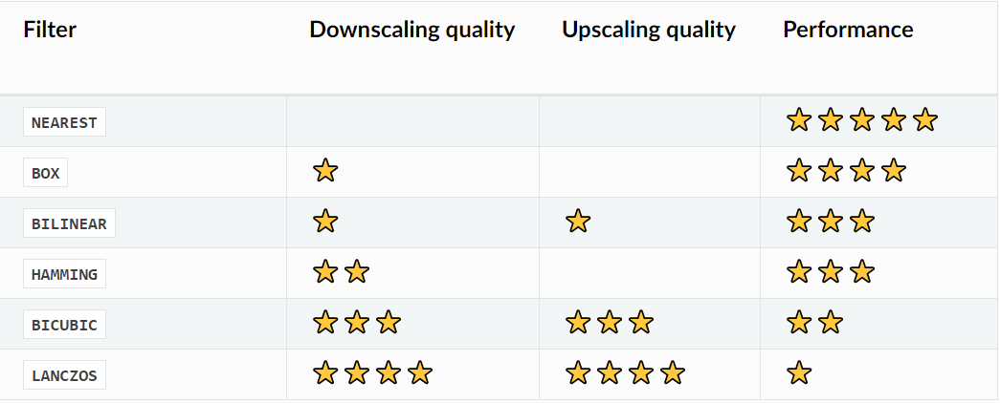
Pillow (2)
Resize comparison

Slide 71
webp
References
https://github.com/anibali/pywebp
pip install webp
Usage
# Save an image
webp.save_image(img, 'image.webp', quality=80)
# Load an image
img = webp.load_image('image.webp', 'RGBA')
# Save an animation
webp.save_images(imgs, 'anim.webp', fps=10, lossless=True)
# Load an animation
imgs = webp.load_images('anim.webp', 'RGB', fps=10)

Slide 72
Piexif
import piexif
exif_dict = piexif.load('img_fn.jpg')
exif_bytes = piexif.dump(exif_dict)

Slide 73
Video
scikit-video
pip install scikit-video
Based on ffmpeg or libav
import skvideo.io
Read
vread(fn) // read all frames into mem
vreader(fn) // frame by frame
FFmpegReader(fn, inputdict, outputdict)
Writer
vwrite(fn, outputdata)
writer = FFmpegWriter(fn, outputdict, verbosity=1)
writer.writeFrame(frame)
writer.close()
Read metadata
ffprobe(fn)
Sample data
import skvideo.datasets
bigbuckbunny, bikes, fullreferencepair
PyAv
Pythonic binding for FFmpeg or Libav
Install
sudo apt install -y python-dev pkg-config libavformat-dev libavcodec-dev libavdevice-dev libavutil-dev libswscale-dev libavresample-dev libavfilter-dev
pip install av
Usage
container = av.open(fn)

Slide 74
Audio - librosa
References
https://librosa.org/doc/latest/tutorial.html
Install
pip install librosa
Usage
import librosa
data, sample_rate = librosa.load(fn_audio)
import librosa.display
plt.figure()
librosa.dipslay.waveshow(data, sample_rate)
plt.show()
Modules
effects: time-domain processing
filters
beat
decompose
display
effects
filters
sequencce
segment
feature
onset
core
util

Slide 75
Audio
References
https://wiki.python.org/moin/Audio
https://realpython.com/playing-and-recording-sound-python/
https://phrasenmaeher-audio-transformat-visualize-transformation-5s1n4t.streamlitapp.com/
pydub
pip install pydub
from pydub import AudioSegment
sound = AudioSegment.from_mp3(fn_mp3)
sound.duration_seconds
target_sound = sound[:2000] // 2000ms
target_sound.export(fn_output, format='mp3')
scipy.io.wavfile
fs, data = wavfile.read(fn)
wavfile.write(fn, fs, data)
sndfile
import soundfile as sf
rate = 44100
data = np.random.uniform(-1, 1, size=(rate * 10, 2))
sf.write('stereo_file.wav', data, samplerate, subtype='PCM_24')

Slide 76
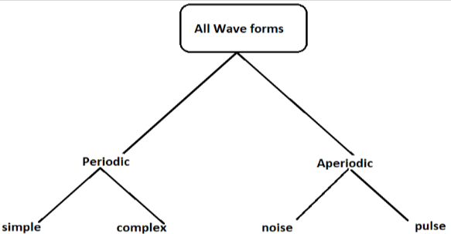
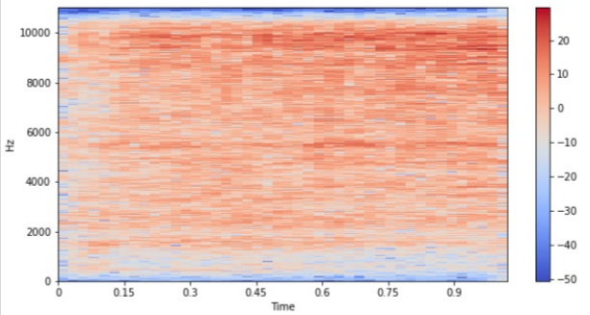
Audio 2
Audio analysis
amplitude
wavelength/frequency
human can hear 20Hz~20KHz
phase
power=2*pie*F/T
db(T)=10*log10(I1/I2)
pysndfx
from pysndfx import AudioEffectsChain
fx = (AudioEffectsChain().highshelf())
from librosa import load
y, sr = load(infile, sr=None)
y = fx(y)
srt subtitle
https://srt.readthedocs.io/en/latest/index.html
pip install srt
subtitle_generator = srt.parse(srt_conents)
subtitle_generator[0].start/end/content
srt_content = srt.compose(subtitles)
srt.Subtitle(index, start, end, content)

Slide 77
Audio Augumentation
References
https://github.com/iver56/audiomentations
https://iver56.github.io/audiomentations/
Categories
waveform transforms
spectrogram transforms

Slide 78
Noise Removal in Audio
noisereduce
https://pypi.org/project/noisereduce/

Slide 79
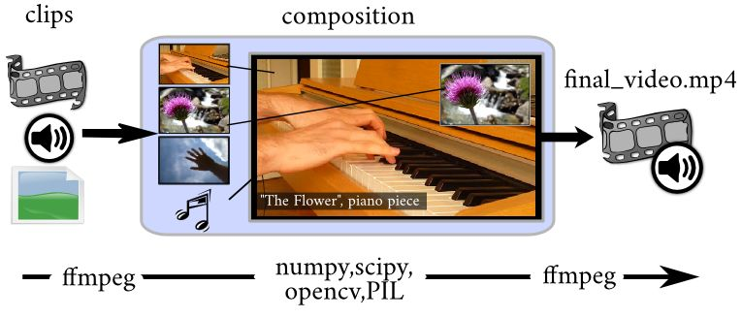
Moviepy - Intro
References
https://moviepy.readthedocs.io/en/latest/index.html
SubtitlesClip
VideoFileClip
ImageClip
VideoClip
ColorClip
TextClip
CompositeVideoClip
AduioClip

Slide 80
Moviepy - VideoClip
write_images_sequence(name_format, fps=None, with_mask=True, logger='bar

Slide 81
Moviepy - AudioClip
AuidoClip
https://moviepy.readthedocs.io/en/latest/ref/AudioClip.html
to_soundarray(tt=None, fps=None, quantize=False, nbytes=2, buffersize=50000)
# adjust aduio speed
au = AudioFileClip(name)
new_au = au.fl_time(lambda t: 1.1*t, apply_to=['mask', 'audio']) # represents 1.1 to adjust the speed
new_au = new_au.set_duration(au.duration/1.1) # 1.1 means adjusting the speed
new_au.write_audiofile(name2)
# logo appears at t=5s for a duration of 3s
final = mp.CompositeVideoClip([video, logo.set_start(5).set_duration(3)])
# add subtitles
from moviepy.editor import *
from moviepy.video.tools.subtitles import SubtitlesClip
generator = lambda txt: TextClip(txt, font='Arial', fontsize=16, color='white')
subtitles = SubtitlesClip("somet.srt", generator)
video = VideoFileClip("some.mp4")
result = CompositeVideoClip([video, subtitles.set_pos(('center','bottom'))])
result.write_videofile("out.mp4", fps=video.fps, temp_audiofile="temp-audio.m4a", remove_temp=True, codec="libx264", audio_codec="aac")
# creating a Image sequence clip with fps = 1
clip = ImageSequenceClip(['frame1.png', 'frame2.png', 'frame1.png', 'frame2.png'], fps = 1)

Slide 82
Moviepy - Mixing clips
Mixing clips
concatenate_videoclips // play one after the other
clip_array // tile clips
CompositeVideoClip
concatenate_audioclips
CompositeAudioClip
from moviepy.editor import VideoFileClip
def flip(image):
"""Flips an image vertically """
return image[::-1] # remember that image is a numpy array
clip = VideoFileClip("my_original_video.mp4")
new_clip = clip.fl_image( flip )
new_clip.write_videofile("my_new_clip", some other parameters)
from moviepy.editor import *
clip = VideoFileClip("my_original_video.mp4")
new_clip = clip.fx(vfx.mirror_y)
new_clip.write_videofile("my_new_clip", some other parameters)
# concatenating both the clips
final = concatenate_videoclips([clip1, clip2])

Slide 83
Moviepy - Effects
moviepy.video.fx
blackwhite
blink
crop
even_size
fadein, fadeout
freeze, freeze_region
gamma_corr
headblur
invert_colors
loop
lum_contrast
make_loopable
margin
mask_end, mask_color, mask_or
mirror_x, mirror_y
multiply_color, multiply_speed
painting
resize
rotate
scroll
supersample
time_mirror
time_symmetrize
Custom effects (latest)
time_transform
my_clip.time_transform(lambda t: 3*t)
image_transform
def invert_green_blue(image):
return image[:,:,[0,2,1]]
modifiedClip = my_clip.image_transform( invert_green_blue )
Custom effects (v1.0.x)
fl_time
fl_image
def invert_green_blue(image):
return image[:,:,[0,2,1]]
modifiedClip = my_clip.fl_image( invert_green_blue )

Slide 84
3D

Slide 85
3D
Load models
objloader, plyfile, PyAssimp, pyntcloud, PyMesh, pptk
3D math functions
pip install pyrr
Rendering
Open3D
https://github.com/IntelVCL/Open3D
pip install open3d
PyOpenGL
ModernGL
Simpler and faster than PyOpenGL
Can render without a window
100% Pythonic
pip install moderngl
VTK
https://vtk.org/
pip install vtk
OSMesa
Mesa's off-screen interface is used for rendering into user-allocated memory without any sort of window system or OS dependencies.
sudo apt-get install libosmesa6-dev
Panda3D
pip install panda3d==1.10.8
https://github.com/panda3d/panda3d
work on both Windows and Linux
Panda3DViewer
based on Panda3D
https://github.com/ikalevatykh/panda3d_viewer

Slide 86
Open3D
Install
pip install open3d
Headless rendering
sudo apt-get install libosmesa6-dev
Get sources
git clone https://github.com/IntelVCL/Open3D
git submodule update --init --recursive
build Open3D with OSMesa
pip install pybind11
cmake -DENABLE_HEADLESS_RENDERING=ON -DBUILD_GUI=OFF -DUSE_SYSTEM_GLEW=OFF -DUSE_SYSTEM_GLFW=OFF ..

Slide 87
Blender
Build blender as a python module
ref: https://wiki.blender.org/wiki/Building_Blender/Other/BlenderAsPyModule
Get source
git clone https://git.blender.org/blender.git
cd blender
git submodule update --init --recursive
git submodule foreach git checkout master
git submodule foreach git pull --rebase origin master
Make
Make install
WITH_INSTALL_PORTABLE=ON
CMAKE_INSTALL_PREFIX=$HOME/.local/lib/python3.7/site-packages
make install
Run blender python scripts
blender -b --python render.py -d -noaudio
-d: debug, -b: background, -noaudio: no audio (useful for WSL)
pip install

Slide 88
trimesh
Install
pip install trimesh
load
creation

Slide 89
pyrender
fuze_trimesh = trimesh.load(fn)
mesh = pyrender.Mesh.from_trimesh(fuze_trimesh)
scene = pyrender.Scene()
scene.add(mesh)
pyrender.Viewer(scene, use_raymond_lighting=True)
Install
pip install pyender trimesh
Windows
<=0.1.39 can work
Viewer
OffscreenRenderer
PerspectiveCamera
PointLight
Scene
Mesh
OrthographicCamera
SpotLight
IntrinsicsCamera
DirectionalLight

Slide 90
Vapory
Depends on POV-Ray
free ray-tracing engine
Install POV-Ray from http://www.povray.org/download/
Modify Lib\site- packages\vapory\config.py
povray.exe -> pvengine64.exe
https://github.com/Zulko/vapory

Slide 91
Mayavi
Install
pip install mayavi pyqt5==5.14.0

Slide 92
Data Visualization

Slide 93
General
Intro
categories
Time-Series, Statistical Distributions, Maps, Hierarchies, and Networks
Libraries
pandas

Slide 94
pandas
import pandas as pd
Iterate rows
for index, row in df.iterrows():
print(row['c1'], row['c2'])
check column exist
if ‘A’ in df.columns:
Get a cell
df.loc[row][column_name]
Update a cell
df.iloc[idx_row, idx_col] = ‘A’
Get column index
index_no = df.columns.get_loc(col_name)

Slide 95
pyecharts
References
https://github.com/pyecharts/pyecharts
https://jishuin.proginn.com/p/763bfbd56b1a
Usage
pip install pyecharts
use_theme(‘dark’)
add(): add data and config
render(): output render.html

Slide 96
folium
References
https://zhuanlan.zhihu.com/p/242268152
Usage
pip install folium

Slide 97
Advanced

Slide 98
Wrap As Exe or Dll
py2exe
MUST run on Windows
pip install py2exe
Create setup.py
python ./setup.py py2exe
Only support python 3.3 or 3.4
PyInstaller
pip install pyinstaller
pyinstaller yourprogram.py
Files are generated into “dist” folder
yourprogram.spec
pyinstaller yourprogram.spec
“build” folder
-F: one-file bundled executable
# setup.py
from distutils.core import setup
import py2exe
setup(
console=['myscript.py'],
options={
'py2exe': {
'packages': ['libaray']
}
}
)

Slide 99
Performance
Refer
https://stackify.com/20-simple-python-performance-tuning-tips/
https://scikit-learn.org/stable/developers/performance.html
List vs. Set
set.add() is much faster than a list, may be 500 times faster for large list.
List comprehension
cube_numbers = [n**3 for n in range(1,10) if n%2 == 1]
much faster than for loop for big loop
Use np functions instead of built-in functions
np.min/np.max instead of min/max
set1 ={1, 2, 3}
set2 = {1, 3, 5}
set1 | set2 # union, in set1 or set2
set1 & set2 # intersection, both in set1 and in set 2
set1 - set2 # diff, in set1 but not in set2
set1 ^ set2 # symmetric diff, only in set1 or set2

Slide 100
Memory
References
https://docs.python.org/3/c-api/memory.html#
https://docs.python.org/3.9/library/tracemalloc.html
https://www.section.io/engineering-education/how-to-fix-memory-leaks-in-python/
https://www.fugue.co/blog/diagnosing-and-fixing-memory-leaks-in-python.html
Garbage collection
gc.enable() // time consuming
gc.isenabled()
gc.get_threshold() // threshold for 3 generations, default (700, 10, 10)
gc.set_threshold(t1, t2, t3)
n_unreached = gc.collect() // return unreachable objects
gc.garbage // uncollectable garbage
gc.get_objects()
tracemalloc
PYTHONTRACEMALLOC
import tracemalloc
tracemalloc.start()
snapshot1 = tracemalloc.take_snapshot()
snapshot2 = tracemalloc.take_snapshot()
top_stats = snapshot2.compare_to(snapshot1, 'lineno')
for stat in top_stats[:10]:
print(stat)

Slide 101
Cython
.c
.so
.pyx
Concept
Cython is an optimising static compiler for both the Python programming language and the extended Cython programming language (based on Pyrex). It makes writing C extensions for Python as easy as Python itself.
Cython language is a superset of the Python language.
Cython codes must be compiled first.
Features
Support to write Python code that calls back and forth from and to C or C++ code natively at any point
Easily tune Python code into plain C performance by adding static type declarations
Install
pip install cython
sudo apt install build-essential
Usage
Write hello.pyx
Write setup.py or pyximport
python setup.py build_ext --inplace
# setup.pyx
from distutils.core import setup
from Cython.Build import cythonize
setup(name='Hello world app',
ext_modules=cythonize("hello.pyx"))

Slide 102
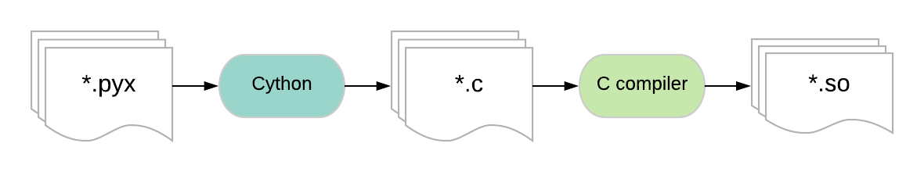
Cython (2)
Static typing
cdef
cythonize
compile to C/C++ files and create python importable modules

Slide 103
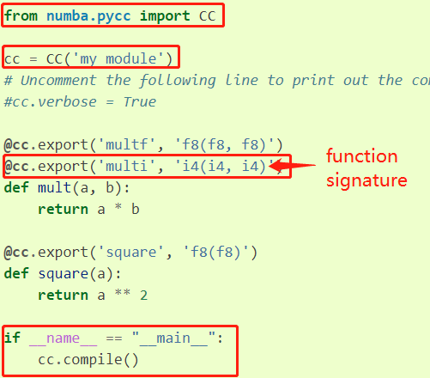
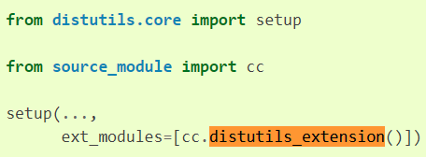
Numba
JIT
from numba import njit
@njit
def func():
func = njit(f)
AOT (Ahead Of Time compilation)
callee:
from numba.pycc import CC
cc = CC('module_name')
@cc.export('func_name', 'rtype(ptype1, ptype2)')
def func_name():
setup.py (cythonize)

Slide 104
Interface with C/C++ Library
References
https://realpython.com/python-bindings-overview/
ctypes
low-level, load dll directly
only C
https://docs.python.org/3/library/ctypes.html
CFFI (C Foreign Function Interface)
from cffi import FFI
Only C
Steps
Write python code describing the bindings
Run the code to generate a loadable module
Modify calling code to import and use the new module
PyBind11
Supports C++
Cython
SWIG
Generating bindings for interpreted languages from C/C++ header files
Boost.Python
https://www.boost.org/doc/libs/1_59_0/libs/python/doc/

Slide 105
Export to Excel
References
https://www.zditect.com/guide/python/python-write-to-an-excel-spreadsheet.html
Methods
pandas
xlwt
openpyxl
xlsxwriter
import xlwt
from xlwt import Workbook
wb = Workbook()
sheet1 = wb.add_sheet('Sheet 1')
#sheet1.write(row,col, data, style)
sheet1.write(1, 0, '1st Data')
sheet1.write(2, 0, '2nd Data')
sheet1.write(3, 0, '3rd Data')
sheet1.write(4, 0, '4th Data')
wb.save('sample_data2.xls')
import xlsxwriter
workbook = xlsxwriter.Workbook('sample_data4.xlsx')
sheet = workbook.add_worksheet()
sheet.write('A1', 'Maisam')
sheet.write('A2', 'Abbas')
workbook.close()

Slide 106
Create Python Packages
References
https://www.geeksforgeeks.org/how-to-build-a-python-package/
Steps
Write codes
Write setup.py
python3 setup.py sdist bdist_wheel
generate folders build, dist, test_package.egg-info
in build folder, .whl file is generated (pip install .whl)

Slide 107
FAQ

Slide 108
Error:
Error message
from .cv2 import *
ImportError: libGL.so.1: cannot open shared object file: No such file or directory
Solution
sudo apt install python3-opencv

