Slide 1
Media Notes
Sparks-Lu
Last updated: 11/10/2021

Slide 2
Change History
11/10/2021
Added audio codec conversion

Slide 3
References
https://helgeklein.com/blog/2017/12/browser-video-codecs-formats-hardware-acceleration/
https://www.fourcc.org/codecs.php
https://trac.ffmpeg.org/wiki/Encode/H.264
http://www.lighterra.com/papers/videoencodingh264/

Slide 4
Image Conversion
SVG -> PNG
convert -density 1200 -resize 200x200 source.svg target.png

Slide 5
Concepts
Streams
ffprobe ../videos/samples_subtitle/1.mp4 |& grep stream -i
video (-vn to turn off)
audio (-an to turn off)
subtitle (-sn to turn off)
data (-dn to turn off)

Slide 6
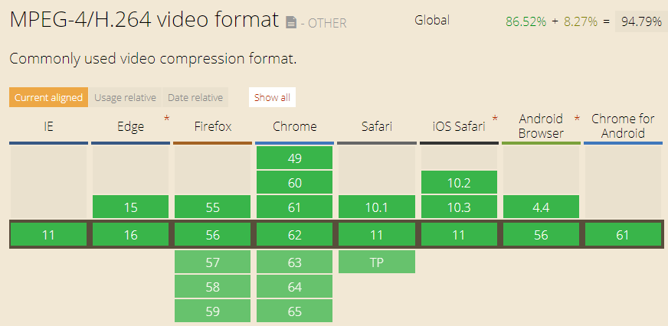
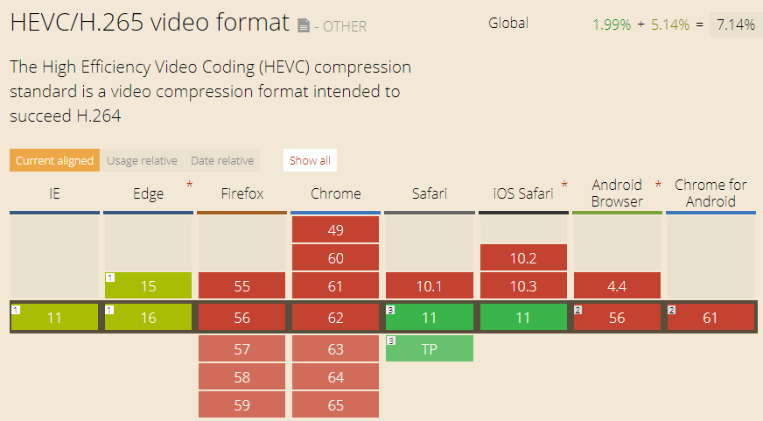
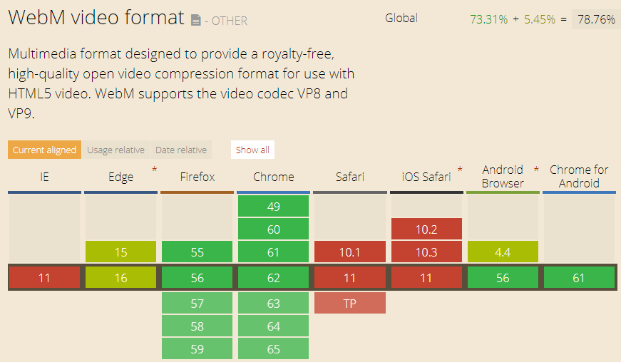
Video Container Format
MP4
audio encoding: AAC, MP3
video encoding: H.264 (AVC), H.265(HEVC)
not royalty-free
WebM
audio encoding: Ogg Vorbis
video encoding: VP8, VP9
royalty-free
default audio encoder for WebM is libopus, but if it is not available libvorbis will be used instead
vp9
libvpx-vp9 is the VP9 video encoder for ​WebM
libvpx-vp9 can save about 20–50% bitrate compared to libx264 (the default H.264 encoder), while retaining the same visual quality.
To install FFmpeg with support for libvpx-vp9, compile FFmpeg with the --enable-libvpx option.
ffmpeg -i input.mp4 -c:v libvpx-vp9 -lossless 1 output.webm
vp8
libvpx is the VP8 video encoder for ​WebM
--enable-libvpx
VP8 includes alpha channel support
ffmpeg -i %04d.png -c:v libvpx -pix_fmt yuva420p -metadata:s:v:0 alpha_mode="1" output.webm

Slide 7
Video Standards
Name |  | Info
MPEG-1 | Used for VCD
MP3 | Part of MPEG-1 standard
MPEG-2 / H.262 | Used for DVD
MPEG-4 / H.264 | Used in Blu-ray
MPEG-H / H.265 / HEVC (High Efficiency Video Coding) | Support 4K and 8K resoluation | Doubles the data compression ratio compared to H.264

Slide 8
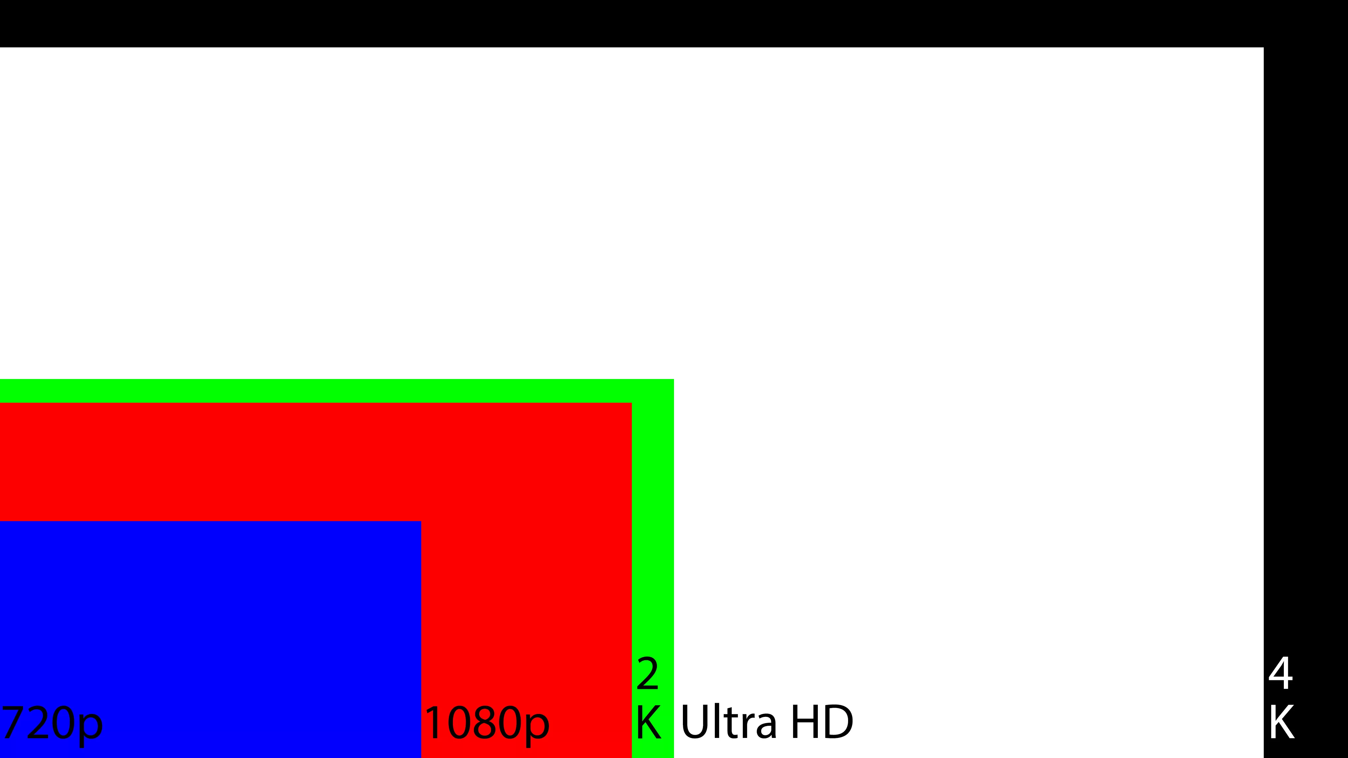
Resolution Standard
Name | Resolution | Note
8K | 7680x4320
4K | 4096x
UHD | 3840x2160 | Ultra High Definition
2K | 2048x
WUXGA | 1920x1200
1080p | 1920x1080 | FHD (Full HD)
720p | 1280x720 | HD (High Definition)

Slide 9
FourCC
Intro
Short for “Four Character Code”
An identifier for a video codec, compression format, color, or pixel format used in a media file.
Video Codecs by FourCC
H264
X264
XVID

Slide 10
FFMPEG Info
Install
sudo add-apt-repository ppa:videolan/master-daily
ffmpeg 3.3.3-2
ffmpeg, ffprobe, ffplay
Task | Commands | Note
Hide banner | ffmpeg -hide_banner
Log level | ffmpeg -loglevel quiet/panic/fatal/error/warning/info/verbose/debug
Print format | ffprobe -show_format -print_format json -v quiet input.mp4
Get duration | ffprobe -i input.mp4 -v quiet -show_entries format=duration -hide_banner -of default=noprint_wrappers=1:nokey=1
Show stream info | ffprobe -v quiet -print_format json -show_format -show_streams input.mp4
Get fps | ffmpeg -i filename 2>&1 | sed -n "s/.*, \(.*\) fp.*/\1/p"

Slide 11
FF* Generic Options
Task | Commands | Note
-version | List ffmpeg version
-buildconf | List ffmpeg build configuration
-formats -demuxers -muxers | List available codec formats
-devices | List available devices
-codec -decoders -encoders | List available codecs, decoding/encoding, video/audio/subtitle/data/attachment, lossy/lossless
-bsfs | List available bitstream filters
-protocols | List available protocols
-filters | List available libavfilter filters
-pix_fmts | List available pixel formats
-sampel_fmts | List available sample formats
-layouts | List channel names and standard channel layouts
-dispositions | List stream dispositions
-colors | List recognized color names

Slide 12
FFMPEG frames
Task | Commands | Note
Convert images into video | ffmpeg -start_number {start} -i %4d.png -r 20 output.mp4 ffmpeg -framerate 1 -i happy%d.jpg -c:v libx264 -r 30 output.mp4 ffmpeg -framerate 1 -pattern_type glob -i '*.jpg' -c:v libx264 -r 30 -pix_fmt yuv420p output.mp4 # glob ffmpeg -f concat -i input.txt -c:v libx264 -r 30 -pix_fmt yuv420p output.mp4 # use concat demuxer ffmpeg -framerate 1 -pattern_type glob -i '*.jpg' -i freeflow.mp3 -shortest -c:v libx264 -r 30 -pix_fmt yuv420p output6.mp4 # audio ffmpeg -framerate 1/2 -i image%03d.jpg -i audio.mp3 -filter_complex "scale=1920:1080:force_original_aspect_ratio=decrease,pad=1920:1080:(ow-iw)/2:(oh-ih)/2 , subtitles=text.srt:force_style='Alignment=10,OutlineColour=&H100000000,BorderStyle=3,Outline=1,Shadow=0,Fontsize=18" -pix_fmt yuv420p -r 30 -t 00:00:22 output.mp4 ffmpeg -loop 1 -t 5 -i happy1.jpg -loop 1 -t 5 -i happy2.jpg -i freeflow.mp3 \ -filter_complex \ "[0:v]scale=1280:720:force_original_aspect_ratio=decrease,pad=1280:720:(ow-iw)/2:(oh-ih)/2,setsar=1,fade=t=out:st=4:d=1[v0]; \ [1:v]scale=1280:720:force_original_aspect_ratio=decrease,pad=1280:720:(ow-iw)/2:(oh-ih)/2,setsar=1,fade=t=in:st=0:d=1,fade=t=out:st=4:d=1[v1]; \ [v0][v1]concat=n=2:v=1:a=0,format=yuv420p[v]" -map "[v]" -map 2:a -shortest output7.mp4 | https://trac.ffmpeg.org/wiki/Concatenate https://shotstack.io/learn/use-ffmpeg-to-convert-images-to-video/ input.txt file 'happy1.jpg' duration 2 file 'happy2.jpg' duration 2
Get frames from video | ffmpeg -i input.mp4 output/frame%04d.jpg
Extract frames with a ratio | ffmpeg -i input.mp4 -r 0.1 ./images/frames_%02d.jpg
Extract a specific frame | ffmpeg -ss 00:00:05.01 -i myvideo.avi -frames:v 1 myimage.jpg

Slide 13
FFMPEG Video
Task | Commands | Note
Change video size | ffmpeg -i input.avi -s 720x480 -c:a copy output.avi ffmpeg -i input.avi -filter:v scale=720:-1 -c:a copy output.avi
Crop video | ffmpeg -i input.mp4 -filter:v "crop=w:h:x:y" output.mp4
Change fps | ffmpeg -i input.mp4 -r 30 output.mp4 | video lengh not changed, frames added or removed
Add logo to video (bottom-right) | ffmpeg -i vt.mp4 -i vhuantech-org.png -filter_complex "overlay=W-w-5:H-h-5" -codec:a copy TempleOfHeaven.mp4
Speed up or slow down | ffmpeg -i input.mp4 -filter:v “setpts=0.5*PTS” output.mp4 ffmpeg -i input.mkv -filter_complex "[0:v]setpts=0.5*PTS[v];[0:a]atempo=2.0[a]" -map "[v]" -map "[a]" output.mkv | fps not changed, video length changed, frames added or removed PTS: presentation timestamp
Generate video from image | ffmpeg -loop 1 -i image.png -t 3 out.mp4
Output to gif | ffmpeg -i input.mp4 -f gif output.gif
Reverse video | ffmpeg -i input.mov -filter:v 'reverse' -filter:a 'areverse' output.mov
Rotate video | ffmpeg -i input.mp4 -filter:v 'transpose=1' rotated-video.mp4 // 1: 90 counter-clockwise, 2: 90 clockwise
Truncate video | ffmpeg -ss 10 -i input.mp3 -t 6 output.mp3
Concat video files | ffmpeg -f concat -safe 0 -i mylist.txt -c copy output.mp4 | mylist.txt: file 'filename1'
Change video codec | ffmpeg -i in.mpg -c:v libx264 out.mp4

Slide 14
FFMPEG Video 2
Task | Commands | Note
Set h264 encoding params | ffmpeg -c:v libx264 -profile:v high/main/baseline -level:v 4.0 -crf 0~51 (constant rate factor, default 23, 0 lossless, 17/18 nearly lossless) -preset // encoding speed, ultrafast, superfast, veryfast, faster, fast, medium (the default), slow, slower, veryslow. A slower preset provides better compression (quality per file size) but is slower. -b:a 128k // set audio bitrate to 128K // profile: video compression features the player must support // level: defines the peak bitrate the player can handle, along with the maximum resolution, and the maximum number of reference frames held in memory during playback
Padding | ffmpeg -i in.mp4 -vf “pad=width=800:height=600:x=10:y=75:color=black” out.mp4 | x/y: start placing point of the original
Web video | -movflags +faststart // Allows video to playback before it is completely downloaded in the case of progressive download viewing. Useful if you are hosting the video, otherwise superfluous if uploading to a video service like YouTube.
Convert to gif | ffmpeg -i video.mp4 -vf scale=500:-1 -t 10 -r 10 image.gif // scale to width=500
Add a poster image to audio to generate video | ffmpeg -loop 1 -i image.jpg -i audio.mp3 -c:v libx264 -c:a aac -strict experimental -b:a 192k -shortest output.mp4
Convert a single image to video | ffmpeg -loop 1 -i image.png -c:v libx264 -t 30 -pix_fmt yuv420p video.mp4

Slide 15
FFMPEG Audio
Task | Commands | Note
从MP4中提取声音 | ffmpeg -i input.mp4 -vn output.mp3
Add subtitle | ffmpeg -i input.avi -vf subtitles=subtitle.srt output.avi ffmpeg -i input.avi -vf “ass=subtitle.ass” output.avi ffmpeg -i movie.mp4 -i subtitles.srt -map 0 -map 1 -c copy -c:v libx264 -crf 23 -preset veryfast output.mkv
Extract audio from video | ffmpeg -i input.mp4 -vn -ac 2 -ab 187 audio.wav -ac number of audio channels -ab audio bitrate in Kbps
Merge audio and video | ffmpeg -i audio.mp3 -i input.mp4 output.mp4
Remove audio from video | ffmpeg -i input.avi -vcodec copy -an output.avi
Convert wav to mp3 | ffmpeg -i input.wav output.mp3
Change audio volume | ffmpeg -i input.wav -af "volume=0.25" output.mp3
Fade in volume | ffmpeg -y -i demo.wav -af "afade=t=in:ss=0:d=15" output.mp3
Reduce background noise | ffmpeg -i input.wav -af "highpass=f=200, lowpass=f=3000" output.mp3 | [200Hz, 300Hz] is kept
Slow down audio by 2 | ffmpeg -i input.mp4 -filter:a "atempo=0.5" -vn output.aac | atempo: 0.5~2.0
Change audio codec | ffmpeg -i in.mp4 -c:a aac out.mp4 | mp3-encoded video cannot play audio correctly in Mac/iOS
Change sample rate | ffmpeg -i input.mp3 -ar 44100 output.mp3 | Change audio sample rate to 44K Hz
Concat two mp3 into one | ffmpeg -i 1.mp3 -i 2.mp3 -filter_complex [0:a][1:a]concat=n=2:v=0:a=1 out.mp3

Slide 16
FFMPEG Subtitle
Task | Commands | Note
Remove soft subtitle | ffmpeg -i video.mkv -vcodec copy -acodec copy -sn video-no-subs.mkv
Add soft subtitle | ffmpeg -i demo.mkv -i sub.ass -codec copy -map 0 -map 1 output.mkv ffmpeg -i input.m4v -i subtitle.srt -map 0 -map 1 -c copy -c:s mov_text output.m4v
Add hard subtitle | # ffmpeg should be built with libass support ffmpeg -version |grep libass -i ffmpeg -i input.mp4 -vf subtitles=”subtitle.srt:fontsdir=/fonts/:force_style='FontName=Droid Sans,Fontsize=12,borderstyle=3,outline=3,PrimaryColour=&H00ff0000,OutlineColour=&H0000ff00'” output.mp4 // color in &HAABBGGRR ffmpeg -i input.mp4 -vf “ass=subtitle.ass:fontsdir=/storage/emulated/0/fonts/” output.mp4 ffmpeg -i input.mp4 -vf "subtitles=subtitle.srt:force_style='Fontname=Roboto,OutlineColour=&H40000000,BorderStyle=3'" output.mp4 // Youtube default ffmpeg -i input.mp4 -vf "subtitles=subtitle.srt:force_style='Fontname=Consolas,BackColour=&H80000000,Spacing=0.2,Outline=0,Shadow=0.75'" output.mp4 // Netflix default ffmpeg -i input.mp4 -vf "subtitles=subtitle.srt:force_style='PrimaryColour=&H03fcff,Italic=1,Spacing=0.8'" output_aesthetic.mp4 // aesthetic (vintage yellow) | borderstyle: 1 (outline + drop shadow), 3 (opaque box) color: &HAABBGGRR https://www.baeldung.com/linux/subtitles-ffmpeg
Extract subtitle from video | ffmpeg -i demo.mkv -map 0:s:0 sub.srt

Slide 17
FFMPEG Audio Filters
References
https://trac.ffmpeg.org/wiki/FilteringGuide
https://ffmpeg.org/ffmpeg-filters.html
Audio filters
acompressor, acontrast, acopy, crossfade, aloop, amerge, amix, lowpass,
Task | Commands | Note
Apply an audio filter | ffmpeg -i input -filter:a loudnorm output
Apply a video filter

Slide 18
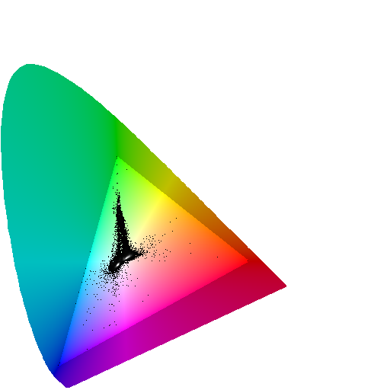
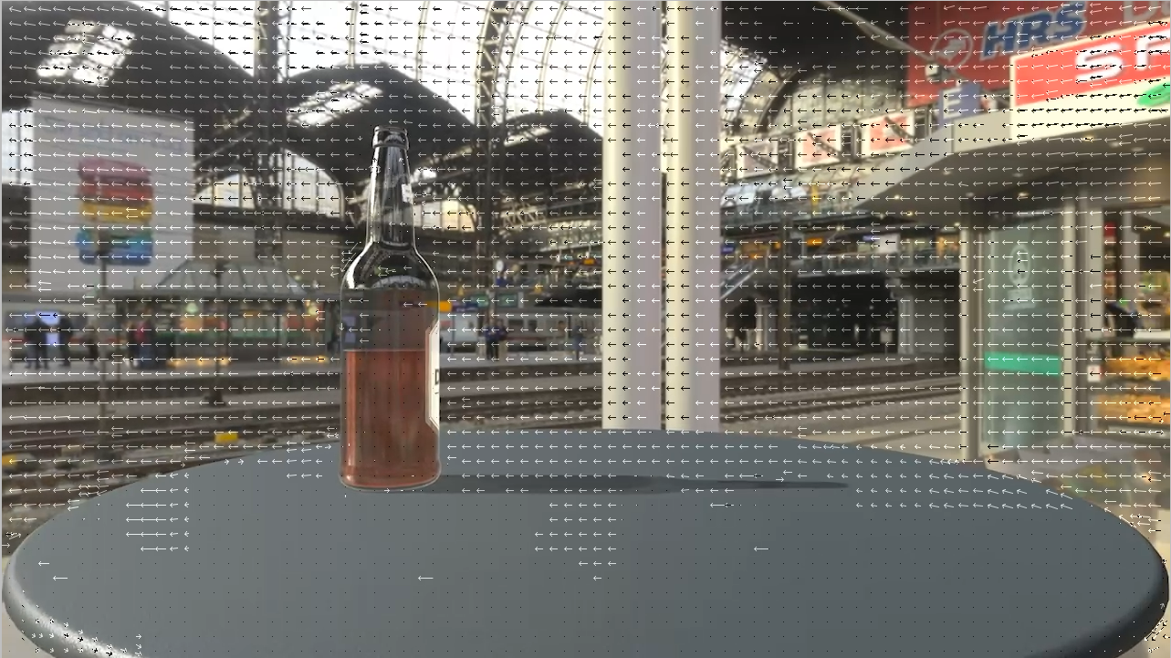
FFMPEG Video Filters
Video filters
ass, blend, boxblur, chromahold/colorhold
chromakey/colorkey
color
similarity(0.01~1): 0.01 for exact key color, 1 for everything
blend: in percentage, higher value for more blending effect
ffmpeg -i input.png -vf chromakey=green:0.1:0.1 out.png
chromashift
cbh (chroma-blue horizontally), cbv, crh, crv, edge (smear, default, warp)
ciescope
display CIE color diagram with pixels overlaid onto it
color system, cie, gamuts, size, intensity, contrast, corrgamma, showwhite, gamma, fill
codecview
visualize info exported by some codecs
mv: motion vectors to visualize
qp: display quantization params using the chroma plane
mv_type: fp (forward predicted MVs), bp (backward predicted MVs)
frame_type: if (intra-coded frame), pf (predicted frames), bf (bi-directionally predicted frames)
ffplay -flags2 +export_mvs input.mp4 -vf codecview=mv=pf+bf+bb

Slide 19
FFMPEG Video Filters 2
Video filters (Cont.)
colorbalance
rs/gs/bs: r/g/b shadow
[-1, 1]
rm/gm/bm: r/g/b medium
rh/gh/bh: r/g/b brightest pixels
pl: preserve lightness
ffmpeg -i sodabottle.mp4 -vf colorbalance=rs=.3 rs.3.mp4
colorcontrast
adjust color contrast between RGB components
colorcorrect
adjust color white balance
rl(-1.0~1.0)/bl/rh/bh/saturation(-3.0~3.0)/analyze(manual/average/minmax/median)
ffmpeg -i sodabottle.mp4 -vf colorcorrect=saturation=3.0 sat3.0.mp4
colorize
Overlay a solid color on the video stream
hue (0~360), saturation (0~1), lightness (0~1), mix
Video filters (Cont.)
colorlevels
rimin/gimin/bimin/aimin: input min, [-1.0, 1.0]
rimax/gimax/bimax/aimax: input max, [-1.0, 1.0]
romin/gomin/bomin/aomin: output min, [0, 1.0]
romax/gomax/bomax/aomax:output max, [0, 1.0]
preserve: non/lum/max/avg/sum/nrm/pwr
ffmpeg -i sodabottle.mp4 -vf colorlevels=rimin=0.058:gimin=0.058:bimin=0.058 darker.mp4
ffmpeg -i sodabottle.mp4 -vf colorlevels=rimin=0.039:gimin=0.039:bimin=0.039:rimax=0.96:gimax=0.96:bimax=0.96 increase_contrast.mp4
colormap/colormatrix/colorspace
colortemperature
temperature: in Kelvin, 1000~40000, default 6500K
mix (0~1, default 1), pl (preserve lightness, 0~1, default 0)

Slide 20
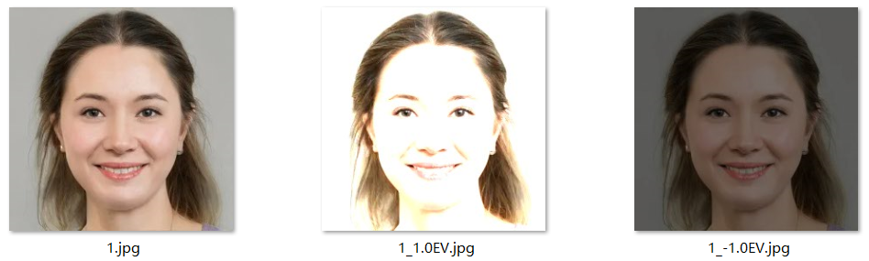
FFMPEG Video Filters 2
Video filters (Cont.)
convolution
matrix for each plane (channel): 3*3/5*5/7*7/horizontal/vertical, up to 49 elements
multiplier for calculated value for each plane, default 1
bias for each plane, added to the result of the multiplication, default 0.0
matrix mode for each plane, square (default) / row/column
sharpen: convolution="0 -1 0 -1 5 -1 0 -1 0:0 -1 0 -1 5 -1 0 -1 0:0 -1 0 -1 5 -1 0 -1 0:0 -1 0 -1 5 -1 0 -1 0"
blur: convolution="1 1 1 1 1 1 1 1 1:1 1 1 1 1 1 1 1 1:1 1 1 1 1 1 1 1 1:1 1 1 1 1 1 1 1 1:1/9:1/9:1/9:1/9"
edge enhance: convolution="0 0 0 -1 1 0 0 0 0:0 0 0 -1 1 0 0 0 0:0 0 0 -1 1 0 0 0 0:0 0 0 -1 1 0 0 0 0:5:1:1:1:0:128:128:128"
edge detect:convolution="0 1 0 1 -4 1 0 1 0:0 1 0 1 -4 1 0 1 0:0 1 0 1 -4 1 0 1 0:0 1 0 1 -4 1 0 1 0:5:5:5:1:0:128:128:128"
laplacian edge detect: convolution="1 1 1 1 -8 1 1 1 1:1 1 1 1 -8 1 1 1 1:1 1 1 1 -8 1 1 1 1:1 1 1 1 -8 1 1 1 1:5:5:5:1:0:128:128:0"
emboss:convolution="-2 -1 0 -1 1 1 0 1 2:-2 -1 0 -1 1 1 0 1 2:-2 -1 0 -1 1 1 0 1 2:-2 -1 0 -1 1 1 0 1 2"
Video filters (Cont.)
crop
width, height, x, y
crop=2/3*in_w:2/3*in_h
curves
preset: none/color_negative/cross_process/darker/increase_contrast/lighter/linear_contrast/medium_contrast/negative/strong_contrast/vintage
vintage effect: curves=r='0/0.11 .42/.51 1/0.95':g='0/0 0.50/0.48 1/1':b='0/0.22 .49/.44 1/0.8'
curves=preset=vintage
dctdnoiz
decimate
drawbox
drawbox=10:20:200:60:red@0.5
drawgrid
drawgrid=w=iw/3:h=ih/3:t=2:c=white@0.5 # width/height/thickness,color
drawtext
compiled with --enable-libfreetype and --enable-libharfbuzz, or --enable-libfontconfig (font options), --enable-libfribidi (text_shaping options)
drawtext="fontfile=/usr/share/fonts/truetype/freefont/FreeSerif.ttf: text='Test Text'"
exposure
exposure:-3.0~3.0, black:-1.0~1.0

Slide 21
FFMPEG Video Filters 3
Video filters (Cont.)
fade
type: in/out, start frame, end_frame
fade=in:0:30
format
pix_fmts
format=pix_fmts=yuv420p
fps
hflip
histogram
hstack
hue
hue=h=90:s=1
hue="H=2*PI*t: s=sin(2*PI*t)+1" // rotate hue and sat
loop
loop=loop=5:size=10:start=0 // loop first 10 frames for 5 times
lut, lutyuv, lutrgb
lutyuv=y=negval // negate luma
lutyuv="y=2*val" // luma burning effect
lutyuv=y=gammaval(0.5) // correct luma gamma
lut2, tlut2
lut2='ifnot(x-y,0,pow(2,bdx)-1):ifnot(x-y,0,pow(2,bdx)-1):ifnot(x-y,0,pow(2,bdx)-1)' // highlight diff between two RGB streams
lut2='ifnot(x-y,0,pow(2,bdx)-1):ifnot(x-y,pow(2,bdx-1),pow(2,bdx)-1):ifnot(x-y,pow(2,bdx-1),pow(2,bdx)-1)' // highlight diff between two YUV streams
Video filters (Cont.)
mpdecimate
normalize
normalize=blackpt=black:whitept=white:smoothing=0 // stretch contrast to use the full dynamic range
overlay
overlay=main_w-overlay_w-10:main_h-overlay_h-10 // draw overlay at 10px from the bottom-right corner of the main window
ffmpeg -i input -i logo -filter_complex 'overlay=10:main_h-overlay_h-10' output // overlay logo on bottom-left corner
pad
pad=640:480:0:40:violet // width/height/x/y
pad="max(iw\,ih):ow:(ow-iw)/2:(oh-ih)/2" // pad as square
pad="ih*16/9:ih:(ow-iw)/2:(oh-ih)/2" // pad as 16:9
rotate
rotate=PI/6
scale
scale=200x100
scale=2*in_w:2*in_h
scroll
h (horizontal scroll speed, -1~1), v (vertical scroll speed, -1~1), hpos (0~1), vpos(0~1)
setdar, setsar
dar (Display Aspect Ratio), sar (Sample Aspect Ratio)
setdar=dar=16/9
signature
MPEG-7 Video Signature
subtitles
subtitles=sub.srt:force_style='Fontname=DejaVu Serif,PrimaryColour=&HCCFF0000'

Slide 22
FFMPEG Video Filters 4
Video filters (Cont.)
thumbnail
Select the most representative frame in a given sequence of consecutive frames
thumbnail=50 // extract one image every 50 frames
ffmpeg -i in.avi -vf thumbnail,scale=300:200 -frames:v 1 out.png
tile
ffmpeg -skip_frame nokey -i file.avi -vf 'scale=128:72,tile=8x8' -an -vsync 0 keyframes%03d.png // produce 8x8 PNG tiles of all keyframes
tmix
tmix=frames=7:weights="1 1 1 1 1 1 1" // average 7 successive frames
trim
ffmpeg -i INPUT -vf trim=60:120 // keep only 2nd minute
untile
ffmpeg -r 1 -i image.jpg -vf untile=1x25 movie.mkv
vidstabdetect
ffmpeg needs to be compiled with --enable-libvidstab
vidstabdetect=show=1
vidstabtransform
ffmpeg -i inp.mpeg -vf vidstabtransform,unsharp=5:5:0.8:3:3:0.4 inp_stabilized.mpeg
vignette
vignette effect
vignette=PI/4
Video filters (Cont.)
xfade
ffmpeg -i first.mp4 -i second.mp4 -filter_complex xfade=transition=fade:duration=2:offset=5 output.mp4
xstack
Stack video inputs into custom layout.
xstack=inputs=4:layout=0_0|0_h0|w0_0|w0_h0
zoompan
zoompan=z='min(zoom+0.0015,1.5)':d=700:x='if(gte(zoom,1.5),x,x+1/a)':y='if(gte(zoom,1.5),y,y+1)':s=640x360
setpts, asetpts
pts (Presentation TimeStamp)
setpts=0.5*PTS // 2x fast
showcqt, showcwt, showfreqs, showspatial, showspectrum, showspectrumpic, showvolume, showwaves, showwavespic,
Convert input audio to a video output representing frequency spectrum logarithmically
ffplay -f lavfi 'amovie=input.mp3, asplit [a][out1]; [a] showspectrum=mode=separate:color=intensity:slide=1:scale=cbrt [out0]'

Slide 23
FFMPEG Video Filters 5
Video filter
ffplay -f lavfi -i mandelbrot
ffplay -f lavfi -i life=s=640x480:mold=10:r=100:ratio=0.1:death_color=blue:life_color=#00ff00,boxblur=2:2
Gradient
ffplay -f lavfi -i gradients=n=3:type=linear,format=rgb0 // linear gradient
ffplay -f lavfi -i gradients=n=3:type=radial,format=rgb0 // radial gradient
ffplay -f lavfi -i gradients=n=7:type=circular,format=rgb0 // circular gradient
ffplay -f lavfi -i gradients=n=7:type=spiral,format=rgb0 // spiral gradient
Waveforms
References
https://trac.ffmpeg.org/wiki/FancyFilteringExamples
ffplay -f lavfi -i mandelbrot -vf "format=gbrp,split=4[a][b][c][d],[d]histogram=display_mode=0:level_height=244[dd],[a]waveform=m=1:d=0:r=0:c=7[aa],[b]waveform=m=0:d=0:r=0:c=7[bb],[c][aa]vstack[V],[bb][dd]vstack[V2],[V][V2]hstack"
ffplay -f lavfi -i mandelbrot -vf "format=yuv444p,split=4[a][b][c][d],[a]waveform[aa],[b][aa]vstack[V],[c]waveform=m=0[cc],[d]vectorscope=color4[dd],[cc][dd]vstack[V2],[V][V2]hstack"
Waveforms
ffplay -i https://archive.org/download/BigBuckBunny/big_buck_bunny_480p_surround-fix.avi -vf "split[a][b];[a]format=gray,waveform,split[c][d];[b]pad=iw:ih+256[padded];[c]geq=g=1:b=1[red];[d]geq=r=1:b=1,crop=in_w:220:0:16[mid];[red][mid]overlay=0:16[wave];[padded][wave]overlay=0:H-h"
ffplay ~/matrixbench_mpeg2.mpg -vf "split[a][b];[a]waveform=e=3,split=3[c][d][e];[e]crop=in_w:20:0:235,lutyuv=v=180[low];[c]crop=in_w:16:0:0,lutyuv=y=val:v=180[high];[d]crop=in_w:220:0:16,lutyuv=v=110[mid] ; [b][high][mid][low]vstack=4"

Slide 24
FFmpeg - Build From Source
References
https://trac.ffmpeg.org/wiki/CompilationGuide/Ubuntu
ffmpeg-git-amd64-static.tar.xz

Slide 25
Video Support in Browser
mp4v
standard mp4 format is not supported in most web browsers
need to convert to h.264 codec
ffmpeg -i output.mp4 -c:v libx264 output2.mp4

Slide 26
FFPlay Options
Task | Commands | Note
-x width -y height | Set player window width/height
-fs | Play in fullscreen mode
-an | Disable audio
-vn | Disable video
-sn | Disable subtitles
-ss {pos} | Seek to pos
-t {duration} | Play duration
-showmode {mode} | 0: video, 1: waves, 2: rdft (audio frequency band using RDFT)
-vf {filtergraph}
-af {filtergraph}

Slide 27
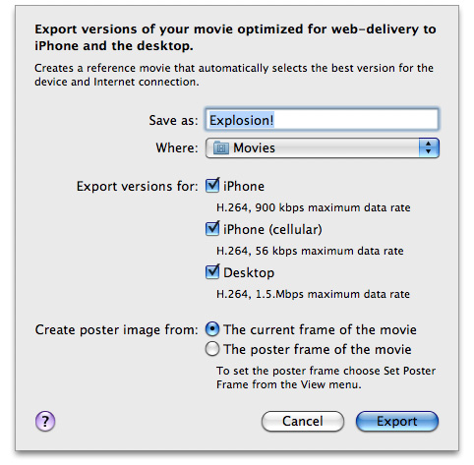
Video Support in Safari
References
https://developer.apple.com/library/archive/documentation/AppleApplications/Reference/SafariWebContent/CreatingVideoforSafarioniPhone/CreatingVideoforSafarioniPhone.html#//apple_ref/doc/uid/TP40006514-SW6
Supported
H.264 Baseline Profile Level 3.0 video, up to 640 x 480 at 30 fps. Note that B frames are not supported in the Baseline profile
MPEG-4 Part 2 video (Simple Profile)
AAC-LC audio, up to 48 kHz
.mov, .mp4, .m4v, and .3gp are supported
Server
Must support byte-range requests
curl --range 0-99 http://example.com/test.mov -o /dev/null

Slide 28
Video Edit Software
References
https://www.lifewire.com/best-free-video-editing-software-programs-4128924
OpenShot
Windows, Mac, Linux
Chinese version supported

Slide 29
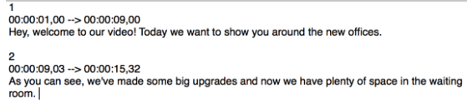
Subtitle
SRT format (.srt)
SubRip Subtitle
plain text
time format: [hours]: [minutes]: [seconds], [milliseconds]
ASS format (.ass)
Advanced SubStation Alpha subtitle
ffmpeg -i input.srt output.ass
ffmpeg -codecs | grep "^...S" // List supported subtitle codecs
[Section of subtitles number]
[Time the subtitle is displayed begins] –> [Time the subtitle is displayed ends]
[Subtitle]

Slide 30
GPU Acceleration
References
https://docs.nvidia.com/video-technologies/video-codec-sdk/12.0/ffmpeg-with-nvidia-gpu/index.html
Steps
ffmpeg -y -vsync 0 -hwaccel cuda -hwaccel_output_format cuda -i input.mp4 -c:a copy -c:v h264_nvenc -b:v 5M output.mp4

