Slide 1
Shopping System Notes
单击此处添加副标题
演讲者：

Slide 2
OSS
https://github.com/Allen7D/mini-shop-server
Flask server
https://github.com/Exrick/xmall
Java, Vue
https://github.com/linlinjava/litemall
SpringBoot, Vue
管理后台，微信小程序

Slide 3
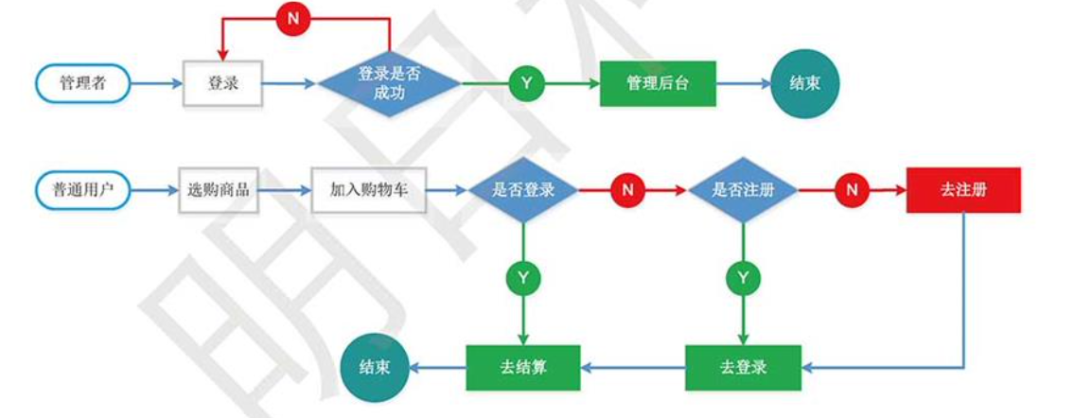
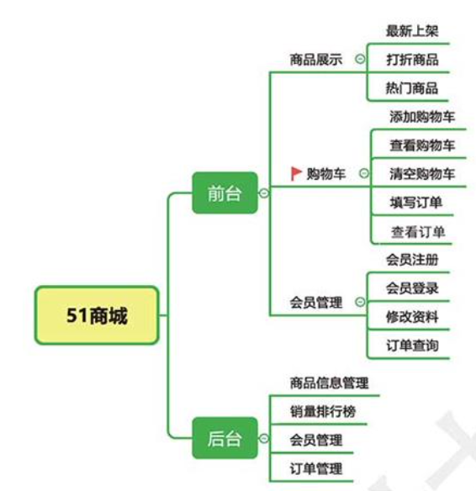
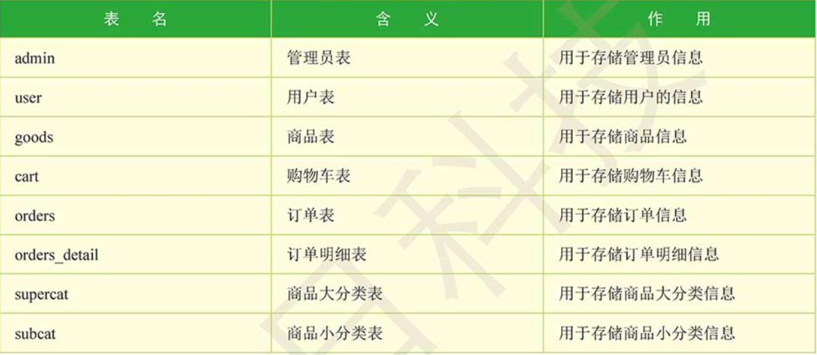
References 1 Flask商城 - 1
https://www.cnblogs.com/yffxwyy/p/13792864.html

Slide 4
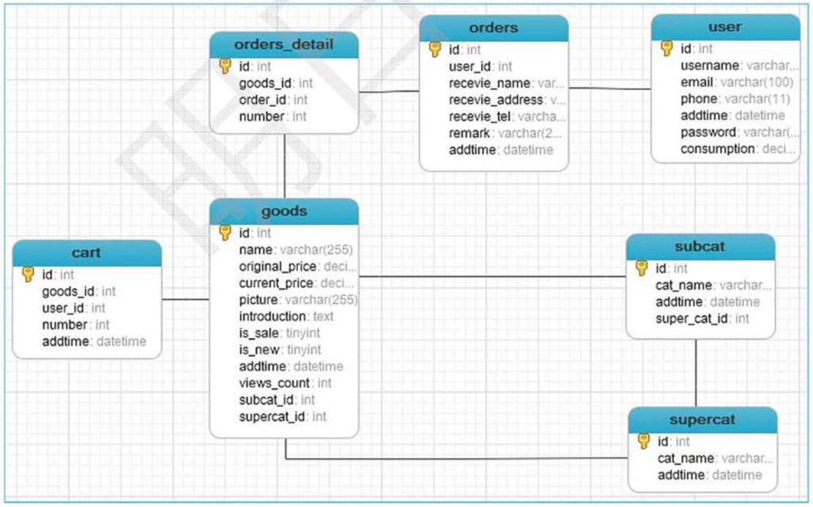
References 1 Flask商城 - 2

