Slide 1
WeChat Notes
Sparks Lu
Last updated: 2021-8-4

Slide 2
Overview

Slide 3
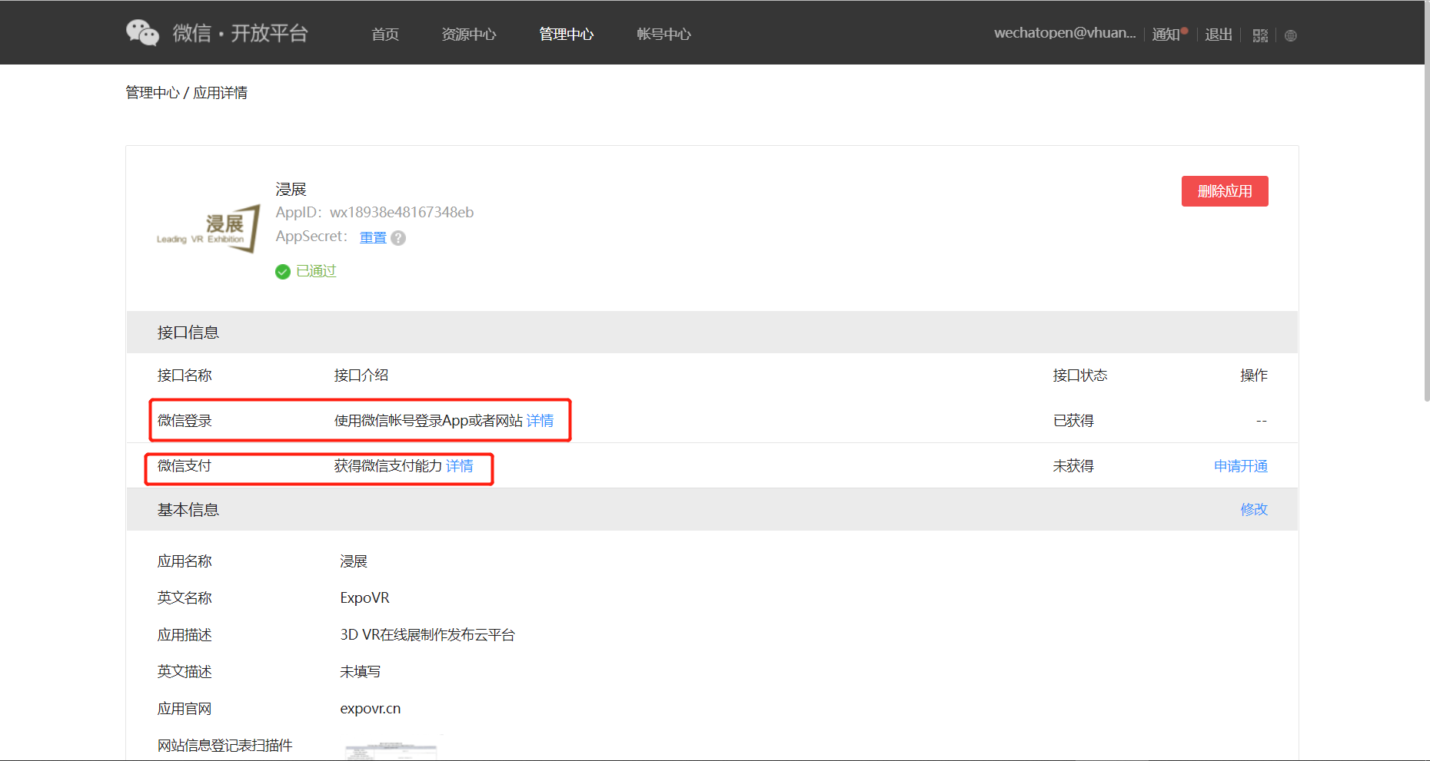
Overview
微信登录、微信支付
微信开放平台支持
open.weixin.qq.com
仅支持一个授权回调域
微信分享
微信公众号支持
mp.weixin.qq.com

Slide 4
Login by Scan QR Code

Slide 5
References
https://developers.weixin.qq.com/doc/oplatform/Website_App/WeChat_Login/Wechat_Login.html
https://developers.weixin.qq.com/doc/offiaccount/OA_Web_Apps/JS-SDK.html
https://blog.csdn.net/zl1zl2zl3/article/details/84261398
https://blog.csdn.net/qq_22034353/article/details/90480732

Slide 6
Prepare
Register website on Wechat open platform
open.weixin.qq.com

Slide 7
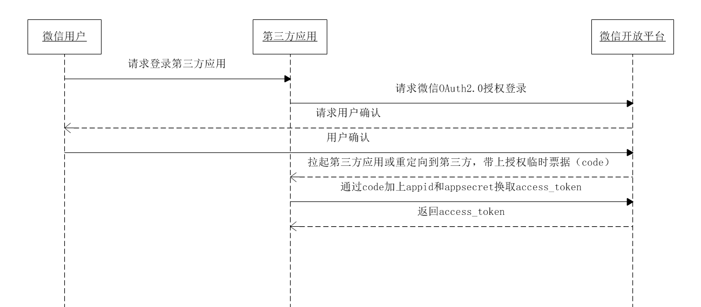
Process

Slide 8
Step 1: Get Code Method 1
前端拉取微信认证授权二维码https://open.weixin.qq.com/connect/qrconnect?appid=APPID&redirect_uri=REDIRECT_URI&response_type=code&scope=SCOPE&state=STATE#wechat_redirect
scope：snsapi_login for web pages
state: 用于防止csrf攻击,可设置为简单的随机数加session进行校验
用户扫码并授权
跳转REDIRECT_URI，并带上code和state

Slide 9
Step 1: Get Code Method 2
前端页面引入http://res.wx.qq.com/connect/zh_CN/htmledition/js/wxLogin.js
id: 显示二维码的容器id
appid:
scope: snsapi_login网页应用
redirect_uri: 用UrlEncode的重定向地址
state: 用于防止csrf攻击,可设置为简单的随机数加session进行校验
前端实例化JS对象WxLogin
用户扫码并授权
微信触发重定向到redirect_uri并带上code参数
根据code获取access token
https://api.weixin.qq.com/sns/oauth2/access_token?appid=APPID&secret=SECRET&code=CODE&grant_type=authorization_code
返回access_token和openID
https://api.weixin.qq.com/sns/userinfo?access_token=AT&openid=OpenID
返回union_id，nickname等

Slide 10
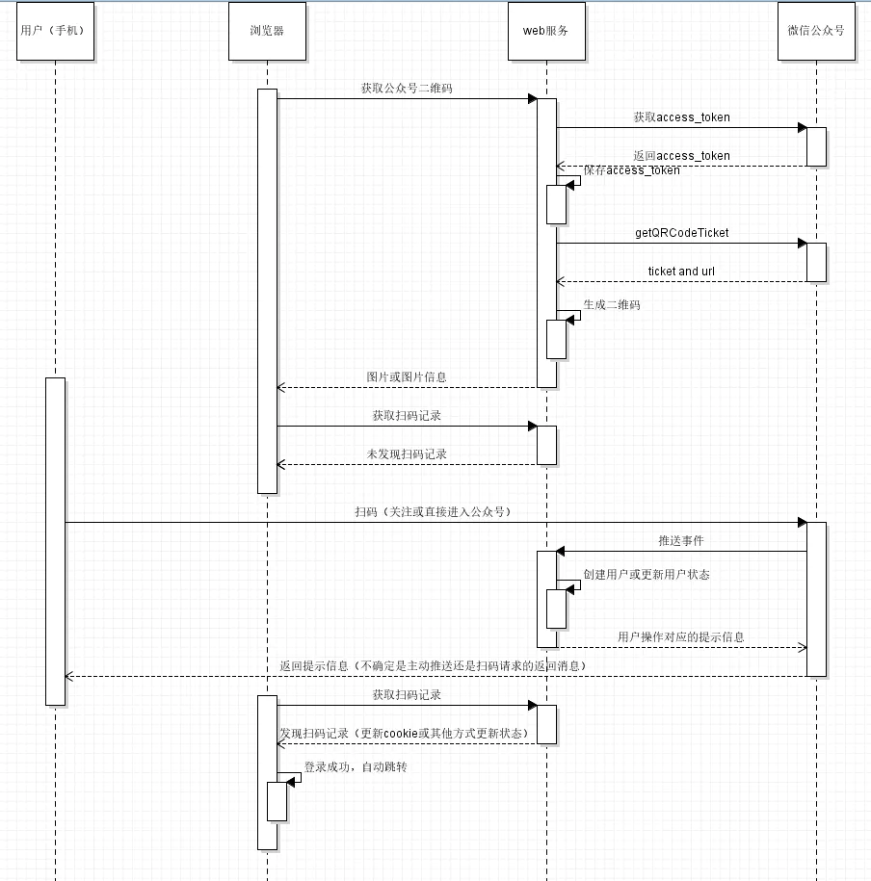
扫码关注并登陆
References
https://developers.weixin.qq.com/doc/offiaccount/Message_Management/Receiving_event_pushes.html
https://developers.weixin.qq.com/doc/offiaccount/Account_Management/Generating_a_Parametric_QR_Code.html
https://juejin.cn/post/7031846857567371271
Logic
使用公众号接口生成带参数的二维码
系统接收微信推送过来的事件(关注/扫码)

Slide 11
Wechat Pay

Slide 12
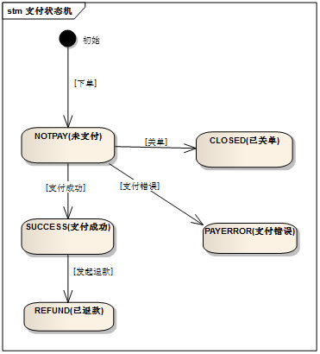
Overview
References
https://pay.weixin.qq.com/wiki/doc/api/native.php?chapter=1_1
https://www.jb51.net/article/159656.htm
准备
微信公众号
商户平台账号
Types
付款码支付
Native支付 （用户扫码支付）
JSAPI支付
微信中打开的H5页面中使用
APP支付
H5支付
小程序支付
账户信息
APPID
商户号
API密钥
AppSecret

Slide 13
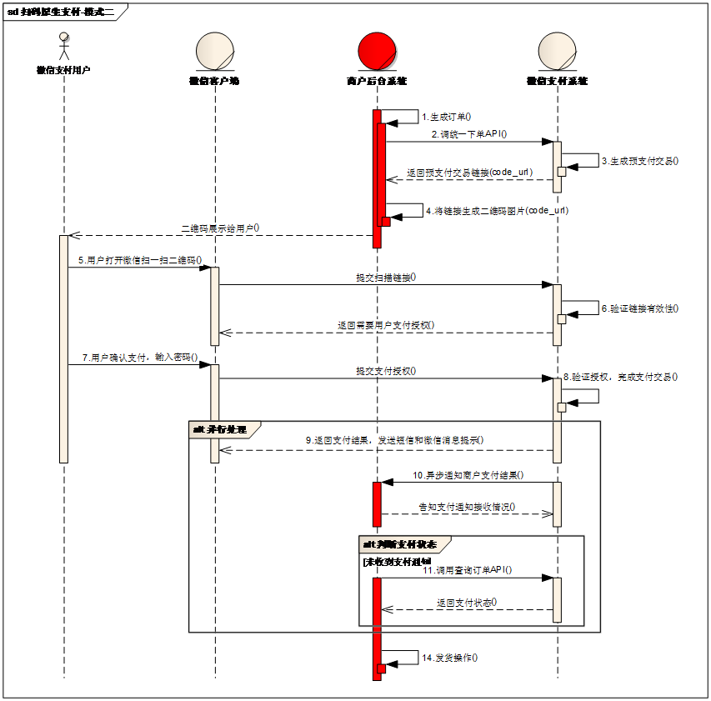
扫码支付

Slide 14
Step1：统一下单
https://api.mch.weixin.qq.com/pay/unifiedorder
appid
mchid 商户号
device_info 设备号 ‘web'
nonce_str 随机字符串
sign 签名 通过签名算法计算得出的签名值
sign_type 默认为MD5，支持HMAC-SHA256和MD5
body 商品描述
detail 商品详情
attach 附加数据
out_trade_no 商户订单号 要求32个字符内，只能是数字、大小写字母_-|* 且在同一个商户号下唯一
fee_type： 标价币种，默认CNY
total_fee： 标价金额，订单总金额，单位为分
spbill_create_ip：终端IP
time_start：交易起始时间
time_expire： 交易结束时间
goods_tag： 订单优惠标记
notify_url： 通知支付结果地址
trade_type： 交易类型
product_id： 商品ID
limit_pay： 指定支付方式
openid： 用户标识
receipt: 电子发票入口开放标识
scene_info: 场景信息
返回二维码链接

Slide 15
Step 2：接收支付结果通知
return_code: SUCCESS/FAIL
return_msg
appid
mch_id
device_info
nonce_str
sign
sign_type
result_code
err_code
err_code_des
openid
is_subscribe
trade_type
bank_type
total_fee
settlement_total_fee
fee_type
cash_fee
cash_fee_type
coupon_fee
coupon_type_$n
coupon_id_$n
coupon_fee_$n
transaction_id
out_trade_no
attach
time_end

Slide 16
WeChat MiniProgram

Slide 17
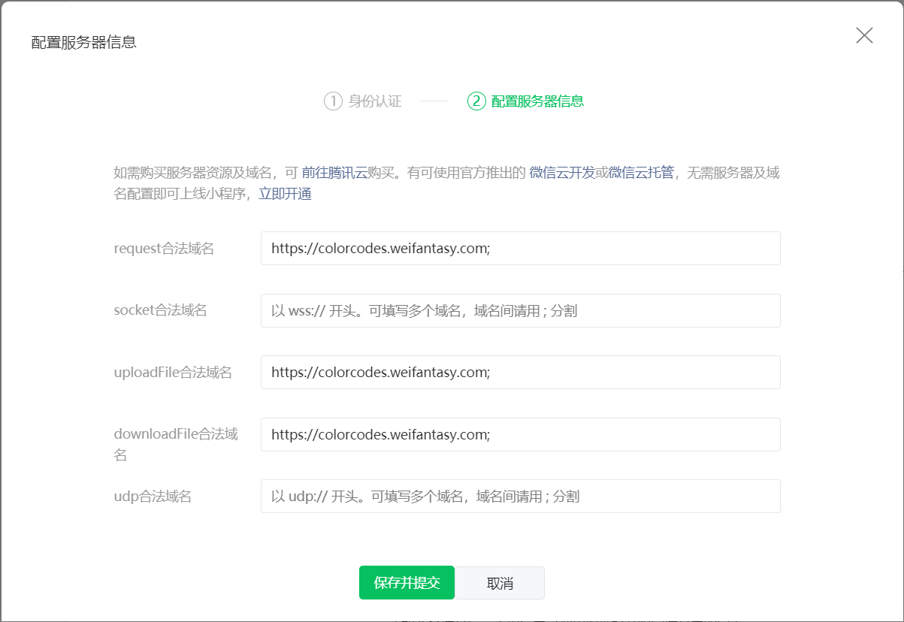
Configuration
Reference
https://developers.weixin.qq.com/miniprogram/dev/framework/ability/network.html
Configure domain name

Slide 18
Framework 1/3
View: WXML/WXSS
Data binding
Behavior binding
Logic: JavaScript
https://mp.weixin.qq.com
WXSS: WeiXin Style Sheet
WXML: WeiXin XML

Slide 19
Framework 2/3
declaration of data
Page({
data: {
var-name: value
},
function-name: function() {
}
onLoad: function() {
}
})
{{var-name}}
<view bindtap=”function-name”>
Binding data
declaration of behavior
Binding behavior
Logic
View

Slide 20
Framework 3/3
Navigate Among Pages
wx.navigateTo({
url: '../logs/logs'
})

Slide 21
Components
View Container
Basic Content
From
view
icon
form
button
input
scroll-view
text
checkbox
radio
picker
swiper
progress
picker-view
slider
switch
label
Miscellaneous
Media
map
audio
canvas
image
Navigation
navigator
contact-button
video

Slide 22
API
Network
Media
File
wx.request
wx.chooseImage
wx.saveFile
wx.uploadFile
wx.previewImage
wx.getSavedFileList
wx.downloadFile
wx.startRecord
wx.getSavedFileInfo
wx.stopRecord
wx.connectSocket
wx.playVoice
wx.removeSavedFile
wx.onSocketOpen
wx.pauseVoice
wx.openDocument
wx.stopVoice
wx.onSocketError
wx.getBackgroundAudioPlayerState
Storage
wx.sendSocketMessage
wx.playBackgroundAudio
wx.onSocketMessage
wx.pauseBackgroundAudio
Location
wx.seekBackgroundAudio
wx.closeSocket
wx.stopBackgroundAudio
Device
wx.onSocketClose
wx.onBackgroundAudioPlay
UI
wx.onBackgroundAudioPause
wx.onBackgroundAudioStop
Wechat
wx.chooseVideo

Slide 23
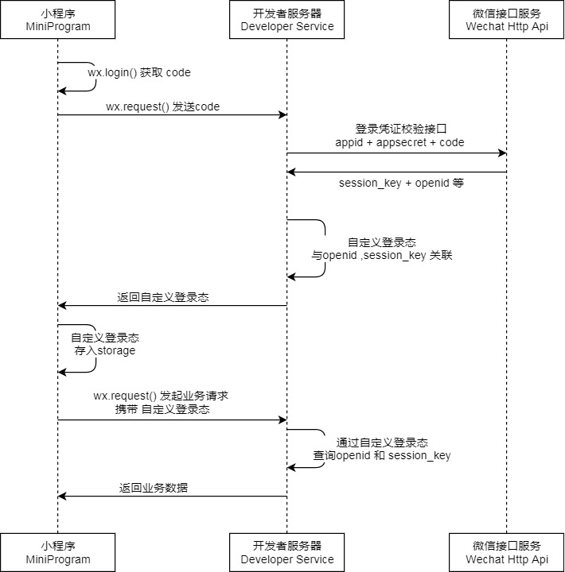
Wechat Login
References
https://developers.weixin.qq.com/miniprogram/dev/framework/open-ability/login.html
https://cloud.tencent.com/developer/article/1608597
Preparation
微信小程序app id， app secret
wx.login()
// get code, phone code
Get access token
Get phone number using access token and phone code
Get OpenID using code

Slide 24
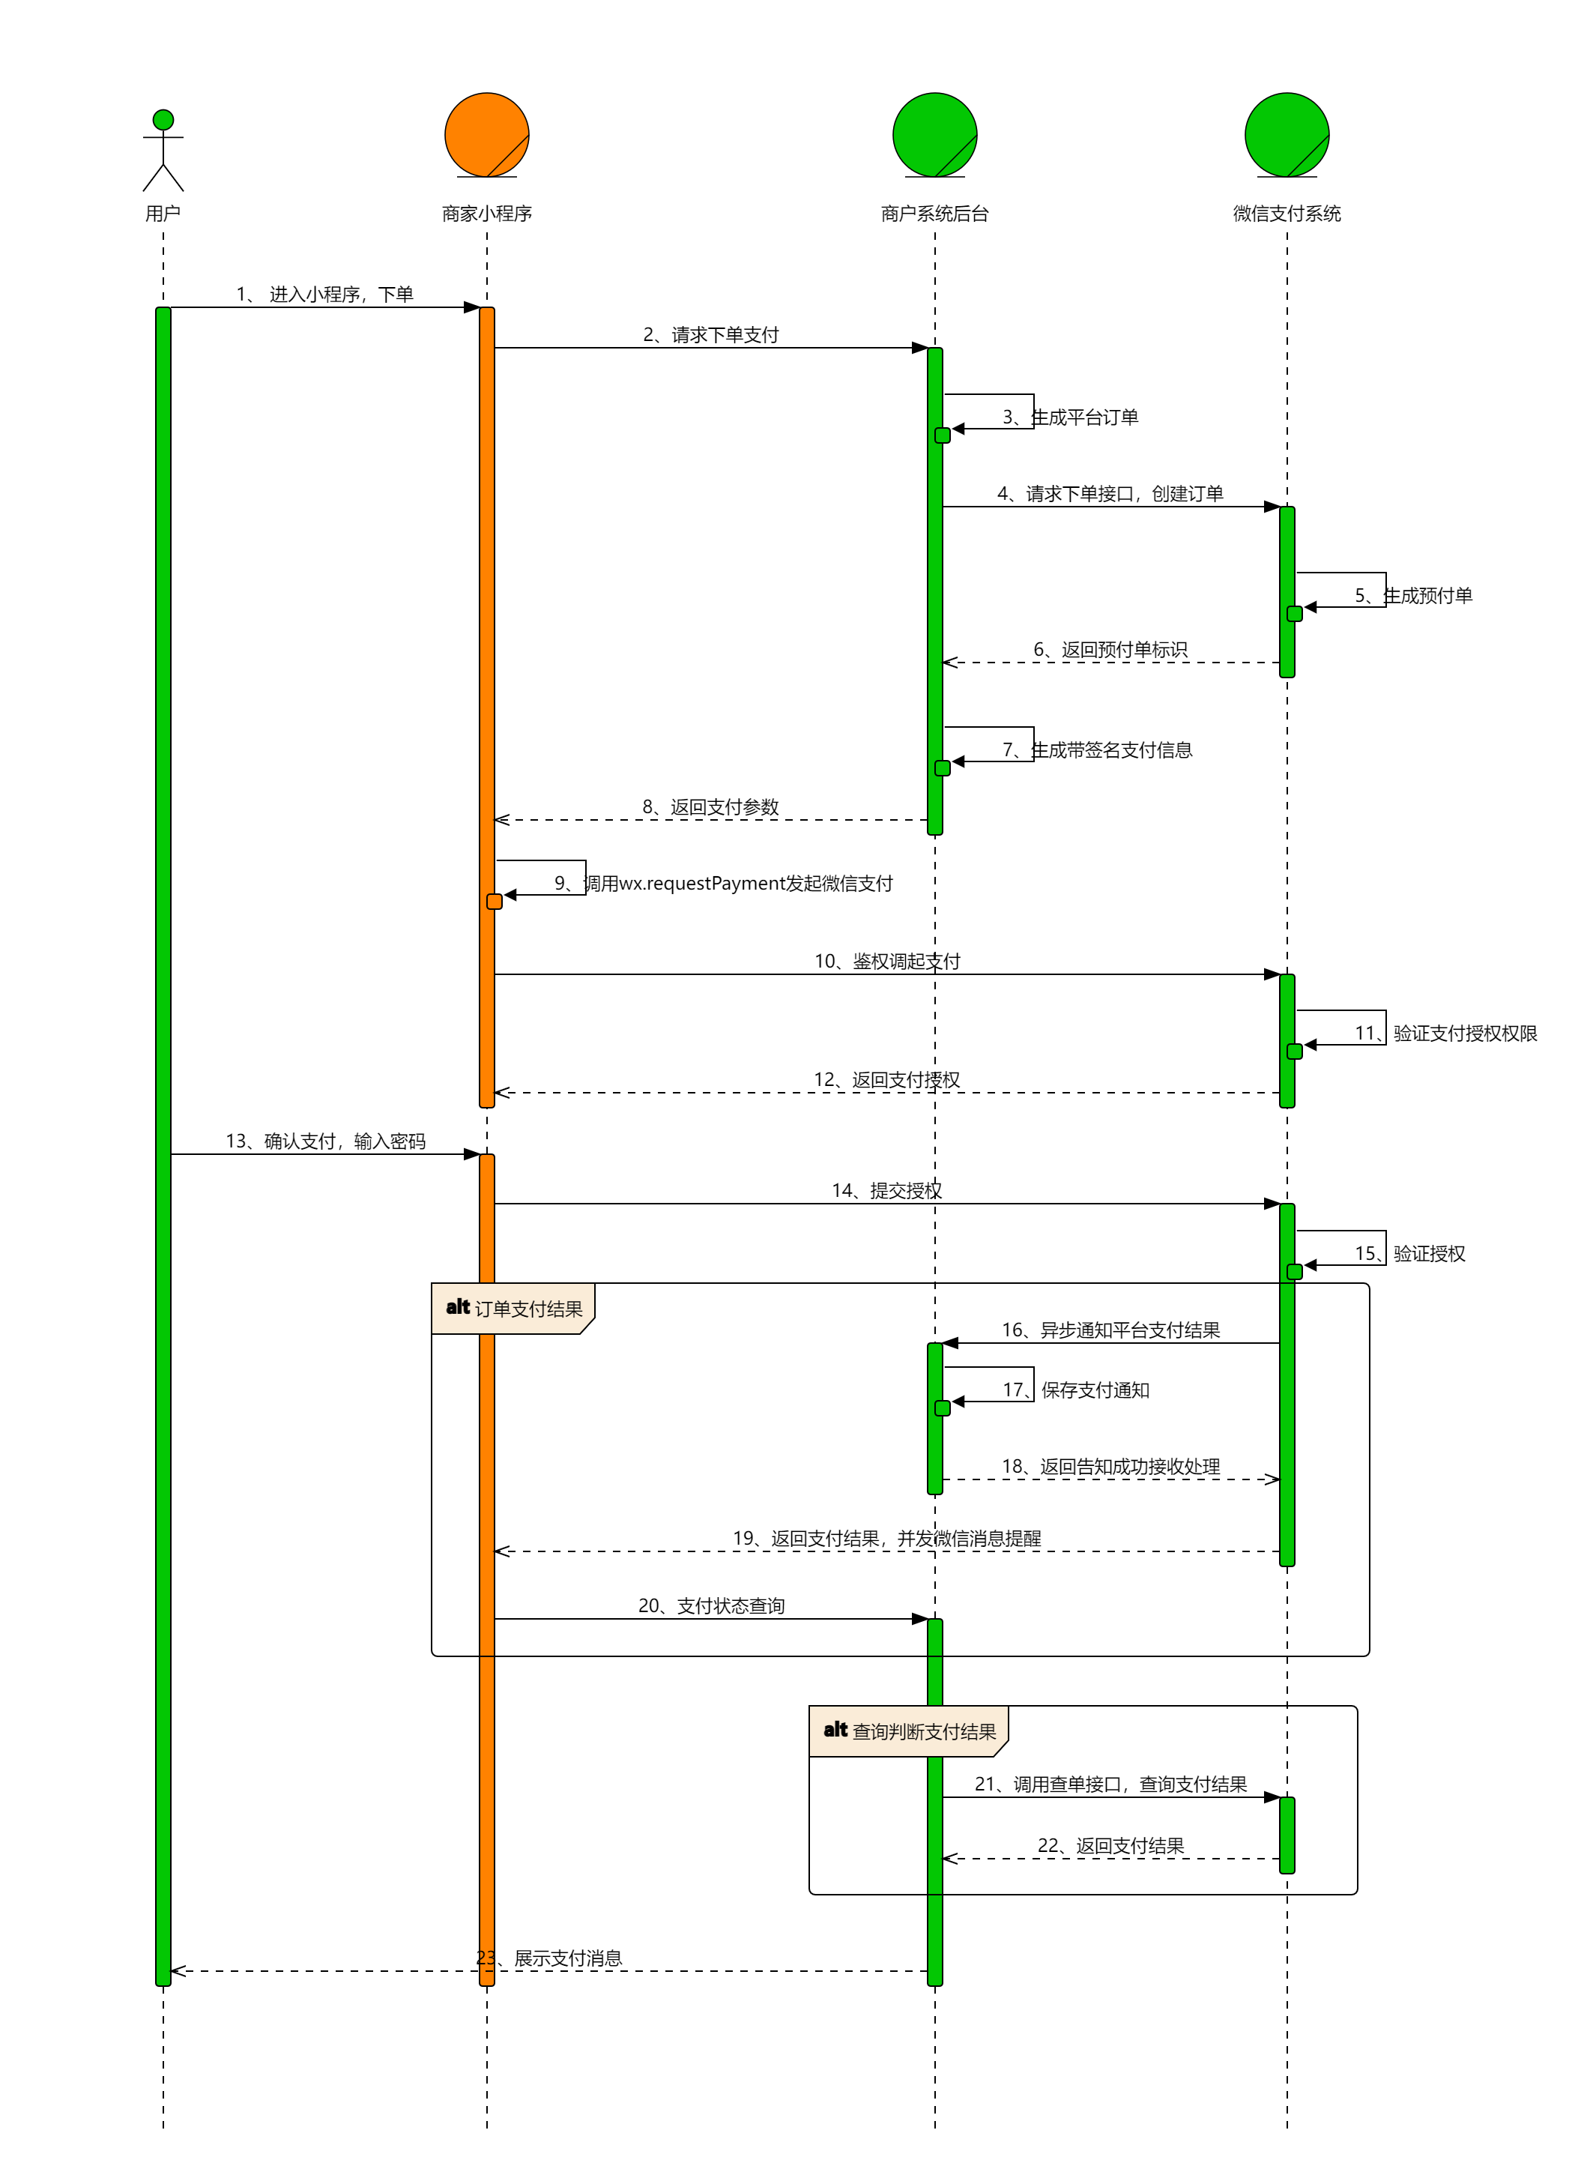
Wechat Pay
References
https://pay.weixin.qq.com/wiki/doc/apiv3/open/pay/chapter2_8_2.shtml
https://zhuanlan.zhihu.com/p/31445760
Preparation
微信小程序app id
微信小程序已认证
关联微信支付商户id
调用付款接口，传入金额和openid
Post unified order
Get phone number using access token and phone code
根据订单uuid，查询订单状态
Get OpenID using code

Slide 25
获取手机号
References
https://developers.weixin.qq.com/miniprogram/dev/framework/open-ability/getPhoneNumber.html
https://developers.weixin.qq.com/miniprogram/dev/api-backend/open-api/phonenumber/phonenumber.getPhoneNumber.html
Steps
小程序端增加按钮
<button open-type="getPhoneNumber" bindgetphonenumber="getPhoneNumber"></button>
在getPhoneNumber中获取code
e.detail.code
服务端
POST https://api.weixin.qq.com/wxa/business/getuserphonenumber?access_token=ACCESS_TOKEN
curl -H "Accept: application/json" -H "Content-type: application/json" -X POST -d '{"code": "e31968a7f94cc5ee25fafc2aef2773f0bb8c3937b22520eb8ee345274d00c144"}' https://api.weixin.qq.com/wxa/business/getuserphonenumber?access_token=ACCESS_TOKEN&
{
"errcode":0,
"errmsg":"ok",
"phone_info": {
"phoneNumber":"xxxxxx",
"purePhoneNumber": "xxxxxx",
"countryCode": 86,
"watermark": {
"timestamp": 1637744274,
"appid": "xxxx"
}
}
}

Slide 26
Bluetooth
References
https://cloud.tencent.com/developer/article/1547965
https://zhuanlan.zhihu.com/p/28756203
https://www.jianshu.com/p/82ee9a908543
https://www.jianshu.com/p/e5a9d800f164
https://blog.csdn.net/Smile_ping/article/details/102938322
https://zhuanlan.zhihu.com/p/352194416
https://www.sunzhongwei.com/small-program-bluetooth-communication-logic-and-interface?from=bottom
https://www.sunzhongwei.com/send-instructions-wechat-small-application-of-bluetooth-communication-hexadecimal-code-conversion
APIs
wx.openBluetoothAdapter, wx.closeBluetoothAdapter
wx.startBluetoothDevicesDiscovery, wx.stopBluetoothDevicesDiscovery
wx.onBluetoothDeviceFound
wx.createBLEConnection, wx.closeBLEConnection
wx.getConnectedBluetoothDevices
wx.getBLEDeviceServices
readBLECharacteristicValue, writeBLECharacteristicValue
notifyBLECharacteristicValueChange
onBLECharacteristicValueChange
wx.openBluetoothAdapter()
wx.getBLEDeviceCharactertics()
wx.startBluetoothDevicesDiscovery()
wx.readBLECharacteristicValue()
wx.onBluetoothDeviceFound()
wx.writeBLECharacteristicValue()
wx.stopBluetoothDeviceDiscovery()
wx.notifyBLECharacteristicValueChange()
wx.createBLEConnection()
wx.onBLECharacteristicValueChange()
wx.getBLEDeviceServices()
wx.closeBLEConnection()

Slide 27
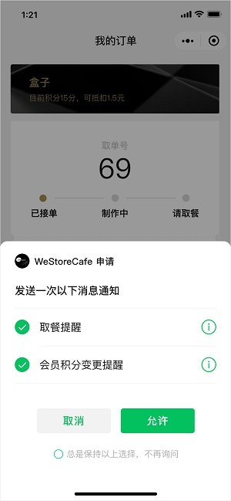
推送消息
模板消息
已于2020年1月10日下线
订阅消息
References
https://developers.weixin.qq.com/miniprogram/dev/framework/open-ability/subscribe-message.html
https://developers.weixin.qq.com/miniprogram/dev/api/open-api/subscribe-message/wx.requestSubscribeMessage.html
订阅消息推送位置：服务通知
订阅消息下发条件：用户自主订阅
订阅消息卡片跳转能力：点击查看详情可跳转至该小程序的页面
使用步骤
获取模板 ID
获取下发权限
wx.requestSubscribeMessage
一次调用最多可订阅3条消息
调用接口下发订阅消息
subscribeMessage.send

Slide 28
客服
References
https://developers.weixin.qq.com/community/develop/article/doc/00026676a30c2804cdbead76056413?highline=sendMessagePath

Slide 29
JSSDK
微信内网页开发工具包

Slide 30
Reference
https://developers.weixin.qq.com/doc/offiaccount/OA_Web_Apps/JS-SDK.html
https://pay.weixin.qq.com/wiki/doc/api/index.html
https://www.jianshu.com/p/b017fd6bb908

Slide 31
Concept
Info
微信JS-SDK是微信公众平台 面向网页开发者提供的基于微信内的网页开发工具包。
通过使用微信JS-SDK，网页开发者可借助微信高效地使用拍照、选图、语音、位置等手机系统的能力，同时可以直接使用微信分享、扫一扫、卡券、支付等微信特有的能力，为微信用户提供更优质的网页体验。

Slide 32
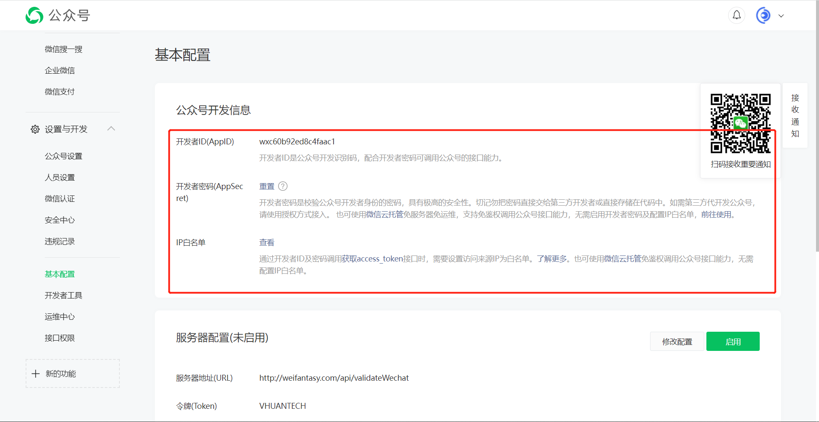
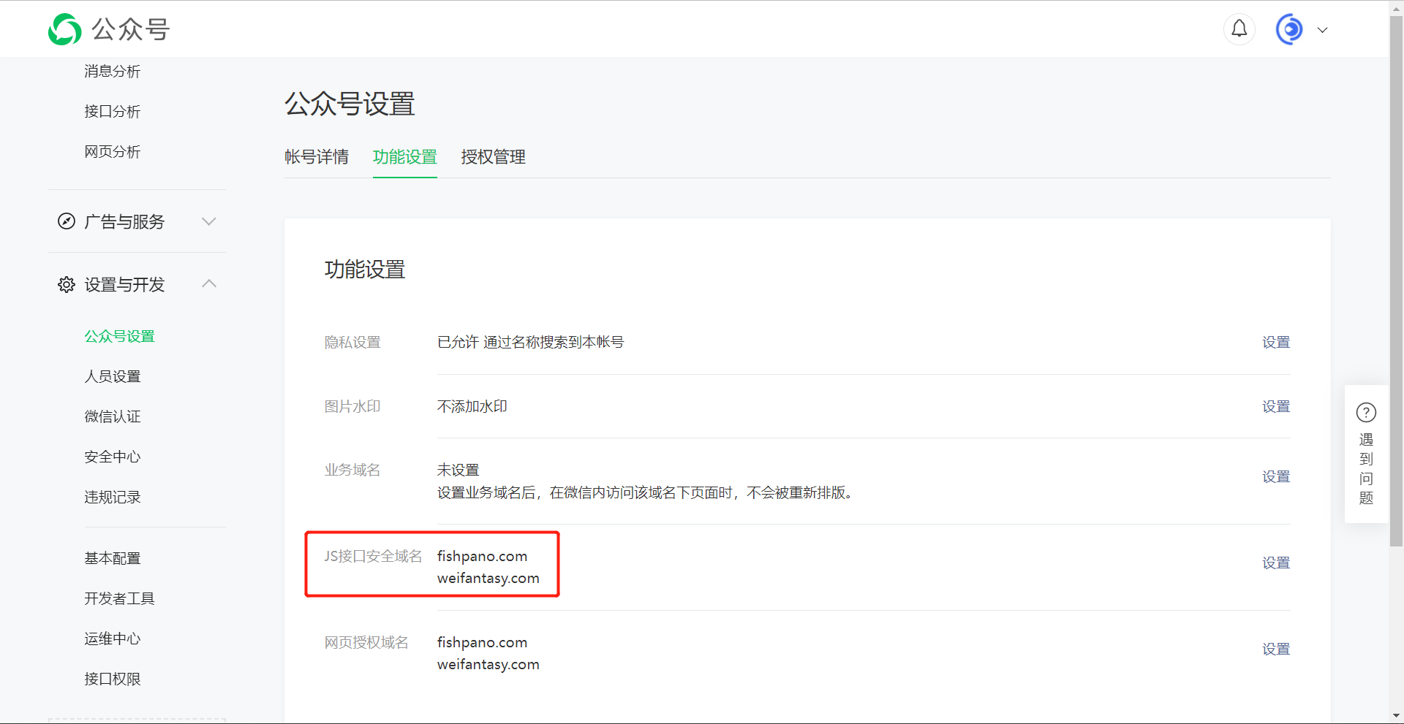
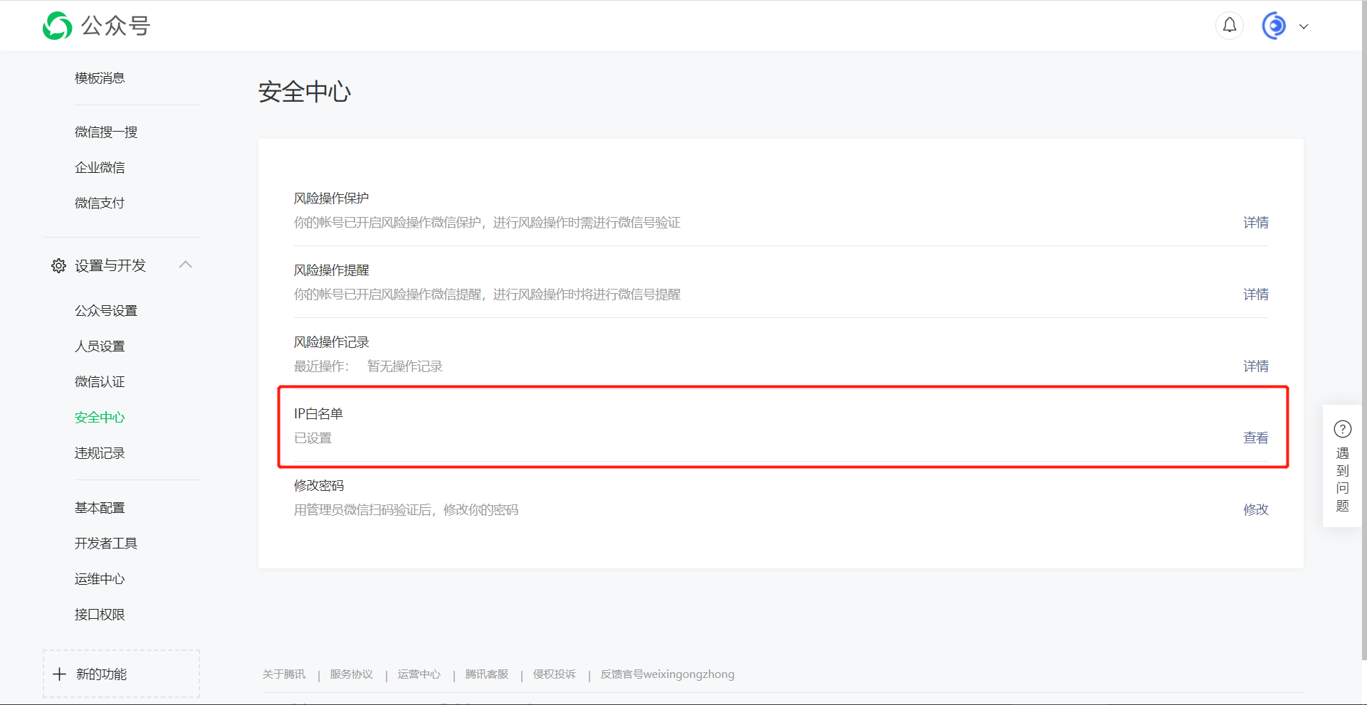
公众号准备
App ID和secret
JS接口安全域名
IP白名单

Slide 33
Prepare
在微信公众平台中绑定域名，设置IP白名单
前端引入相关JS文件
通过config接口注入权限验证配置
分享好友
分享朋友圈

Slide 34
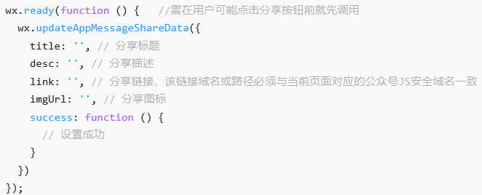
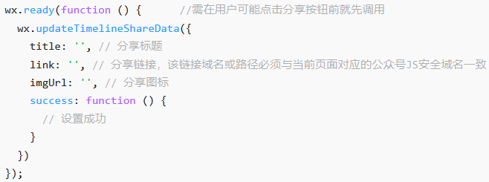
Share

Slide 35
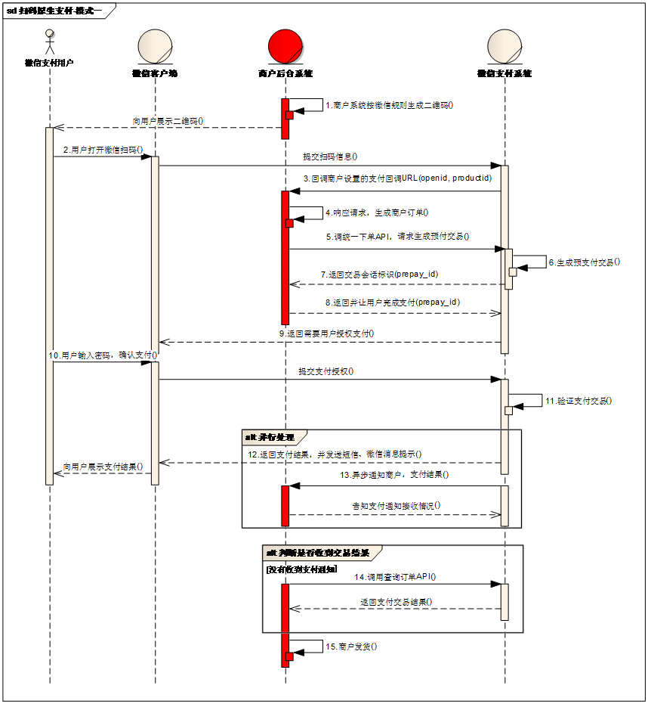
Pay
扫码支付

Slide 36
JSSDK
wx.config({
debug: true, // 开启调试模式,调用的所有api的返回值会在客户端alert出来，若要查看传入的参数，可以在pc端打开，参数信息会通过log打出，仅在pc端时才会打印。
appId: '', // 必填，公众号的唯一标识
timestamp: , // 必填，生成签名的时间戳
nonceStr: '', // 必填，生成签名的随机串
signature: '',// 必填，签名
jsApiList: [] // 必填，需要使用的JS接口列表
});
获取access token
https://developers.weixin.qq.com/doc/offiaccount/Basic_Information/Get_access_token.html
获取jsapi ticket
https://api.weixin.qq.com/cgi-bin/ticket/getticket?access_token=ACCESS_TOKEN&type=jsapi
签名

Slide 37
公众号获取openid
步骤
参考
https://developers.weixin.qq.com/doc/offiaccount/OA_Web_Apps/Wechat_webpage_authorization.html
获取code
https://open.weixin.qq.com/connect/oauth2/authorize?appid=APPID&redirect_uri=REDIRECT_URI&response_type=code&scope=SCOPE&state=STATE#wechat_redirect
例子：https://open.weixin.qq.com/connect/oauth2/authorize?appid=wx520c15f417810387&redirect_uri=https%3A%2F%2Fchong.qq.com%2Fphp%2Findex.php%3Fd%3D%26c%3DwxAdapter%26m%3DmobileDeal%26showwxpaytitle%3D1%26vb2ctag%3D4_2030_5_1194_60&response_type=code&scope=snsapi_base&state=123#wechat_redirect
获取access token
https://api.weixin.qq.com/sns/oauth2/access_token?appid=APPID&secret=SECRET&code=CODE&grant_type=authorization_code
该接口返回openid字段

Slide 38
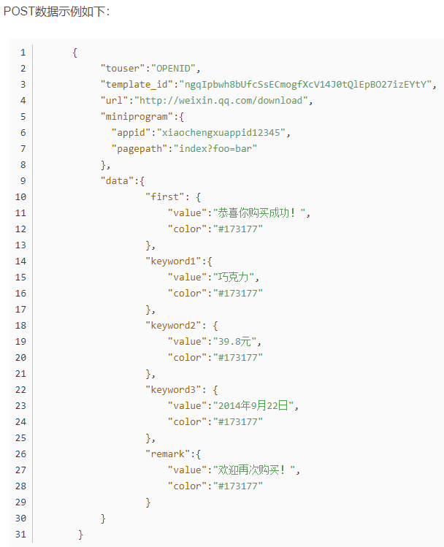
发送模板消息
步骤
POST https://api.weixin.qq.com/cgi-bin/message/template/send?access_token=ACCESS_TOKEN
概要
认证的微信服务号发送模板消息通知
各类型公众号权限
https://developers.weixin.qq.com/doc/offiaccount/Getting_Started/Explanation_of_interface_privileges.html
模板消息运营规范
https://developers.weixin.qq.com/doc/offiaccount/Message_Management/Template_Message_Operation_Specifications.html
模板消息接口
https://developers.weixin.qq.com/doc/offiaccount/Message_Management/Template_Message_Interface.html
https://mp.weixin.qq.com/advanced/tmplmsg?action=faq&token=1723160200&lang=zh_CN
https://www.zhihu.com/question/48864270/answer/1157763869
POST请求
https://api.weixin.qq.com/cgi-bin/message/template/send?access_token=ACCESS_TOKEN
开通步骤
登录服务号
功能-》添加功能插件-》模板消息
申请开通模板消息接口
审核需2~3天

Slide 39
公众号开发

Slide 40
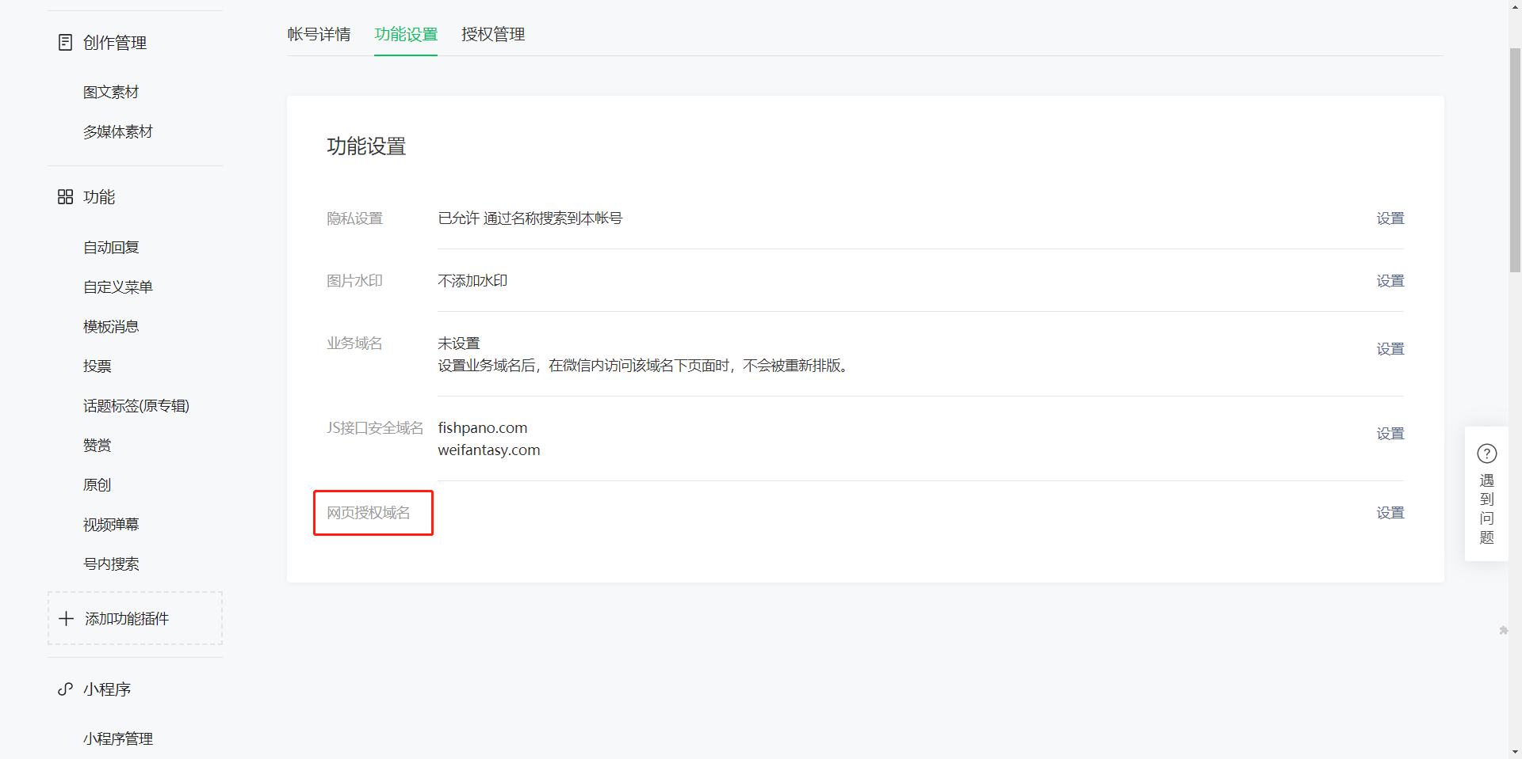
基本信息
参考
https://developers.weixin.qq.com/doc/offiaccount/Basic_Information/Access_Overview.html
基础
公众平台接口调用仅支持80端口。
appid，appsecret
IP白名单
网页授权
https://developers.weixin.qq.com/doc/offiaccount/OA_Web_Apps/Wechat_webpage_authorization.html
开发 - 接口权限 - 网页服务 - 网页帐号 - 网页授权获取用户基本信息，修改回调域名

Slide 41
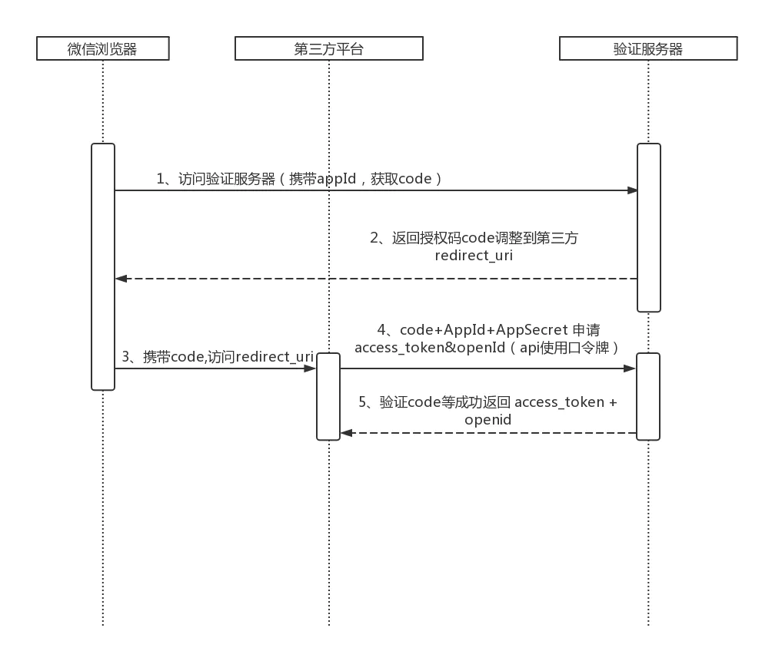
获取OpenId
参考
https://www.jianshu.com/p/b7e2100b56e4
概念
openId：用户在当前公众号下的唯一标识
unionId：同一用户，对同一微信开放平台下的不同应用（移动应用、网站应用和公众帐号），unionid是相同的
获取步骤
前端调用微信authorize接口获取code
https://open.weixin.qq.com/connect/oauth2/authorize?appid=' + window.APPID + '&redirect_uri=' + encodeURIComponent(local) + '&response_type=code&scope=snsapi_base&state=1#wechat_redirect'
前端将code发送给后端
后端调用微信access_token接口获取openid
https://api.weixin.qq.com/sns/oauth2/access_token?appid=APPID&secret=SECRET&code=CODE&grant_type=authorization_code
常见问题
同一微信号每次获取的code不同
同一code只能获取一次openid，第二次获取会返回错误

Slide 42
第三方平台接入

Slide 43
注册
注册第三方平台
https://open.weixin.qq.com/
管理中心-》第三方平台-》创建第三方平台
审核需7个工作日

